Slide 1
Warm-up #8
Which events on your gallery walk do you think most upset the colonists and why?
Which events do you think most upset the King (English government) and why?

Slide 2
Review Causes Gallery Walk
Use my key to add to your answer.
How would you have responded to these events if you were the king, if you were a colonist?

Slide 3

Watch the causes of the American Revolution video and add at least one new idea to your causes gallery walk.

Slide 4
Warm-up #9
Take the mix and match quiz on your desk.
No, you can’t use your notebook or textbooks. It’s a pop quiz.
Unit test will be on Tuesday of next week.
Start studying now!

Slide 5

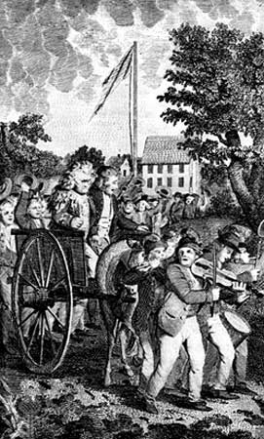
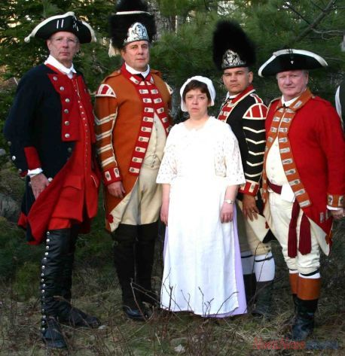

Slide 6

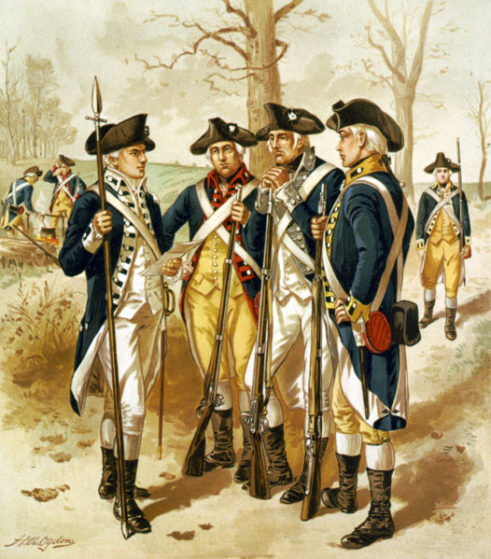


Slide 7
Loyalists v Patriots
We are going to read about two colonial perspectives on the events before the American War for Independence.
As we read, we will mark our text to help us identify arguments for and against declaring independence from England.
What connections to the ideas of the Enlightenment and Great Awakening can we make?

Slide 8
Loyalists v Patriots T-Chart
Using your reading from yesterday, make a T-Chart for the reasons for and against colonists declaring independence from England.
We will use this information for a philosophical chairs discussion about if the colonists should declare independence.

Slide 9
Philosophical Chairs Obs. Sheet
Intro – what is philosophical chairs.
Complete front of worksheet for homework
“Volunteers” for debate on each side (loyalist and patriot).

