Slide 1
ASL Essay
Pollution and Dishonesty

Slide 2
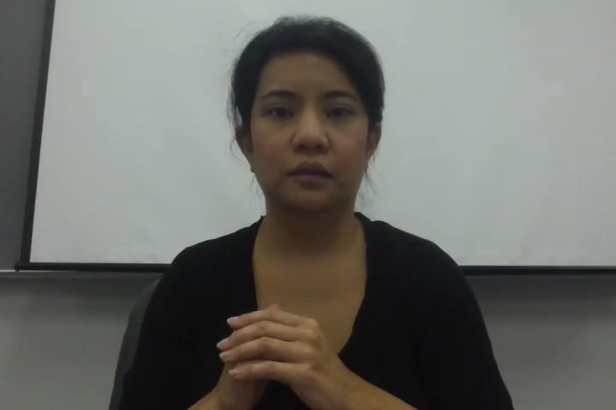
ASL Essay

Slide 3
When you finish..
When you finish your essay, show to another student. Ask them what they think.
E-mail the essay to me (Alisa Nakano) for your grade. Have me initial your paper.

