Slide 1
Constitution and Confederation
Prior Knowledge- What do you want the Federal Government (President Obama) to do for you? Will it take a more powerful or less powerful government to achieve your goals? Explain
Objectives- students will…
  Know problems with the Articles of Confederation
    1) Identify 3 key weaknesses with the Articles and evaluate why the Articles of Confederation could not work
  -Know reasons why America had to create a stronger central government
    2) Analyze how state governments could not fulfill their prime directive and explain why the country needed a stronger central government

Slide 2
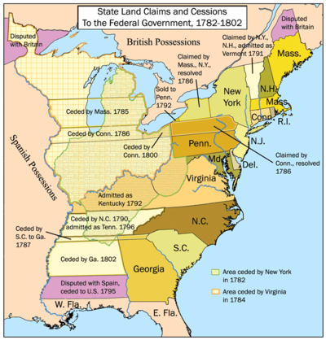
Prior Knowledge-
“These United States”- What is problem with American identity?
Declaration of Independence- “free and independent states”
  States felt they were independent countries, not one big country
Believed small republics work better because people share same ideas and values
  Analyze if you feel smaller countries with less diversity work more smoothly than large diverse countries? Explain

Slide 3
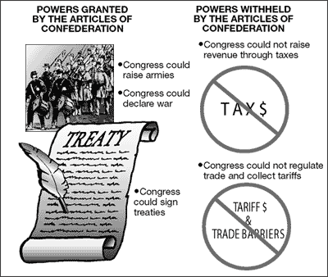
Articles of Confederation- 1st Gov. of the United States
Confederation- loose grouping of nations
  Goal- to create a weak central government
    ?Why?
Authority- declare war, make peace, Indian affairs, raise an Army
Taxes- could not force states to pay
No executive branch
  ?Identify what powers a government should have that are absent from the AofC?

Slide 4
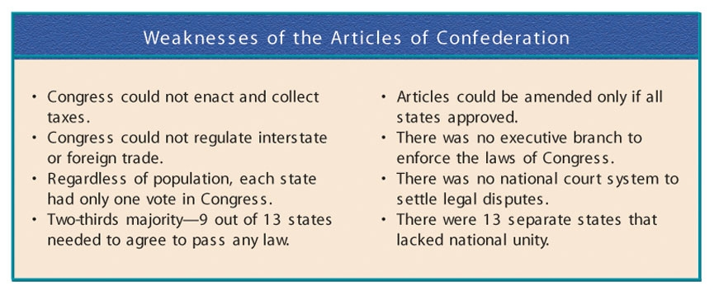
?How will these weaknesses lead to an ineffective government?
Pick two of the weaknesses and explain how you would solve that weakness

Slide 5
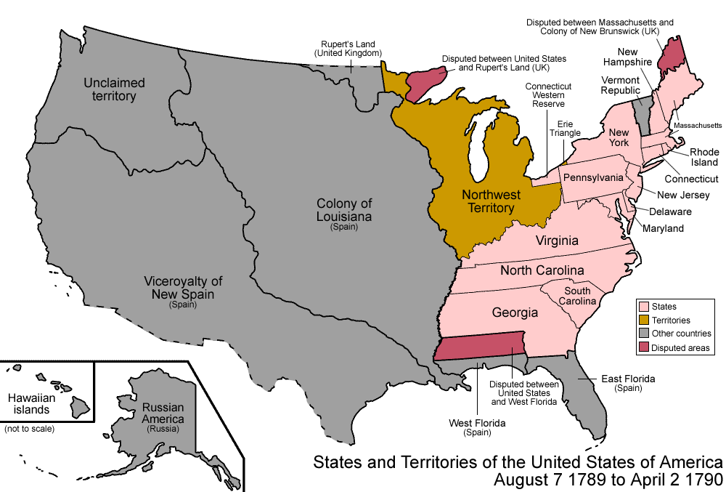
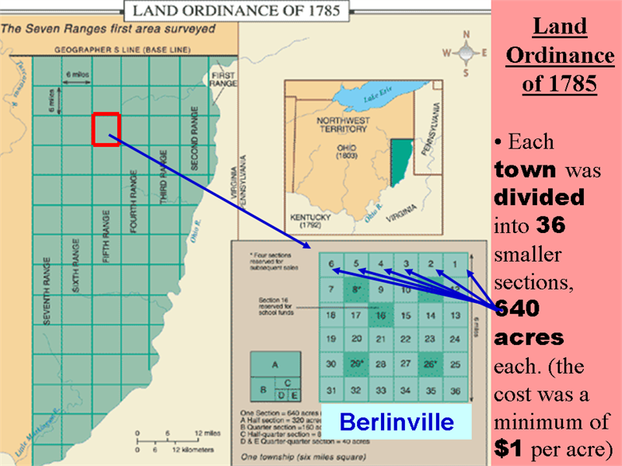
Road to Constitution
Shay’s Rebellion- indebted farmers in Western Mass. wantMass. Gov. to protect their farms from bank take over
  What is the role of government under Natural Rights?
    Farmers want Gov. to protect property
  Farmers v militia- Mass. Raises an army, chases farmers into New York
    Need strong central government
Northwest Ordinance- allowed a way for western areas to become states
  Statehood (60,000 people)
  *1 positive legacy of AofC

Slide 6
  Constitution and Confederation (Cont.)
  Prior Knowledge- Does your vote count? Explain ( why it is or is not important to vote)
  Objective- Know how the Constitution created a strong central government, yet limited the ability of government to become tyrannical (too powerful) and allow people to still have indirect control of the government
    1) Identify the Great Compromise and explain how it is reflected in our federal government today?
    2) Explain the 3 branches of government and the role of each branch.
    3) Evaluate the Electoral College and how the EC can impact an election.
    4) Analyze the debate to ratify the Constitution (identify the Federalists and Anti-Federalist and explain their beliefs)

Slide 7
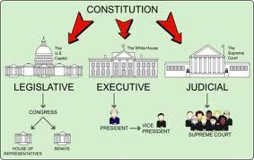
Constitutional Convention
What are the states giving up in order to join a stronger central government?
Issue of Representation- how much power/votes will each state have in new government/legislature
  Viginia Plan (large state)
    Three Branches
    Bicameral Legislature
      Executive Branch
    Proportional Representation based on population
  New Jersey Plan (Small State)
    Unicameral Assembly
    Apportioned Representation- equal rep. per state
    Neither big, nor small states want to lose power

Slide 8
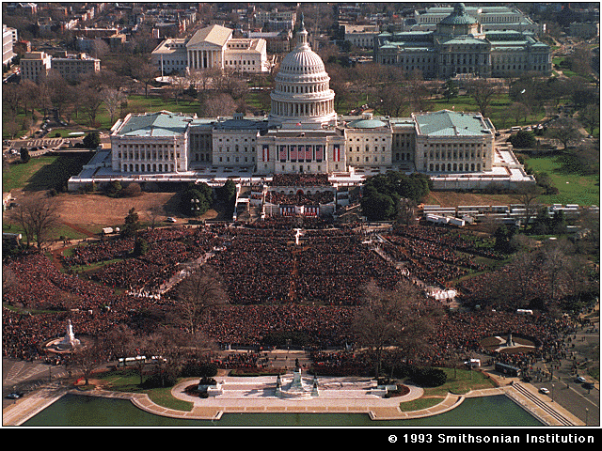
Great Compromise (Benjamin Franklin)- solves issue of representation for both large and small states, creates legislative branch
Upper House (Senate) 2 per state, 6 years service
  How many senators does Ca (33 mil people) and Wy (500K) have?
Lower House (House of Representatives) based on state population, 2 years service (Ca- 52, Wy 1)
  IS it fair that WY has a place in gov. where WY has as much power as CA? Explain

Slide 9
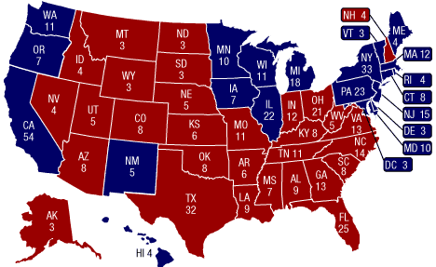
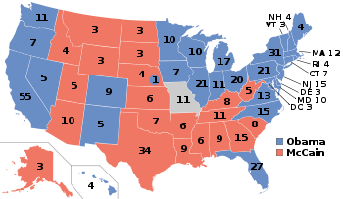
Other Compromises
3/5 Compromise
  Meant to get Southern States to agree
  Slaves=3/5’s person counting population for state representation
Electoral College (elects the president)
  States # votes= # of Reps in house+2 senators
    winner of state takes all votes
    Should the US still have an Electoral College or not? How can it manipulate elections or minimize people’s votes

Slide 10
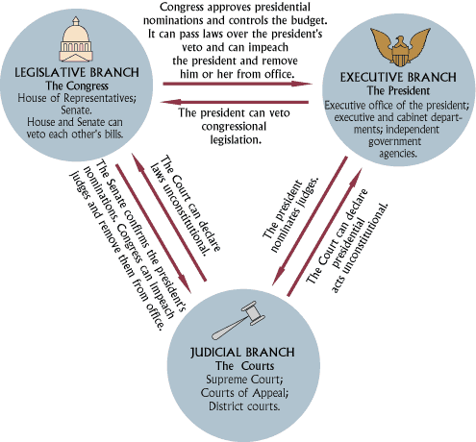
Prior Knowledge- What rules are in place that prevent the President or a group from taking over total control of the government?
Checks and Balances
Legislative Branch
  Make laws
  Control $
Executive Branch
  Enforce laws
  Commander in Chief
  Veto power
Judicial Branch
  Make sure laws are
  fair
  *Who has the most power?

Slide 11
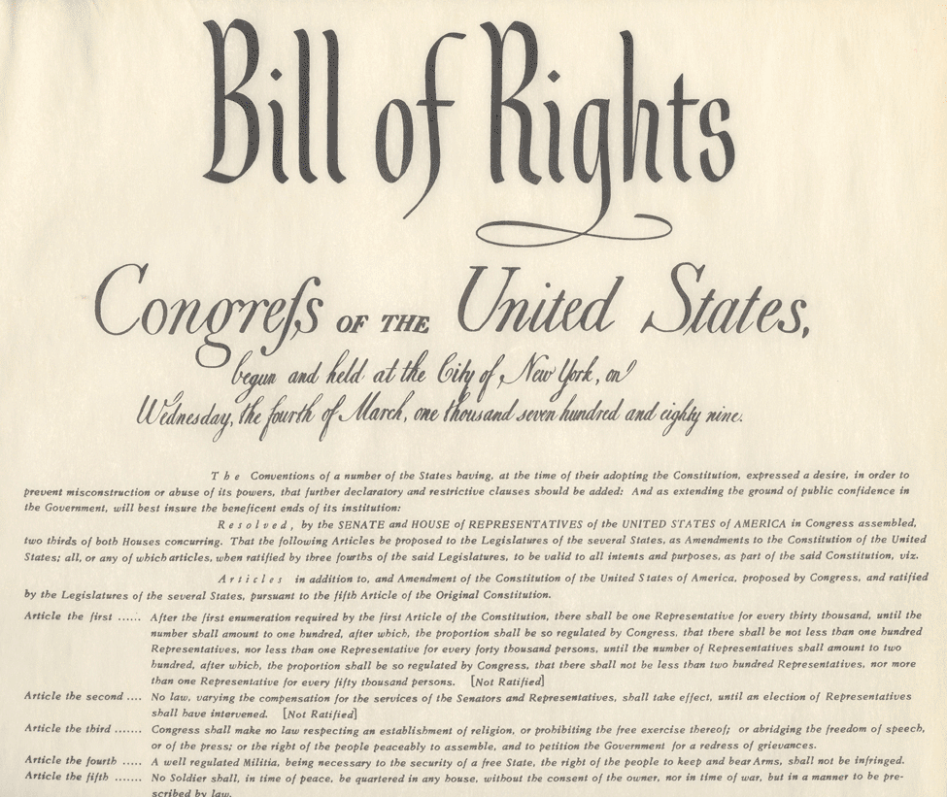
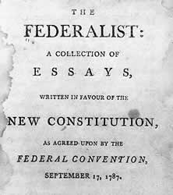
Ratification- constitution goes back to states for them to sign onto new government and lose sovereignty
Anti-Federalists- against Constitution
  Why would people be against the new form of government drawn up in Philadelphia?
  Anti-Central Government- fear of tyranny
  Large Republic- too many different groups
  Bills of Rights- want protection from gov.
    How would America be different without a Bill of Rights?
Federalists- favor Constitution
  Large Republics- are a positive
    ?What group dominates America today?
    Federalist Paper #10- no group dominates with diversity
  Checks and Balances- prevents one group taking over by checking what other branches are up too
    Bill of Rights added to Constitution and Anti-Feds approve Const.

