Slide 1
Ch. 4-3 DNA and It’s Scientific History
EQ: How did the structure of DNA lead scientist to the function of the molecule?

Slide 2
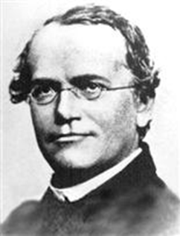
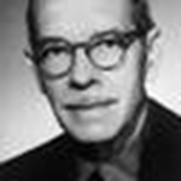
Griffith and Transformation
In 1928, Fredrick Griffith was experimenting with different types of the pneumonia bacteria and used two different types on mice in his lab

Slide 3
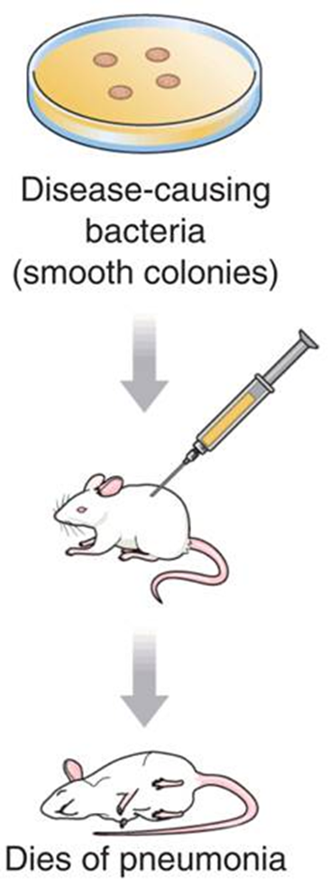



Griffith’s Experiments
Injected mice with Disease bacteria
Injected mice with harmless bacteria
Heated the disease bacteria and then
injected the heat-killed bacteria

Slide 4
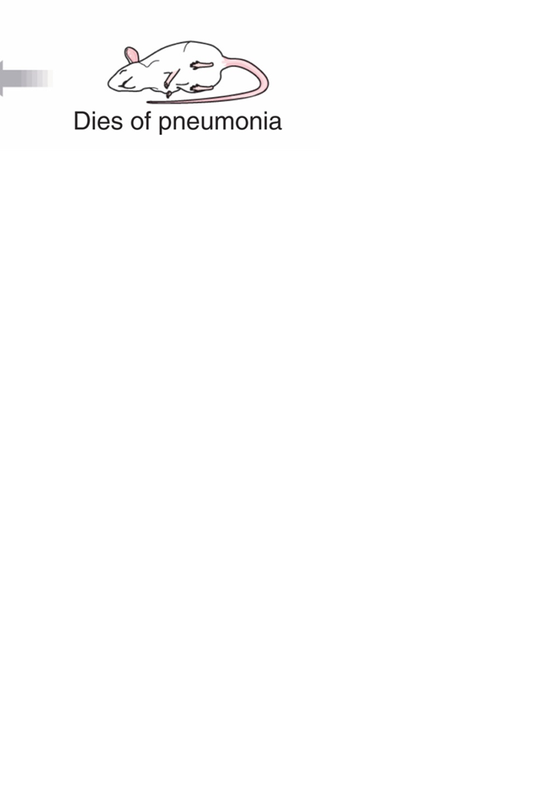
Griffith’s Experiments
Mixed heat-killed bacteria with harmless bacteria and injected the mixture in the mice

Slide 5
Transformation
Griffith called this process transformation because one strain of bacteria (the harmless strain) had changed permanently into another (the disease-causing strain).
Griffith hypothesized that a FACTOR must contain information that could change harmless bacteria into disease-causing ones.
Some later scientists experimented using Griffith’s methods and discovered that DNA was the FACTOR

Slide 6
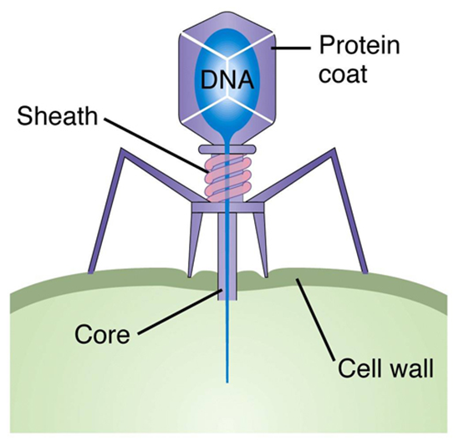
The Hershey-Chase Experiment
A virus that infects bacteria is known as a bacteriophage
They are made up of DNA and protein
They placed markers on the proteins of one set of viruses
They placed markers on the DNA of
another set of viruses

Slide 7
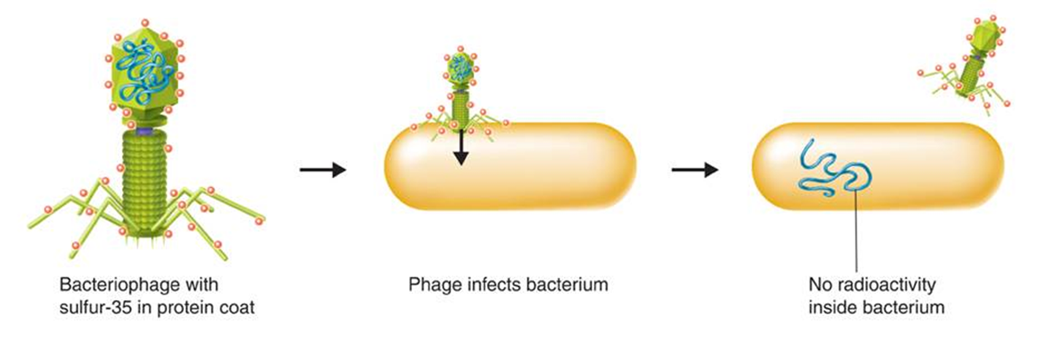
Hershey-Chase Experiment
No marker seen with the protein marked viruses

Slide 8
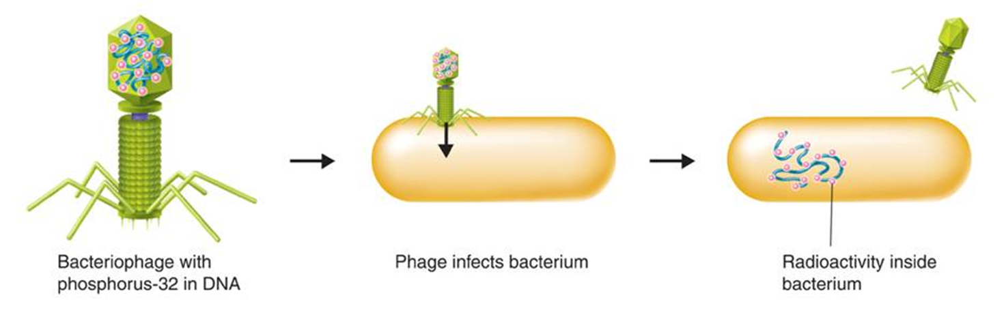
Hershey-Chase Experiment
Virus with DNA marked showed up after the virus infected the bacteria

Slide 9
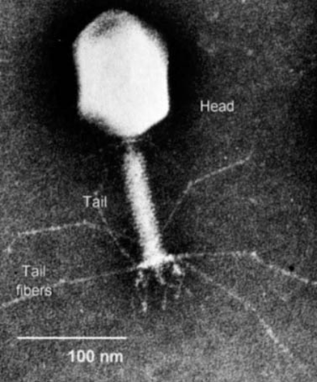
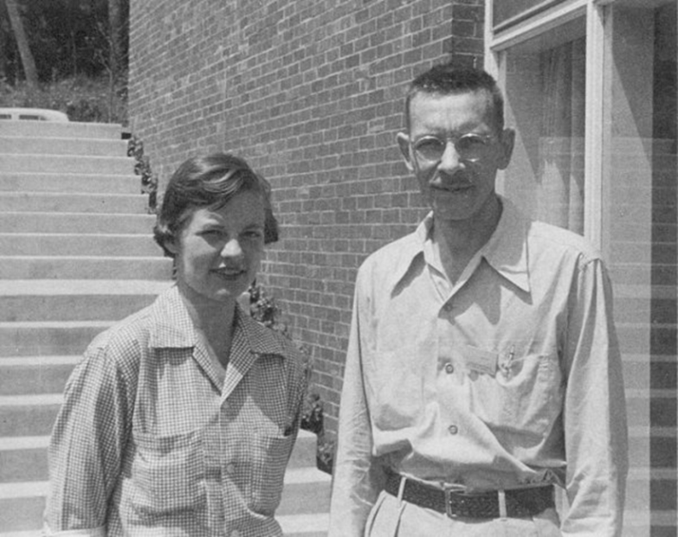
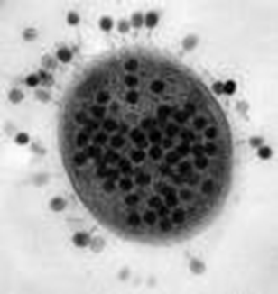
Hershey-Chase Experiment
Hershey and Chase concluded that the genetic material of the virus was DNA, Not Protein

Slide 10
The Components and Structure of DNA
DNA is made up of nucleotides – is a monomer of nucleic acids made up of 3 components:
Deoxyribose – 5-carbon Sugar
Phosphate Group
Nitrogen Base

Slide 11
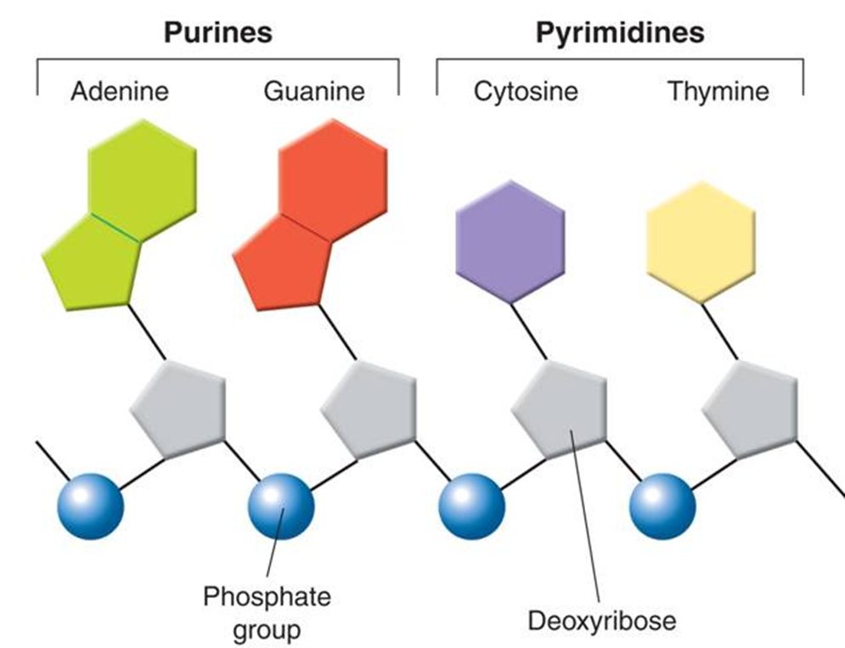
Nitrogen Bases
There are four kinds of nitrogen bases in DNA:
Purines:
Adenine (A)
Guanine (G)
Pyrimidines
Cytosine (C)
Thymine (T)

Slide 12
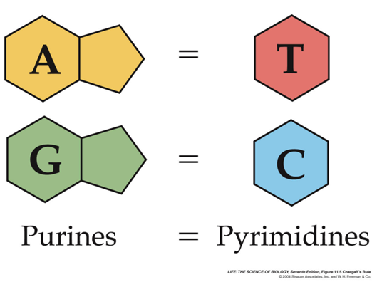
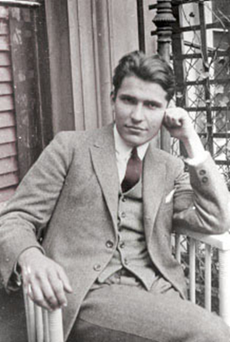
Chargaff’s Rule
Erwin Chargaff discovered that:
The amount of guanine (G) always equals the amount of cytosine(C)
The amount of adenine (A) always equals the amount of thymine (T)

Slide 13
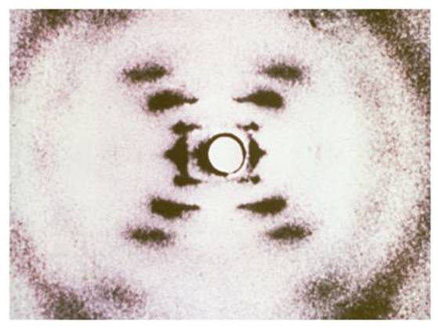
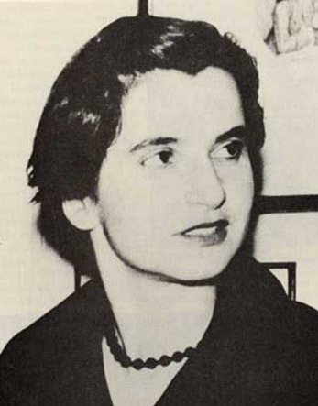
Rosalind Franklin and X-rays Evidence
Rosalind Franklin used
X-ray diffraction to find the
structure of DNA
Her photos were later used by Watson and Crick to come up with the structure of DNA.

Slide 14
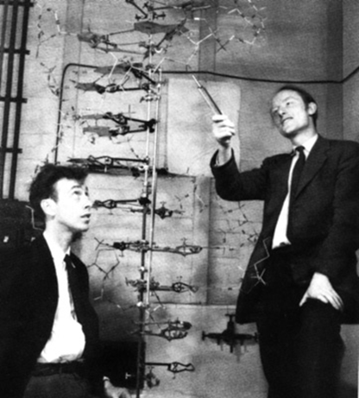
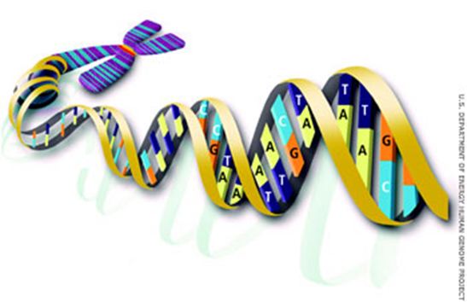
Watson and Crick
Using clues from Franklin’s X-ray photos, Watson and Crick built a model that explained how DNA carried information and could be copied
Watson and Crick’s model of DNA was a Double-Helix, in which two strands were wound around each other

Slide 15
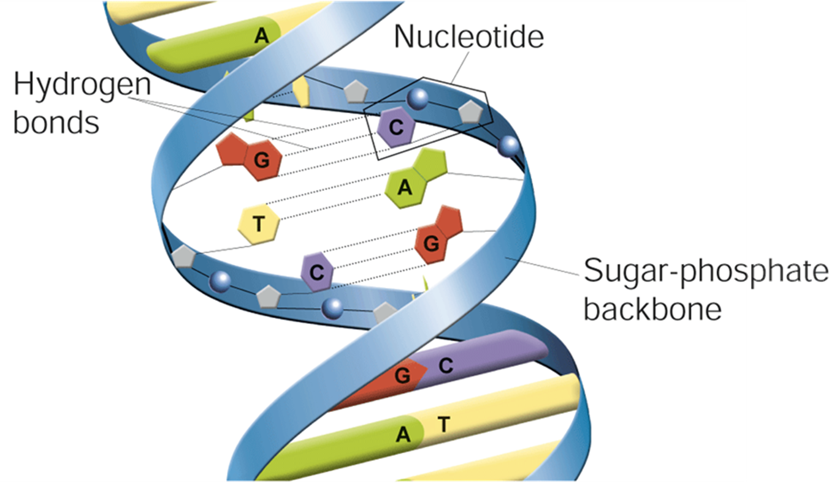
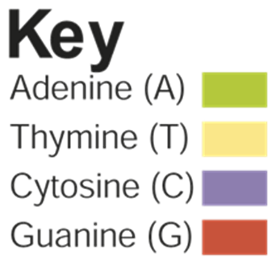
DNA Double Helix

Slide 16
Base-Pairing
Watson and Crick discovered that hydrogen bonds can form between nitrogen bases.
The base pairs are:
Adenine and Thymine – A pairs with T
Guanine and Cytosine – C pairs with G

Slide 17
Question 1
DNA is a long molecule made of monomers called
Nucleotides
Purines
Pyrimidines
Sugars

Slide 18
Question 2
Chargaff’s rule state that the number of guanine must equal the number of
Cytosine
Adenine
Thymine
Thymine plus adenine

Slide 19
Question 3
In DNA, the following base pairs occur:
A with C, and G with T
A with T, and C with G
A with G, and C with T
A with T, and C with T

