Slide 1
Warm-up #6
If you were a emperor, who would you trust to protect your land?
How much power would you give this protector? Explain.

Slide 2
Feudalism
A political, economic, and social system based on loyalty, the holding of land, and military service.

Slide 3

What was the social hierarchy (social rank) like in Medieval Japan?

Slide 4
Feudalism
A political, economic, and social system based on loyalty, the holding of land, and military service.
Japan:
Shogun
Land - Shoen
Loyalty
Land - Shoen
Daimyo
Daimyo
Loyalty
Samurai
Samurai
Samurai
Food
Protection
Peasant
Peasant
Peasant
Peasant

Slide 5
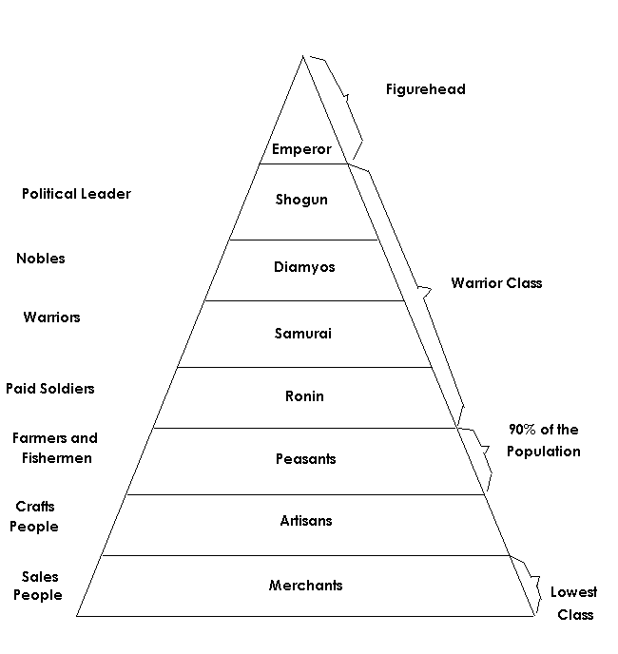
The emperor
reigned, but did not always rule!
Feudal Society

Slide 6
Homework
Answer questions #1a and #1b on page 216 of the notebook.

