Slide 1
Parasites: -Giant Intestinal Fluke -Chinese Liver Fluke -Sheep Liver Fluke

Slide 2
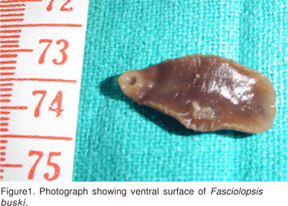
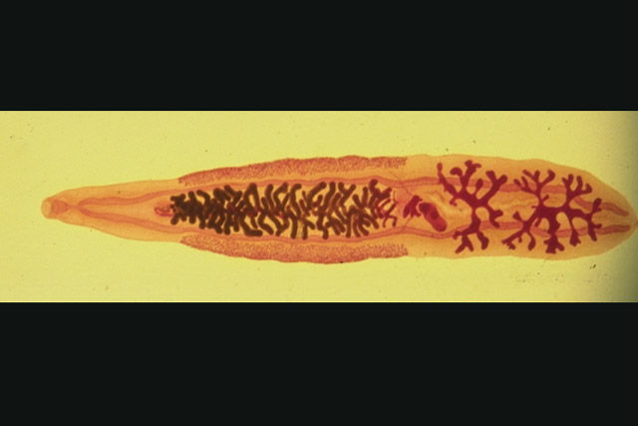
Giant Intestinal fluke
Attaches to the intestinal wall; In severe cases can be found throughout intestinal tract.
The scientific name – Fasciolopsis buski
Their size is 2 to 7.5 cm long and 0.8 to 2 cm wide.

Slide 3
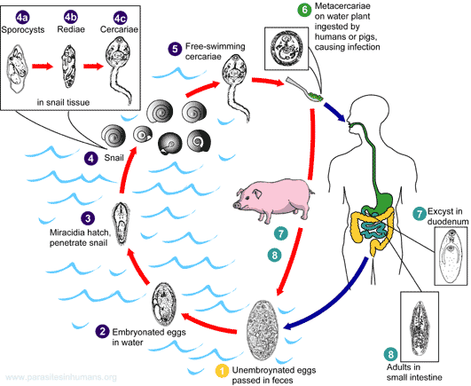
Life Cycle
Can get the fluke by ingesting raw water chestnuts or bamboo shoots
Also can infect pigs, dogs and rabbits

Slide 4
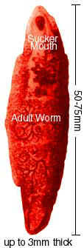
Symptoms
Causes local inflammation, ulceration and possible bleeding.
With severe cases; abdominal pain and diarrhea.
With the most severe cases, stools are profuse, light yellow and contain undigested food.
You also do not get all the nutrient you need

Slide 5
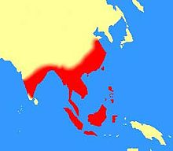
Epidemiology
Found in China (including Taiwan), Vietnam and Thailand. Along with other Pacific Islands groups

Slide 6
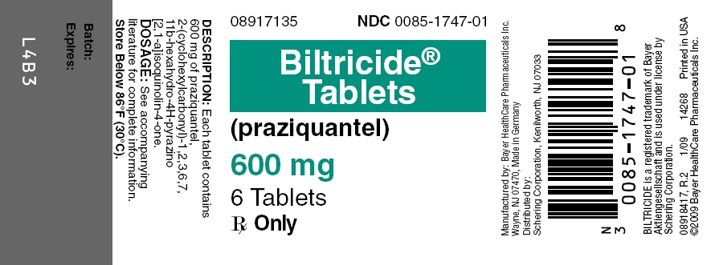
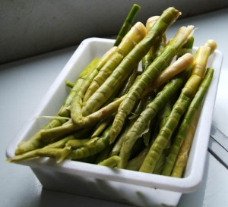
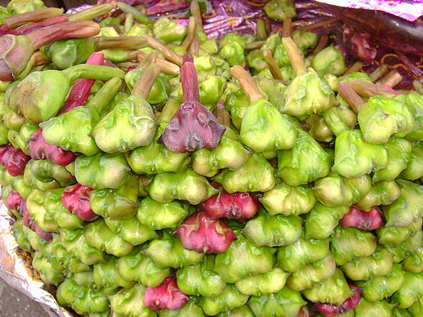
Treatment / Prevention
The drug of choice:
Biltricide; ingested 3 times daily until symptoms are gone.
Some side effects are intestinal pain, dizziness and drowsiness
Prevention:
Cook bamboo shoots and Water chestnuts

Slide 7
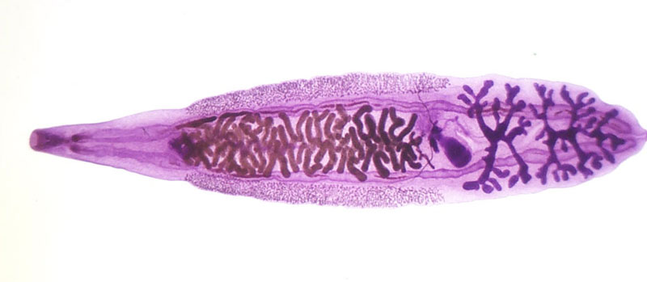
Chinese Liver Fluke
Scientific name is – Clonorchis sinesis
Some worms can live as long as 30 years
Will find their way into your gall bladder and pancreatic duct
Can tell if a person is infected by the recovery of the eggs from the feces

Slide 8
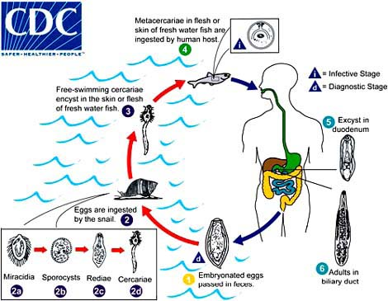
Life Cycle
Two intermediate host
The first is a snail where the matured miracidium enter into it’s tissue
The second is a fresh water fish that a cercaria that would be ingested by the fish
We get the parasite from eating infected uncooked fish.

Slide 9
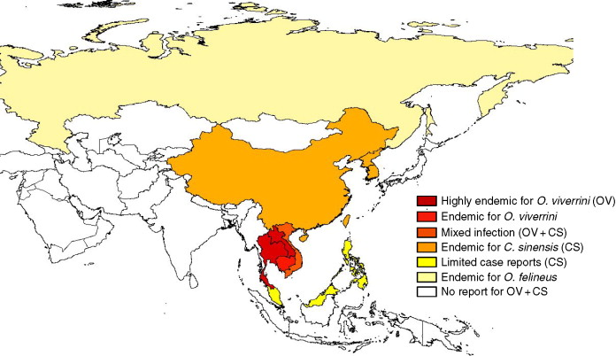
Epidemiology
Found in large areas of China, Japan, Korea and Vietnam

Slide 10
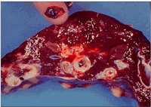
Symptoms / Treatment
Light infections are asymptomatic - meaning no symptoms
Heavier ingestion of a large number have seen the following symptoms:
Fever
Diarrhea
Stomach pain
Tender liver
Sometimes Jaundice
Longer exposure to liver fluke can cause more severe liver damage
Treatment:
Drug used is praziquantel given three times daily for 1 day

Slide 11
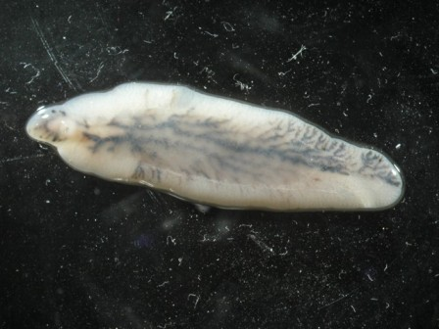
Sheep Liver Fluke
Nearly 3 cm long
Lives in the passages and ducts that lead to and from the gall bladder.
First starts with finding their way to the small intestine and will burrow into and through the intestinal wall and migrate to the liver.
Scientific Name:
Fasciola hepatica

Slide 12
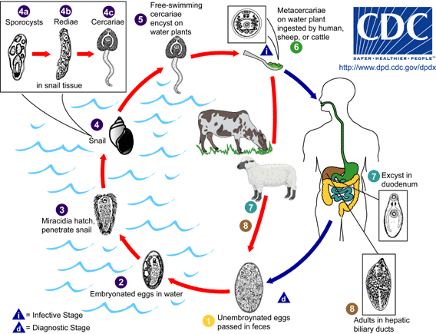
Life Cycle
Miracidia find a snail and will then become free swimming.
They will then form cyst on water plants that then are ingested by humans or other animals like cows or sheep.

Slide 13
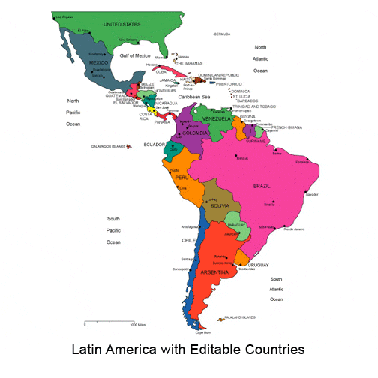
Epidemiology
Mostly found in Central and South America and is a major problem for farmers of cattle and sheep. But found on every other continent as well.
There is an estimated 2.4 million people that are infected with the parasite

Slide 14
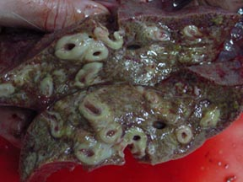
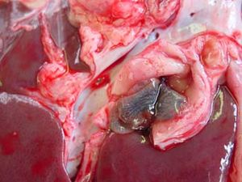
Symptoms
It is not use to humans as a host and will sometimes migrate to other regions of the body and form cysts.
Main Symptoms:
Fever
Abdominal pain
Jaundice
Later stages become asymptomatic which can last for months or years with out problems.
Eventually can cause chronic problems with gall bladder

Slide 15
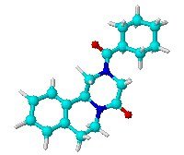

Treatment/ Prevention
Nondrug:
Protein-rich diet. Also lots of Iron and vitamins for absorption
Drugs:
Praziquantel
Also possible surgery to remove parasite
Prevention:
Wash vegetables
Cook water grown vegetables before eating

