Slide 1
Characteristic of Life

Slide 2
living things are composed of cells.
Living things are made of small self-contained units called cells.
Cells are the basic units of structure and function in all living things. Cells are the building blocks of all organisms.
Organisms that are composed of one celled (single cell), are called unicellular organisms.
Organisms that are composed of many cells (hundreds, thousands, even trillions) are called multicellular organisms.
Cells are not found in nonliving matter unless that matter was once alive.

Slide 3
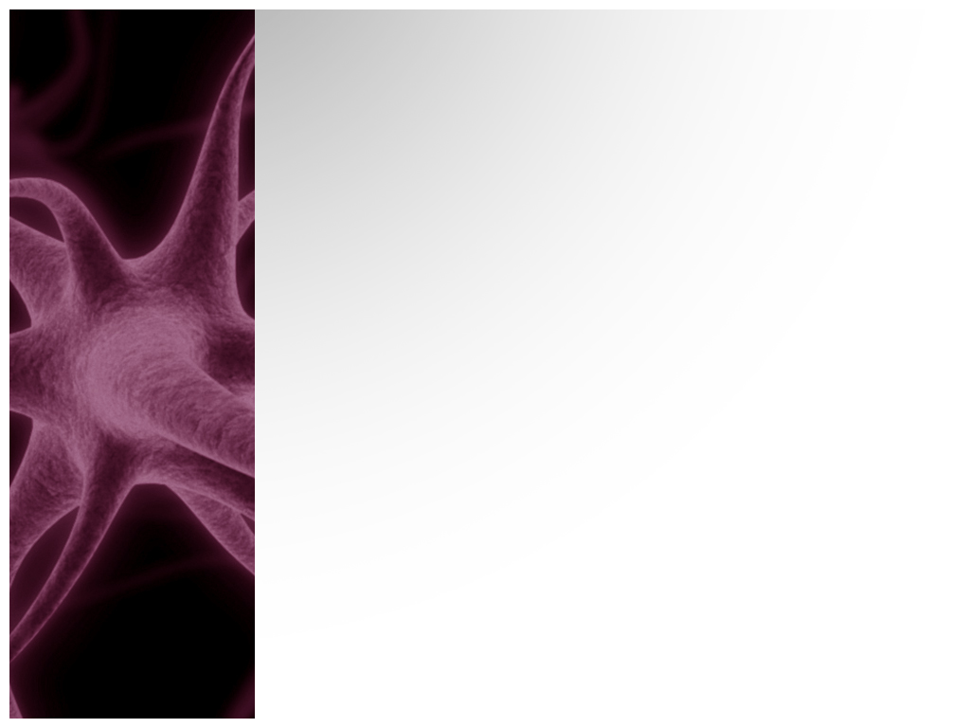
All living things are highly organized.
Living things take in substances from the environment and organize them in complex ways.
In individual cells, specific structures have specific jobs. For example, the nucleus of the cell is the brain of the cell while the mitochondria of the cell supplies energy to the entire cell.
In multicellular organism, cells and groups of cells are organized by their function. Blood cells provide the entire organisms with oxygen while nerve cells carry information from the brain to the rest of the body.

Slide 4
All living things obtain and use energy.
The sum of all the chemical processes that occur in an organism is called metabolism.
Energy is needed to maintain molecular and cellular organization as well as growing, developing, and reproducing.
Autotrophic organisms, like plants, obtain energy directly from the sun and perform photosynthesis.
Heterotrophic organisms, like animals, cannot make their own food. These organisms obtain energy by taking in other organisms or food.

Slide 5
All living things maintain a stable internal condition called homeostasis.
Anything in the environment that causes an organism to react is called a stimulus.
Kinds of stimulus include light, temperature, odor, sound, gravity, heat, water, pressure, etc.
The ability of living things to respond is called irritability.
A plant example of irritability: Plant growing in the shade. The leaves tend to grow toward the sun.
An animal example of irritability: Horses growing a winter coat and then shedding during the Spring.
Living things respond to stimuli in ways that improve their chances for survival.

Slide 6
All living things grow and develop.
Living things grow as a result of cell division and cell enlargement. Cell division is the formation of two cells from one existing cell.
In unicellular organisms, when a cell divides, the result is a new organism.
In multicellular organisms, cell division and cell enlargement result in growth.
Adulthood is due to development. Development is defined as repeated cell divisions and cell differentiation.
An organism goes through development by absorbing raw materials and processing them into various tissues and structures.

Slide 7
All living things reproduce.
All species of organisms have the ability to reproduce. Reproduction however, is not essential to the survival of an organism. Reproduction is necessary to continue a species.
There are two types of reproduction:
  Sexual – requires 2 cells from different individuals. Sperm and egg.
  Asexual – single organism can reproduce without the aid of another .

