Slide 1
Warm-up #1
Make a KWL chart with at least three things you know and three things you would like to know about Japan (specifically geography).
Know | Want to Know | Learn

Slide 2
Essential Question
How has Japan’s geography affected it both positively and negatively?

Slide 3
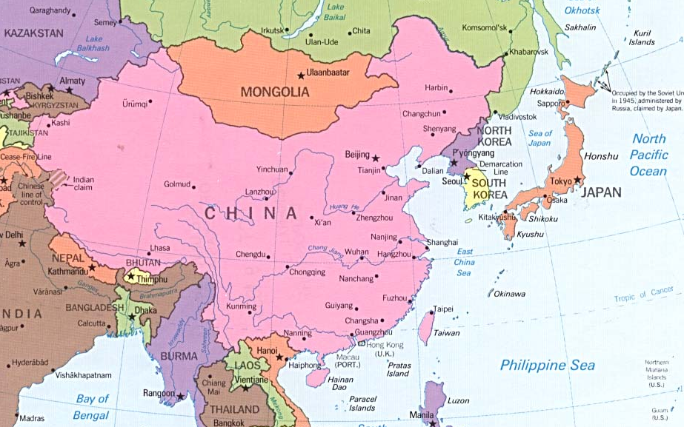
Japan
China

Slide 4
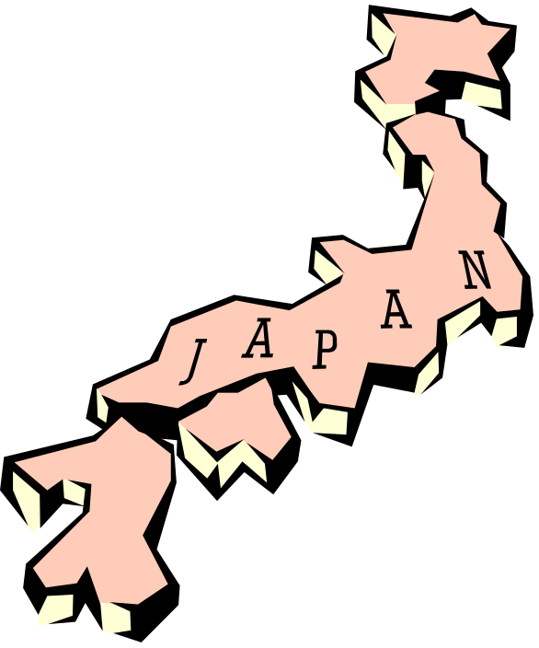
Size and Population
Located on a series of islands.
Slightly smaller in size than California.
CA population: 35 million
JP population: 127 million
Only about 20% of the land is flat enough for farmingand most of that land is used for cities.

Slide 5
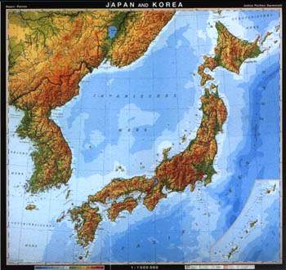
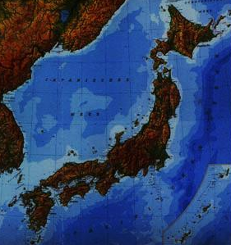
The Land
Made up of many islands with 4 main ones.
Very mountainous so not much farmland.
Lots of earthquakes and volcanoes.

Slide 6


What would you do?
Problem: Only 20% of the land is open for farming.
Problem: Animals use more land to raise than vegetables.
Problem: Meat provides protein, a necessary nutrient.
Look at the map on the next slide and answer and write down how you would handle the problem.
Notes:
Hope to add a physical puzzle cut out for this eventually. If anyone does so, let me know!

Slide 7
The more red the land, the higher the elevation (that means there’s mountains!)

Slide 8
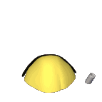

The Sea
Japan relied on the sea (ocean) for food and transportation.
Food: Rice and fish
The sea also kept Japan isolated (removed from the rest of the world.)

