Slide 1
Interactions within Communities
Ch. 24-3 Notes
- Energy Flow
EQ: How is energy
moved through the
living environment?

Slide 2
Where does Energy come from?
Without a constant input of energy, living systems cannot function.
Sunlight is that constant input of energy

Slide 3
Producers
Only plants, some algae and certain bacteria can capture energy from sunlight or chemicals and use that energy to produce food.
These are called producers or also autotrophs, because they can make their own food.
Photosynthesis is the process that these organisms use to produce their food.

Slide 4
Consumers
Many organisms cannot harness energy directly from the environment
Organisms that rely on other organisms for energy and food supply are called heterotrophs or also consumers

Slide 5
Different types of Heterotrophs/Consumers
Herbivores eat plants.
Carnivores eat animals.
Omnivores eat both plants and animals.
Detritivores feed on plant and animal remains and other dead matter.
Decomposers, like bacteria and fungi, break down organic matter

Slide 6
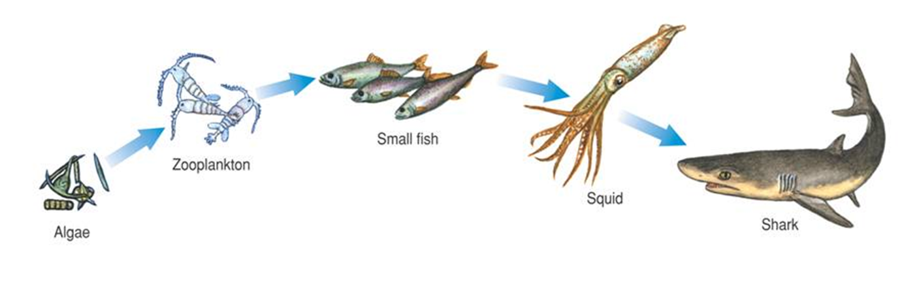
How does energy flow through living systems?
Energy always starts with the SUN
Sun » producers » consumers
A food chain is a series of steps in which organisms transfer energy by eating and being eaten.

Slide 7
Food Webs
Ecologists describe a feeding relationship in an ecosystem that forms a network of complex interactions as a food web
A food web links all the food chains in an ecosystem together.

Slide 8
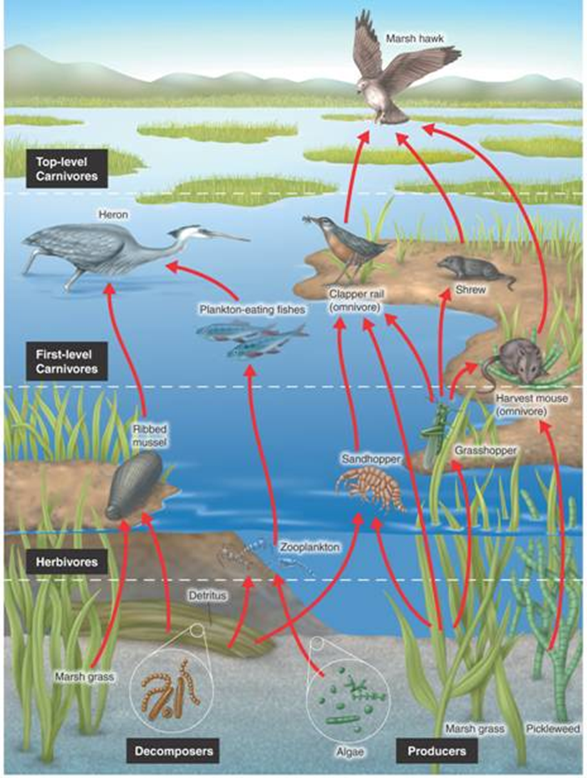
Food Webs
This food web shows some of the feeding relationships in a salt-marsh community.

Slide 9
Question 1
The main source of energy for life on Earth is
Organic compounds
Inorganic compounds
Sunlight
producers

Slide 10
Answer
A. Sunlight

Slide 11
Question 2
Organisms that feed on plant and animal remains and other dead matter are
Detritivores
Carnivores
Herbivores
autotrophs

Slide 12
Answer
A. Detritivores

Slide 13
Question 3
How does a food web differ from a food chain?
A food web contains a single series of energy transfers.
A food web links many food chains together.
A food web has only one trophic level.
A food web shows energy passes from producer to consumer.

Slide 14
Answer
B. A food web links many food chains together.

