Slide 1
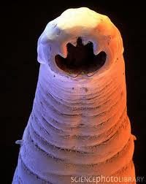
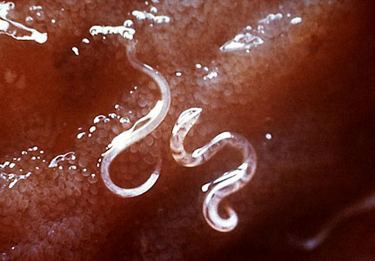
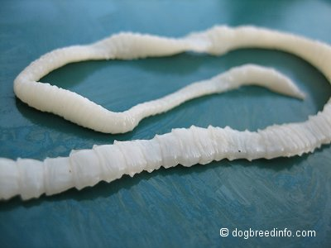
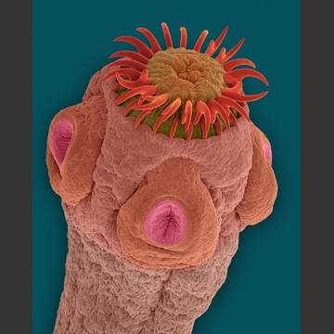
Introduction to Parasitology

Slide 2
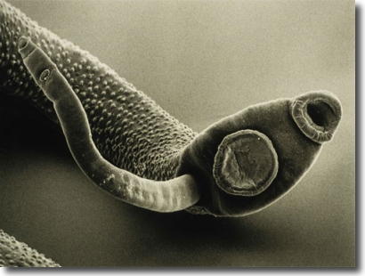
What is a Parasite?
A parasite is an animal that lives at the expense of its host.
A host in an animal that the parasite lives in or has a symbiosis with.

Slide 3
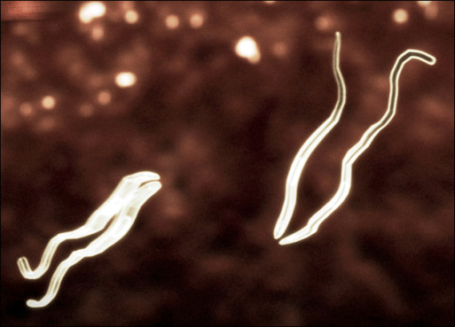
Effect of the Parasite on the host
The presence of a parasite may injure the host in a number of ways:
Interference of vital processes
Destruction of host tissue
Produce toxins harmful to the host
Depriving host of nutrients

Slide 4
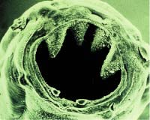
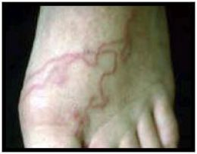
Effect of the Host on the Parasite
There are certain genetic and environmental conditions that parasites are effected by when they invade a host:
Genetic conditions
Sickle Cell Trait
Diet or Nutritional status of the host
Immune processes
Medications taken by host

Slide 5
Prevalence of Parasites Infections
Estimates of the prevalence of parasites based on World Health Organization (WHO)and CDC.
Malaria: 500 million infected; 2.5 million deaths
African Sleeping Sickness: 100,000 new cases a year; 50,000 deaths
Hookworm: 1 billion infected
Elephantiasis: 128 million infected

Slide 6
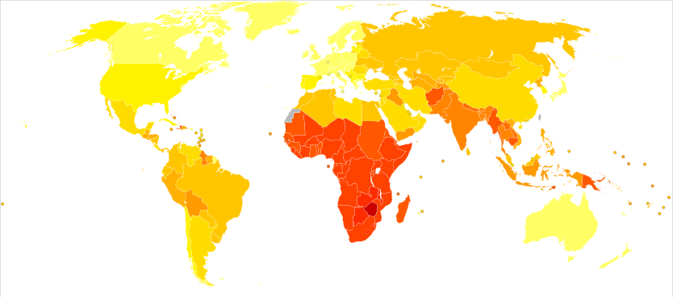
World Distribution of Parasitic Diseases

Slide 7
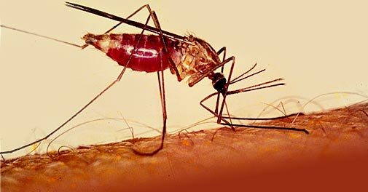
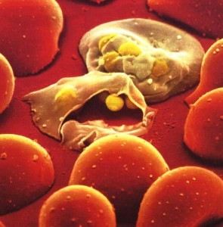
Malaria Background
Scientific name for the parasite that causes malaria is Plasmodia falciparum
Attacks the red blood cells.
The mosquito is an intermediate host of the parasite.

Slide 8
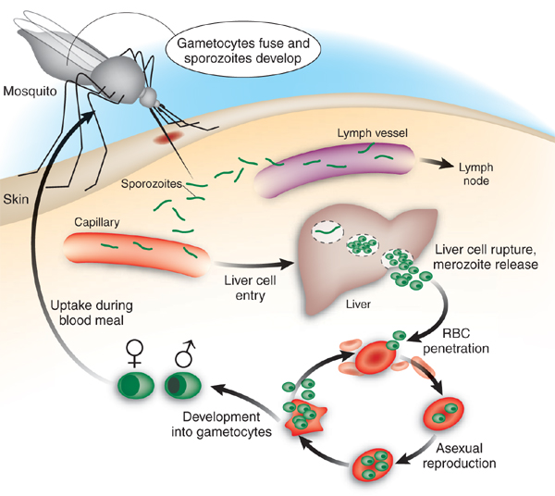
Malaria Life Cycle
http://www.youtube.com/watch?v=iwAEsOpvHn0

Slide 9
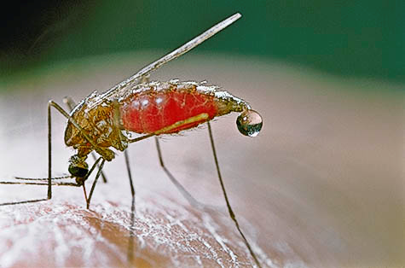
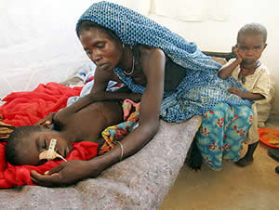
Diagnosis and Symptoms
Diagnose malaria by taking blood sample and finding parasite
Symptoms of Malaria infection:
Headache
Muscle ache and pains
Nausea and vomiting
Intense fever and chills
Restlessness, disorientation and delirious

Slide 10
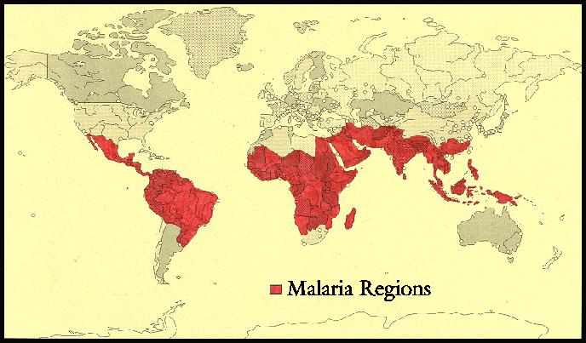
Epidemiology
Epidemiology is the study of the distribution and patterns of health-events.
The disease is found primarily in tropic climates.
Some cases have been found but in very small numbers in the United States.

Slide 11
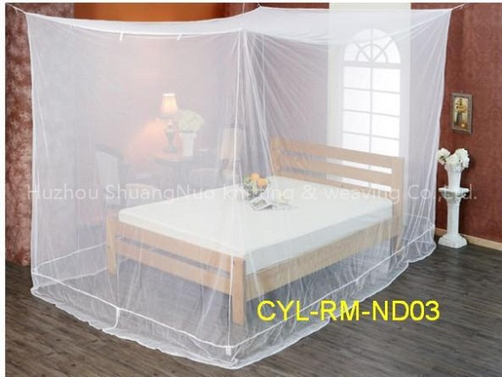
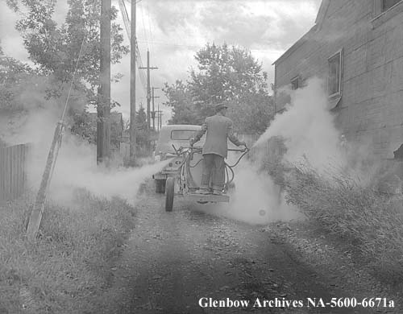
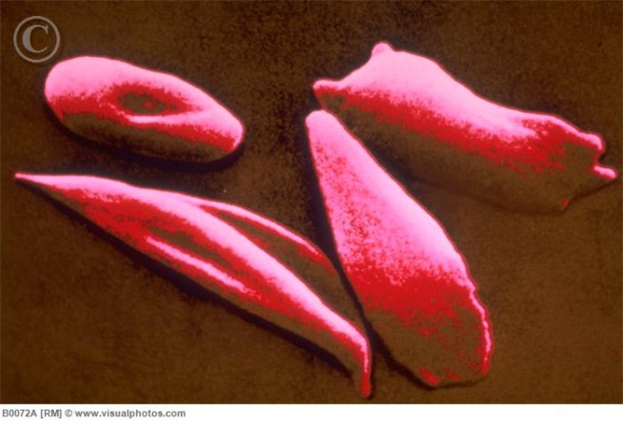
Treatment
Medications and prevention methods that can be taken:
Use of bed nets in tropic climates
Quinine (medication)
DDT to kill mosquito
Use of DEET to keep mosquitos away (bug spray)
Use of Malaria Vaccine
Sickle Cell Trait
Sickle cell trait tends to have a resistance to the parasite that causes malaria.

Slide 12
Review Questions
What is parasitology?
What is epidemiology?
What are some symptoms associated with malaria?
What are some measure that can be taken to prevent malaria?

