Slide 1
Immune Response (specific defenses) –
Immune system consists of about (special type of white blood cell) distributed throughout the body but clustered in
Immune response results from interactions among the various types of lymphocytes and the molecules that they produce

Slide 3
A successful immune response involves:
Recognizing an invader,
Launching a successful attack to overcome the invader, and
Retaining a memory of the invader to ward off future attacks

Slide 4
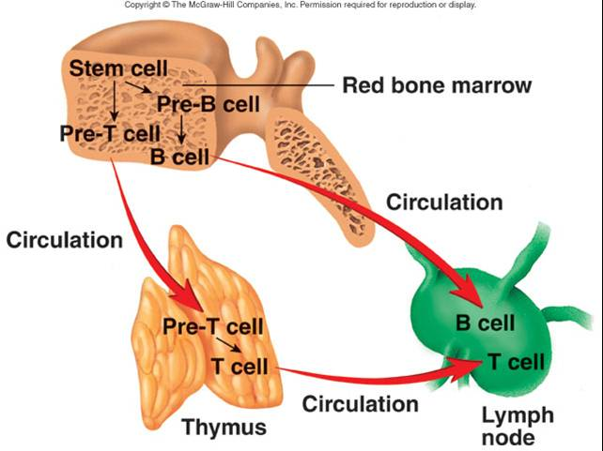
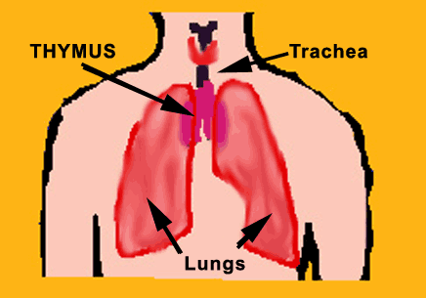
Two key lymphocyte cells are involved in the immune response:
Arise from
Some of these cells are released into bloodstream and
http://www.myasthenia.org.au/html/treatments.htm

Slide 5
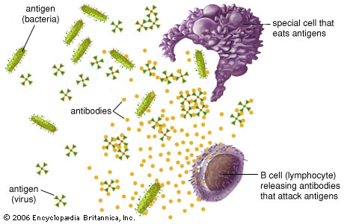
6.3.5 Distinguish between antigens and antibodies.
Details of the Immune Response:
Step 1:
Antigens –
Antigen (bacteria)
Can be (usually large proteins, polysaccharides, and glycoproteins)
Antigens on our own cells are recognized as “ ” and do not stimulate an immune response
Macrophage
B cell (lymphocyte) releasing antibodies that attack antigens
http://kids.britannica.com/elementary/art-89116/Special-cells-that-eat-antigens-are-a-part-of-natural

Slide 6
6.3.5 Distinguish between antigens and antibodies.
The surfaces of the body’s own cells bear large proteins and polysaccharides just like microbes do
These proteins are collectively called the
MCHs are – one person’s MHCs would be recognized as foreign antigens in another person’s body
Which is why

Slide 7
6.3.5 Distinguish between antigens and antibodies.
Any foreign material entering the body can act as an antigen and stimulate an immune response
“Anti-” means & “-gen” means , so antigen is an

Slide 8
6.3.5 Distinguish between antigens and antibodies.
Antibodies
Y-shaped molecules made of 4 polypeptides ( )
Antibodies have two sites that stick out and constantly look for antigens (and attach to antigens) and one site that sticks to the surface of its lymphocyte

Slide 9
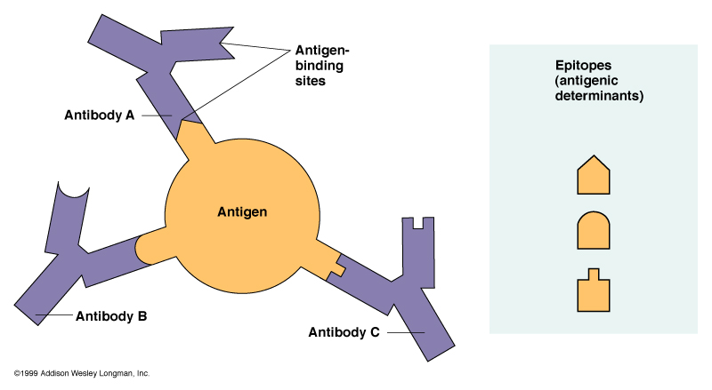
6.3.5 Distinguish between antigens and antibodies.
Antibodies act in two ways:
Act as
Act as effectors and circulate in bloodstream
Tips of antibodies form for antigens – each site has a specific shape and binds only to a specific type of antigen

Slide 10
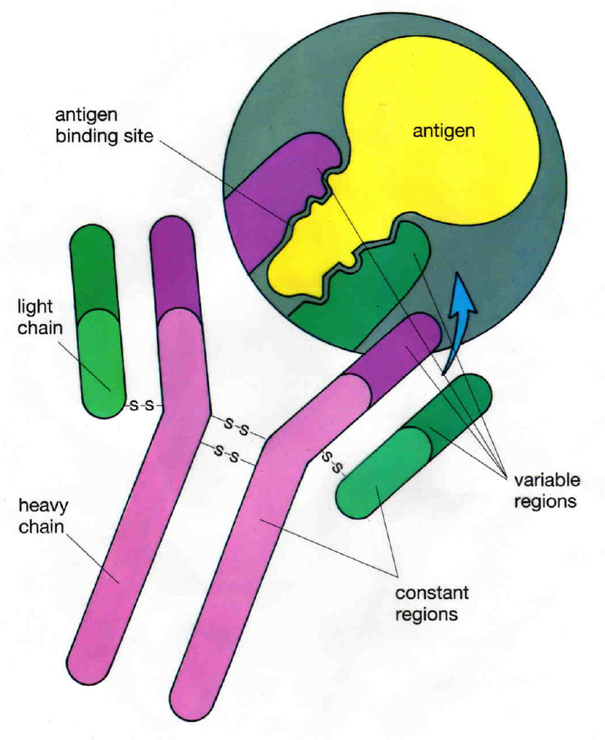

Slide 12
– T-cells also have receptors on their surfaces
These are
Act (as compared to antibodies that act as receptors to trigger a response AND function in destroying foreign antigens)

Slide 13
Details of the Immune Response:
Step 2: – the immune system mounts two types of attacks:
Humoral Immunity is provided by
Cell-mediated Immunity is produced by

Slide 14
6.3.6 Explain antibody production.
Humoral Immunity
Produced by – because antibodies circulate in the bloodstream, humoral immunity can only defend against invaders in blood and extracellular fluid
B cells with specific antibodies on their surfaces bind to
Binding causes B cells to divide rapidly → – resulting population of cells are

Slide 15
6.3.6 Explain antibody production.
Daughter cells differentiate into two cell types:
: do not release antibodies but play an important role in future immunity
: become enlarged and make huge quantities of their own specific antibodies that are released into bloodstream

Slide 16
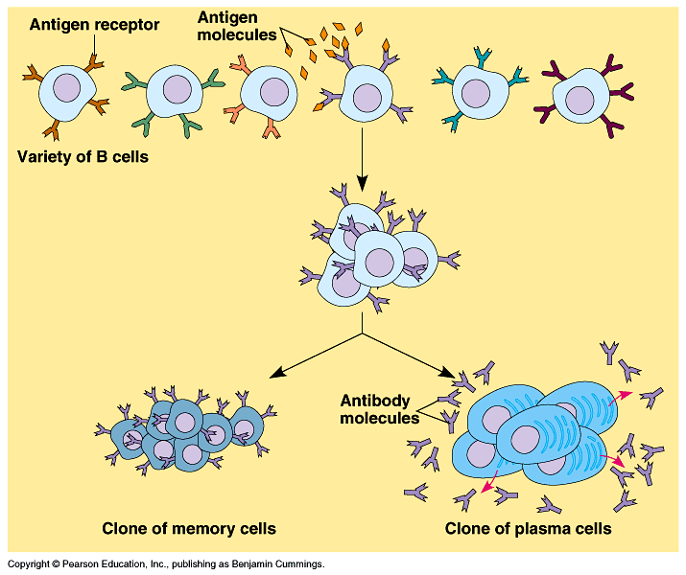

Slide 17
Antibodies destroy microbes in four ways:
Neutralization – antibody may
Promotion of phagocytosis – antibody may

Slide 18
Agglutination – antibodies have multiple binding sites and may bind to antigens on two different microbes, holding them together
This
Complement reactions – the antibody-antigen complex on the surface of an invading cell may trigger a series of reactions with blood proteins called the
These complement proteins bind to antibodies and attract phagocytic cells or may directly destroy invaders by creating holes in their plasma membrane (similar to natural killer cells)

Slide 19
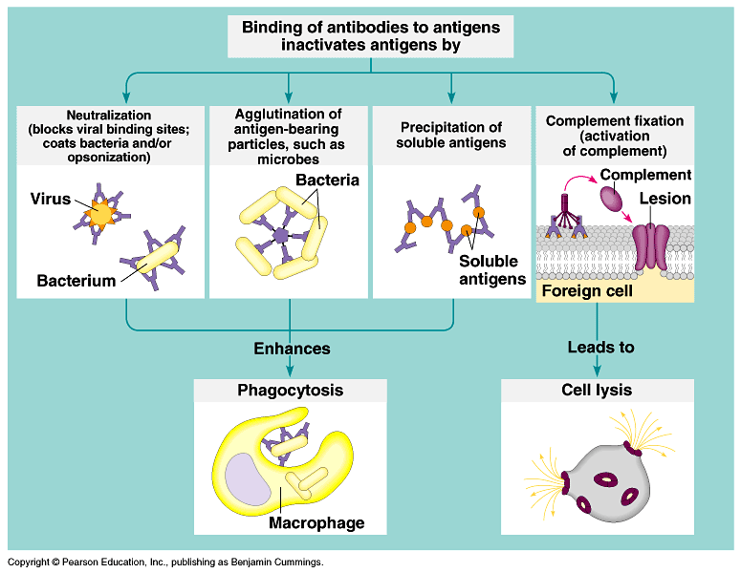

Slide 20
Cell-mediated Immunity
Produced by , primary defense against
Also important in overcoming infection by fungi or protists
Three types of cells contribute to cell-mediated immunity:
Cytotoxic T-cells
Helper T-cells
Suppressor T-cells

Slide 21
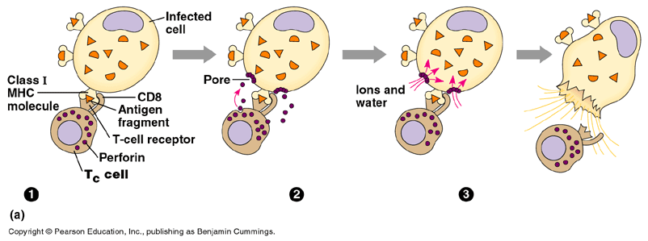
Cytototoxic T-cells
Release
This attack is activated when receptors on the cytotoxic T-cell’s membrane bind to antigens on surface of infected cell – create giant holes in target cell’s membrane
Animation: http://highered.mcgraw-hill.com/sites/0072507470/student_view0/chapter22/animation__cytotoxic_t-cell_activity_against_target_cells__quiz_1_.html

Slide 22
Helper T-cells
When receptors of these cells bind to an antigen, the cells (hormone-like) that assist other immune cells in their defense of the body
The chemicals released by Helper T-cells
Very little immune response (cell-mediated or humoral) can occur without the boost provided by helper T-cells (reason why AIDS is so deadly)

Slide 23
Suppressor T-cells
Act after an infection has been conquered – help to
After infection is over, some suppressor T cells and helper T cells remain and function as memory T cells to help protect the body against future exposure to the same antigen

Slide 24
Details of the Immune Response:
Step 3: :
Memory cells allow us to retain immunity to antigens
B and T memory cells survive for many years

Slide 25
If the body is exposed to antigens the immune system has previously encountered:
The appropriate
Second immune response is – invasion is overcome so fast, there

Slide 26
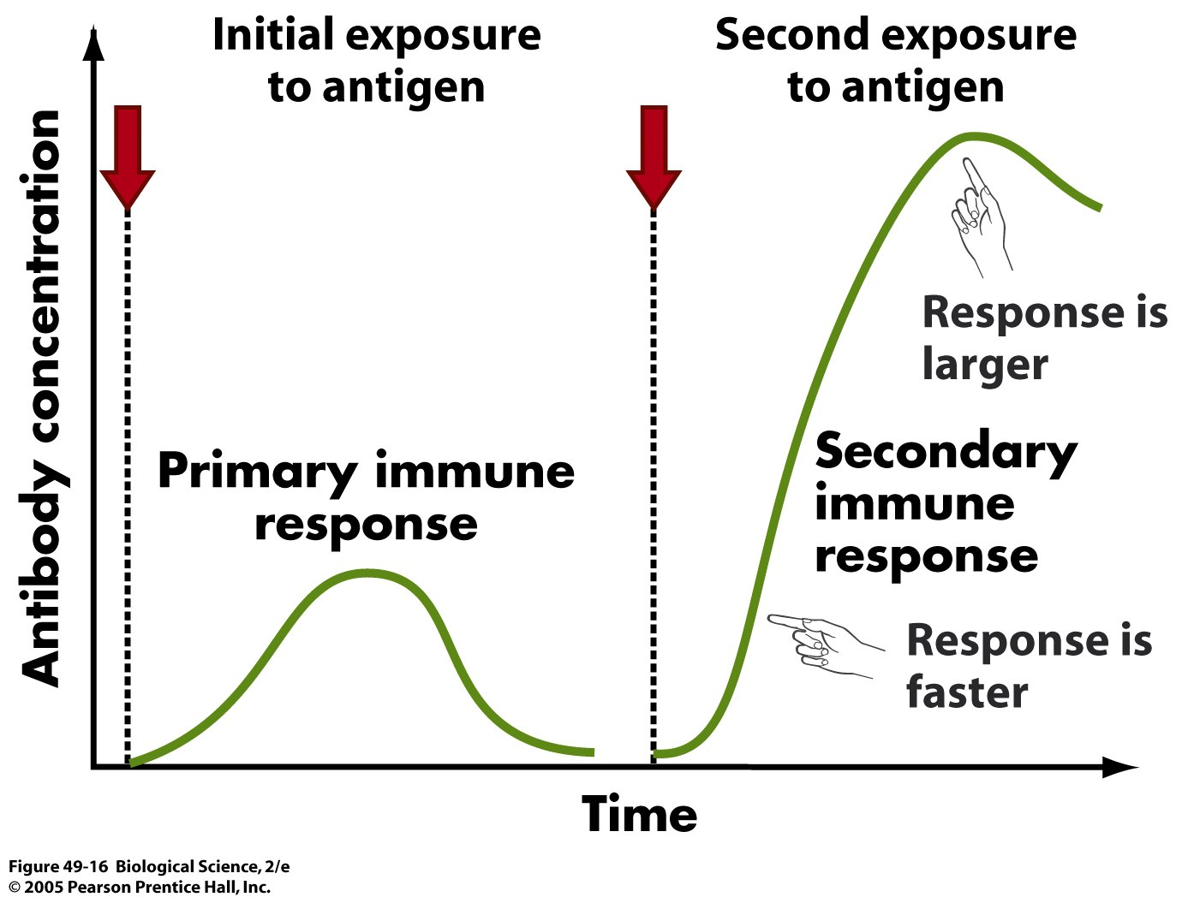
Secondary Immune Response

Slide 27
Summary:

Slide 28
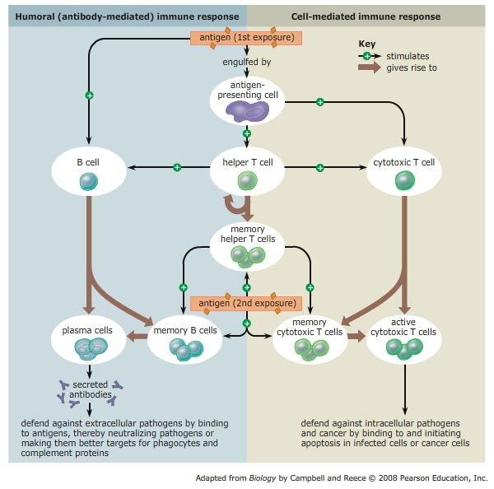
Summary:

Slide 29
6.3.8 Discuss the cause, transmission and social implications of AIDS.
AIDS – Acquired Immune Deficiency Syndrome
Cause:
Caused by two viruses –
HIV is a – contains RNA as its genetic material
AIDS describes the

Slide 30
6.3.7 Outline the effects of HIV on the immune system.
Effect:
HIV viruses
HIV reproduces by
Eventually the infected cell begins
Proliferating viruses eventually

Slide 31
6.3.7 Outline the effects of HIV on the immune system.
As the number of helper T-cells decline, the lymphocytes are
AIDS does not directly kill its victims, → As the helper T-cell population declines they become more susceptible to opportunistic diseases

Slide 32
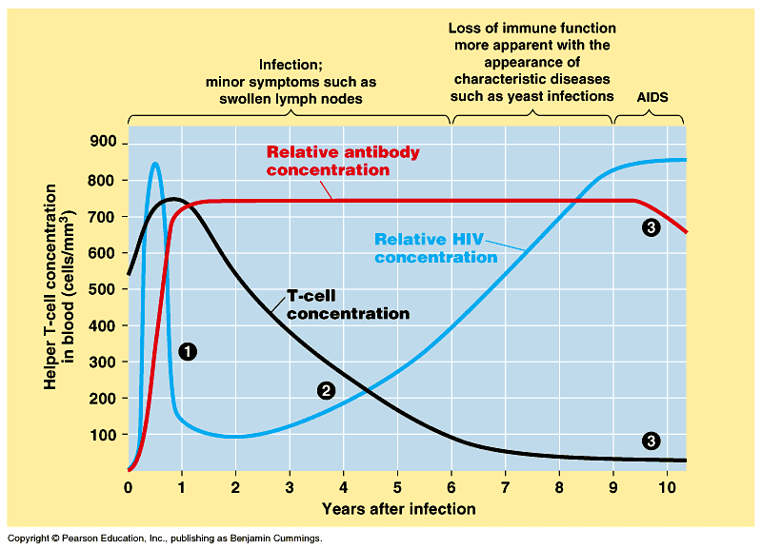

Slide 33
6.3.8 Discuss the cause, transmission and social implications of AIDS.
Transmission:
Sexual intercourse – virus is present in semen and vaginal secretions
In traces of blood on a hypodermic needle that is shared by IV drug abusers
Across the placenta from a mother to a baby, or through cuts during childbirth or in milk during breast-feeding

Slide 34
6.3.8 Discuss the cause, transmission and social implications of AIDS.
In transfused blood or with blood products such as Factor VIII used to treat hemophiliacs
Accidents causing blood contamination – the disease can be transmitted between a patient and a surgeon during operations, and between a patient and a dentist through cuts in open skin
Tattoos and ear piercing with infected needles

Slide 35
6.3.8 Discuss the cause, transmission and social implications of AIDS.
Social Implication of AIDS:
Due to ignorance about the methods of transmission,
HIV positive people may have difficulty
Sexual life styles have changed due to the awareness of and education about AIDS –
Children may become
May

