Slide 1
Hot Words
#61-66

Slide 2
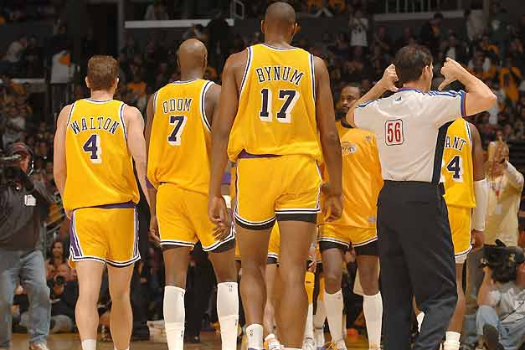
flagrant
(adj)
glaringly wrong; conspicuously evil
- That was a flagrant move from the referee to suspend Odom from the rest of the game.

Slide 3
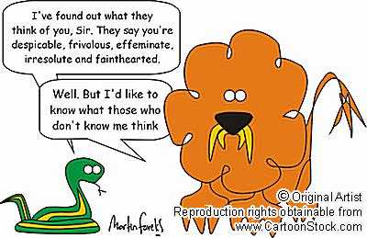
frivolous
(adj)
unimportant; not worthy of serious notice
- My mom thinks cartoons are a frivolous way to distract people during their time off.

Slide 4
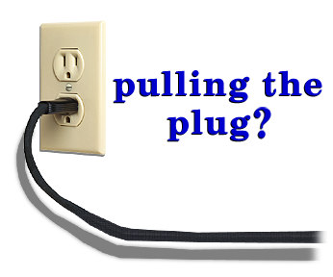
futile
(adj)
hopeless; without effect
- Telling a baby not to play with electrical outlets is a futile effort for parents. Babies touch everything!

Slide 5
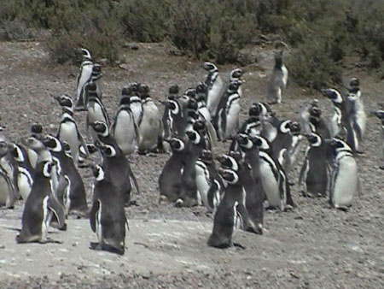
gregarious
(adj)
enjoying and seeking the company of others
- Penguins are a very gregarious species of animals. They spend copious amounts of time together.

Slide 6

guile
(n)
cunning; deceitfulness
-A well-known characteristic of a fox is his guile in the wild.

Slide 7

gullible
(adj)
-overly trusting
- My sister was so gullible when we were growing up that I told her that dolls came alive at night, and she believed me!

