Slide 1
Tuesday May 21, 2013
Opener: Write a list of:
5 U.S. cities you would like to visit
5 National parks you would like to visit

Slide 3

A Trip Across America
U.S. History
Mrs. Janiak’s classes

Slide 4
- As you have studied U.S. History this year, you have come to realize the density and complexity of our nation’s past. You may have also come to realize how large our nation is, with amazing places and culture to experience.
- The project you are about to embark on, will allow you to explore places you want to travel and visit in the future, during a summer vacation, graduation trip or just some day in your future! Have fun exploring the possibilities of traveling in the U.S., as well as learning to budget your traveling expenses!

Slide 5
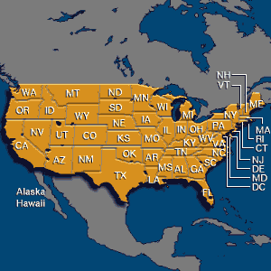
Your trip must:
start and end in San Diego
reach the East Coast (Atlantic Ocean)
include at least 10 major cities
include 10 national or state parks
include 10 cool attractions (restaurants, amusement parks, ballparks, museums, etc.)
at least 21 days long
cost no more than $3,000 per person
utilize realistic transportation (car, RV, bus, train or airplane)

Slide 6
You must create a presentation: PowerPoint, Prezi or video for your trip that includes:
a map of the U.S. showing your route and how many days for each leg and how many days each stop will take
an itinerary showing the daily schedule- places, activities, etc.
a rough budget showing how much you will spend on lodging, food, transportation, and entertainment
at least 15 pictures of stuff you will see

Slide 7
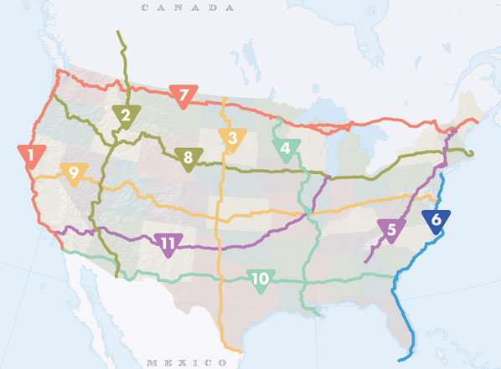
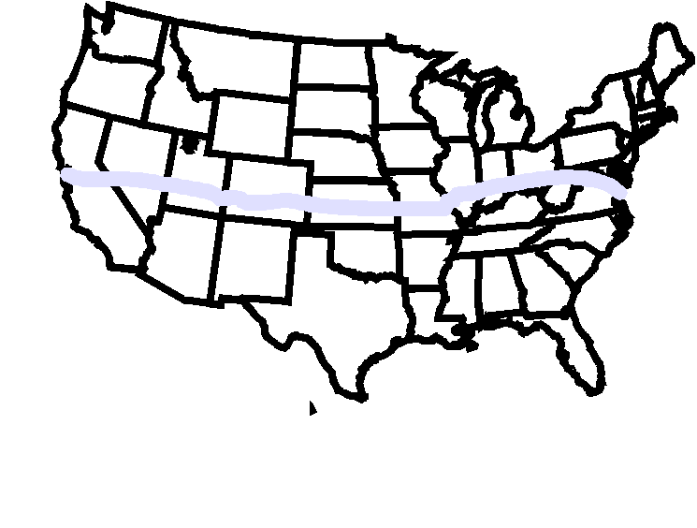

Slide 8
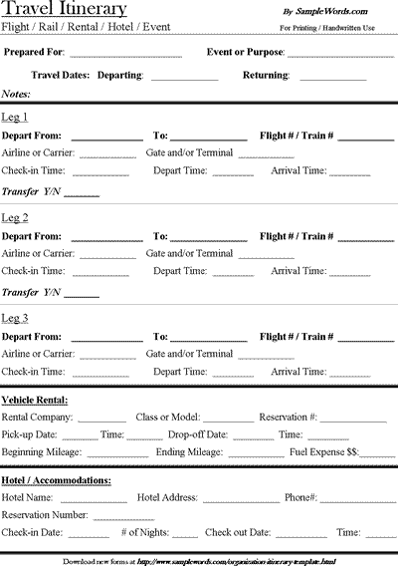
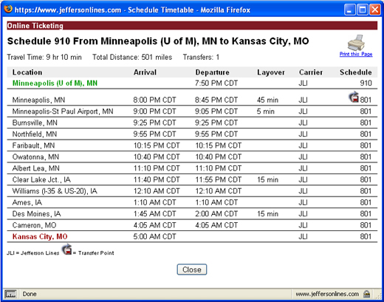

Slide 9
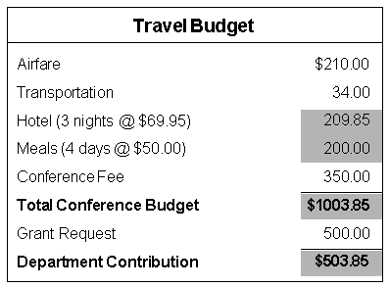

Slide 10
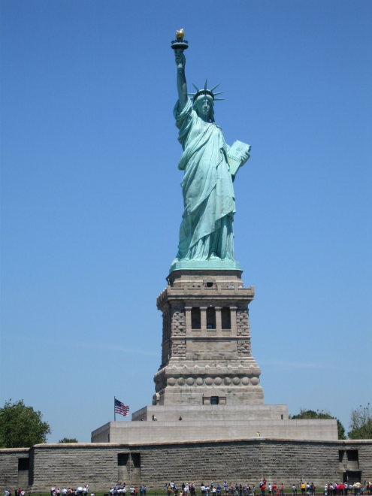
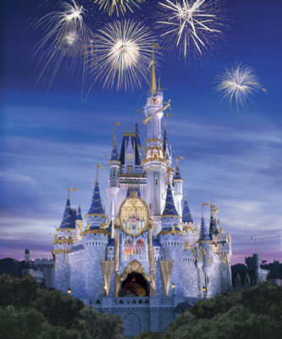

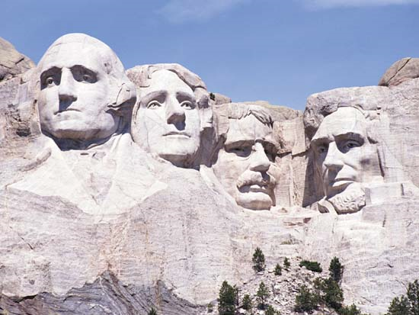

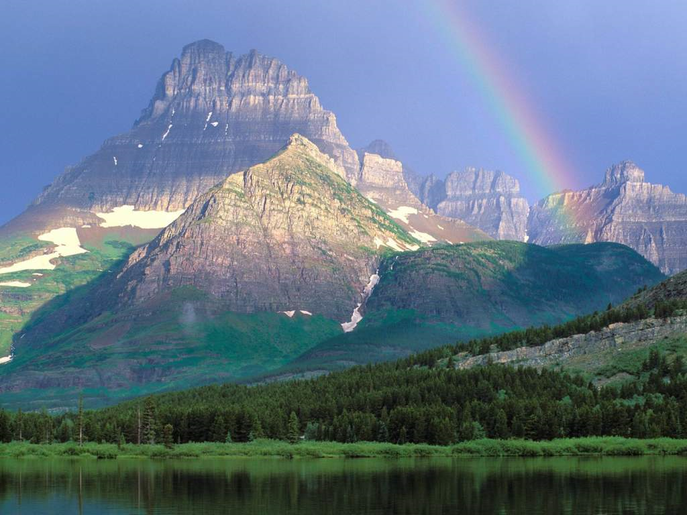
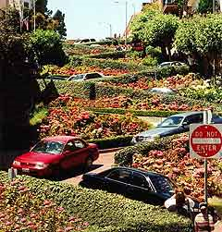
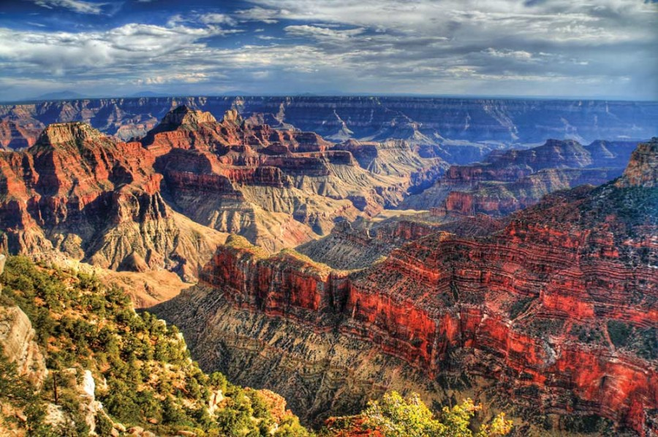

Slide 11
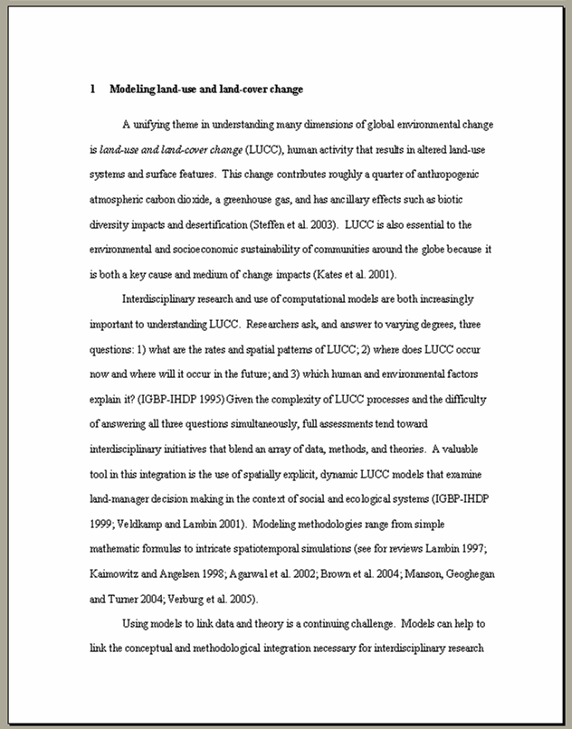

You must also:
Type a two-page description (300-450 words) of the five reasons others should take your trip (easy paragraph per reason)

Slide 12
It is your choice:
If you want to work alone on this project
With a partner
Or in a group, no larger than 4
If you work with someone, your budget of $3,000 each can be put together but you cannot go over the budget (example: I work with Katie and we now have $6,000 to travel with)
Remember- if you choose to work with someone, each person is responsible to contribute to the project. Group projects can often fail due to slacking, think before you group up with people!
Each person will be required to type their own papers as part of their individual grade.

Slide 13
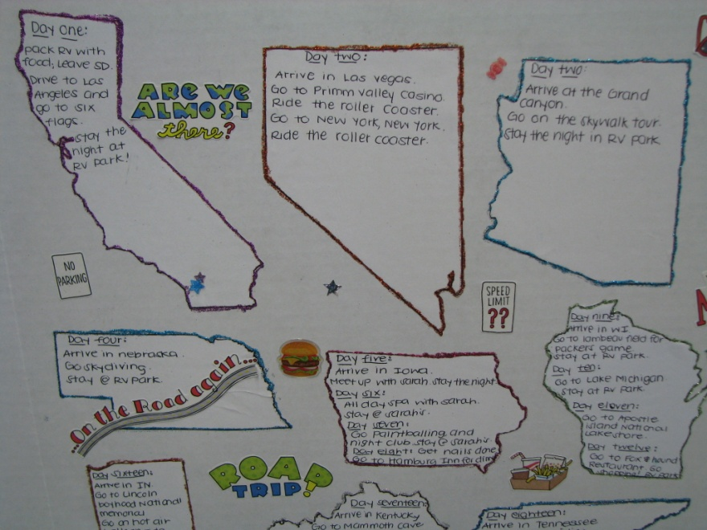
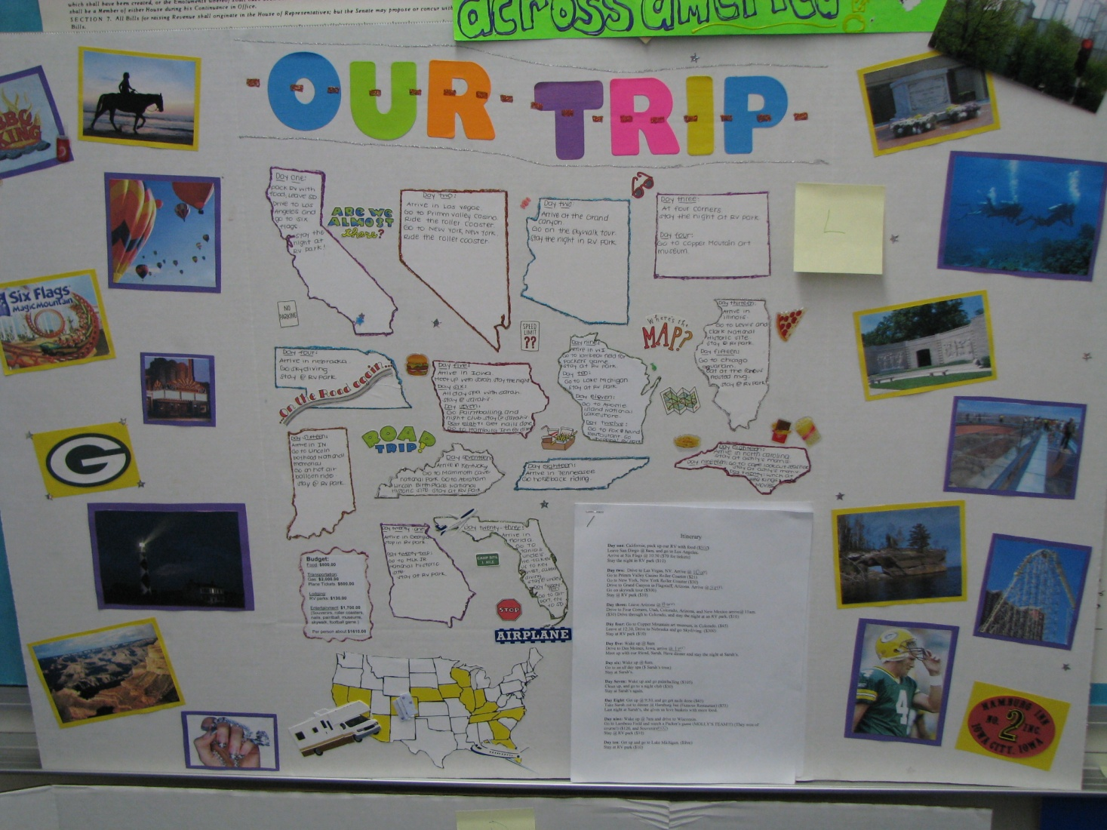
Examples from the past, just to inspire and give you an idea….

Slide 14
