Slide 1


The Sniper
The Sniper
Liam O’Flaherty

Slide 2
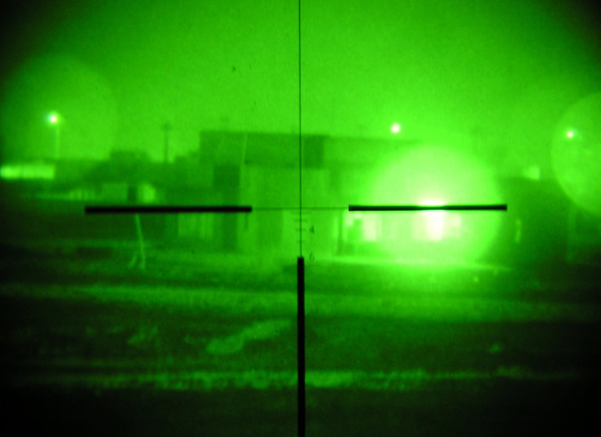
“The Sniper”
Reading Notes
Directions: Label a piece of lined paper with the story’s title and author’s name at the top.
Use this piece of paper to take notes and respond to questions before, during, and after the story.
Label each section of your notes with the slide headings in order to receive full credit.

Slide 3
“The Sniper”
Quickwrite
Make the Connection: Under Pressure
What qualities enable people to perform well when facing heart-pounding fear or stress?
Think about your own experiences or those of someone you know, as well as news stories or fiction you’ve read. Then, jot down your thoughts about people taking action when the stakes are high.

Slide 4
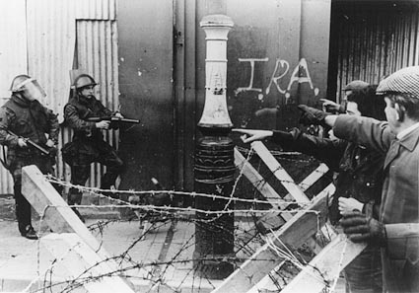
“The Sniper”
Background (textbook p.4)
This story is set in Dublin, Ireland, in the 1920s, during a time of bitter civil war. On one side were the Irish Republicans (IRA); they wanted all of Ireland to become a republic, totally free from British rule.
On the other side were the Free Staters; they had compromised with Britain and had agreed to allow the English to continue to rule six counties in the northern province of Ulster.

Slide 5

The Two Irelands
Orange (Northern)=
  Protestant
  Part of United Kingdom (Britain)
Green (Southern)= Republic of Ireland
  Catholic
  Independent from Britain

Slide 6
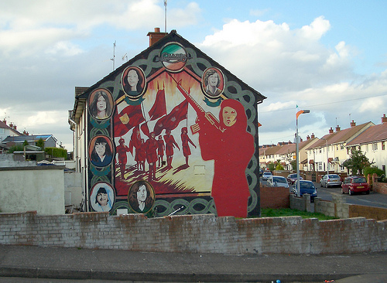
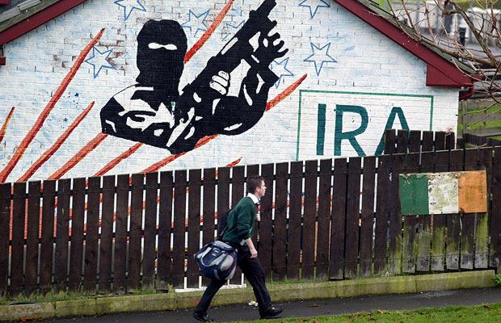
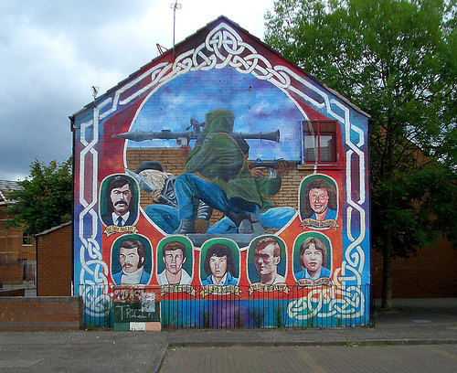
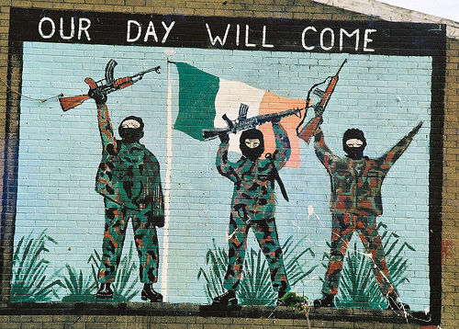
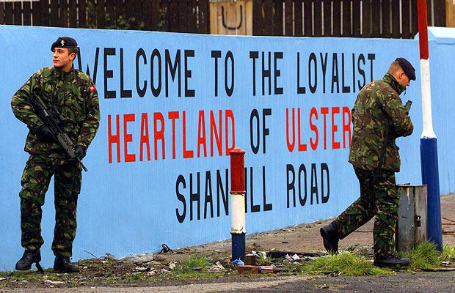
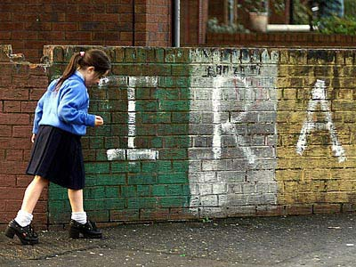
Conflict in Ireland today

Slide 7
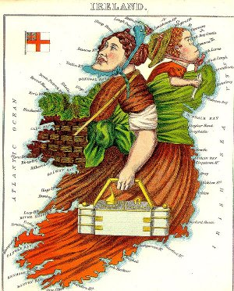
Analyze
Artwork
What do you think this artist is saying about Ireland?

Slide 8
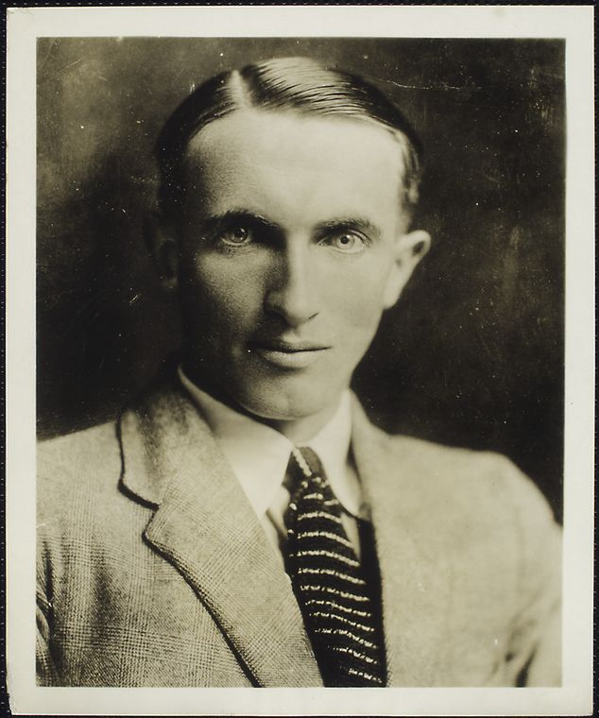
“The Sniper”
Meet the Author: Liam O’Flaherty
Liam O’Flaherty (1896-1984) was born to a large, poor family on Inishmore, one of Ireland’s rocky Aran Islands.
As a young man in his 20s, he witnessed and participated in the Irish Civil War.
O’Flaherty took inspiration from his experiences, writing frequently about the political conflicts in Ireland.

Slide 9
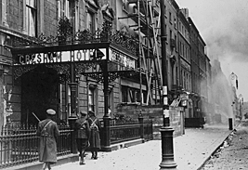
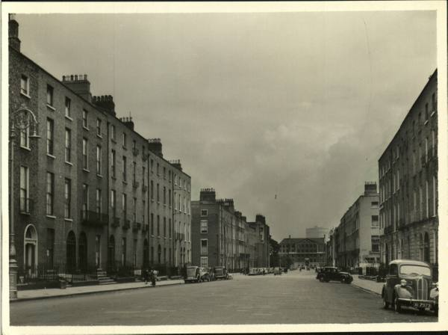
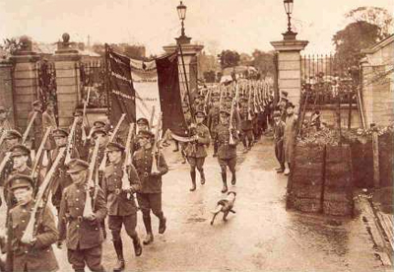
Setting of “The Sniper”
Dublin, 1920s

Slide 10

Setting
Where?
__________________________________
-Dublin, Ireland
-a rooftop
When?
__________________________________
-1920’s
-in June
-at night
Descriptive Details:
______________________________________________________
-darkness
-fleecy clouds
-bright moon
-sounds of machine guns and rifles
Historical Context:
_____________________________________________
-Civil War in Ireland
-Republicans vs.
Free-Staters

Slide 11
“The Sniper”
Vocabulary Preview
beleaguered v. used as adj.: surrounded and under attack.
ascetic adj.: severe; also, self-disciplined.
fanatic n.: person whose extreme devotion to a cause is excessive or unreasonable.
ruse n.: trick.
silhouetted v. used as adj.: outlined.
remorse n.: deep guilt.

Slide 12
“The Sniper”
Vocabulary Practice
Directions: Fill in the blanks with the correct Word Bank words.
beleaguered fanatic ruse silhouetted remorse
1. I tried to trick her, but she didn’t fall for my __________ .
2. The ___________ troops fought off the attack bravely.
3. My sister doesn’t just love opera; she is a __________ .
The convict did not apologize or show any __________ .
The horse was __________ against the bright sunset.

Slide 13
“The Sniper”
ANSWER KEY to Vocabulary Practice
Directions: Fill in the blanks with the correct Word Bank words.
beleaguered fanatic ruse silhouetted remorse
1. I tried to trick her, but she didn’t fall for my __________ .
2. The ___________ troops fought off the attack bravely.
3. My sister doesn’t just love opera; she is a __________ .
The convict did not apologize or show any __________ .
The horse was __________ against the bright sunset.
ruse
beleaguered
fanatic
remorse
silhouetted

Slide 14
“The Sniper”
Footnotes
Footnotes are tools to help us with rare words that we need to know to understand a story, but that we probably won’t see again for awhile!
Before reading, scan the footnotes. During reading, refer to them using the little numbers near the footnote words.
Liffey: a river that runs through Dublin
Four Courts: government buildings in Dublin under attack
parapet: a low wall or railing
paroxysm: a sudden attack; a fit
breastwork: a low wall put up as a military defense

Slide 15
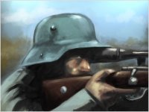
“The Sniper”
Making Predictions
As you read “The Sniper,” keep these questions in mind to help you make predictions:
    Will the main character escape the enemy?
    Will each new action help the main character or create new problems?
    How will it all end?
Look for any clues the writer has given about the outcome of the story.
Enjoy the story!

Slide 16
Reflecting:
“The Sniper”
Were you surprised by the ending of the story? Explain why or why not.
What message do you think the author was trying to convey by ending the story this way?

Slide 17
Post-reading:
“The Sniper”
1-Complete the comprehension and analysis questions (on handouts)
*You are encouraged to work with a partner (to discuss and assist), but no duplicate answers will be accepted.
2-Label your reading notes “The Sniper”
3-Store your notes in your English folder. DO NOT lose them!
4-Turn in your completed comprehension and analysis questions before the end of the period.

Slide 18
Conflict in Ireland:
True Stories
Read informative
non-fiction about “The Troubles” in Ireland:
Workbook p. 242

