Slide 1
The Romans as Engineers
How does technological change transform architectural structures?
How do technological advances allow the Roman Empire to expand?
How does concrete allow the Roman Empire to replicate its values throughout a far-flung empire?

Slide 2
The Romans built upon the engineering developments
of the Greeks and Etruscans (central Italy, 750-200 BCE).
Etruscans
  The Etruscans gave the Romans:
      the arch
      the vault
      advances in land-drainage, irrigation, and sewer design
      the atrium house
      the rectangular temple plan
Greeks
  The Greeks gave the Romans:
      the gridiron town plan
      the peristyle form (columns all around)
But the Romans invented concrete.

Slide 3
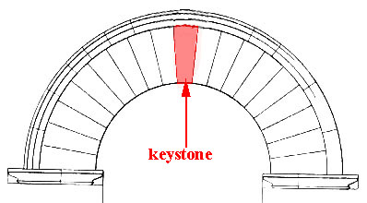
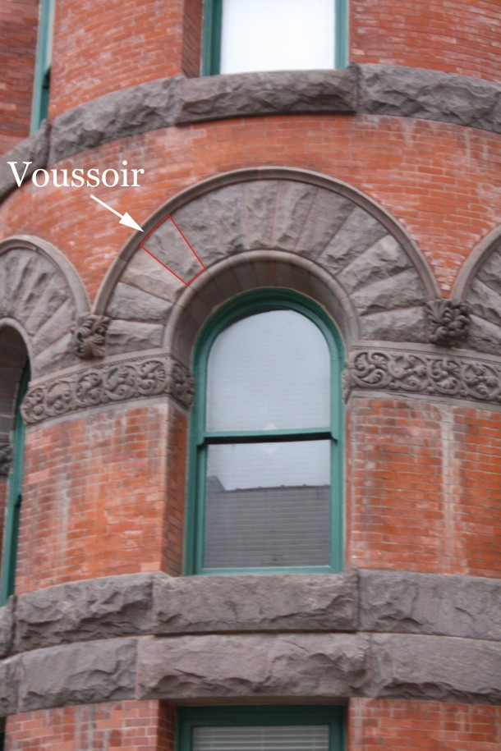
Why do the keystone and voussoir matter?
Why are these two terms so significant?
Why is wood necessary?
What are the limitations?

Slide 4
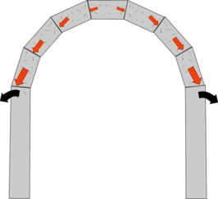
How does practical reality of thrust affect architectural design?
thrust– a force orthogonal to the main load
http://www.thenakedscientists.com/HTML/content/kitchenscience/wierd/exp/the-potato-arch/
http://www.youtube.com/watch?v=CdNYTjXJPKE

Slide 5
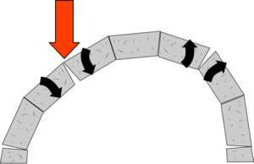
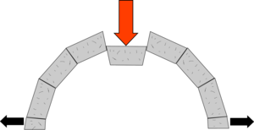
How can an arch collapse?
There are two main ways, if the piers are not very secure they can get pushed outwards until the arch can't span the gap, or loading can cause parts of the arch to rotate and become unstable.

Slide 6
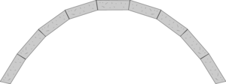
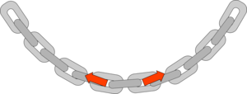
What is the perfect shape for an arch?
A hanging chain has very similar forces to an arch, but in tension rather than compression, and a chain link will move until there are no overall rotational forces on it, so a hanging chain is always in pure tension.
Robert Hooke worked out that if you make an arch in the shape of an inverted chain there will be no rotational forces on it, and it will be stable, even if it is very thin, for a uniform chain this shape is called a catenary.
If the arch has a different weight distribution, it should be the shape of the chain of this weight distribution.

Slide 7
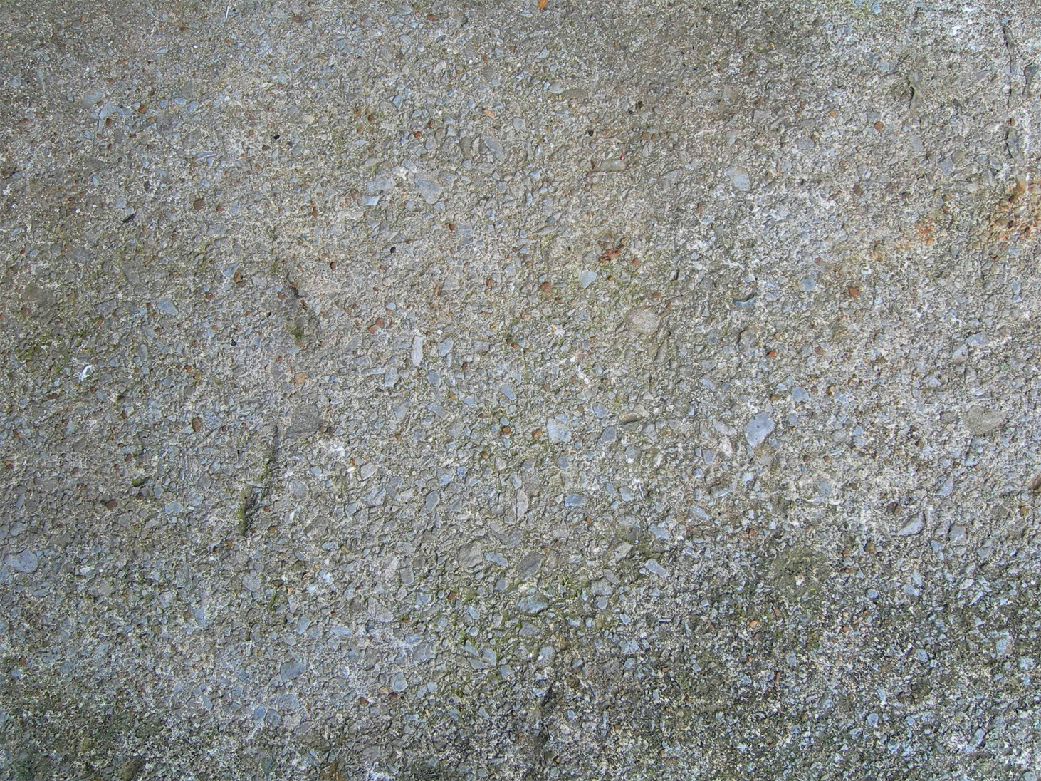
Big Bad Concrete
A Roman Innovation

Slide 8
Big Ideas
Recipe= small gravel, coarse sand, hot lime, and water (and sometimes foreign objects such as blood, fats, milk, ash, horse hair, etc.)
Concrete was extremely portable (unlike stone blocks)—concrete has a relatively light weight and is made of raw materials that are commonly found
Building with concrete did not require highly-skilled masons like stone construction (blocks cut from quarries and recut to shape)
The materials required were relatively inexpensive, compared to the cost of the arduous process of quarrying marble and other metamorphic rocks

Slide 9
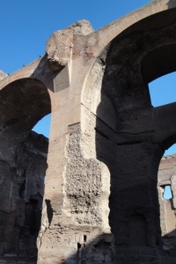
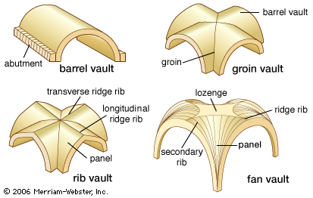
Concrete allowed the Romans to cover spaces of a size unequaled until the advent of cast iron in the 19th century.
Concrete was especially invaluable for vaulting: the stone semi-circular barrel vault and cross-vault which the Romans developed were heavy, cumbersome and difficult to build; concrete, poured into shape, suited the curves and awkward junctions which arise in vaulting.
Roman concrete vaults at the Baths of Caracalla, Rome

Slide 10
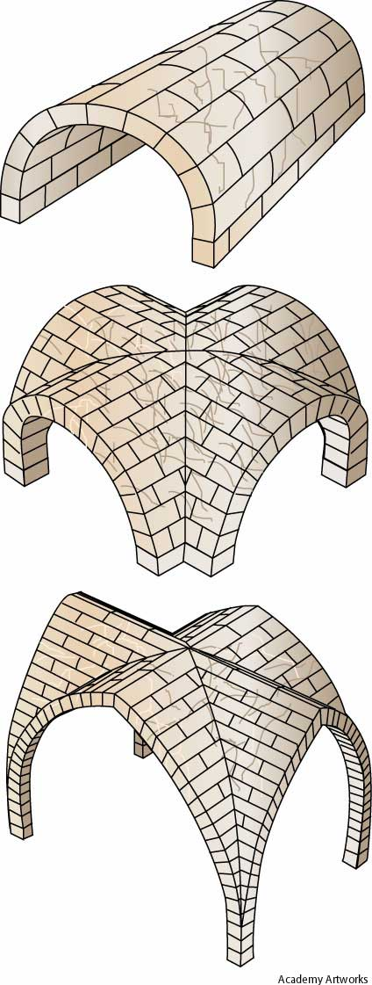
When two barrel-vaulted spaces intersect each other at the same level, the result is a groin vault or cross vault.
If the vault is “pointed” and has a “rib” on the top, then the it is referred to as a rib vault.

Slide 11
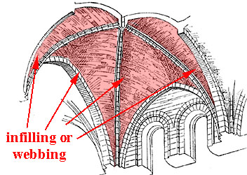
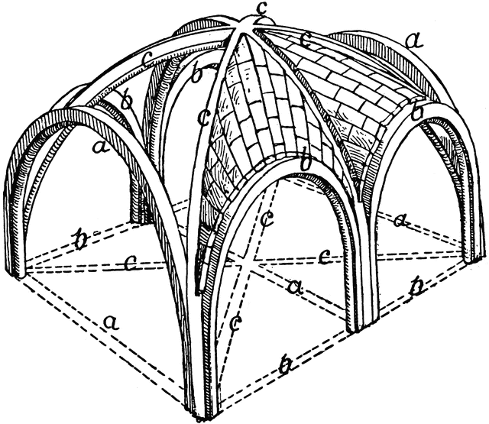
rib vault

Slide 12
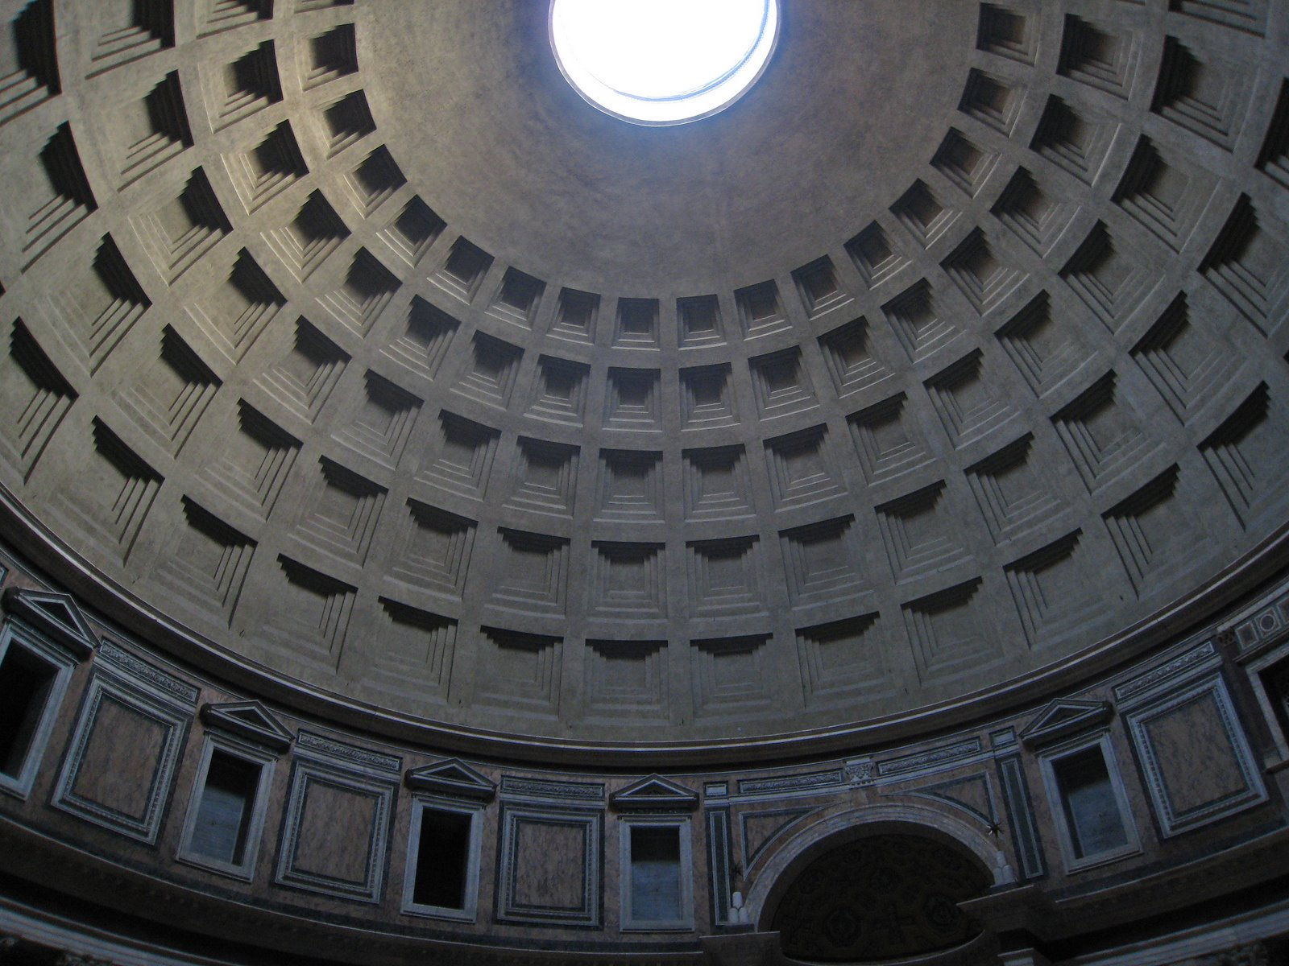
The Pantheon Rome 125-128 CE
This enormous dome has been made possible by concrete!
http://www.youtube.com/watch?v=B8IcwFwNLr8

Slide 13
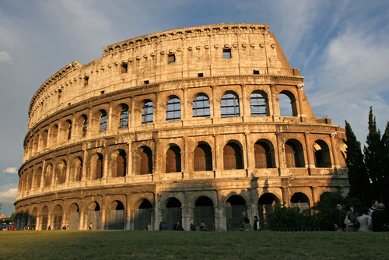
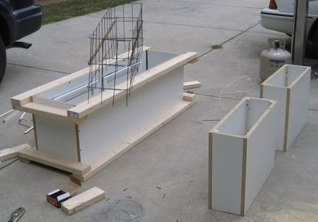
Concrete revolutionized construction methods in that it allowed the constructor to create rather than extract. Craftsmen were able to create forms by molding the concrete, rather than excavate the form by carving away the excess stone.
Casting Concrete

Slide 14
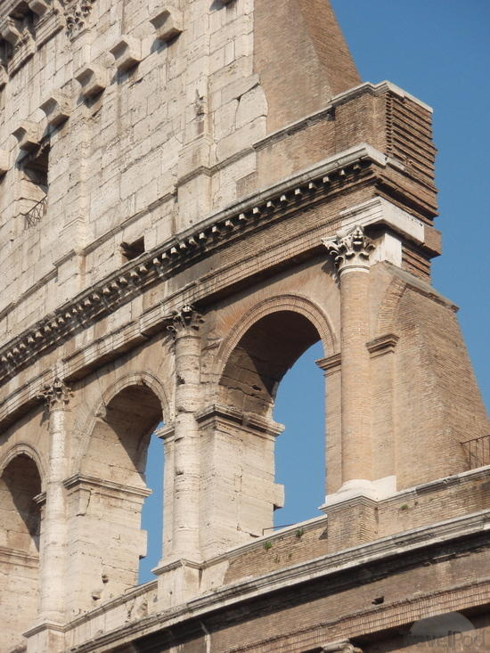
Structures made of concrete and brick could be faced with veneers of marble rather than built entirely from solid marble or another type of stone, like granite.

Slide 15
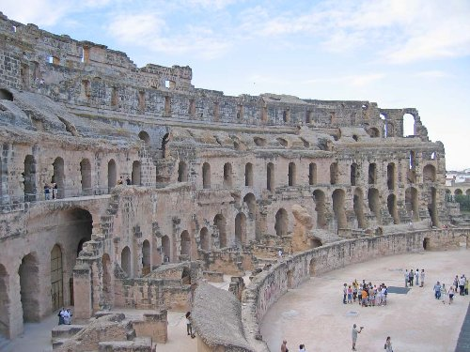
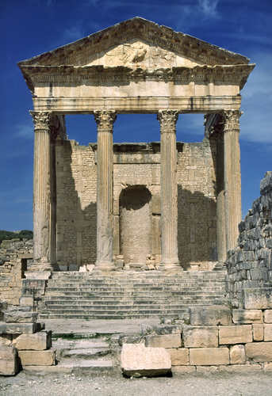
Roman Architecture could be spread across its vast empire because of concrete’s portability
Roman Architecture in Tunisia, Northern Africa.

Slide 16
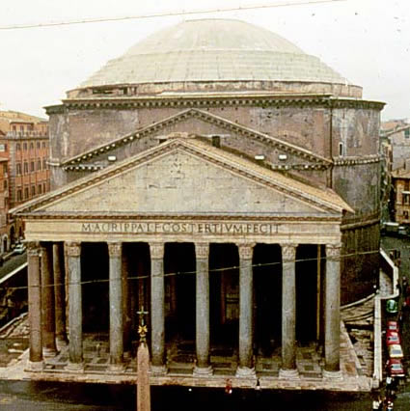
An example of a building made with concrete and “cut” stone construction.

Slide 17
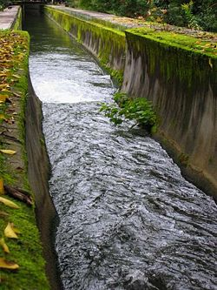
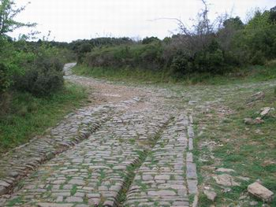
Concrete in Everyday Life
Concrete was used to create aqueducts and roads(5,300 miles of roads) that spanned across the Roman Empire.
Roman techniques are still implemented today when constructing roads and aqueducts.

Slide 18
Roads and Aqueducts
Since the Romans had such a massive empire, a vast and sophisticated network of roads, bridges, and aqueducts were built.
Roads helped to efficiently move the armies, promote commerce, and increase the speed of transport and communications.
Aqueducts helped to deliver and channel water from a distant, safe and plentiful water source to urban centers.
Roman roads and aqueducts were highly durable and practical because of the use of concrete construction.
    Connect to the Inca Empire which also had thousands of miles of roads. Messages could be carried between Cuzco and the edges of the empire in about a week.

Slide 19
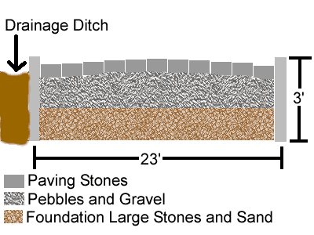
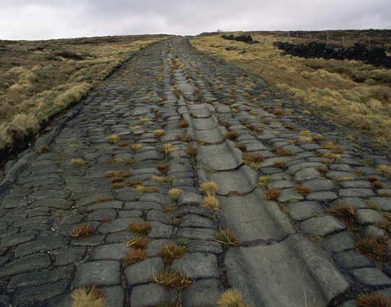
Notes:
19
An example of a still intact Roman road. The diagram on the right demonstrates the Romans practicality in their use of concrete construction when building their roads. (See medium: concrete)

Slide 20
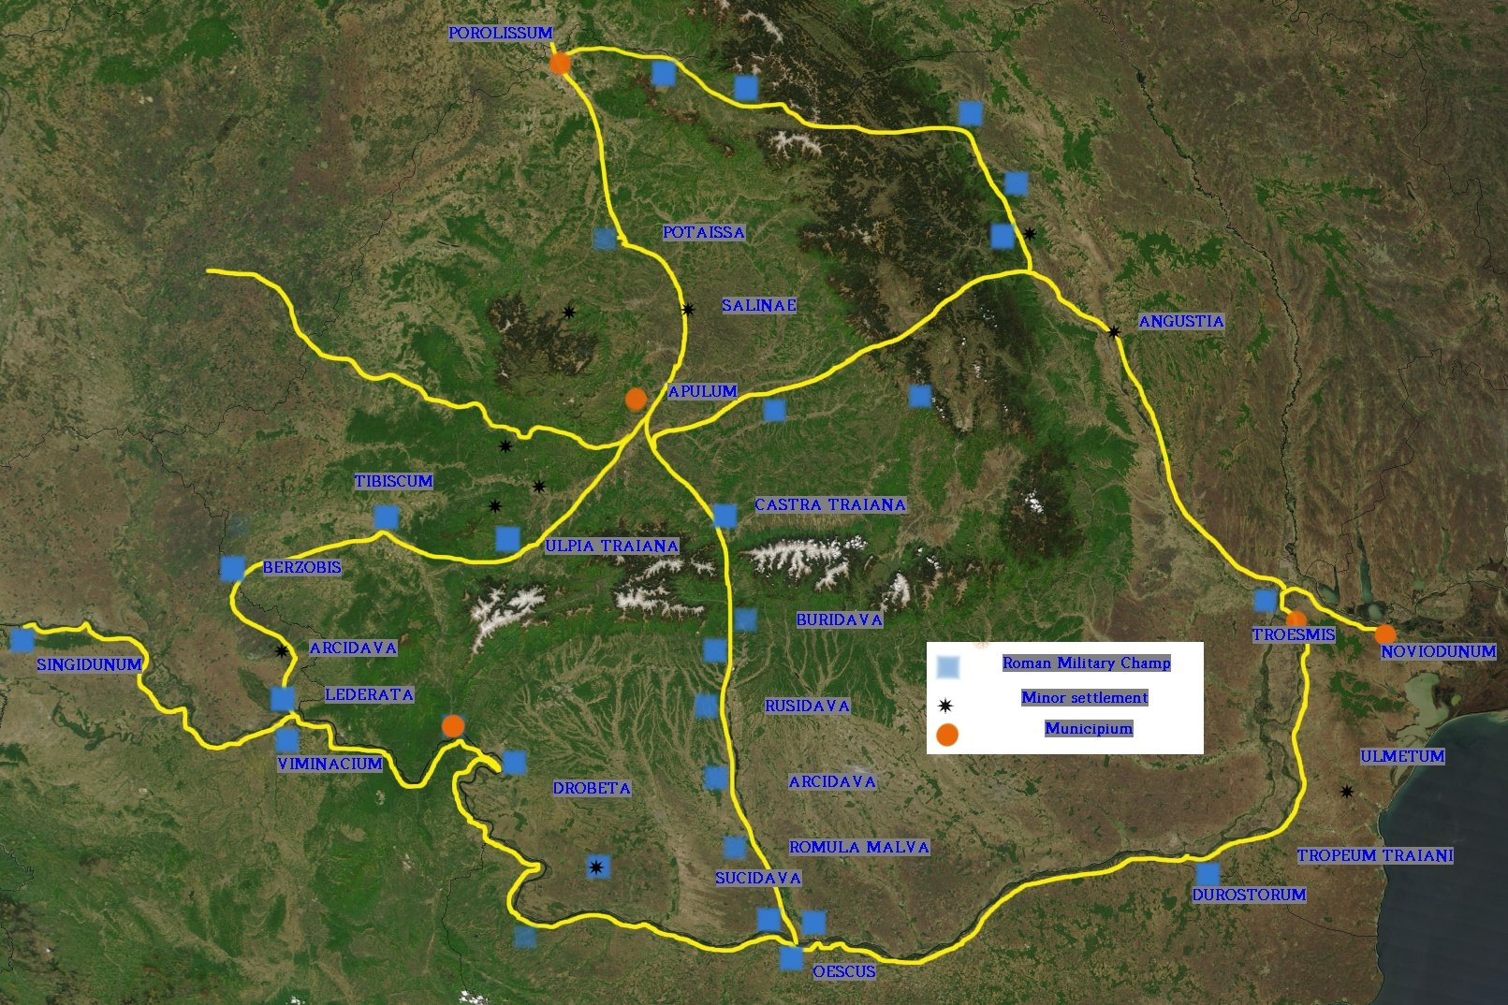
Roman roads that are still extant in the Balkans.

Slide 21
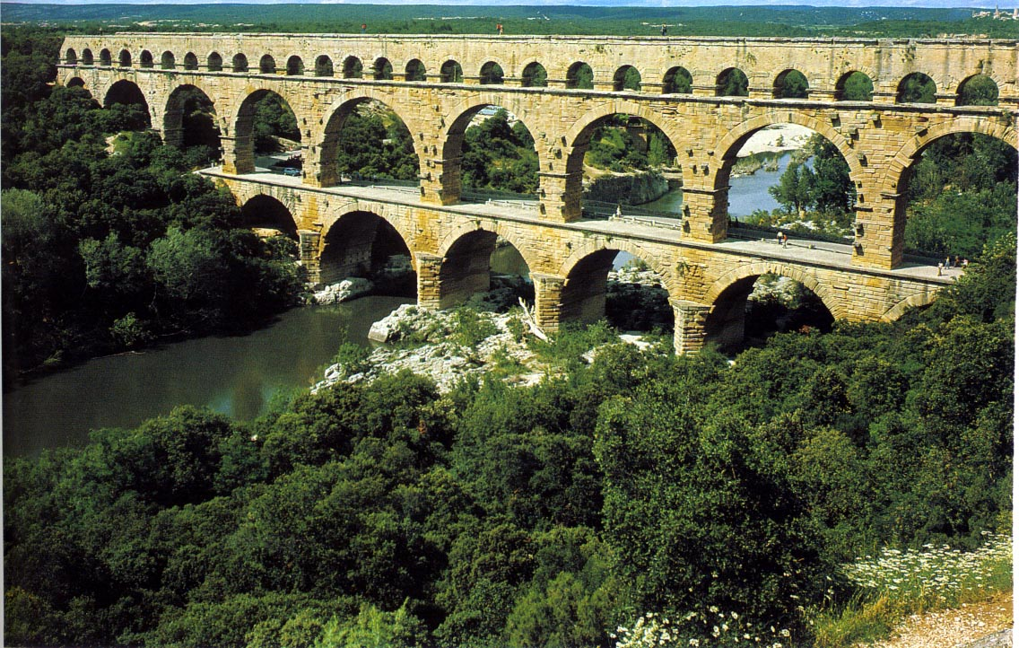
Pont du Gard
Late 1st Century
Nimes, France
Since Roman concrete construction allowed for roads and bridges to be extremely durable, many of them continue to last to today. With only a few repairs, Roman aqueducts built about two thousand years ago can function again.
http://www.youtube.com/watch?v=fBiOoolZvmk
Notes:
21
Since Roman concrete construction allowed for roads and bridges to be extremely durable, many of them continue to last to today. With only a few repairs, Roman aqueducts built about two thousand years ago can function again. The aqueduct at Pont du Gard is a powerful reminder of Rome’s rapid spread and enduring impact. Entirely functional, the aqueduct conveys the balance, proportion, and rhythmic harmony of a great work of art and fits naturally into the landscape, a reflection of the Romans’ attitude toward the land.

Slide 22
The aqueduct at Pont du Gard is a powerful reminder of Rome’s rapid spread and enduring impact. Entirely functional, the aqueduct conveys the balance, proportion, and rhythmic harmony of a great work of art and fits naturally into the landscape, a reflection of the Romans’ attitude toward the land.
Notes:
22
Since Roman concrete construction allowed for roads and bridges to be extremely durable, many of them continue to last to today. With only a few repairs, Roman aqueducts built about two thousand years ago can function again. The aqueduct at Pont du Gard is a powerful reminder of Rome’s rapid spread and enduring impact. Entirely functional, the aqueduct conveys the balance, proportion, and rhythmic harmony of a great work of art and fits naturally into the landscape, a reflection of the Romans’ attitude toward the land.

Slide 23
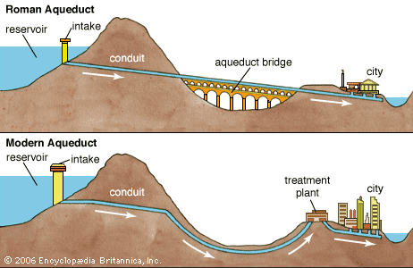
Diagram of a Roman Aqueduct

Slide 24
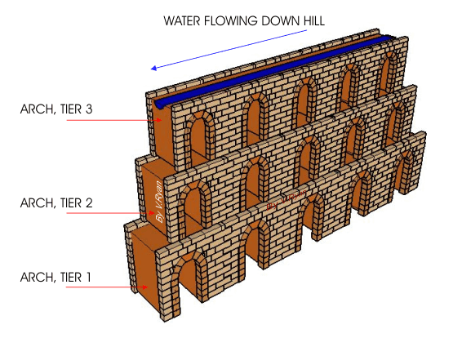
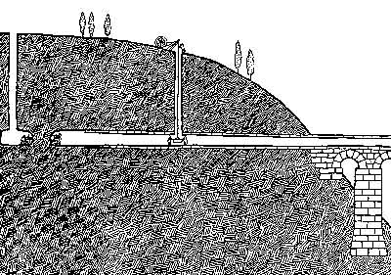
Diagram of a Roman Aqueduct

Slide 25
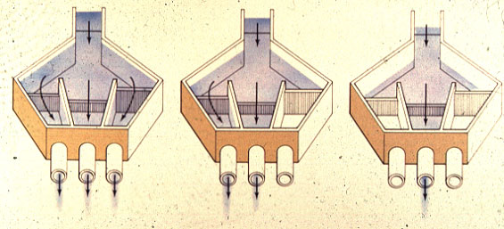
By increasing and decreasing the number of valves open at a distribution tank,
the Romans were able to control the force of the water. For example, more pressure was needed to raise the water up a hillside.

Slide 26
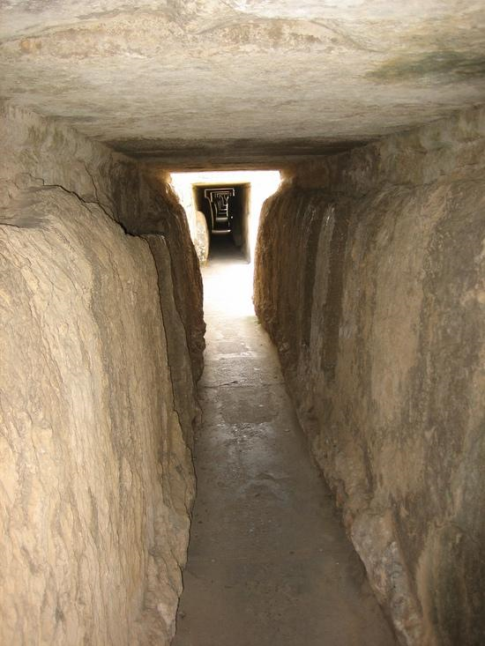
This is the inside of the aqueduct atop the Pont du Gard.
Notes:
This is the inside of the aqueduct atop the Pont du Gard.
26

Slide 27
Arches
Arches were first used extensively by the ancient Greeks; although the Romans did not invent “arches”, the Romans were the first to make widespread use of them.
They are structures which span a space while supporting weight.
The development of concrete by the ancient Greeks allowed them to exploit arches to their full potential.

Slide 28
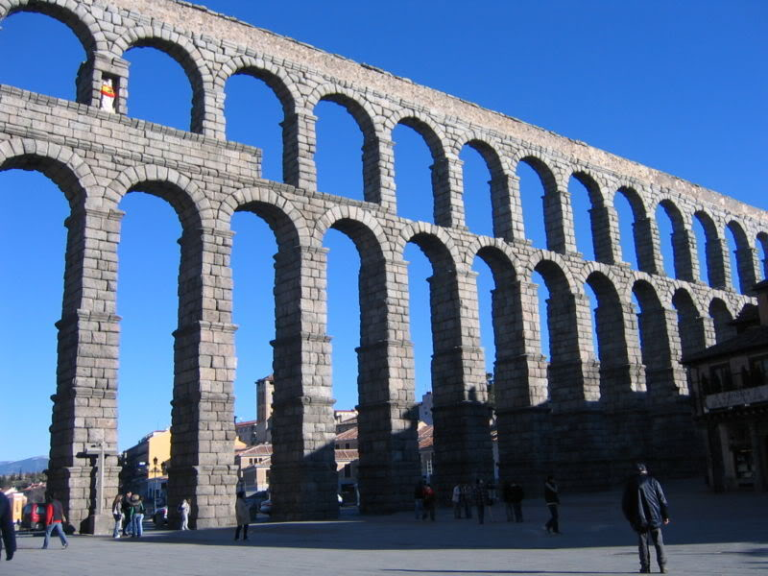
Roman Aqueduct at Segovia
Notes:
28

Slide 29
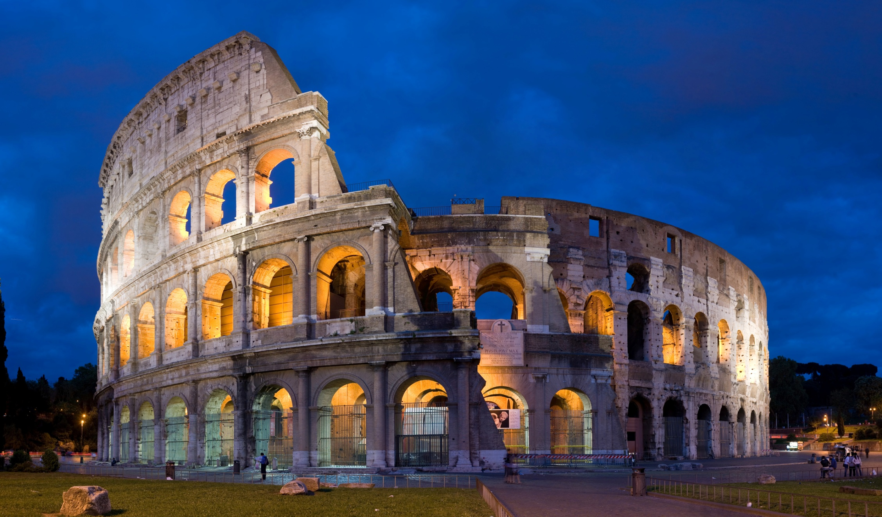
The Colosseum

Slide 30
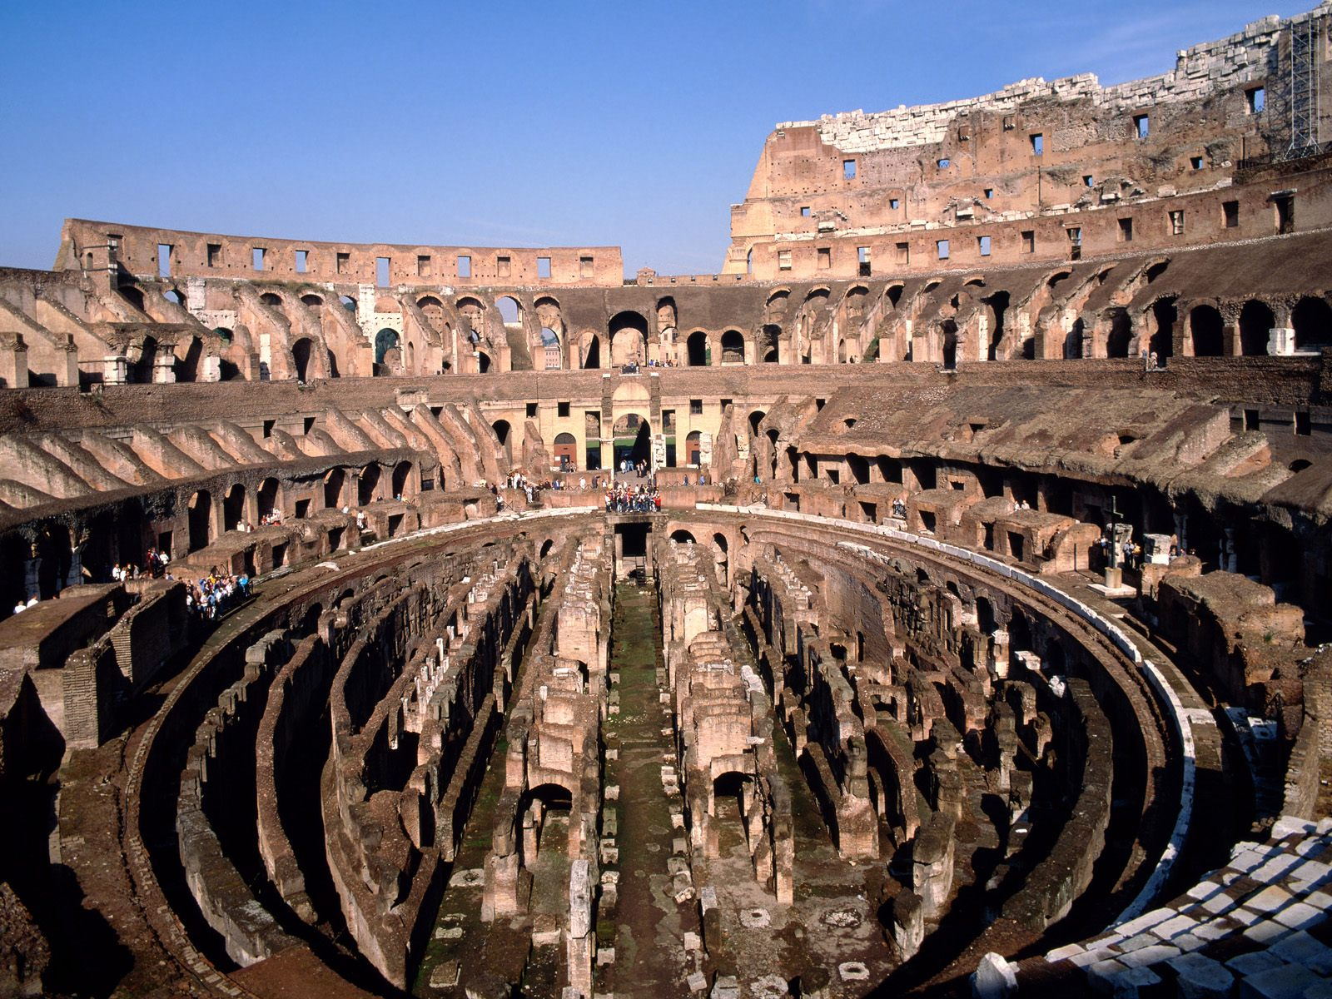

Slide 31
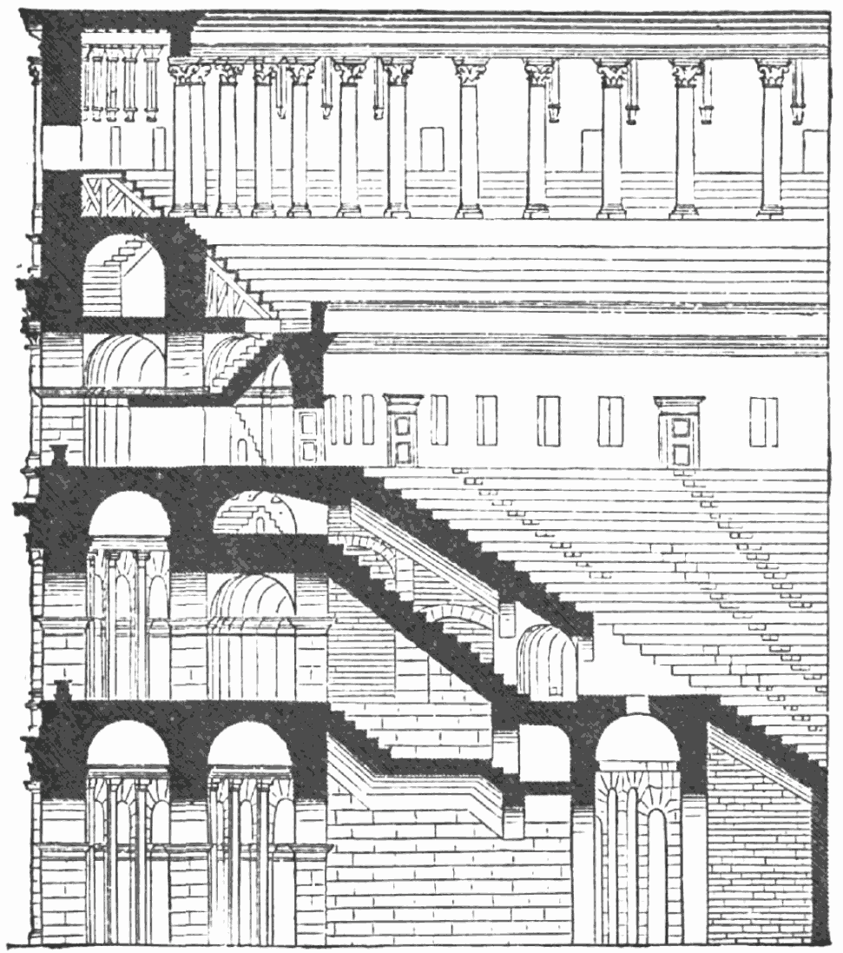
side view of the inside of the colosseum

Slide 32
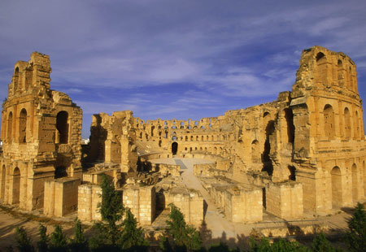
The Roman coliseum at El Djem, Tunisia in northern Africa.

