Slide 1
The Spread of Islam
From Egypt to France

Slide 2
Warm-up #7
Read Umayyads Seize Power on page 102 of the Orange McDougal Textbook.
Who were the Umayyads?
2) How did the Umayyad rule different from the caliphs that came before?
If you finish early read pages 114-116.

Slide 3
Warm-up #7
Who were the Umayyads?
The Umayyads were a family that created a dynasty in the Muslim empire after Ali’s assassination.
How did the Umayyad rule different from the caliphs that came before?
The first four caliphs were selected by the Muslim leaders out of their own ranks, while the Umayyads took control by force and formed a hereditary dynasty; the early caliphs ruled from Medina, while the Umayyads ruled from Damascus; early caliphs followed a Bedouin lifestyle, while the Umayyads did not.

Slide 4
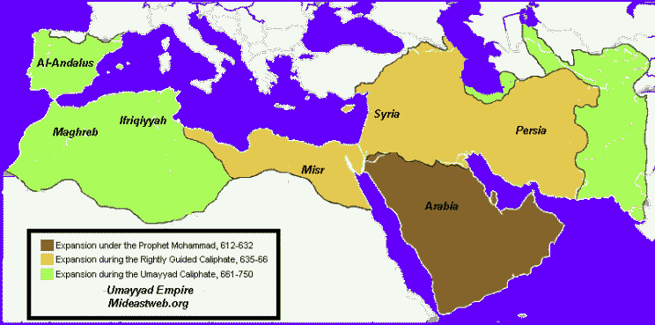
Umayyad Expansion

Slide 5
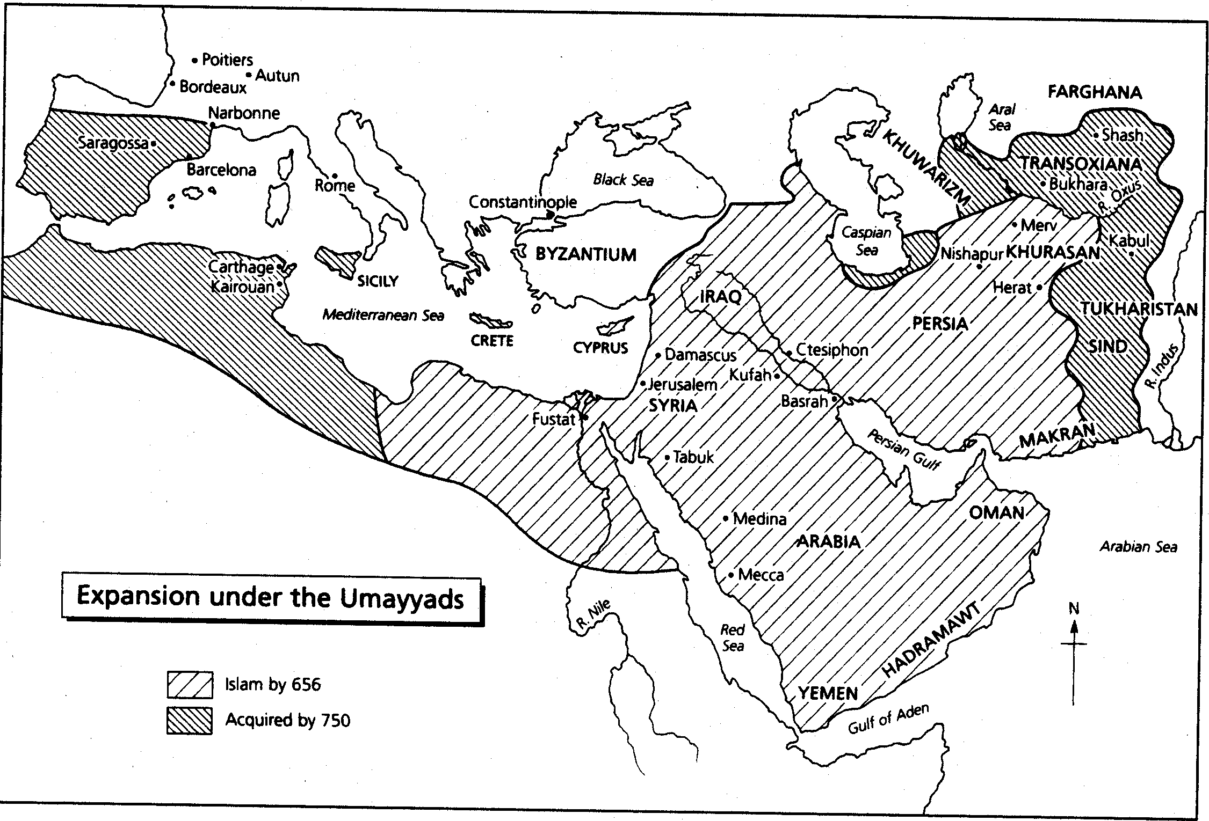

Slide 6
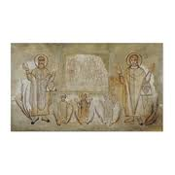
Egypt before Islam
Byzantine Rulers
Egyptians spoke Greek and Coptic
Mostly Coptic Christians
641 AD invaded by Arabs from Palestine

Slide 7
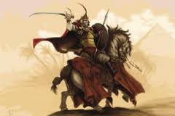
Arab conquest of Egypt
Army led by Amr ibn al-Aas crushes the Byzantine Army
Arabic becomes the dominant language
Slowly many Egyptians choose to convert to Islam
The Christians were taxed (Jizya) but allowed to keep their religion

Slide 8
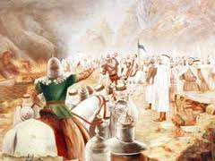
The spread across North Africa
Byzantine rule was ended in North Africa by Islamic invasions of Tunisia (647-648 AD) and Morocco (682 AD)
The Berbers, native inhabitants of North Africa, resisted and then converted to Islam and aided in its expansion

Slide 9
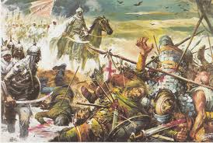
Spain before Islam
Spain was ruled by the Visigoths
Rodrigo, their king, was a usurper and not well liked by his people
In 711 an Islamic army invaded across the straits of Gibraltar
Rodrigo met them at the battle of Guadalete where many of his forces abandoned him on the battlefield, leading to his death and defeat of his army

Slide 10
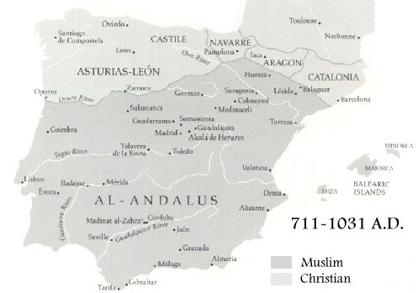
Córdoba
In 756 Córdoba was the Muslim capital of Spain
It became a major center of trade between the Arab world and Europe
By the early 900’s it was the largest and most advanced city in Europe
It was a great center of learning
Córdoba – Muslim capital in Spain

Slide 11
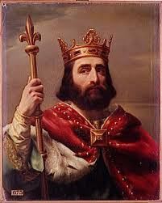
Battle of Tours
In the early 700’s Islamic raiders pushed north into France looting and plundering
In 732 they were met by a Frankish army under the command of Charles “The Hammer” Martel near the city of Tours

Slide 12
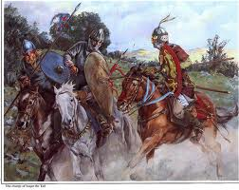
Battle of Tours continued
The Frankish knights were outnumbered, and unable to meet the Moorish (the name for Spanish Muslims) cavalry head on.
They instead dismounted and formed a shield wall on a wooded hillside

Slide 13
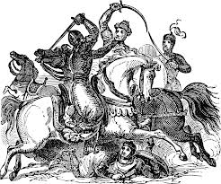
Battle of Tours continued
The Islamic cavalry was unable to break through the Frankish shield wall after several uphill charges
Meanwhile, the Franks sent a small group of knights around the rear of the Moorish army to attack their supply camp

Slide 14
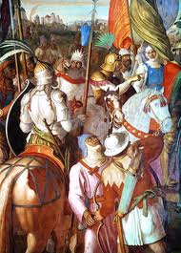
Battle of Tours continued
The Moorish army heard that their camp was being attacked, and began to retreat in hopes that they would be able to defend their war spoils that were stored in there.

Slide 15
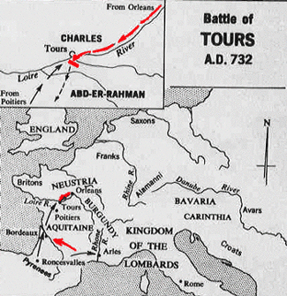

Slide 16
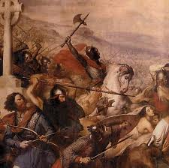
Battle of Tours continued…
This retreat quickly turned into a chaotic mob
The Frankish knights charged down the hillside and routed the fleeing Moors
This marked the end of the Muslim advance into Europe and began the Reconquista in Spain

Slide 17
Homework
Medieval Times Article on Battle of Tours

Slide 18
Umayyad Chart
Copy the chart, use the Reading Study Guide on your desk to complete the chart.
Umayyad Expansion | Unifying the Empire | Umayyad Downfall
Used treaties and military might |  | Discontent with rule grew
 | Introduced a common currency.

Slide 19
Umayyad Chart
Read pages 113 to 116 of the orange McDougal book and complete the graphic organizer below:
Umayyad Expansion | Unifying the Empire | Umayyad Downfall
Used treaties and military might | Established a bureaucracy; instituted Arabic as the common government language | Discontent with rule grew
Extended empire to east and west | Introduced a common currency. | Abbasids gained support and overthrew Umayyads.

