Slide 1
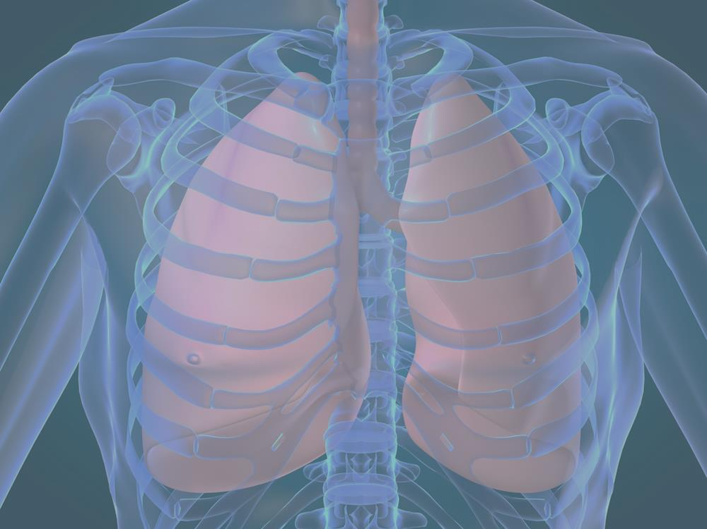
Gas Exchange
CORE 6.4

Slide 2
6.4.1 Distinguish between ventilation, gas exchange and cell respiration.
Cellular respiration is . It is a continuous process in all cells.
Aerobic:

Slide 3
6.4.1 Distinguish between ventilation, gas exchange and cell respiration.
To support aerobic cellular respiration, cells take in oxygen from their environment and give out carbon dioxide, by a process called .
Gas exchange ultimately relies on .

Slide 4
6.4.1 Distinguish between ventilation, gas exchange and cell respiration.
All animal respiratory systems share two features that facilitate diffusion:
  Respiratory system
  Respiratory system must have
Most animals have evolved specialized respiratory systems

Slide 5
6.4.1 Distinguish between ventilation, gas exchange and cell respiration.
In general, gas exchange in most respiratory systems occurs in the following stages:
  Air or water, containing oxygen, is moved past a respiratory system by (fluids or gases move in bulk through relatively large spaces, from areas of higher pressure to areas of lower pressure) –

Slide 6
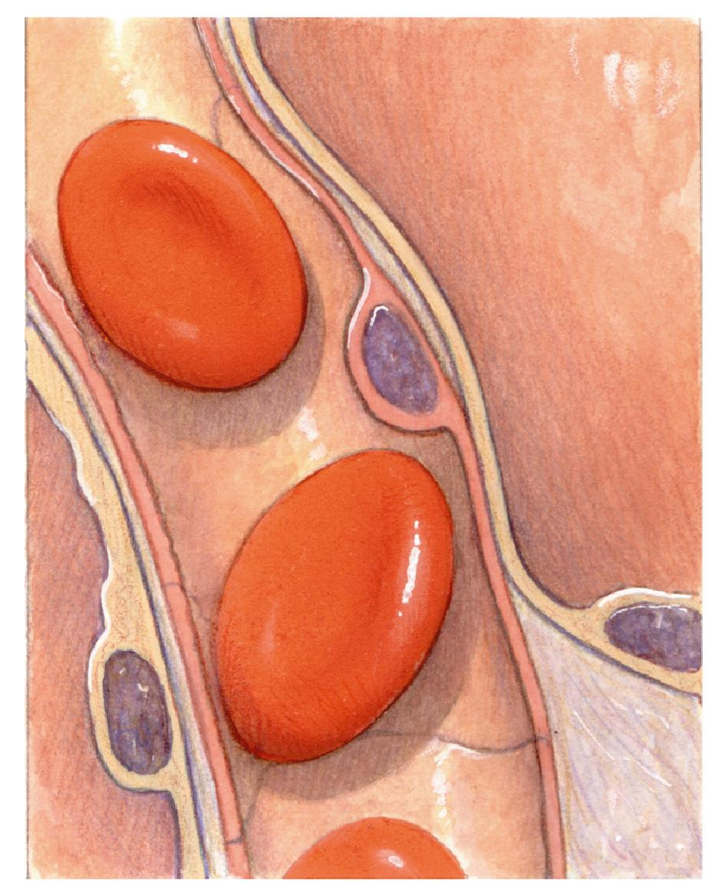


6.4.1 Distinguish between ventilation, gas exchange and cell respiration.
O₂
  Oxygen and carbon dioxide are exchanged through the respiratory surface by diffusion;
CO₂
Capillary

Slide 7
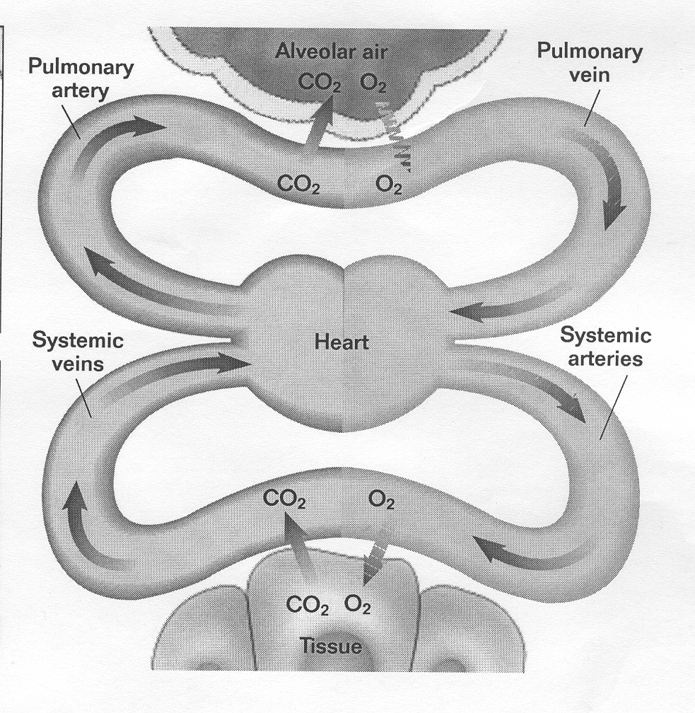
6.4.1 Distinguish between ventilation, gas exchange and cell respiration.
  Gases are transported between respiratory system and tissues by

Slide 8
6.4.1 Distinguish between ventilation, gas exchange and cell respiration.
  Gases are exchanged (oxygen diffuses out into tissue and carbon dioxide diffuses into capillaries based on concentration gradients)

Slide 9
6.4.1 Distinguish between ventilation, gas exchange and cell respiration.
Most terrestrial animals respire by means of – chambers containing moist, delicate respiratory surfaces that are protected in body
  (bathed in body fluids) and
  Highly

Slide 10
6.4.1 Distinguish between ventilation, gas exchange and cell respiration.
6.4.2 Explain the need for a ventilation system.
Because the lungs are protected in the thorax (chest), air must be brought in.
This results in the need for a ventilation system:

Slide 11
Human Respiratory System (and other vertebrates) is divided into two parts:
  The conducting portion –
  The gas exchange portion –

Slide 12
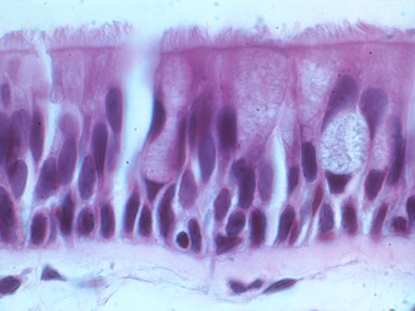
Passageway of air in respiratory system:
Nostrils –
Nasal cavities –
  Lined with that trap particles in mucus and move it to the throat to be swallowed
Cilia

Slide 13
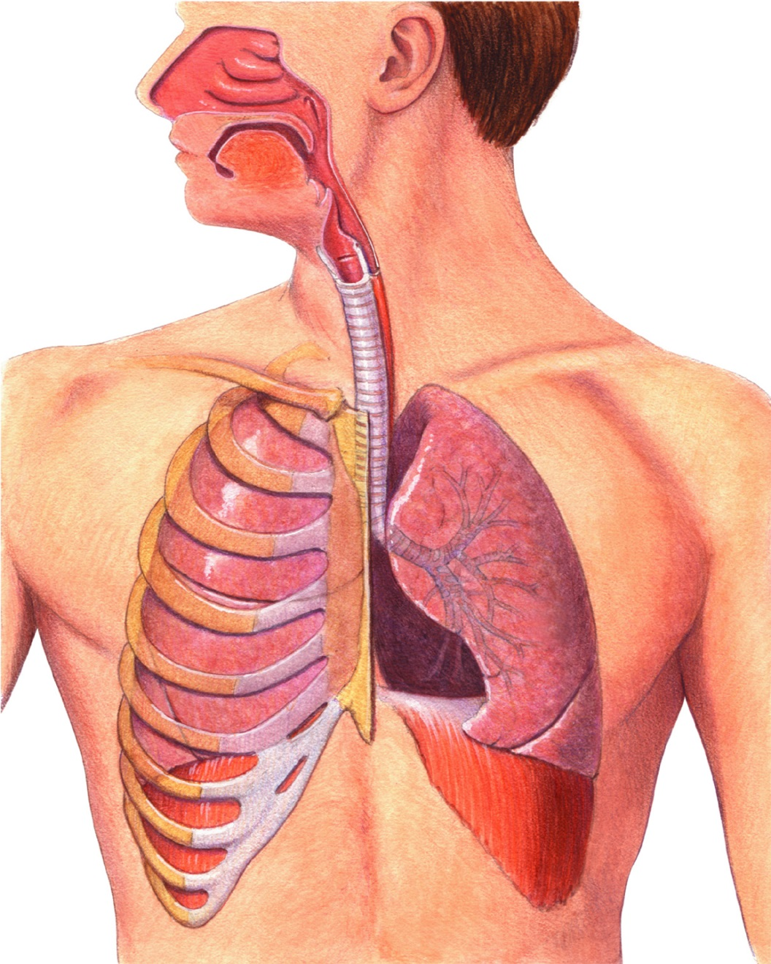
6.4.4 Draw and label a diagram of the ventilation system, including trachea, lungs, bronchi, bronchioles and alveoli
#3
Pharynx
#1
Pharynx –
Nose
#2
Mouth

Slide 14
Epiglottis –
Larynx –
  Contains vocal cords
#5
Larynx
#4
Epiglottis
Epiglottis
Notes:
The respiratory system is responsible for the exchange of oxygen and carbon dioxide.

Slide 15
Trachea – also called ; tube that carries air down to lungs – reinforced with
Bronchi –
Lungs
#6
#7
Trachea
Bronchus
Notes:
The respiratory system is responsible for the exchange of oxygen and carbon dioxide.

Slide 16
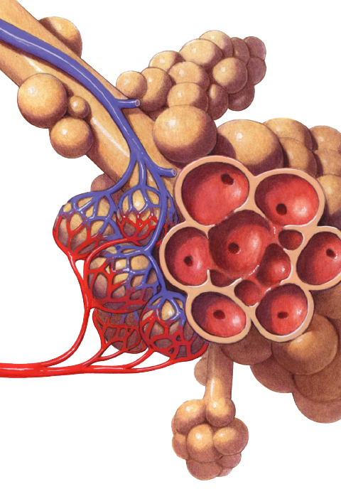

Bronchioles –
#9
Alveoli
Bronchiole
#8
Bronchioles
Notes:
The respiratory system is responsible for the exchange of oxygen and carbon dioxide. After reaching the lungs, the trachea branches into smaller and smaller tubes called bronchioles, which end in alveoli, or air sacs.

Slide 17
Lungs – large, paired spongy organs
  Right lung is divided into
  Left lung is divided into
  Each is covered by a – forms a sac and lines the thoracic cavity
  Secretes a

Slide 18
6.4.3 Describe the features of alveoi that adapt them to gas exchange.
Alveoli –
  Numerous small clusters for
  Walls of alveoli are extremely thin ( ) and are
  Gases diffuse freely through the wall of the alveolus and capillary
Pulmonary artery
Pulmonary vein
Capillaries
Notes:
The respiratory system is responsible for the exchange of oxygen and carbon dioxide.

Slide 19
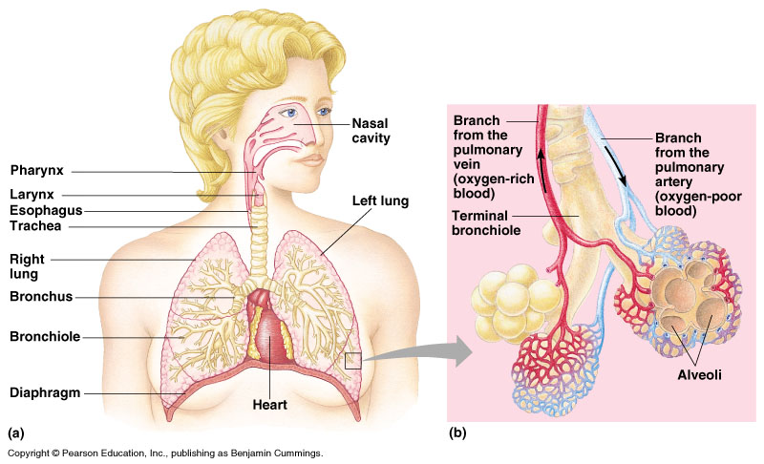

Slide 20
6.4.5 Explain the mechanism of ventilation of the lungs in terms of volume and pressure changes caused by the internal and external intercostal muscles, the diaphragm and abdominal muscles.
Breathing (ventilation) is the mechanical process of moving air from the environment into the lungs and expelling air from the lungs
  The thorax is an
  Pressure changes allow for air to be forced into or out of the lungs

Slide 21
6.4.5 Explain the mechanism of ventilation of the lungs in terms of volume and pressure changes caused by the internal and external intercostal muscles, the diaphragm and abdominal muscles.
  Inspiration (inhalation):
    Diaphragm (dome-shaped muscle forming floor of thoracic cavity)
    (internal intercostal muscles relax)
    This which lowers air pressure inside (below atmospheric pressure)
    Air from outside rushes into lungs to equalize air pressure

Slide 22
6.4.5 Explain the mechanism of ventilation of the lungs in terms of volume and pressure changes caused by the internal and external intercostal muscles, the diaphragm and abdominal muscles.
  Expiration (exhalation)
    Diaphragm
    causing ribs to drop back down (external intercostal muscles relax)
    This which increases air pressure inside
    Air from inside lungs rushes out to equalize air pressure
    When you . This squeezes your abdominal organs which puts pressure on the diaphragm.

Slide 23
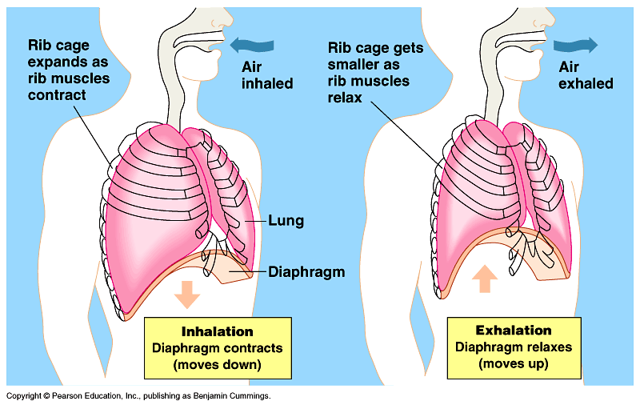

Slide 24
Control of Breathing Rate
  Breathing rate is controlled by – located in
  muscles are stimulated to contract by impulses from respiratory center
  nerve cells in respiratory center generate cyclic bursts of impulses that cause the alternating contraction and relaxation of respiratory muscles

Slide 25
  Respiratory center receives input from several sources and adjusts breathing rate and volume to meet body’s changing needs
  in medulla, and in walls of the aorta and carotid arteries are

