Slide 1
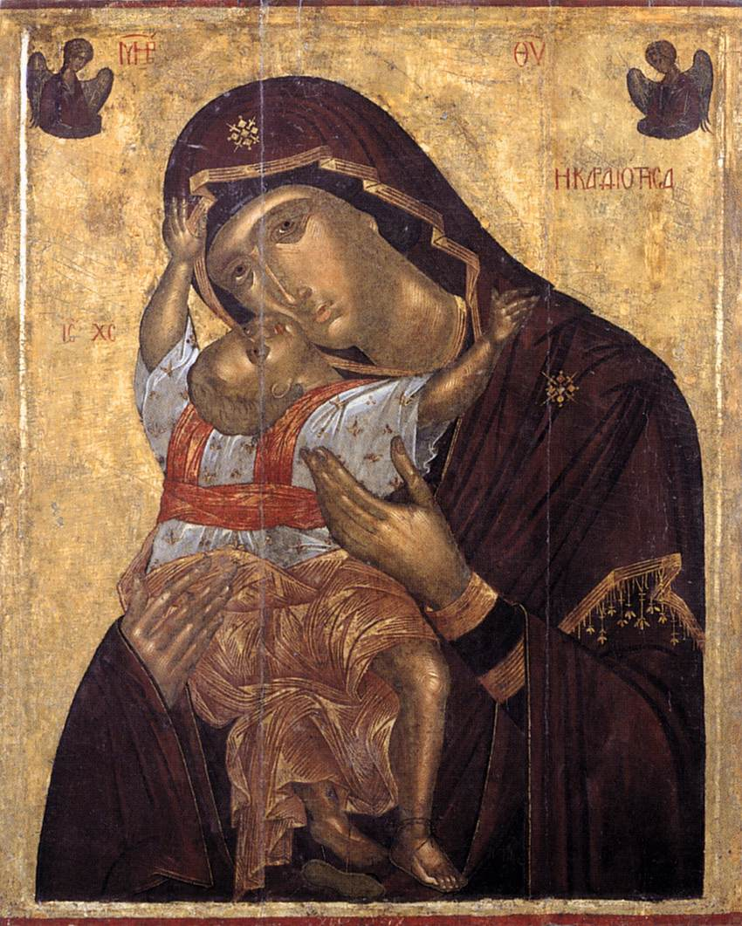
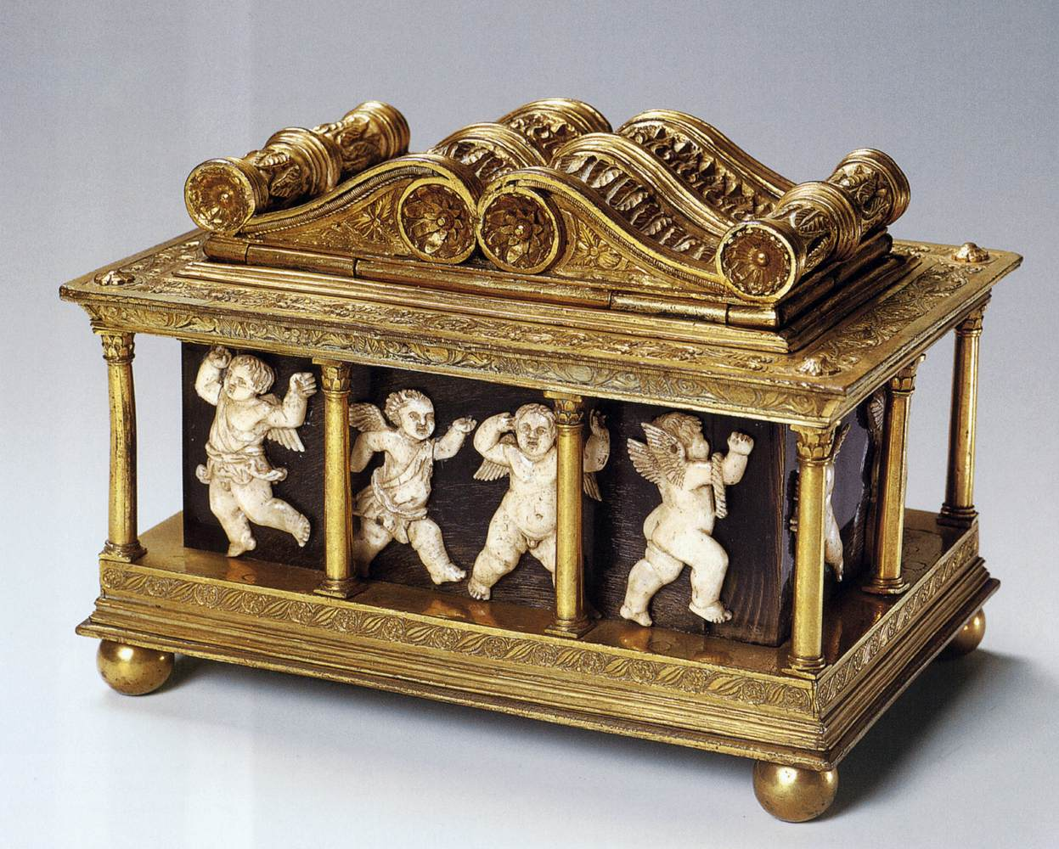
What is the difference between an icon and a reliquary?
Maso di Bartolommeo
Reliquary for the Holy Girdle of the Virgin
c. 1446
embossed copper, engraved and gilded, wood, panels of horn, ivory, and fabric
Angelos Akotantos
The Virgin Cardiotissa
1400-50
tempera and leaf on panel
Notes:
Angelos Akotantos
The Virgin Cardiotissa
1400-50
tempera and leaf on panel
Byzantine and Christian Museum, Athens
Maso di Bartolommeo
Reliquary for the Holy Girdle of the Virgin
c. 1446
embossed copper, engraved and gilded, wood, panels of horn, ivory, and fabric, 16 x 21 x 15 cm
Museo dell'Opera del Duomo, Prato
Other works by the artist...

Slide 2
Holy Thorn Reliquary
British Museum
History of the World in 100 Objects: #66
http://www.bbc.co.uk/ahistoryoftheworld/objects/pZ-Jq-iaTOiazy-YLBF2fg

Slide 3
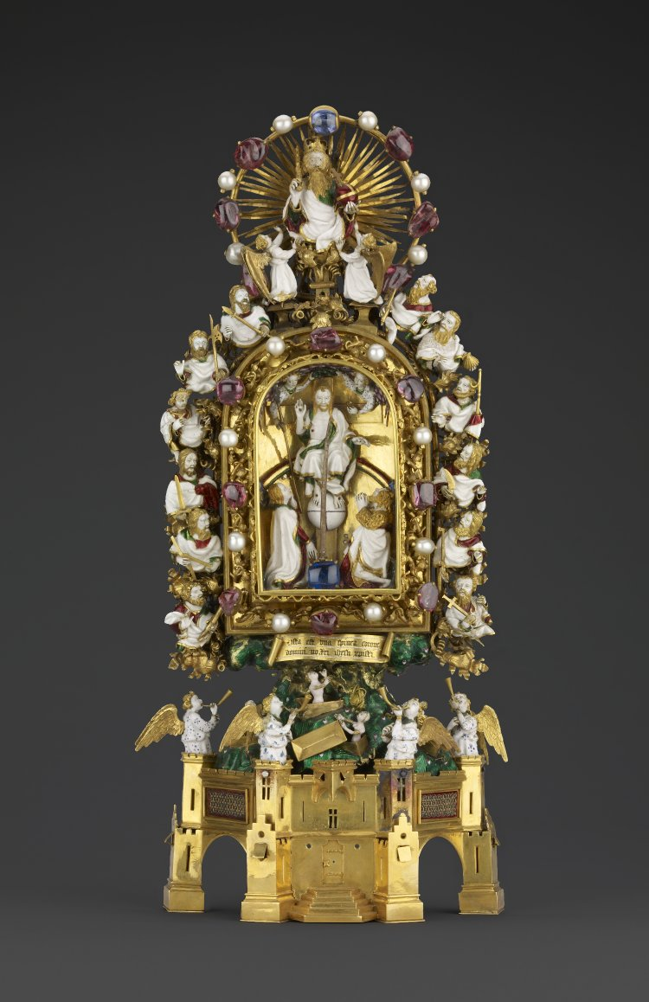
The Crown of Thorns, worn by Jesus when he was mocked and crucified, was one of the great relics of medieval Christianity. It was acquired by Louis IX, king of France, in Constantinople in AD 1239 for the price of 135,000 livres - nearly half the annual expenditure of France. Jean, duc de Berry (1340-1416) commissioned this elaborate reliquary to house just one of the thorns, which is mounted on a large sapphire in the centre.

Slide 5
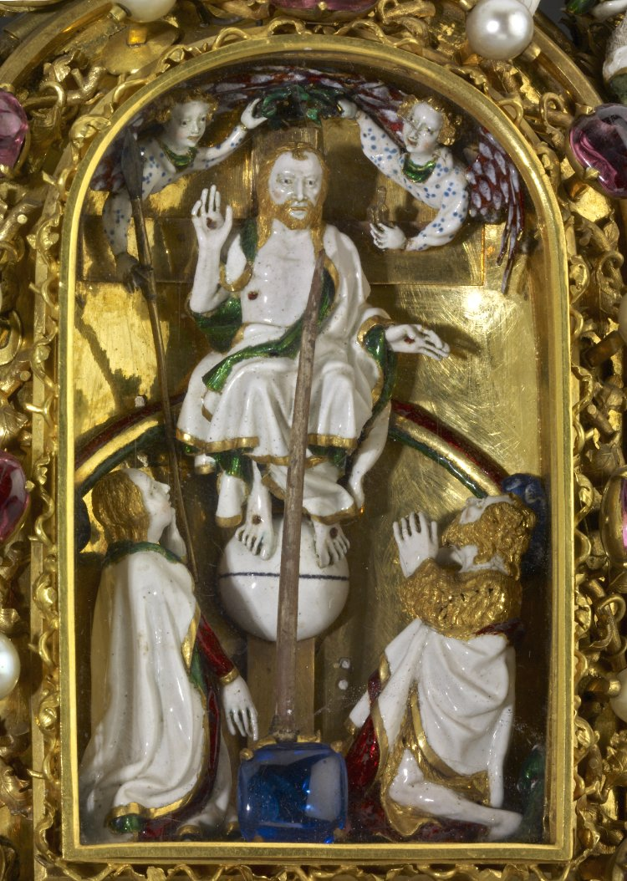
How were relics used in medieval Europe?
Christian relics were usually part of the physical remains of a saint, though they could also be associated objects or clothing. Medieval worshippers would contemplate relics as a means of getting closer to a saint or Christ himself. Relics were also associated with miraculous powers of healing. Pilgrims would travel hundreds of miles to visit important relics in shrines, such as Jerusalem or Canterbury. Trade in holy relics was a huge business in Medieval Europe and kings would assemble large collections and even go to war to secure them

Slide 6
