Slide 1
Trip Across Cities.
- Marisol Robles & Luis Gonzalez

Slide 2
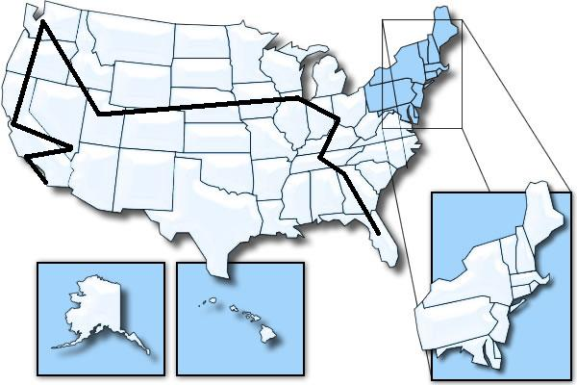
Cities Visited
Los Angeles, CA
Las Vegas, NV
San Jose, CA
Seattle, WA
Salt lake city, Utah
Chicago, IL
Cincinnati, Oh
Nashville, TN
Atlanta, GA
Florida, Orlando

Slide 3
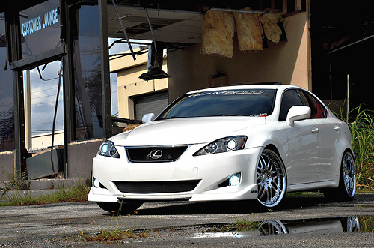
Transportation / Total Money used
2009, Lexus IS350
Total money cost out of 6000 -> $3262.45/$6000

Slide 4
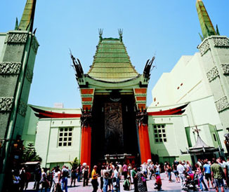
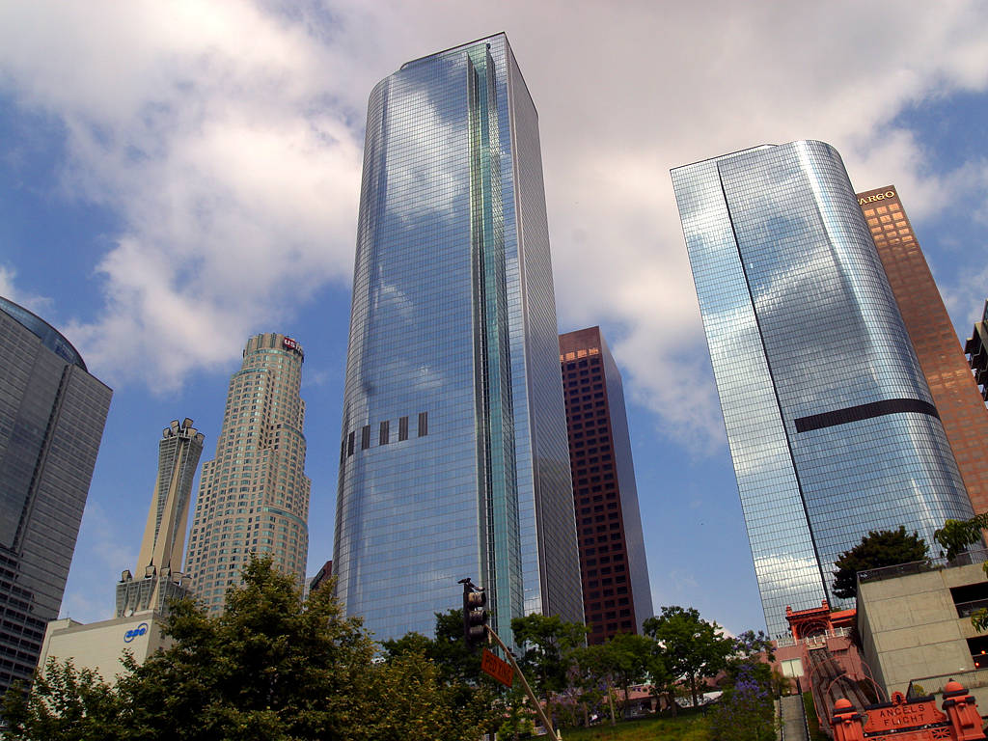
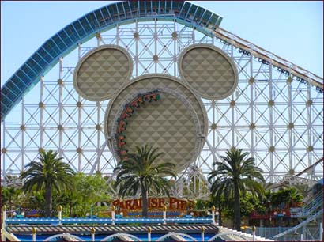
Los Angeles, CA
From San Diego to Los Angeles is about 2 hours and 3mins.
We’ll be spending a total of $15.09 on Gas.
Free Lodging
Attractions : Disneyland , Hollywood Boardwalk.
National Park : Channel Islands.
2-3days.

Slide 5
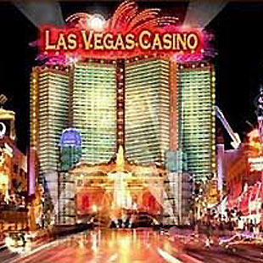
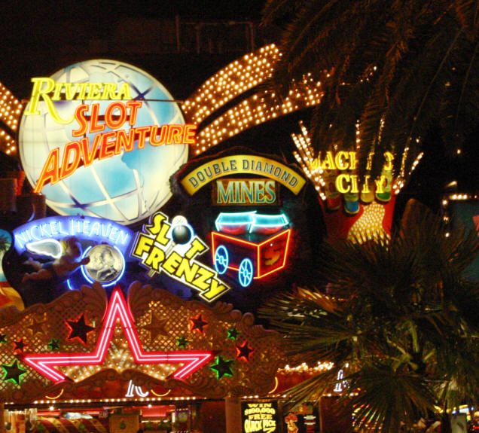
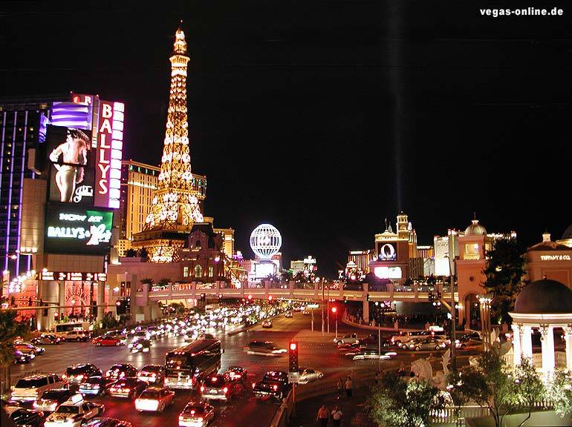
Las Vegas, NV
From Los Angeles to Vegas will be about 4 hours ans 21 mins
We’ll be soending about $34.57 on gas.
Free Lodging
Attractions : Casinos + Adventure dome
National Park : Great Basin.
3days.

Slide 6
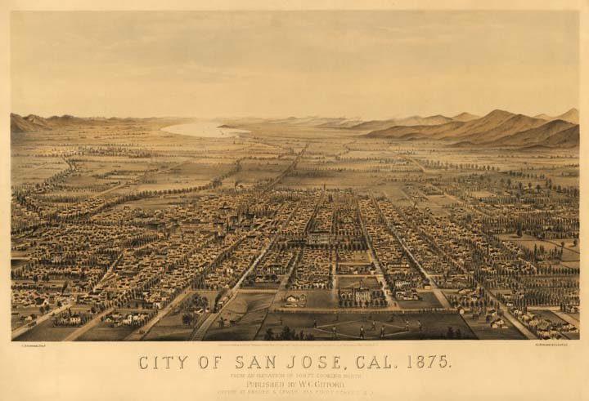
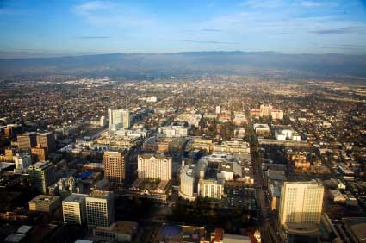
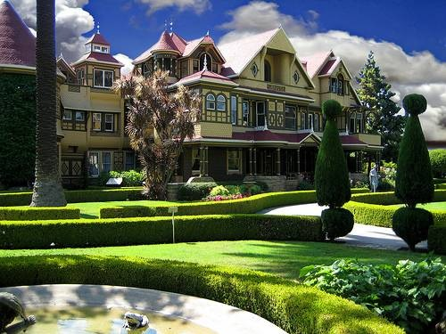
San Jose, CA
From Las Vegas to San Jose is about 8hours and 14 mins
We’ll be spending about $65.89 0n gas.
Free Lodging.
Attractions : Winchester Haunted House ,
National Park : Golden Gate + Yosemite National Park.
2days

Slide 7
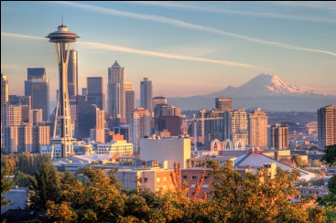
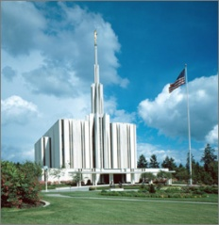
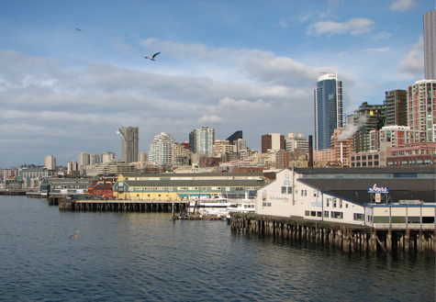
Seattle, WA
From san jose to seattle is about 14 hours and 27 mins
Well be soending about $102.45 on gas
Free Lodging
Attraction : Space Needle
National Park : Ebeys Landing
2days

Slide 8
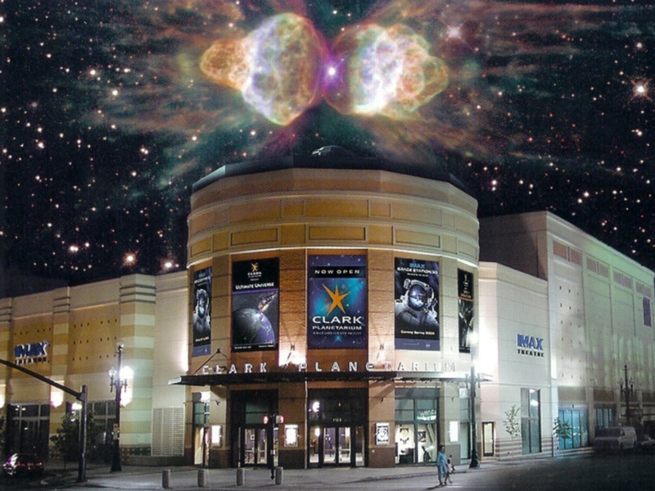
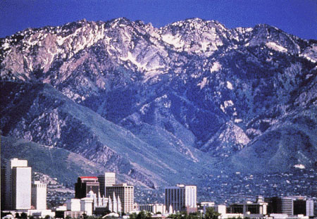
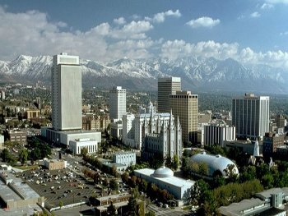
Salt Lake City, UT
Form Seattle to Salt Lake City is about 13 hours and 5 mins
We’ll be spending about $105.85 on gas
We’ll be staying in a 4-star Marriott hotel spending $396 per day
Attraction : Clark Planetarium
National Park : Arches Mountains' .
2days

Slide 9
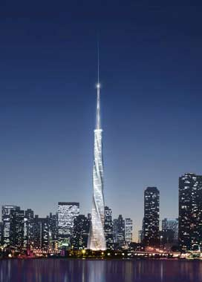
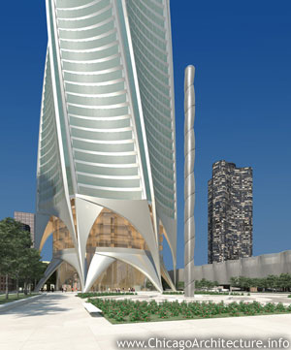
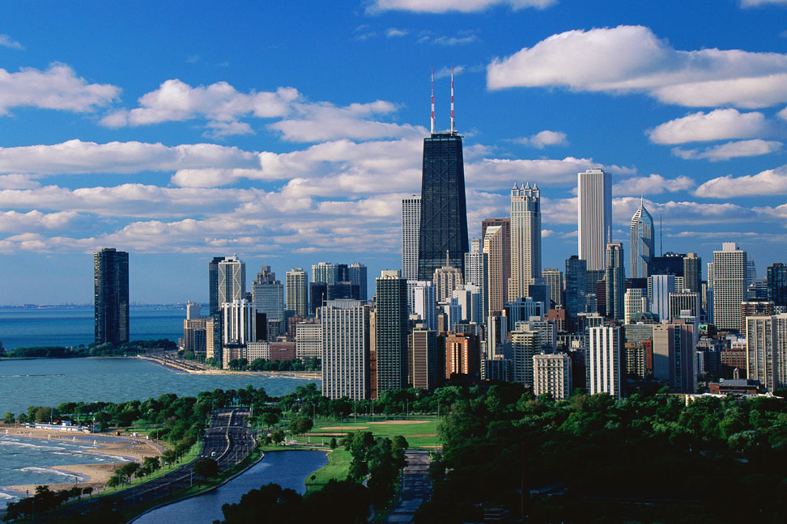
Chicago, IL
From Salt Lake City to Chicago Is about 21 hours and 46 mins.
We’ll be spending about $166.44 on gas
Free Lodging.
Attraction : Architecture Foundation.
National Parks : Perry’s Victory + International Peace Memorial.
3days

Slide 10
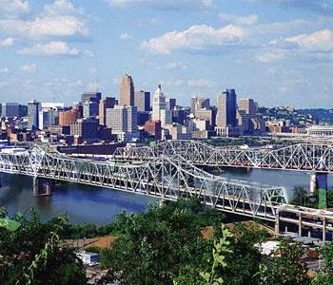
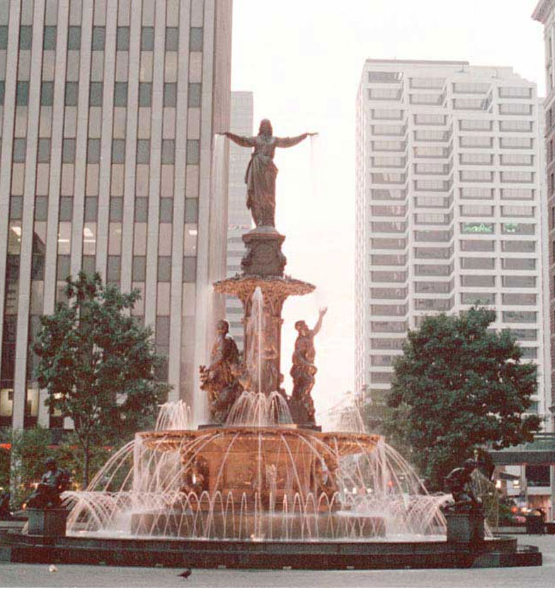

Cincinnati, OH
From Chicago to Cincinnati is about 5 hours and 3 mins.
We’ll be spending about $40.86 on gas
Well be staying at motel 8 spending 144 per night
Attractions : Cincinnati Zoo + Botanical Garden
National Park : Obed Wild + Scenic River
2days.

Slide 11
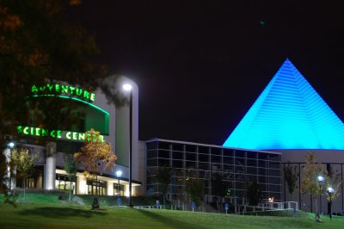
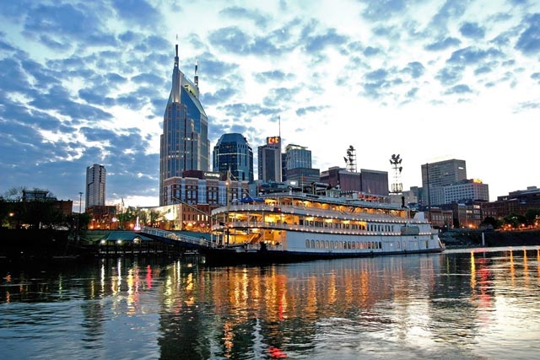
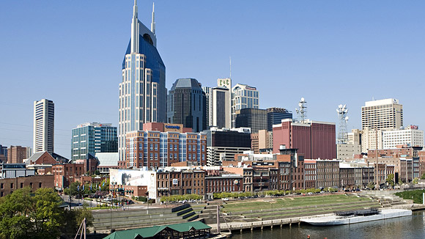
Nashville, TN
From cincinnati to Nashville is about 4hours straight
We’ll be spending about $31.88 on gas
We’ll be staying at a 5-star marriot hotel , which will cost us about 328 per night
Attraction : Adventure Science Center
National Park : Cumberland Island.
2days

Slide 12
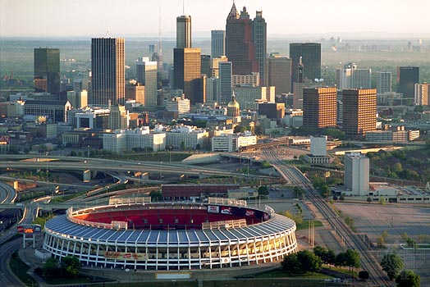
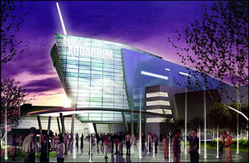
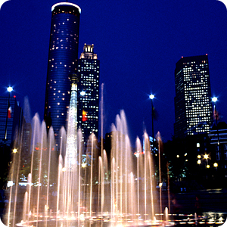
Atlanta, GA
From Nashville to Atlanta is about 4 hours and 33 mins
We’ll be spending about $29.31 on gas
Free Lodging
Attraction : Atlanta Aquarium + Atlanta Falcons Stadium.
National Park : National Seashore.
3days.

Slide 13
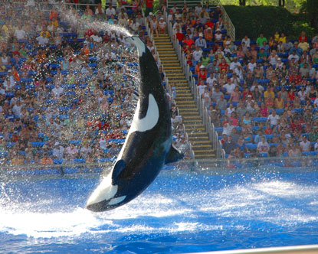
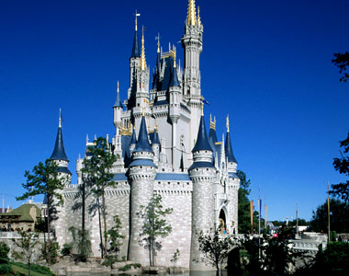
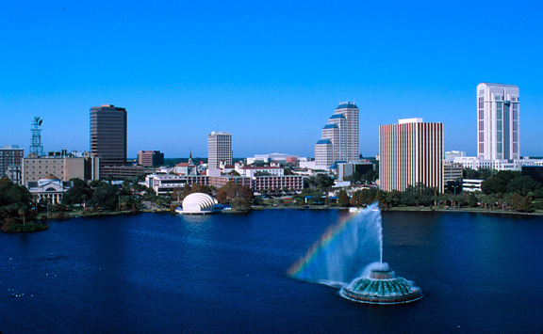
Orlando, FL

