Slide 1
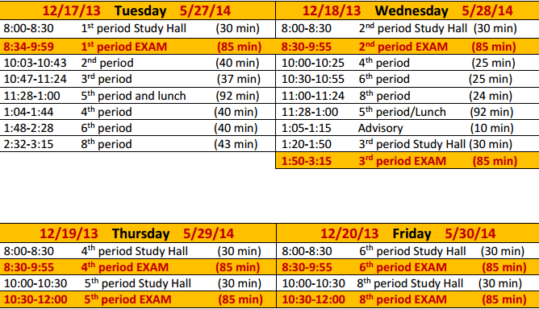
Tuesday May 27, 2014

Slide 2
Review Game today!
10 mins to review on your own
Clear off desks after 10 mins!

Slide 3
A direct object is…

Slide 4
The receiver of the action in a sentence
Example: I lost my project that is due today!
The direct object is…

Slide 5
A prepositional phrase is…

Slide 6
Describes in relation to space and time
On Wednesdays we wear pink.
The preposition is… The prepositional phrase is…

Slide 7
The subject of a sentence is…

Slide 8
Who or what the sentence is mainly about
Mr. Williamson and Mr. Antesberger like to coach sports.
The subject is…

Slide 9
An interjection is…

Slide 10
Used to exclaim or protest
Yikes! That spider looks like Fluffy from Harry Potter.
The interjection is…

Slide 11
An adjective is…

Slide 12
A word that describes a noun or pronoun
The anxious students waited for the final bell signaling summer!
The adjective is…

Slide 13
A verb is…

Slide 14
An action or linking word
She slammed the car door in frustration
The verb is…
He is going to Disney World this summer
The verb is…

Slide 15
What are the two types of conjunctions?

Slide 16
Subordinating & Coordinating

Slide 17
What are subordinating conjunctions used for?

Slide 18
To begin a dependent clause

Slide 19
What type of sentence includes a subordinating clause?

Slide 20
A complex sentence!

Slide 21
What are coordinating conjunctions used for?

Slide 22
To combine two independent clauses

Slide 23
What type of sentence is made up of two independent clauses?

Slide 24
A compound sentence!

Slide 25
What comes before a coordinating conjunction in a sentence?

Slide 26
A comma!

Slide 27
When you SIFT in poetry, what are you looking for?

Slide 28
Symbolism, Imagery, Figurative Language, Tone / Theme

Slide 29
What is sybolism?

Slide 30
The deeper meaning associated with an object or individual

Slide 31
What is imagery?

Slide 32
Descriptions that appeal to the senses

Slide 33
What is figurative language?

Slide 34
Poetic devices
Metaphor
Simile
Personification
Consonance
Assonance
Alliteration
Etc

Slide 35
A stanza in a poem is…

Slide 36
A group of lines within a poem that go together

Slide 37
Who came up with the concept of the Hero’s Journey?

Slide 38
Joseph Campbell

Slide 39
In the hero’s journey, the approach to the inmost cave is…

Slide 40
When the hero faces challenges along the journey that helps him gain knowledge and insight

Slide 41
An Allegory is…

Slide 42
A story, poem, or picture that can be interpreted to reveal a hidden meaning, typically a moral or political one

Slide 43
What is the correct way to do in text citation?

Slide 44
“__________________” (Myers 9).

Slide 45
What are the coordinating conjunction?

Slide 46
FANBOYS
For
And
Nor
But
Or
Yet
So

Slide 47
What are the subordinating conjunctions?
3 A’s
2 B’s
TUTU
IS
6 W’s

Slide 48
After, although, as
Because, before
Though, unless, than, until
If, since
When, whenever, where, wherever, while, whether

Slide 49
An appositive is…

Slide 50
Provides additional information about a noun

Slide 51
An infinitive is…

Slide 52
To form of a verb

Slide 53
A participle is…

Slide 54
A verb acting as an adjective
Because it is an adjective what does it describe?

Slide 55
A gerund is…

Slide 56
A verb acting as a noun

Slide 57
Because it is a noun what role can it play in a sentence?

Slide 58
Subject
Object of a preposition
Direct object
Predicate noun (subject + to be verb + gerund) gerund = predicate noun

