Slide 1
Warm-up #4
Write a paragraph using the following words:
  Legislature
  House
  Senate
  Term
  Citizen
  Law
  Elected

Slide 2

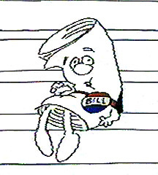
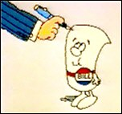
How does a bill become a law?
We are going to watch a short video from School House Rock.
Label the boxes on the worksheet with the name of each place that bill goes before becoming a law.
Now answer the questions on the bottom of page explaining the process of making law.

Slide 3

How does a bill become a law?

Slide 4
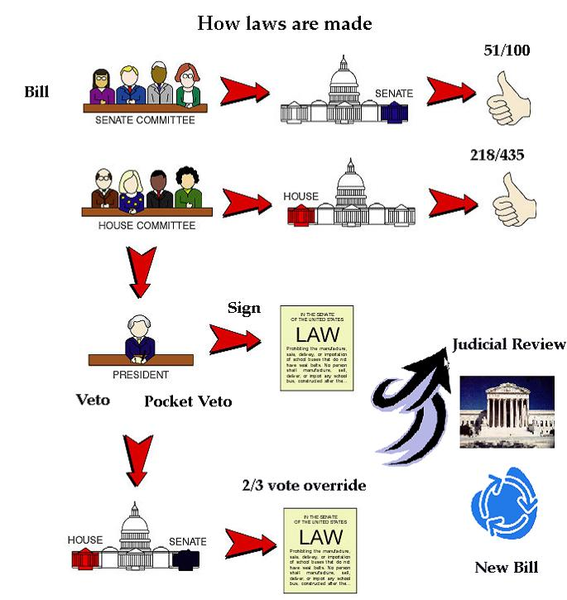

Slide 5
How Laws are Made
Read and answer the questions in complete sentences.

Slide 6

Think of a bill to propose to our “mock congress”
Homework

