Slide 1
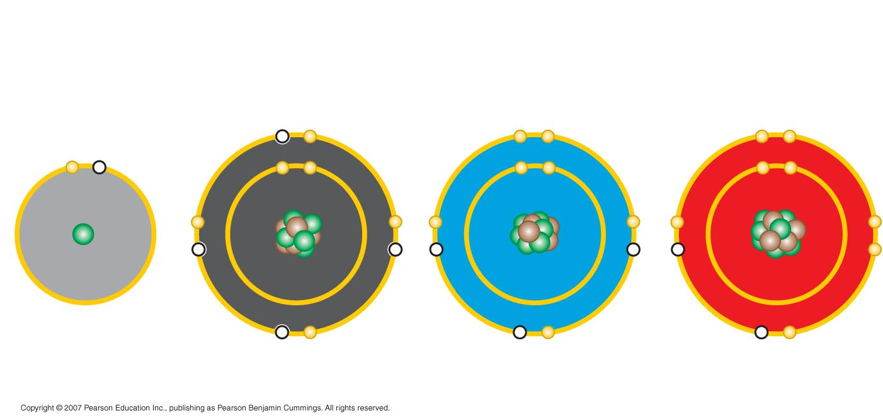

Slide 2
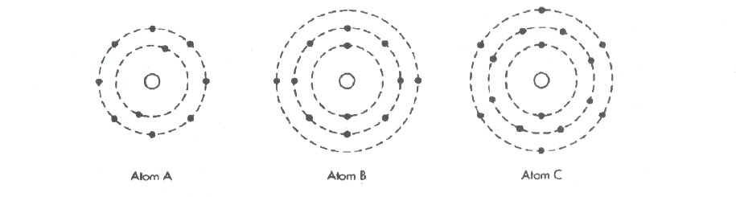

Slide 3
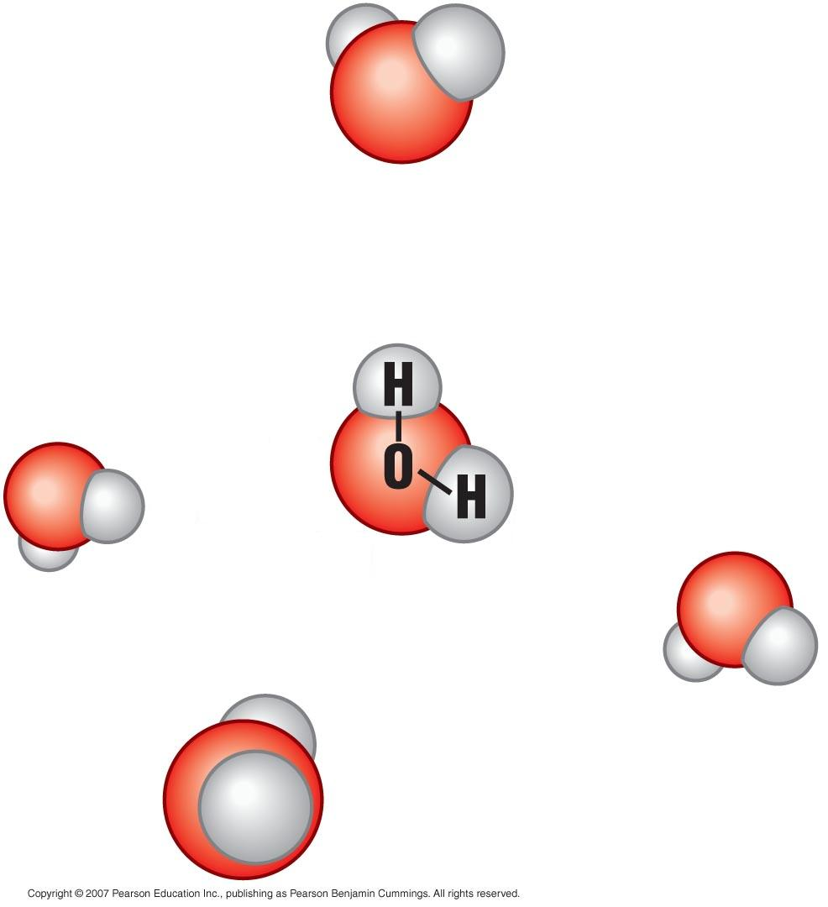

Slide 4
Structure of water
Oxygen and hydrogen of water is covalently bonded to create a stable molecule.
Water is polar because the oxygen region is slightly negative and the hydrogen region is slightly positive (draw on your diagram).

Slide 5
Structure of water continues
Because of water’s polarity hydrogen bonding is possible. The negative region of oxygen from 1 molecule will form a hydrogen bond with a positive region of hydrogen from another molecule.
Draw hydrogen bonding on your diagram.

Slide 6
Properties of water
Because of the hydrogen bonding in water, special properties are found in water.
  Floating ice
  Universal solvent
  Cohesion
  Moderation of temperature

Slide 7
Biological significance of ice floating
In nature where do you find floating ice?
Why must ice float in this area? What would happen if ice sank instead of floating?

Slide 8
Biological significance of ice floating
If ice didn’t float, life in the ocean, lakes, ponds, etc. would die when the water freezes over.

Slide 9
Why does ice float?
When various liquids freeze does it become more or less dense?
When water freezes does it become more or less dense?
Why?

Slide 10
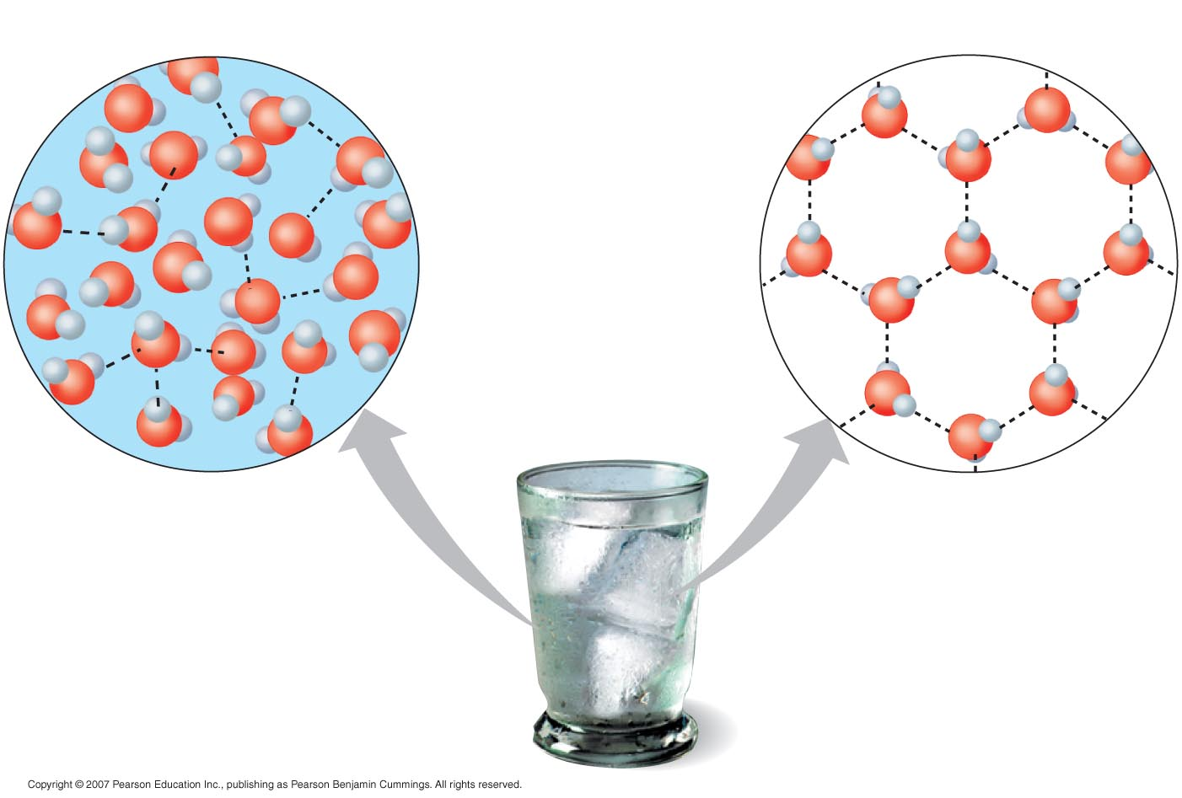
As water freezes the molecules more farther and farther apart.
Ice float because it is less dense than the liquid around it.

Slide 11
Water – universal solvent of life
Because of water’s polarity (positive and negative charges) it is able to dissolve other polar molecules and ionic compound.
  Table salt

Slide 12
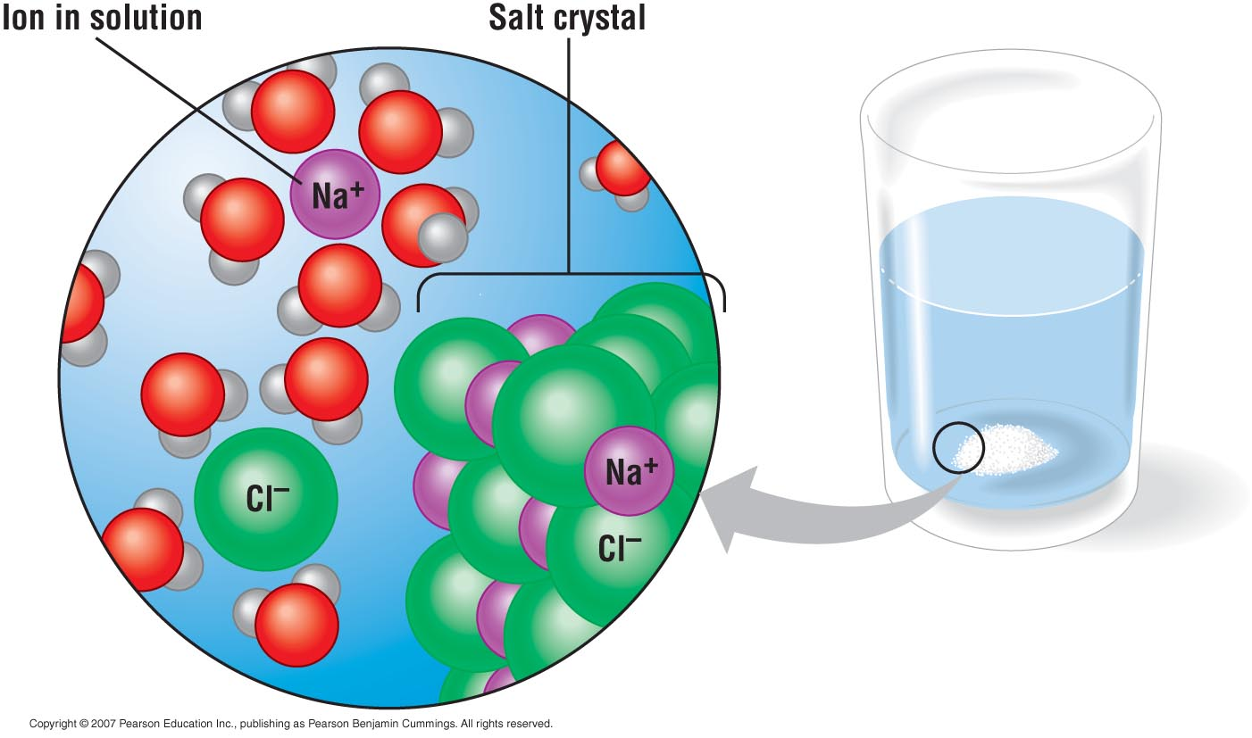

Slide 13
Water – universal solvent of life
The fluids of living organisms are aqueous solutions.
Dissolving of various solutes is necessary for life processes within our cells, blood, even plant sap.
As a solvent, may chemical reactions take place in water.

Slide 15
Can a tree drink water?
How does the water go from the roots through the branches to the leaves to provide the water needed for photosynthesis as well as providing nutrients needed for survival?

Slide 16
It drinks water using cohesion!
Cohesion is the attraction between molecules of the same kind. For example water being attracted to water.
Adhesion is the attraction between molecules of different kind. For example water being attracted to the plant vascular tissue.
Capillary action is the use of cohesion and adhesion to move water up a thin tube; like the vascular tissue in plants.

Slide 17
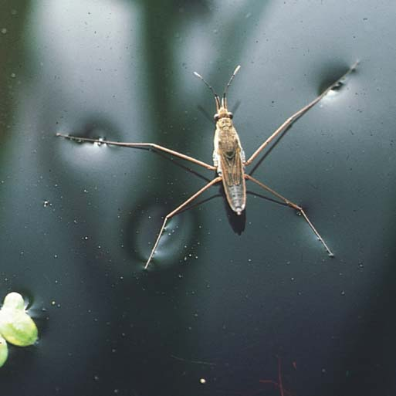

Slide 18
Surface tension
Related to cohesion is surface tension or the ability to break the surface of a liquid.
Water as a high surface tension because of hydrogen bonding.

Slide 19
Moderate temperature
Water has a strong resistance to temperature.
Boiling water example.
  Heat must first break the hydrogen bonds and then the hydrogen and oxygen atoms start to move faster and faster eventually raising the heat.
Cooling hot water
  Hydrogen bonds must first reform and as that happens, heat is released dropping the temperature of water slightly.

Slide 20
Evaporative cooling
When a substance evaporates (liquid to gas) the surface of the liquid remaining behind cools down.
  Maintaining body temperature of 98.6

