Slide 1
Chapter 19
Early Latin America

Slide 2
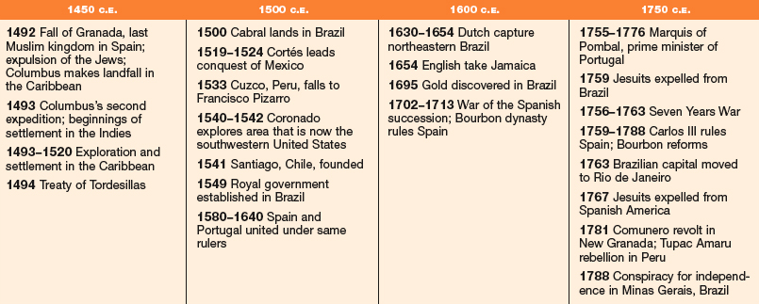

Slide 3
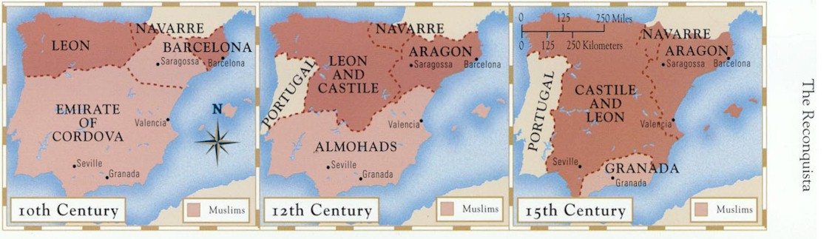
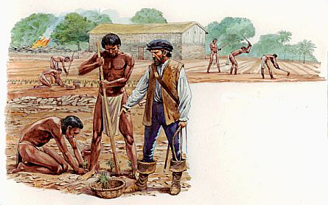
I. Spaniards and Portuguese: From Reconquest to Conquest
Iberia
  Zone of cultural contact
  Arab Muslims invade in 8th century
    Long multicultural period
  Reconquest
    Small Christian states to unification
    1492, completed
      Jews expelled
A. Iberian Society and Tradition
Features
  Strongly urbanized
  Iberian commoners seek to raise their status
  Encomiendas (large estates)
    Patriarchal culture
  Slavery
  Centralized governments
  Close ties to church

Slide 4
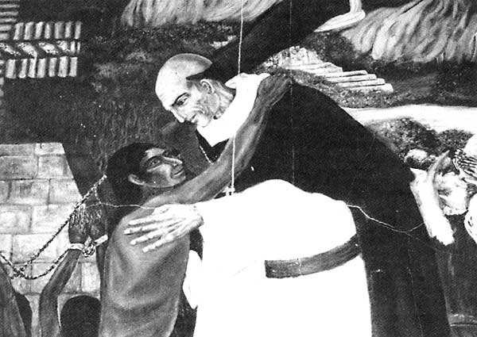
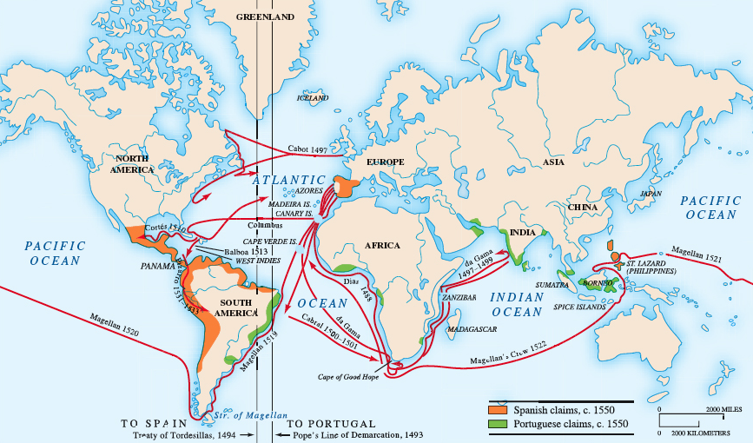
I. Spaniards and Portuguese: From Reconquest to Conquest
B. The Chronology of Conquest
  First stage, 1492-1570
    Foundations
  Second stage, 1570-1700
    New society, institutions take shape
  Third stage, 1700s
    Reform, reorganization
    Discontent, unrest
C. The Caribbean Crucible
  Native Indians become laborers
    Decimated by disease
  Cities
    Grid
    Central plaza
  Professional bureaucrats
  16th century
    African slaves, Spanish women - new society
  Bartolomé de las Casas
    Opposes abuses of Indians
Spanish and Portuguese Exploration, 1400-1600

Slide 5
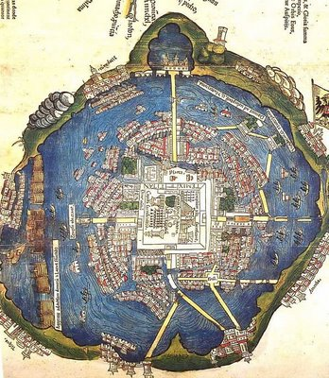
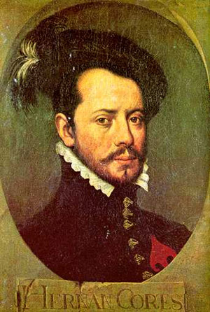
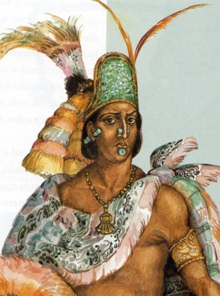
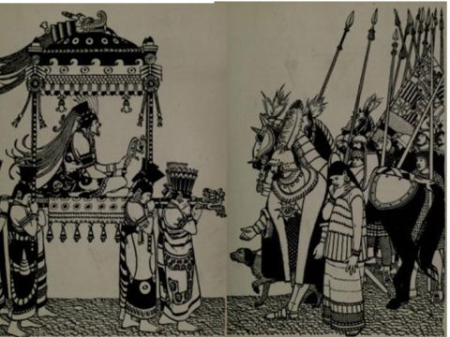
I. Spaniards and Portuguese: From Reconquest to Conquest
D. The Paths of Conquest
  Not unified
  Mexico
    1519, Hernán Cortés into Mexico
      Attacks Aztecs
      Tenochtitlan
        Moctezuma II killed
    By 1535, central Mexico under Spain
    Kingdom of New Spain
  Inca
    Weakened by civil war
    Francisco Pizarro
      1532, begins conquest
    Cuzco falls, 1533
    New capital at Lima

Slide 6
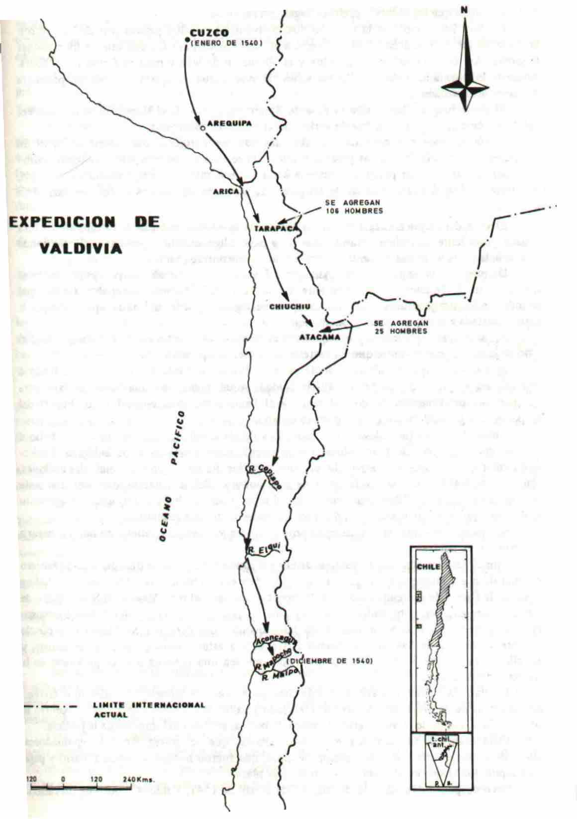
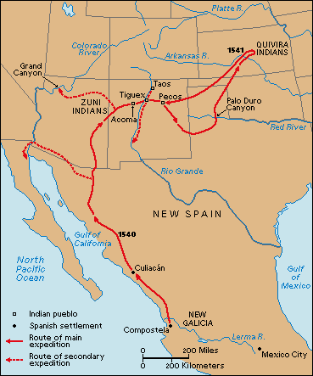
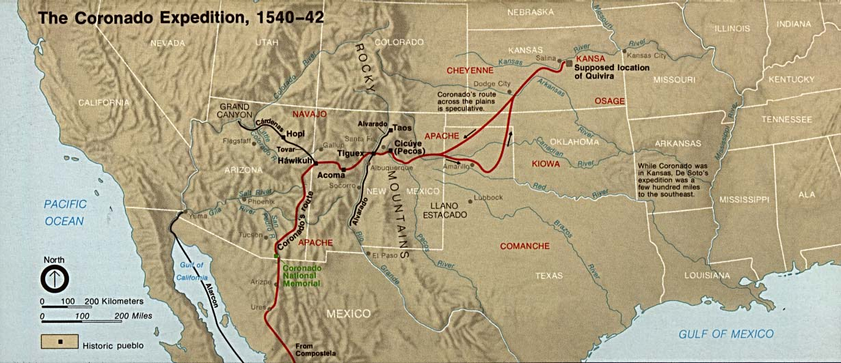
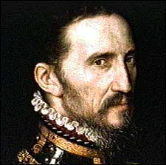
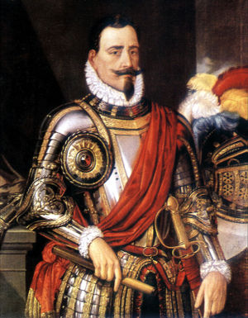
I. Spaniards and Portuguese: From Reconquest to Conquest
D. The Paths of Conquest
  American Southwest
  Francisco Vázquez de Coronado
    Exploration in the 1540s
  Chile
    Pedro de Valdivia
      Conquers central Chile
      1541, founds Santiago
  By 1570, 192 Spanish towns

Slide 7
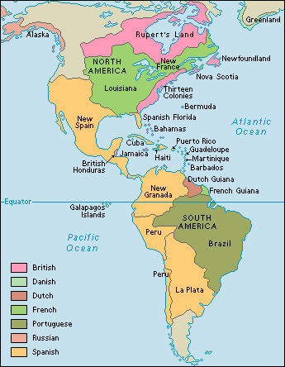
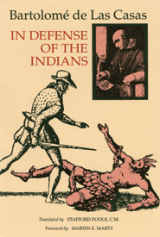
I. Spaniards and Portuguese: From Reconquest to Conquest
F. The Conquerors
  Contracts between crown and leaders of expeditions
    Followers get booty
G. Conquest and Morality
  Conquests questioned
    Indians considered sub-human
      Conversion a duty
  Las Casas' work lessens abuses

Slide 8
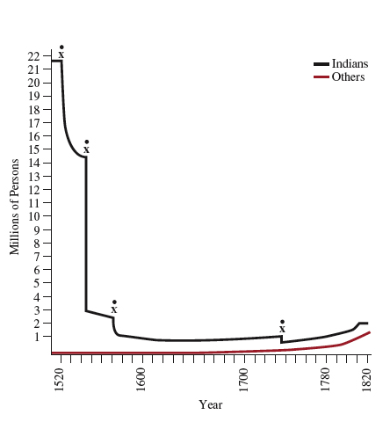
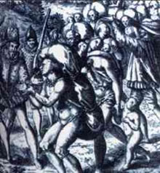
II. The Destruction and Transformation of American
Indian Societies
Population Decline in New Spain
The example of Mexico
  Indigenous population
    25 million to fewer than 2 million
A. Exploitation of the Indians
  Encomiendas
    Adds to decline of native populations
    Modified by crown, fearing threat
  Mita
    Native system of forced labor
    Natives used for state projects

Slide 9
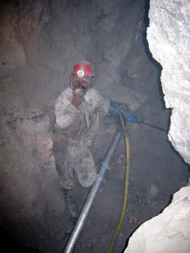
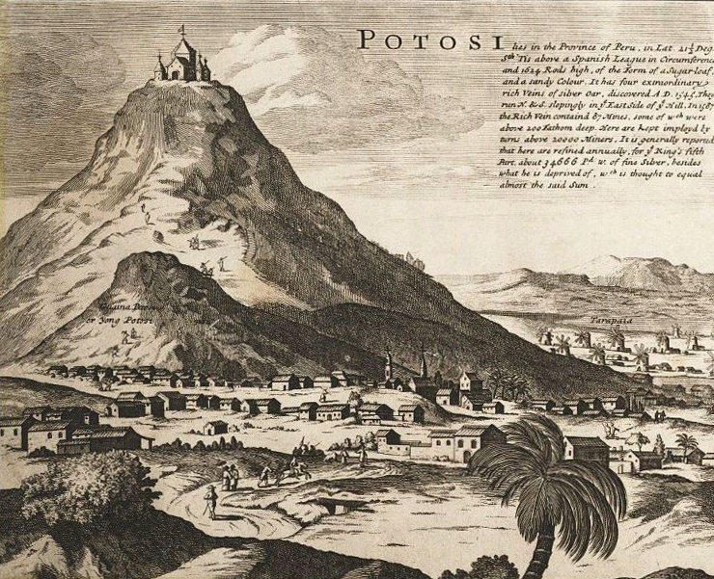
III. Colonial Economies and Governments
80 percent work in agriculture, ranching
Mining crucial
A. The Silver Heart of Empire
  Mexico, Peru
  Potosí, Bolivia
    Largest
  Zacatecas, Mexico
B. Haciendas and Villages
  Haciendas
    Spanish agricultural estates
    Produce for domestic use
    Give rise to aristocracy

Slide 10
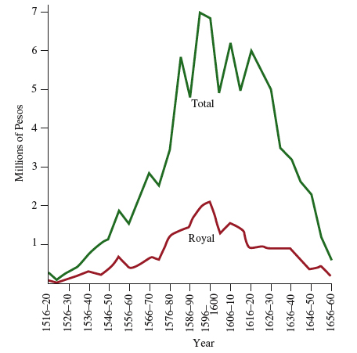
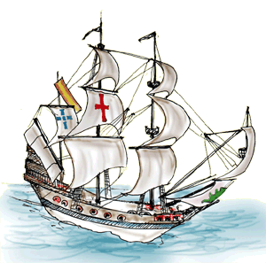
III. Colonial Economies and Governments
Silver Production in Spanish America
1516-1660
C. Industry and Commerce
  Sheep raising
    Textile sweatshops
  Silver trade preeminent
    Only for Spaniards
    Convoys cross Atlantic
      Protected by galleons
  Board of Trade
    Oversees commerce
    Consulado, merchant guild

Slide 11
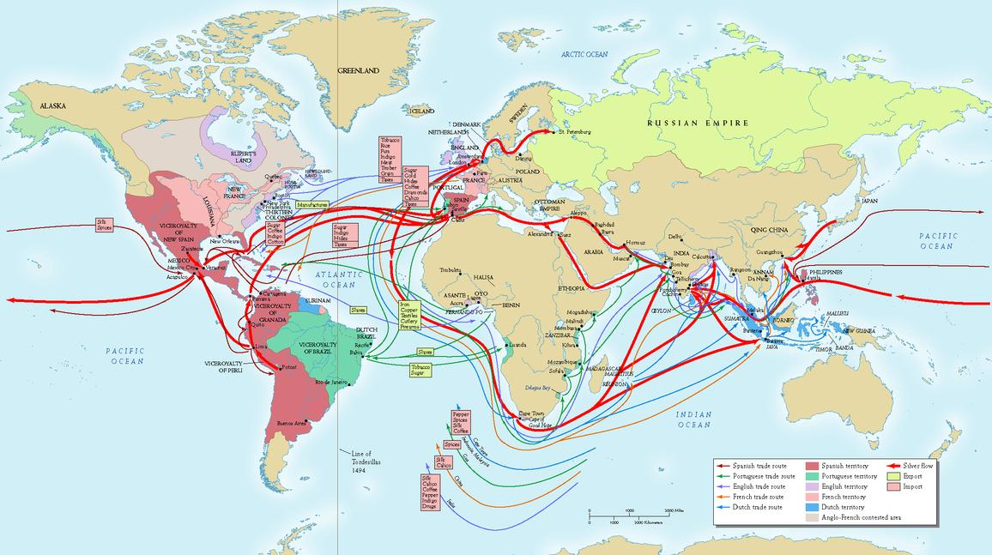

Slide 12
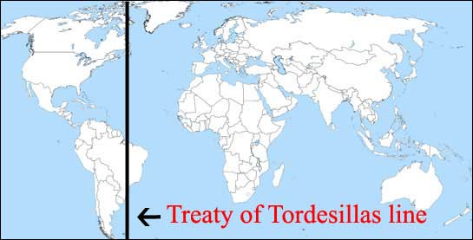
III. Colonial Economies and Governments
D. Ruling an Empire: State and Church
  Treaty of Tordesillas, 1494
    Spain and Portugal
    Portugal gets Brazil
    Rest to Spain
  Spanish Empire
    King at top
    Council of Indies
    Viceroyalties
      Mexico City, Lima
    Clergy
      Religious and secular functions
    Inquisition

Slide 13
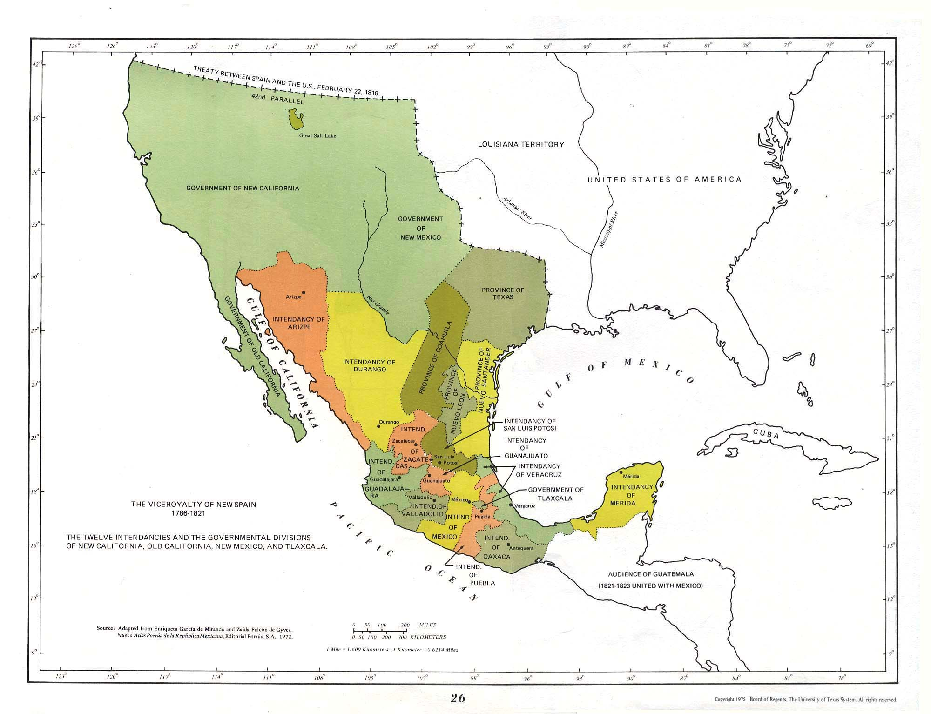

Slide 14
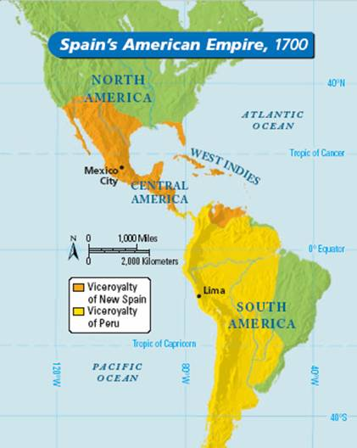
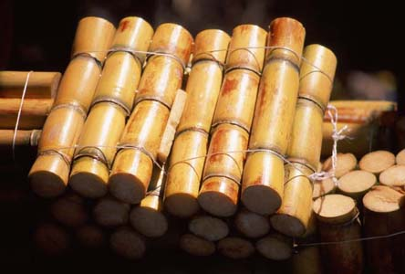
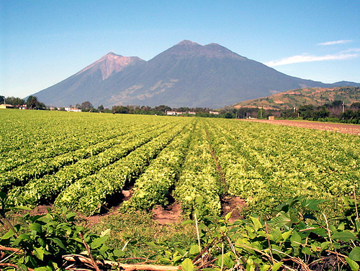
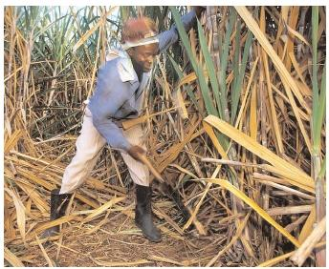
IV. Brazil: The First Plantation Economy
1500, Pedro Alvares Cabral
  Only interested in dyewoods
1532, new system developed
  Spurred by French interest
  Land grants to increase colonization
1549, governor creates administration
  Capital at Salvador
A. Sugar and Slavery
  Sugar
    Labor intensive
  Society
    White plantation-owners dominate
    Slaves at bottom
    Great variety in between
  Administration
    Staffed by lawyers
    Regional governors
    Missionaries run ranches, schools

Slide 15
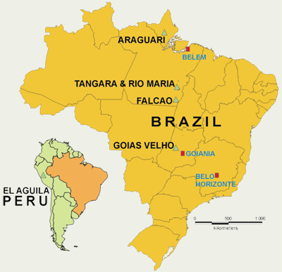
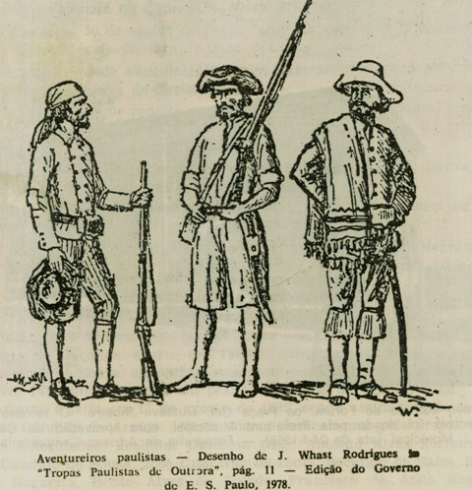
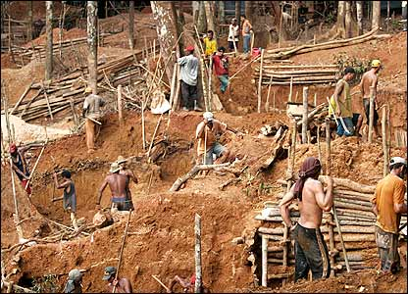
IV. Brazil: The First Plantation Economy
B. Brazil's Age of Gold
  European conflict affects Brazil, 1600s
    Dutch occupy Brazil until 1654
  Dutch, English, French
    Sugar plantations in Caribbean
    Price of sugar drops, slaves more expensive
  Paulistas
    Explorers into interior
    Discover gold, Minas Gerais, 1695
  Government controls production
    Interior developed
  Rio de Janeiro
    Closer to mines

Slide 16
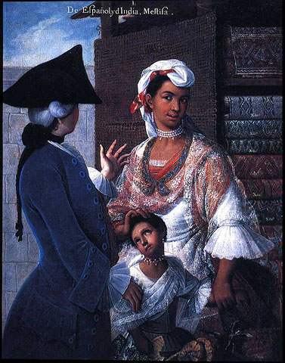
V. Multiracial Societies
Castas, mixed races
A. The Society of Castas
  Miscengenation
    Sexual exploitation of Indian women
    Mestizo population
  Peninsulares (born in Spain) v. Creoles (born in New World)

Slide 17
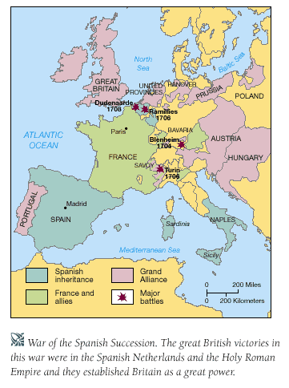
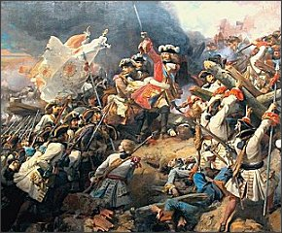
VI. The 18th-Century Reforms
A. The Shifting Balance of Politics and Trade
  Spain weakened in 18th century
    Conflict with France, England, Holland
      Loss of overseas territories
    Silver imports drop
    Colonies more self-sufficient
  1701-1713, War of the Spanish Succession
    Bourbons victorious

Slide 18
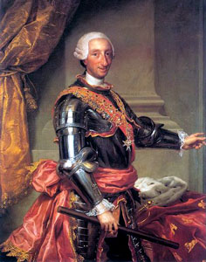
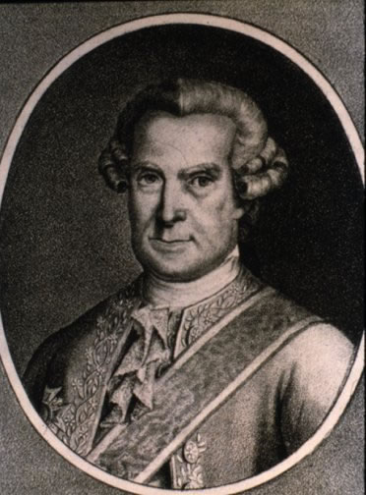
VI. The 18th-Century Reforms
B. The Bourbon Reforms
  Charles III (1759­1788)
    Reforms
    Jesuits expelled from Spain, empire, 1767
    French forms introduced
  José de Gálvez
    Reforms
    Creoles lose high office
  Spain and France allied now
    Spain involved in Anglo-French wars
  Seven Years War
    English take Havana
    Reaction
      Better defenses of New World territory
      Frontiers extended
      California settled
      State takes more control of economy
        Monopoly companies develop new regions

Slide 19
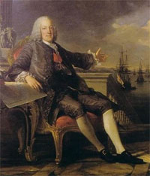
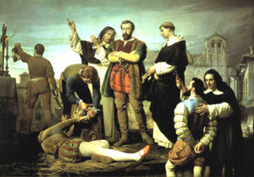
VI. The 18th-Century Reforms
C. Pombal and Brazil
  Marquis of Pombal, 1755 to 1776
    Authoritarian
    Jesuits expelled from empire, 1759
    Reforms
      Monopoly companies to develop agriculture
      Rio de Janeiro the new capital
      Slavery abolished in Portugal
D. Reforms, Reactions, and Revolts
  Mid-18th century
    Great economic growth
    Population, production up
    Traditional leaders threatened by reforms
  New Granada
    Comunero Revolt, 1781
  Peru
    Tupac Amaru

