Slide 1

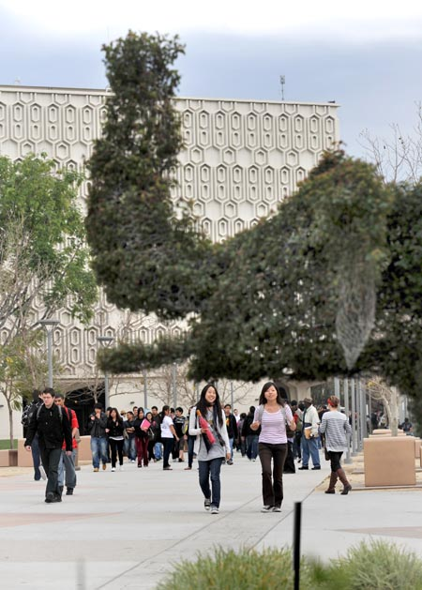
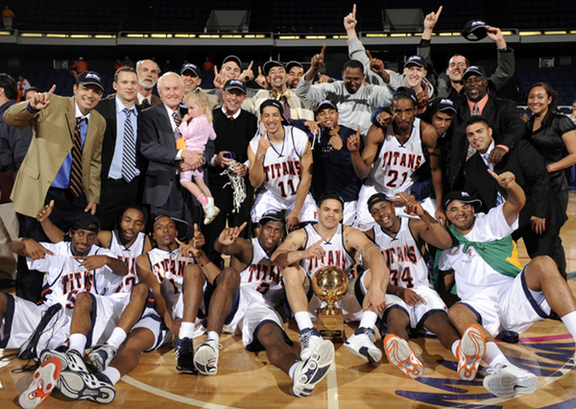

Have you thought about college?
Start with the
Early Assessment Program!
Notes:
Introduction

Slide 2
College Eligibility Vs. College Readiness
College Eligible
  Meeting all admission requirements to the CSU
College Ready
  Possessing the Academic skills necessary to be successful in college, especially in math & English
  Being prepared mentally for the rigors of college (i.e., “Habits of mind”)
  Taking college level math and English courses in your first semester thereby avoiding any remedial courses while in college
Notes:
College Eligible: you may be aware that you need to get through Algebra II and 4 years of English to be eligible for the CSU, but that doesn’t automatically mean that you will start in College Level math and/or English in your first semester at the CSU. Many students who are college eligible are not yet college ready…
College ready means that you (read off slide)…. And we want to help you get there! (next slide)

Slide 3

We Want YOU to be College Ready!
Remedial Coursework in your first semester adds courses to your course load increasing cost, increases your timeframe to completion of a degree, and sets you back!
Your first semester in College you should be in College Level Math & English. We want to help you get there!
Notes:
You’ll be more likely to graduate on time, and even more likely to graduate, if starting at college level

Slide 4
Did you Know?
Once admitted, during your Senior year, you will need to take a placement test for Math & English
These CSU placement tests (EPT & ELM) determine whether you will start at college level math & English, or whether you will be required to take remedial coursework first to catch up…
UNLESS, you are already exempt from the test & eligible for college level math and English
CSU Placement Tests | ELM , Saturday test 1.5 hrs $18 | EPT, Saturday test 2.5 hrs $18

Slide 5


Early Assessment Program Exam
EAP Exam: An opportunity to avoid CSU placement tests and earn college readiness in math and English!
A simple test in your Junior year of high school can allow you to start in college level math and English in your first semester of college.
How it works…
Notes:
Your EAP exam will be Marc 26th.

Slide 6
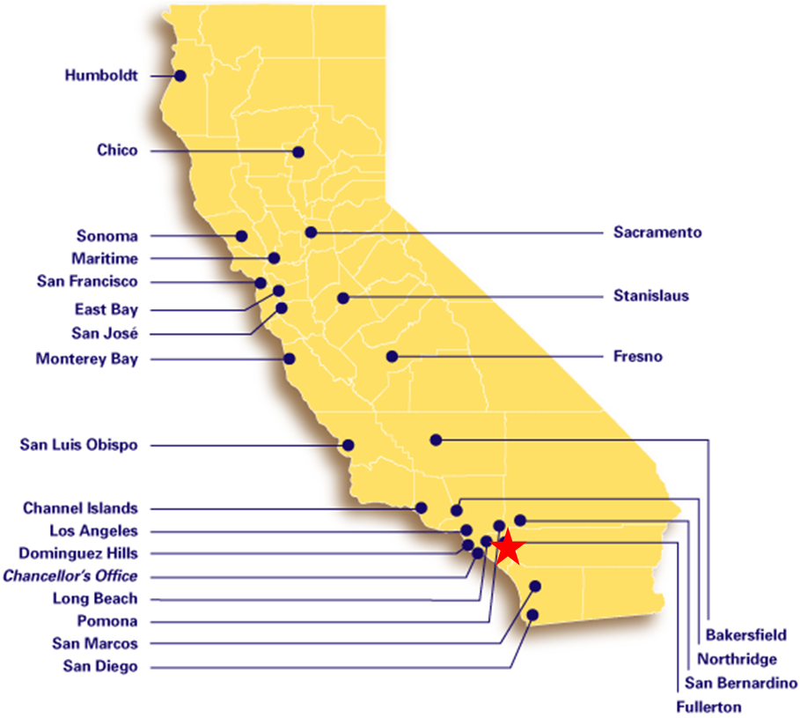
The Early Assessment Program Exam
EAP Exam: free voluntary
test administered in the11th grade in conjunction with the California Standards Test (CST).

Slide 7

The Early Assessment Program
How does the Test Work?
Spring semester of Junior year across the state:
  California Standards Test (CST)
  In your case, March 26th!
EAP Exam Components
  45 of the 60 questions on the CST (75%)
  15 extra questions in *math & English after the test
  English only: an essay
Your results are determined from these components
*To take the EAP Exam in math, you must be eligible for Intermediate Algebra
Notes:
We say “Results” not “Score”
* Essay prompt is given in the month of March before the CST.
* We look at 75% of CST questions
*All components of both English and Math must be completed in order for a student to receive a score.

Slide 8

What Do the EAP Test Results Mean?
  Ready for CSU College-Level Courses
    You’ve earned an exemption from the CSU Placement Test Requirement!
    Enroll in college level classes.
  Ready for CSU college-level courses – Conditional
    Student will need to take an approved English/math class in their Senior year… course options for English include:
  Not yet demonstrating readiness for CSU college-level English courses
    Unable to avoid exemption through EAP
Notes:
Results can be found on the back of the STAR report

Slide 9

Conditional Status
Senior Year Experience Options
  English
    AP English
    Honors English (as noted on the UC A-G List)
    IB Baccalaureate English
    ERWC
  Math
    Trigonometry Math Analysis
    Pre-Calculus Calculus
    AP Calculus AB AP Calculus BC
    AP Statistics AP Physics
    Algebra II (repeat) *Most courses with Alg II prereq
This program helps you to measure your readiness for college, specifically in math and English
If Conditional, you are almost there! Don’t let up!

Slide 10
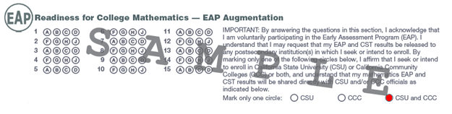
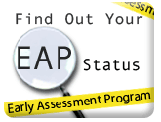
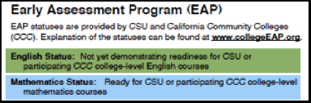
Check EAP Results Online
If a student released their scores…
Then they can check their results online!
www.calstate.edu/eap/results
*Students Log in with their CSU Mentor Username and Password
Also located on STAR results
Notes:
Make sure to bubble in to release to both the CSU and CCC

Slide 11
Student can also avoid the ELM/EPT through:
SAT
500 or above on the English section
ACT
Obtaining a score of 22 or above on the English section
AP
Obtaining a score of 3 or higher on the AP English or Math exams
Other College Course
Completing a college course that satisfies the requirement in Quantitative Reasoning, with a grade of C or better
23 or above for the math section
Obtaining a score of 550 or above on the Math section
(Caution: AP Scores not received until July! Highly encourage students to take the EPT/ELM, and CSU will honor either passing score.)
Notes:
Make sure to bubble in to release to both the CSU and CCC

Slide 12

College Ready is a BIG Deal…
Timeline of Student opportunities to become College Ready:
  1.
  EAP Test Result:
  Not Ready
Early Start
If remediation still needed
2. Other opportunities
    High SAT/ACT scores, AP Exam, etc.
3. CSU Placement Tests
College Ready
In addition to above, ERWC & SMI support the effort
GOAL… to reduce remediation and increase the number of students entering College Ready!
Notes:
Your first opportunity to earn exemption and to be college ready is through EAP.

Slide 13

Exemption from CCC Placement Tests?
Can Students also be exempt from California Community College placement tests through the EAP Exams?
A list of participating CCs and which exemptions they recognize can be found at:
http://extranet.cccco.edu/Divisions/StudentServices/EAP.aspx
Or, simply Google: Community College EAP

Slide 14
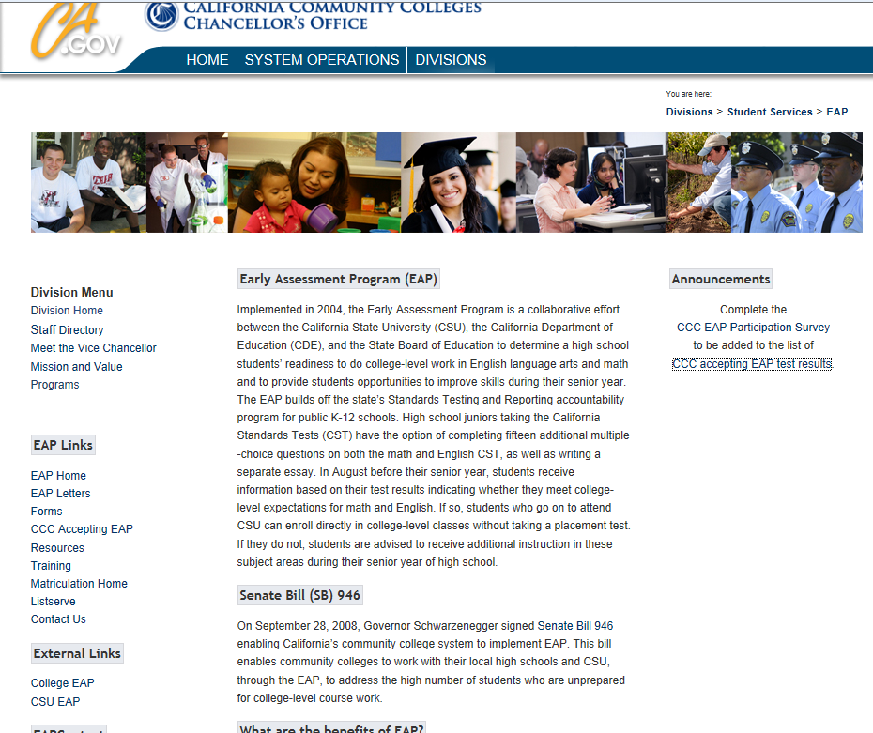
“CCC Accepting EAP Test Results”

Slide 15
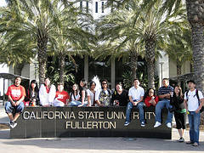


What Juniors Should Know to be Ready for College
Make yourself competitive
  Focus on GPA and A-G requirements
Visit and apply to multiple colleges
Do whatever you can to be college ready and avoid remediation
  EAP Exam
  Consider other opportunities as well
Don’t start behind! Stay on track and get ahead!
Notes:
First two bullets you traditionally hear a lot as you begin to think about and prepare for college. Being college ready is a newer term, but is just as important.

Slide 16
Resources
For Information about EAP for English & Math
  www.CSUsuccess.org
Cal State Fullerton EAP office
  Email: EAP@fullerton.edu
  Phone: 675.278.8592
Additional Resources
  www.CalState.edu/EAP

