Slide 1
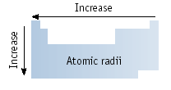
Atomic Size
Size goes UP on going down a group.
Because electrons are added further from the nucleus, there is less attraction. This is due to additional energy levels and the shielding effect. Each additional energy level “shields” the electrons from being pulled in toward the nucleus.
Size goes DOWN on going across a period.

Slide 2
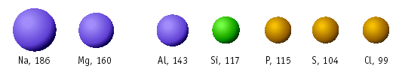
Atomic Size
Size decreases across a period owing to increase in the positive charge from the protons. Each added electron feels a greater and greater + charge because the protons are pulling in the same direction, where the electrons are scattered.
Large
Small

