Slide 1

Warm-Up Day : 8/19/14
What is the most important word in any language? Why?
Prefix: a-, an-
Meaning: without, not
Examples:
amoral: without moral
anarchy: without rule

Slide 2

Name
A name is the symbol of your identity
Whether you like your name or not, you identify with it.
It is probably the most important word in your life

Slide 3

WHAT &WHY
What: Today we are looking at the question: what is the most important word in any language?
Why: Because words impact the way we act and feel.

Slide 4
8th Grade After Reading the Passage…
Answer the following questions on a separate sheet of paper.
You do not have to write the question down, but must re-state it in the answers.
Questions
Identify the literary device and explain its meaning in the line: “It is the Mexican records my father plays on Sunday mornings when he is shaving, songs like sobbing.”
2. Identify the literary device and explain its meaning of the line: “ …they say my name funny as if the syllables were made out of tin and hurt the roof of your mouth.
3. What is the theme of the piece?

Slide 5
8th Grade Adv. After Reading the Passage…
Answer the following questions on a separate sheet of paper.
You do not have to write the question down, but must re-state it in the answers.
Questions
Identify two literary devices in the passage and explain their meaning on the text.
What is the significance of including the story of her great-grandmother in her lamentation of disliking her name? What purpose does it serve?
How would you describe the theme of this vignette?

Slide 6
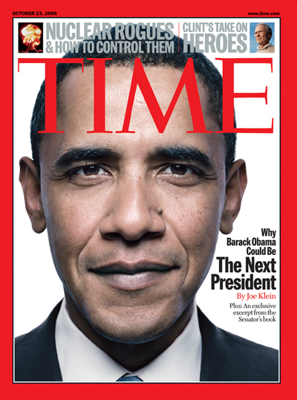
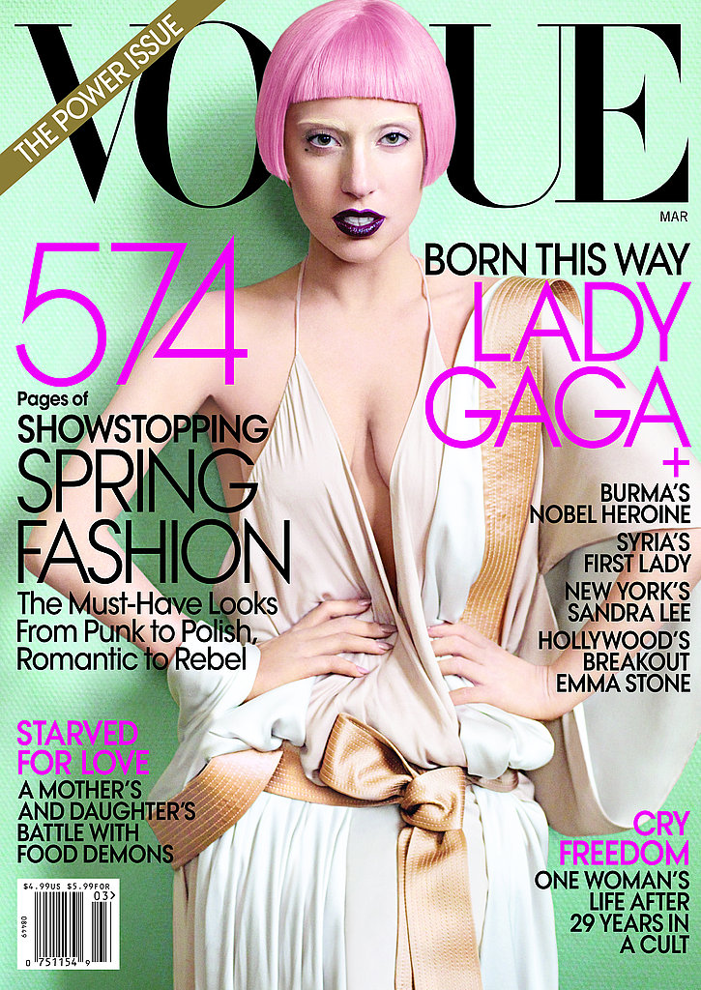
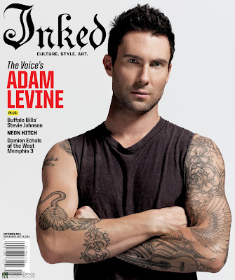
Magazine Covers

Slide 7
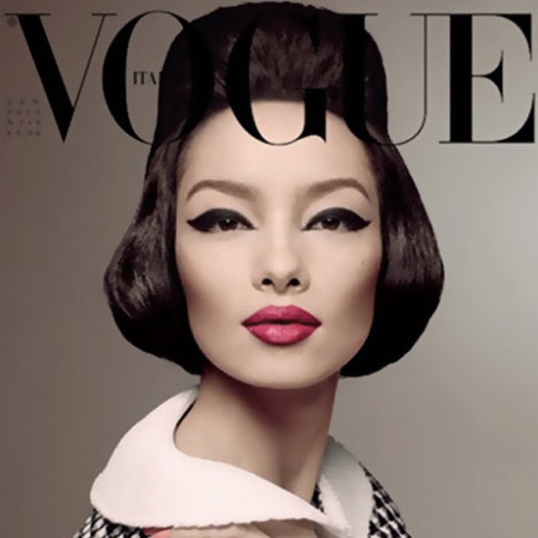
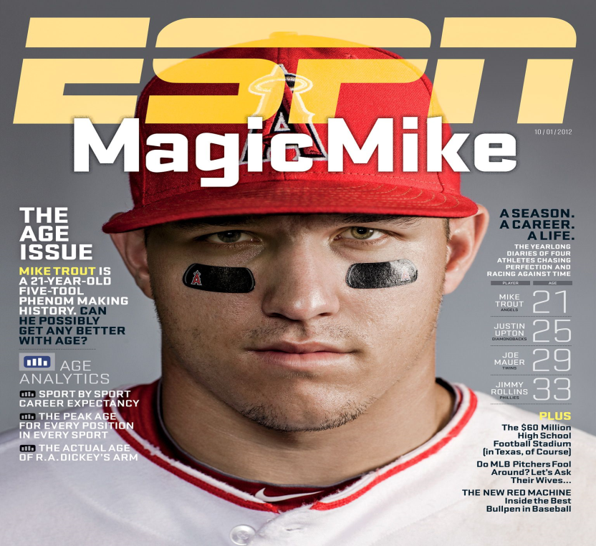
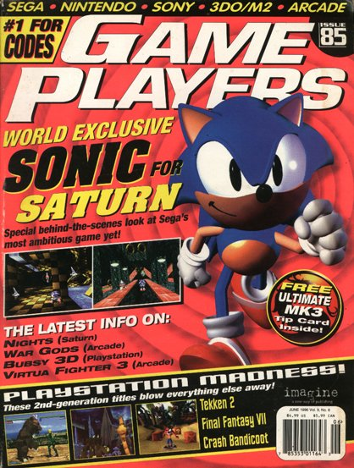
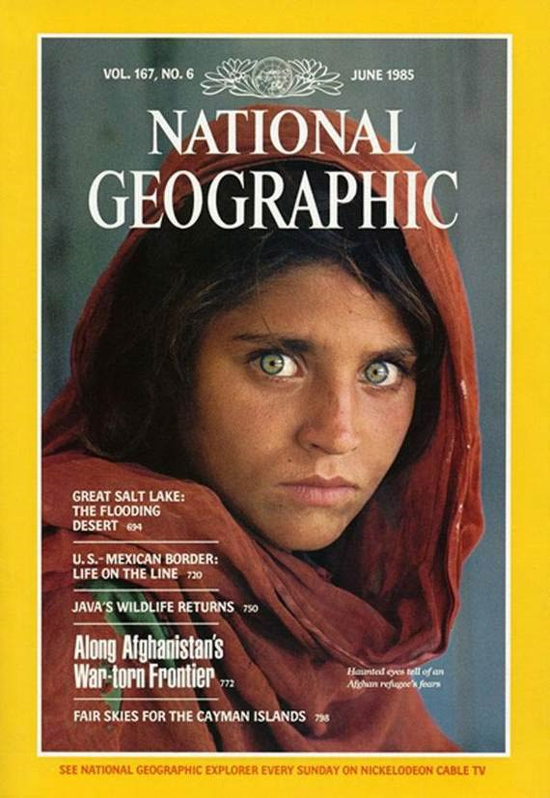

The Purpose of the Magazine Cover is to…
Grab the readers attention with visuals (word graphics and images)
To quickly tell the reader what is in this issue of the magazine

Slide 8
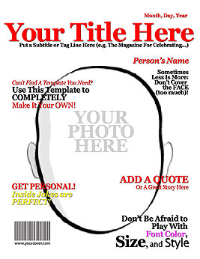
Task
Create an autobiographical magazine cover
Focusing on well-chosen images and words, you will design a cover that tells this classroom about you.

Slide 9
Requirements
Title –must be your name
Have at least 5 different sub-headlines
Visually appealing with color and graphics
(must have a picture of you as cover)
Date in upper right corner

Slide 10


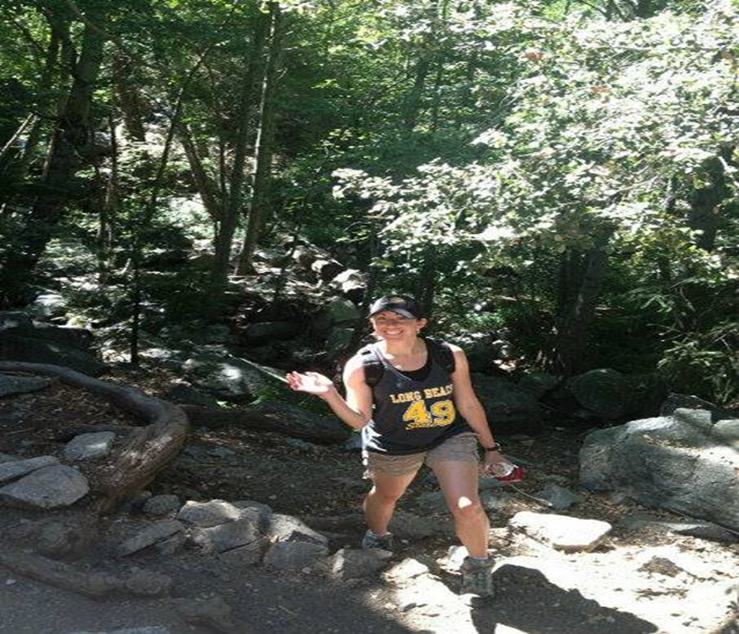


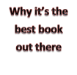
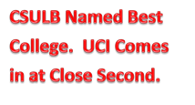
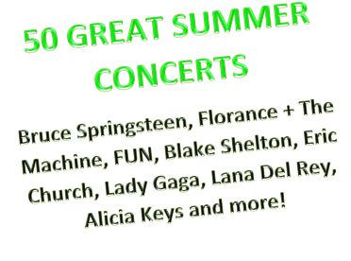


Slide 11
CLOSURE
Write a 2 sentence summary explaining to someone why our names our the most important word in any language.

