Slide 1
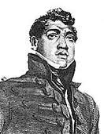
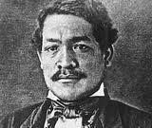
Kamehameha II and III
Their life and legacy

Slide 2
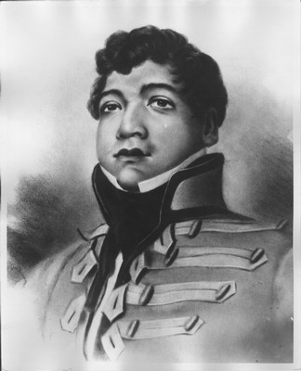
Kamehameha II Liholiho

Slide 3
Birth
Mother: Keopuolani
Father: Kamehameha
Date: 1797
Where: Hilo

Slide 4
Childhood
Prepared from a young age to be the next King, so he spent much time with Dad
He and his brother Kauikeaouli were so high in mana, even Kamehameha bowed before them

Slide 5
Personal Life
Favorite of his five wives was Kamamalu
No children

Slide 6
Becoming King
When Kamehameha died, it was decided that he was too young and possibly not ready to handle the responsibilities of a King
Kaahumanu would be Kuhina Nui, making her “in charge” of ruling the Kingdom
Liholiho’s role was more for ceremony and show

Slide 7
Notable Events During Reign
Coming of the Missionaries 1820
Ending of the Kapu system with Kaahumnanu
Detrimental effects of the Sandalwood trade
Trip to England

Slide 8
Death
Both caught the measles in England and died there
Date of Liholiho’s death: July 14, 1824- He was 27 years old
Buried at the Royal Mausoleum in Nuuanu, HI

Slide 9
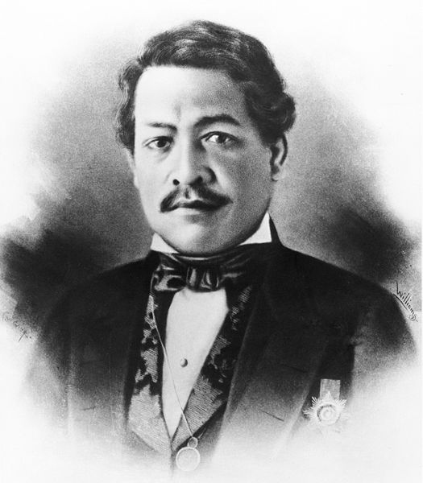
Kamehameha III Kauikeaouli

Slide 10

Birth
Mother: Keopuolani
Father: Kamehameha
Date: Around Aug. 11, 1813, but he changed it to Mar. 17 because he wanted it to be on St. Patrick’s Day

Slide 11
Childhood
Raised by Chief Kaikio`ewa in Kona
Was 5 years old when he witnessed the breaking of the kapu
One of the first children to be educated by Missionaries

Slide 12
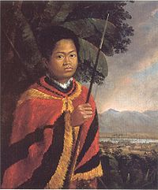
The Young King Kamehameha III

Slide 13
Personal Life
Married his sister Nahienaena, but after pressure from the missionaries saying it was sin, he ended the marriage after 7 months
Raised his nephew Alexander Liholiho (Kamehameha IV) as his own son

Slide 14
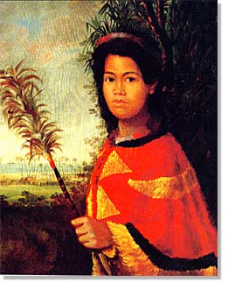
A Young Nahi`ena`ena

Slide 15
Becoming King
Liholiho dies in 1824
Kauikeaouli is only 10 years old, too young to rule a kingdom
Ka`ahumanu would serve as kuhina nui/regent
Tried to rebel and get his power back as sole ruler, but unsuccessful and went back to sharing power with the Kunina Nui 1835.

Slide 16
Notable Events During Reign
Paulet Episode 1843 (Hawaii under British rule for a short period of time)
Constitution of 1840 and 1852
Great Mahele 1848
Kuleana Act 1850
Rise of the whaling industry 1840
Start of the sugar industry 1835
Arrival of Chinese to work on plantations 1852

Slide 17

Death
December 16, 1854 after being in poor health for more than a year
41 years old
Buried at the Royal Mausoleum in Nu`uanu
Hanai son Alexander Liholiho becomes Kamehameha IV

