Slide 1
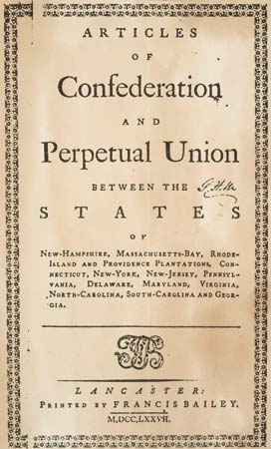
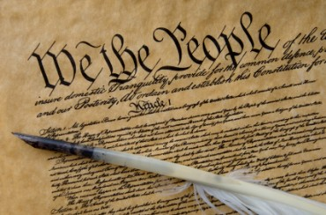
The Confederation and the Constitution

Slide 2
Spirit of ‘76
Spirit of equality across the states
Virginia statute of religious freedom (1786)
  Thomas Jefferson
  Free to practice or not practice
New state constitutions written across the nation

Slide 3
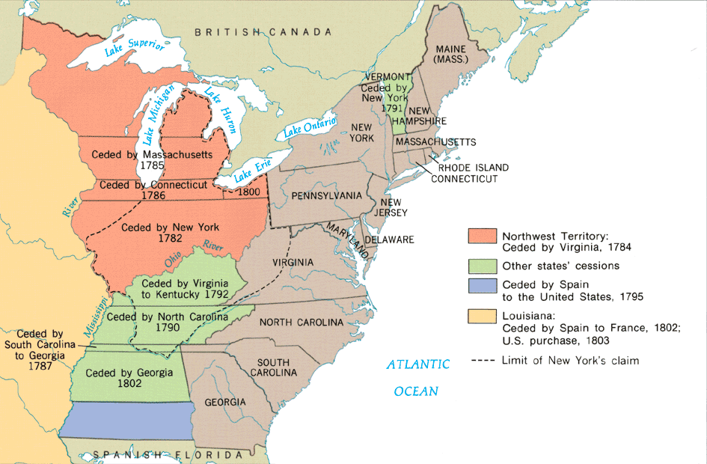

Slide 4
State Powers
Legislatures rule the states
Royal lands confiscated
Trade agreements struck with new nations
  No more British laws
National economy unstable

Slide 5
Northwest Ordinance (1787)
Process to become a state
Territories under control of federal government
When land has 60,000 people, can apply for statehood
  Slavery banned in old northwest
Template for westward expansion

Slide 6
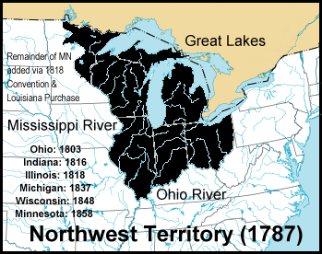

Slide 7
Articles of Confederation
No executive (King or president)
One weak legislative chamber (mostly foreign affairs)
  Can make treaties
Judicial dealings left to the states

Slide 8
Problems with the Articles
Can’t regulate trade
  States undercut each other
No tax collection
No ability to raise an army
No separation of powers

Slide 9
Foreign Affairs
Britain refuses to make treaties with America
Spain is openly hostile
France demands payment for the war
N. African pirates raiding American ships

Slide 10
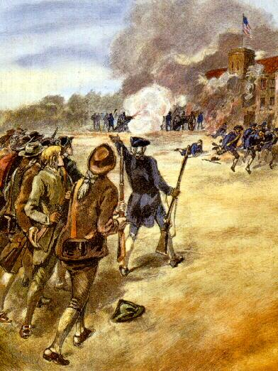
Shays’ Rebellion

Slide 11
Shays’ Rebellion
Farmers in Mass. losing farms
  Foreclosures/Tax problems
Daniel Shays leads fight against tax collectors
U.S. not allowed to raise army
Articles need to be fixed

Slide 12
Convention (1787)
Washington elected chairman
Madison, Hamilton, Franklin there
Jefferson, Adams, Henry, Paine absent

Slide 13
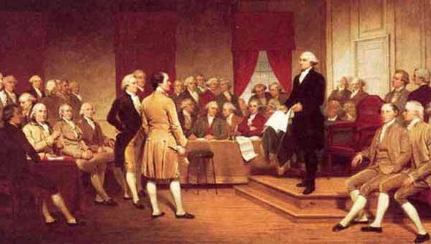
Constitutional Convention

Slide 14
Virginia Plan
Two chambers of Congress
  Both based on representation (state population)
Benefits large states
  Especially Virginia
“Large State Plan”

Slide 15
New Jersey Plan
One chamber of Congress
  Like Parliament
Equal representation for all states
Benefits small states
“Small State Plan”

Slide 16
“Great Compromise”
Two chambers
One based on population
  House of Representatives
One based on state equality
  Senate
Creation of Executive (enforce laws and veto bills)

Slide 17
The Slave question
Do you count slaves for representation?
North says no, South says yes
3/5 Compromise:
  Slaves counted as 3/5 of a person
  60% counted as people

Slide 18
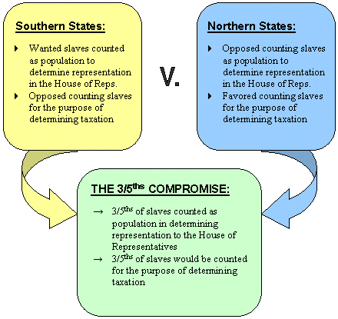

Slide 19
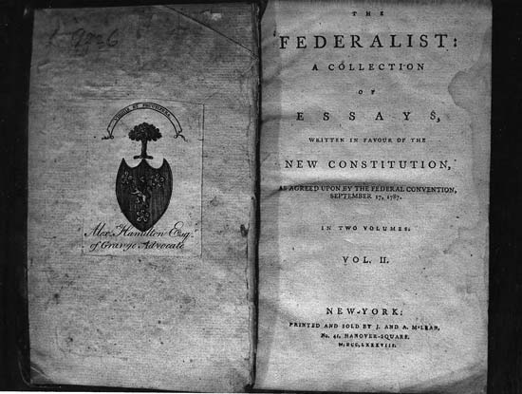
Federalists vs. Anti-Federalists

Slide 20
Ratification of Constitution
Anti-federalists
  Generally poorer
  Afraid of strong government
  Can’t pay debts
Federalists
  Richer, better educated
  Conservative
  Distrustful of “The People”

Slide 21
Compromise
Bill of Rights added to the Constitution
Ratified by the states
George Washington elected first president, 1789

Slide 22
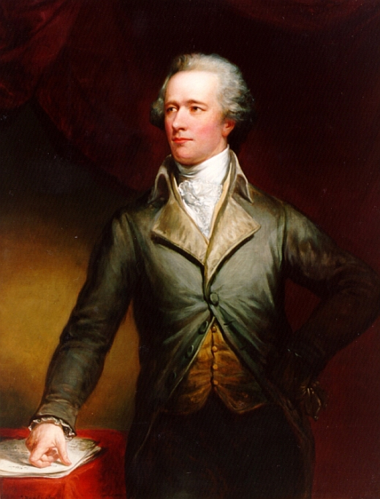
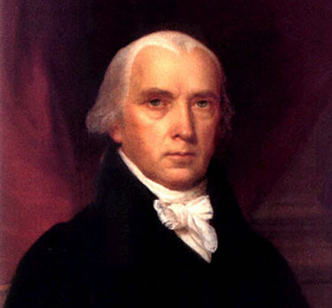
Federalists
Alexander Hamilton
James Madison

Slide 23
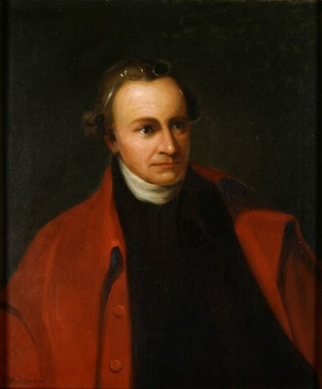
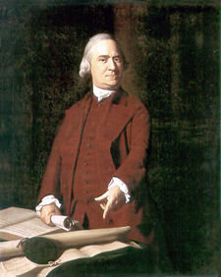
Anti-Federalists
Patrick Henry
Samuel Adams

Slide 24
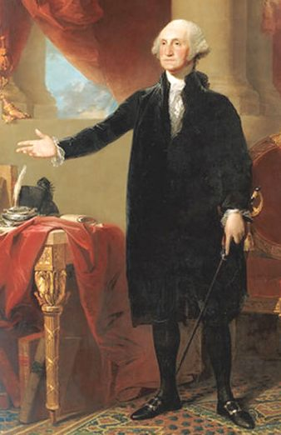
George Washington

Slide 25
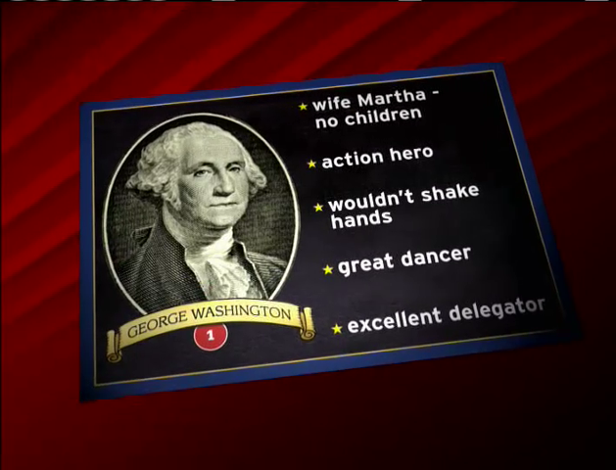

Slide 26
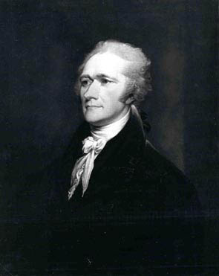
Alexander Hamilton: Secretary of the Treasury

Slide 27
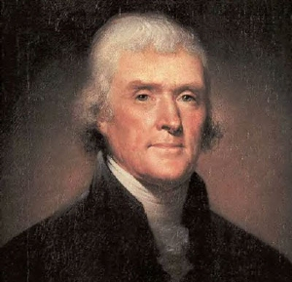
Thomas Jefferson: Secretary of State

Slide 28
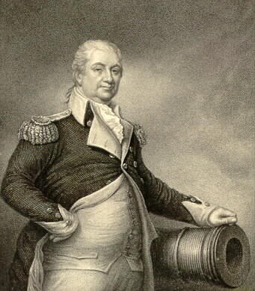
Henry Knox: Secretary of War

