Slide 1
Warm-up #6
Create a KWL chart for Michelangelo. Fill in as much of the K and W sections as you can.
Know | Want to Know | Learn

Slide 2
Brainpop Quiz
Write your answers on the side of your warm-up or a scrap piece of paper.

Slide 3
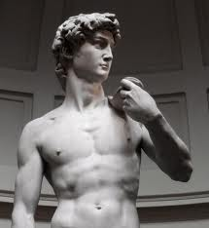
Michelangelo Reader
Read the handout on Michelangelo.
Answer the questions using complete sentences.

Slide 4
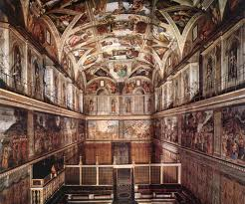
Michelangelo simulation
Option 1:
  Sit on the ground. Put your paper on your notebook and hold it above your head.
  Now follow the directions and draw in each of the four boxes on you handout.
Option 2:
  Lay down on the floor with you head under your desk.
  Tape your paper to the bottom of the desk.
  Follow directions to draw in each of the four boxes on the back of your worksheet.

Slide 5
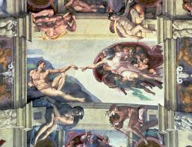
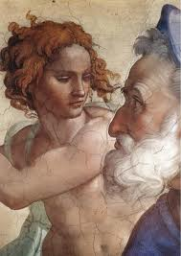
Michelangelo simulation compare your work to Michelangelo’s. What does this activity tell you about his skill as an artist?

