Slide 1
Title your notes
“Scientific Method &
Controlled Experiment “
BIG BOOK

Slide 2

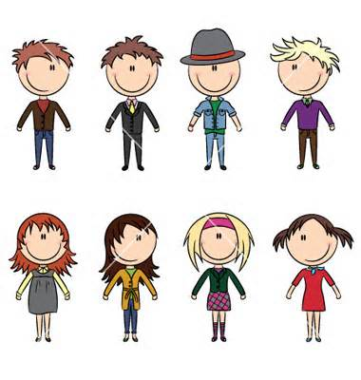
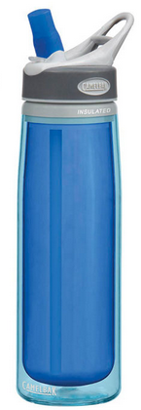
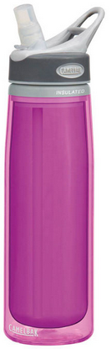
Smithers is trying to increase the productivity of his factory workers. He thinks that a special juice will make his workers work faster. He creates two groups of 50 workers each and assigns each group the same task (in this case, they're supposed to staple a set of papers).
Group A is given 100 mL of the special juice to drink while they work.
Group B is given 100 mL of regular apple juice to drink while they work.

Slide 3
Smithers is trying to increase the productivity of his factory workers. He thinks that a special juice will make his workers work faster. He creates two groups of 50 workers each and assigns each group the same task (in this case, they're supposed to staple a set of papers).
Group B is given 100 mL of regular apple juice to drink while they work.
Group A is given 100 mL of the special juice to drink while they work.
What is the problem Smithers is trying to solve?

Slide 4
Will the special juice increase worker productivity?

Slide 5
Smithers is trying to increase the productivity of his factory workers. He thinks that a special juice will make his workers work faster. He creates two groups of 50 workers each and assigns each group the same task (in this case, they're supposed to staple a set of papers).
Group B is given 100 mL of regular apple juice to drink while they work.
Group A is given 100 mL of the special juice to drink while they work.
What is Smithers hypothesis?

Slide 6
If the workers drink the special juice, then the workers will staple more papers.

Slide 7
Smithers is trying to increase the productivity of his factory workers. He thinks that a special juice will make his workers work faster. He creates two groups of 50 workers each and assigns each group the same task (in this case, they're supposed to staple a set of papers).
This group is called the control group.
Group B is given 100 mL of regular apple juice to drink while they work.
Group A is given 100 mL of the special juice to drink while they work.
Which group is the “normal” group?

Slide 8
Smithers is trying to increase the productivity of his factory workers. He thinks that a special juice will make his workers work faster. He creates two groups of 50 workers each and assigns each group the same task (in this case, they're supposed to staple a set of papers).
This group is called the experimental group.
Group B is given 100 mL of regular apple juice to drink while they work.
Group A is given 100 mL of the special juice to drink while they work.
Which group is the group that is not “normal”? Which one is being tested?

Slide 9
Smithers is trying to increase the productivity of his factory workers. He thinks that a special juice will make his workers work faster. He creates two groups of 50 workers each and assigns each group the same task (in this case, they're supposed to staple a set of papers).
This is called the controlled variables.
Group B is given 100 mL of regular apple juice to drink while they work.
Group A is given 100 mL of the special juice to drink while they work.
What is the same between the 2 group?

Slide 10
Smithers is trying to increase the productivity of his factory workers. He thinks that a special juice will make his workers work faster. He creates two groups of 50 workers each and assigns each group the same task (in this case, they're supposed to staple a set of papers).
This is called the independent variables.
Group B is given 100 mL of regular apple juice to drink while they work.
Group A is given 100 mL of the special juice to drink while they work.
What is the one thing that is different between the 2 group?

Slide 11
Smithers is trying to increase the productivity of his factory workers. He thinks that a special juice will make his workers work faster. He creates two groups of 50 workers each and assigns each group the same task (in this case, they're supposed to staple a set of papers).
This is called the dependent variables.
Group B is given 100 mL of regular apple juice to drink while they work.
Group A is given 100 mL of the special juice to drink while they work.
By giving the workers the special juice, what does Smithers hope will happen?

Slide 12
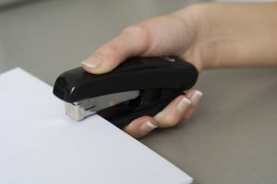
After an hour, Smithers counts how many stacks of papers each group has made.
What should Smithers conclusion be?
Group A made 1,587 stacks
Group B made 2,113 stacks.

Slide 13
The special juice had no affect on increasing worker productivity.

Slide 14



Bart Simpson believes that mice exposed to microwaves will become extra strong. He obtains 20 white mice from the local pet store.
He places 10 mice in a microwave for 15 seconds.
leaves the other 10 mice alone.
What is the problem Bart is trying to solve?

Slide 15
Will mice exposed to microwaves be stronger than those that are not?

Slide 16
Bart Simpson believes that mice exposed to microwaves will become extra strong. He obtains 20 white mice from the local pet store.
He places 10 mice in a microwave for 15 seconds.
leaves the other 10 mice alone.
What is Bart’s hypothesis?

Slide 17
If mice are exposed to microwaves, they will be stronger.

Slide 18
Bart Simpson believes that mice exposed to microwaves will become extra strong. He obtains 20 white mice from the local pet store.
This group is called the control group.
He places 10 mice in a microwave for 15 seconds.
leaves the other 10 mice alone.
Which group is the “normal” group?

Slide 19
Bart Simpson believes that mice exposed to microwaves will become extra strong. He obtains 20 white mice from the local pet store.
This group is called the experimental group.
He places 10 mice in a microwave for 15 seconds.
leaves the other 10 mice alone.
Which group is the group that is not “normal”? Which one is being tested?

Slide 20
Bart Simpson believes that mice exposed to microwaves will become extra strong. He obtains 20 white mice from the local pet store.
This is called the controlled variables.
He places 10 mice in a microwave for 15 seconds.
leaves the other 10 mice alone.
What is the same between the 2 group?

Slide 21
Bart Simpson believes that mice exposed to microwaves will become extra strong. He obtains 20 white mice from the local pet store.
This is called the independent variables.
He places 10 mice in a microwave for 15 seconds.
leaves the other 10 mice alone.
What is the one thing that is different between the 2 group?

Slide 22
Bart Simpson believes that mice exposed to microwaves will become extra strong. He obtains 20 white mice from the local pet store.
This is called the dependent variable.
He places 10 mice in a microwave for 15 seconds.
leaves the other 10 mice alone.
By microwaving the mice, what does Bart think will happen?

Slide 23

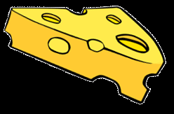
To test if the microwaves had any affect on the mice, Bart places heavy pieces of wood (all of the same weight) that blocked the mice’s food.

Slide 24
He found that 8 out of 10 of the microwave mice were able to push the wood out of the way while 7 out of 10 of the non-microwaved mice were able to do the same.
What should Bart’s conclusion be?

Slide 25
Your Assignment!
Sit with your “can it be replicated” partner.
Take out your notebook. Pick up scissors and tape.
Grab ONE computer, log on and go to school website class page.
Find today’s assignment called “Scientific method & controlled experiment”.
Open the file.
Follow the instructions on the screen.

