Slide 1
Notes Ch.1-2
EQ: How is an organism able to maintain proper conditions? Provide an example

Slide 2
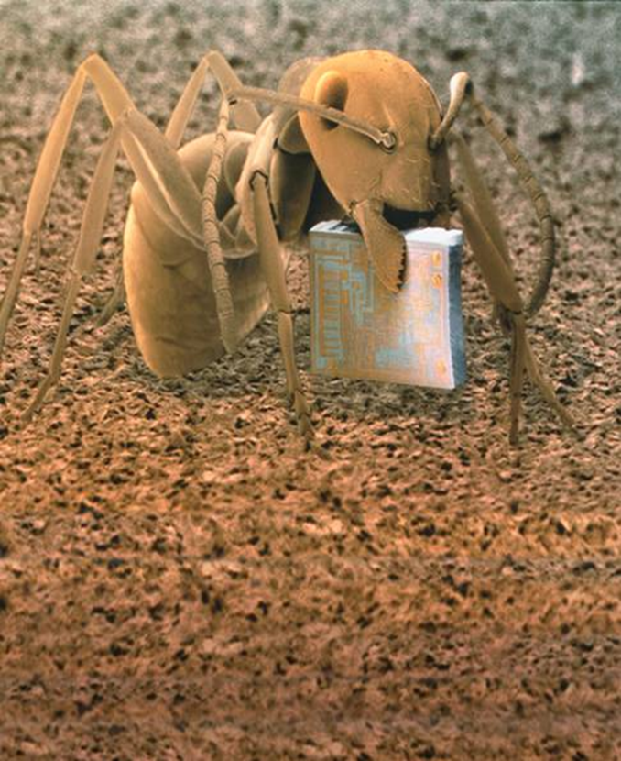
What are the Characteristics of Living Things?
They share the following –
Made up of cells
Reproduce
Based on genetic code
Obtain and use materials and energy
Respond to their environment
Maintain stable internal environment
Change over time

Slide 3
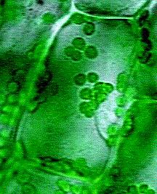
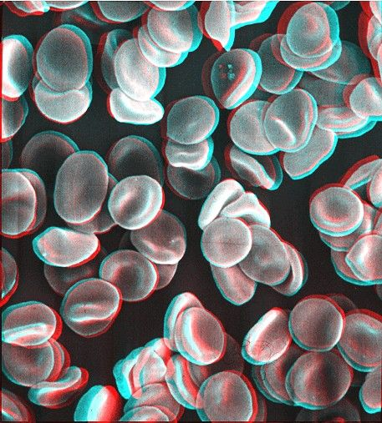
Living Things are Organized
Cell – smallest unit of an organism that carries on the functions of life
These cells have specific functions and take in material and use it in complex ways.
These cells contain hereditary material which contain the instructions for the cells functions

Slide 4
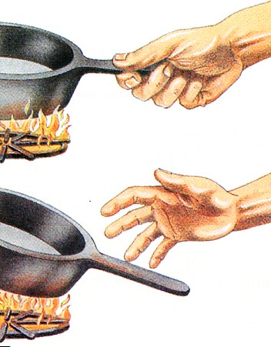
Living Things Respond
Living things are able to interact with their surroundings
Anything that causes some change in a organism is a stimulus.
The reaction to a stimulus is a response
http://www.youtube.com/watch?v=2NvFC-qyatU

Slide 5
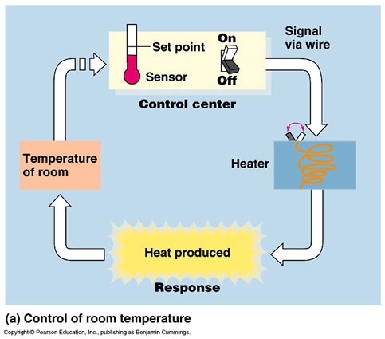
Living Things Respond
Living things also respond to a stimulus that occurs inside them.
An organism’s ability to keep the proper conditions inside no matter what is going on outside the organism is called homeostasis

Slide 6
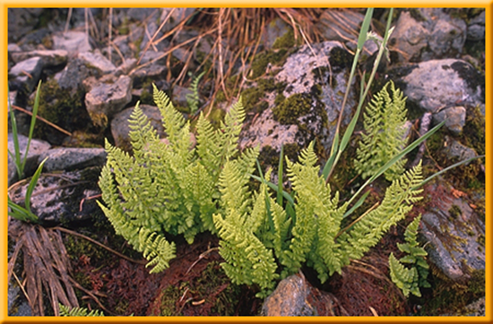
Living things use energy
Majority of organism use energy that comes from the sun either directly or indirectly
Plants use Sun’s energy and Carbon Dioxide to make food

Slide 7
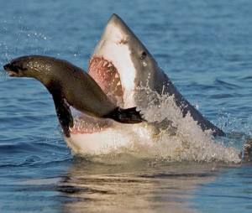
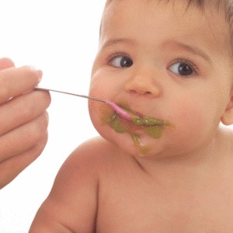
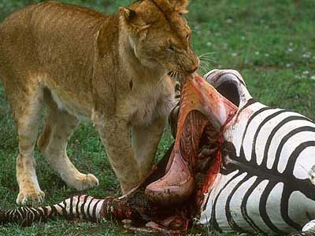
Living Things Use Energy
Humans and other animal organisms can’t use sunlight. Instead you use food as a source of energy.

Slide 8
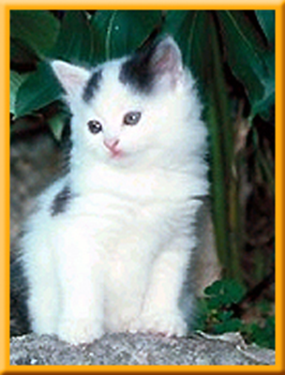
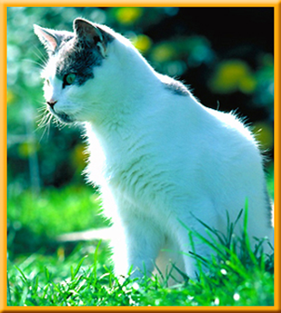
Living Things Grow
Growth is also a characteristic of an organism
Many-celled organisms: growth mostly due to increase in the number of cells
One-celled organisms: growth due to increase in cell size

Slide 9

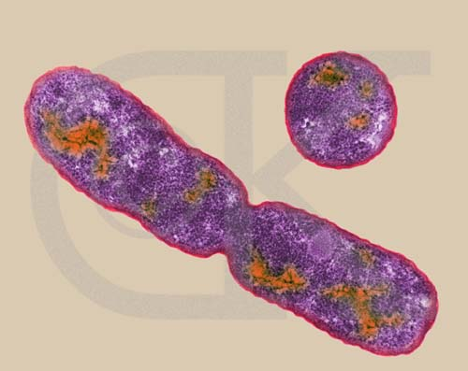
Living Things Reproduce
Cats, dogs, fish, birds, bees and trees all reproduce
Without reproduction, living things would not exist to replace those that die.

Slide 10
Turn to page 32
Homework / Classwork
Chapter Review pg. 32 - 1, 2 , 5, 7, 8, 10, 13, 18
Standardized questions pg. 34 – 1, 6, 9, 10
Write out Question and answer

