Slide 1
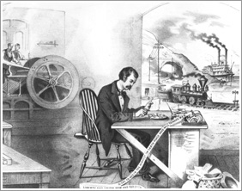
Invention Project
The Industrial Revolution

Slide 2
Standard
10.3.2. Examine how scientific and technological changes and new forms of energy brought about massive social, economic, and cultural change (e.g., the inventions and discoveries of James Watt, Eli Whitney, Henry Bessemer, Louis Pasteur, Edison).

Slide 3
Objective
SWBAT examine how the new inventions of the Industrial Revolution brought many changes to society by creating a invention commercial.

Slide 7
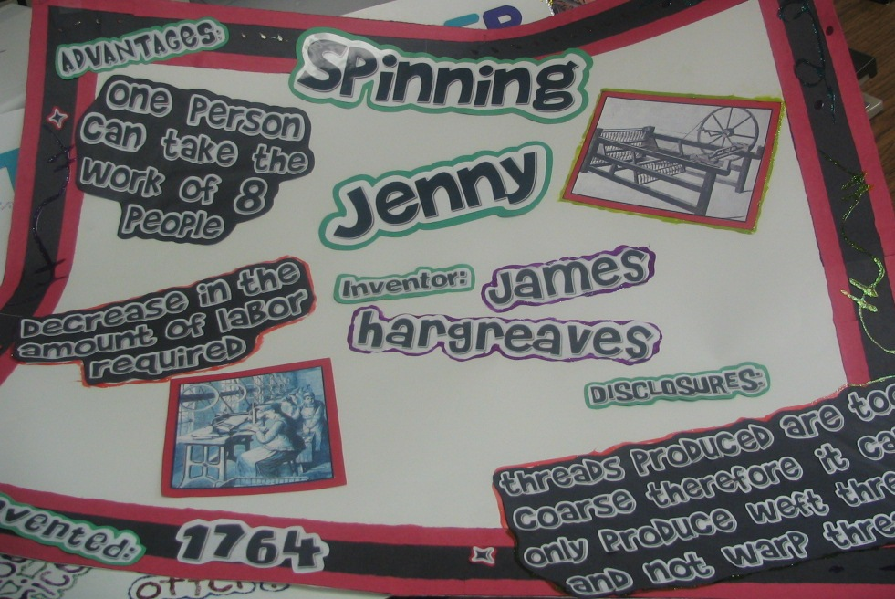
Example

Slide 8
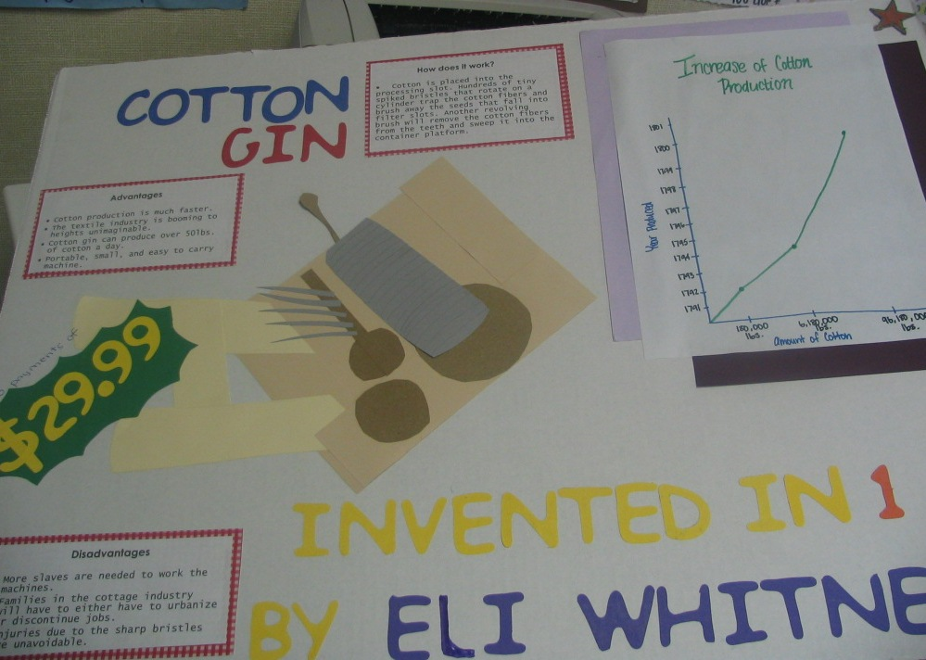
Example

Slide 9
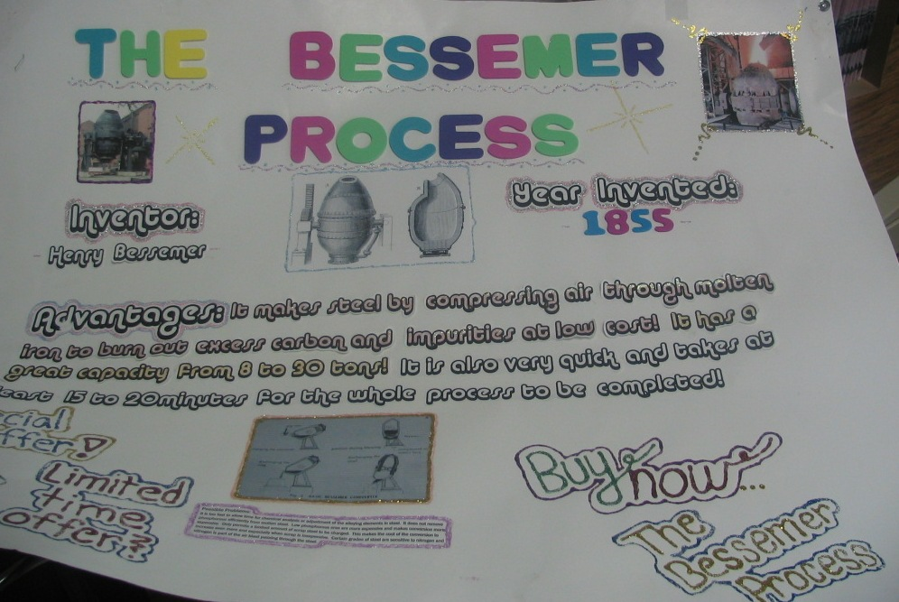
Example

Slide 11
