Slide 1
THE JIM CROW ERA
Segregation and Racism in America

Slide 2
DO NOW: Let’s Take a Look…
Jim Crow Examples:
Intermarriage: The marriage of a person of Caucasian blood with a Negro, Mongolian, Malay, or Hindu shall be null and void. Arizona
Cohabitation: Any negro man and white woman, or any white man and negro woman, who are not married to each other, who shall habitually live in and occupy in the nighttime the same room shall each be punished by imprisonment not exceeding twelve (12) months, or by fine not exceeding five hundred ($500.00) dollars. Florida
Barbers: No colored barber shall serve as a barber [to] white women or girls. Georgia
Burial: The officer in charge shall not bury, or allow to be buried, any colored persons upon ground set apart or used for the burial of white persons. Georgia
What does this say about the nation?
Are these beliefs held around the
country or in specific areas?
How are these laws used? What is their purpose?

Slide 3
Where did it all begin?
FOURTEENTH AMENDMENT (1868)
  Citizenship Clause
  Due Process Clause- prohibits state and local governments from depriving persons of life, liberty, or property without certain steps being taken to ensure fairness.
  Equal Protection Clause-requires each state to provide equal protection under the law to all people within its jurisdiction.
PLESSY VS. FERGUSON (1896)
  Louisiana passed a law requiring railroads to provide “equal but separate accommodations for the white and colored races”
  1896- Supreme court ruled this law did not violate the 14th Amendment.
  UPHOLDS SEPARATE BUT EQUAL.

Slide 4
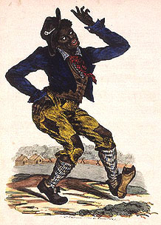

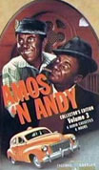
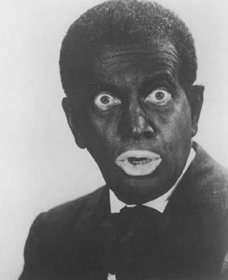
Who is “Jim Crow”?
"Come listen all you galls and boys,
I'm going to sing a little song,
My name is Jim Crow.
Weel about and turn about and do jis so,
Eb'ry time I weel about I jump Jim Crow.“
- The song and dance of Rice, “black face”
A white actor in black face portraying an African
American; highly stereotypical and exaggerated
Black figure that was subject to white humor.

Slide 5
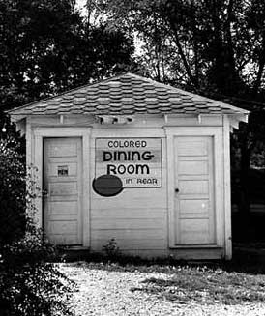

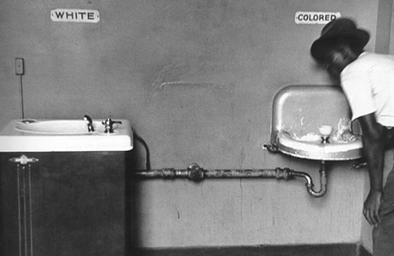
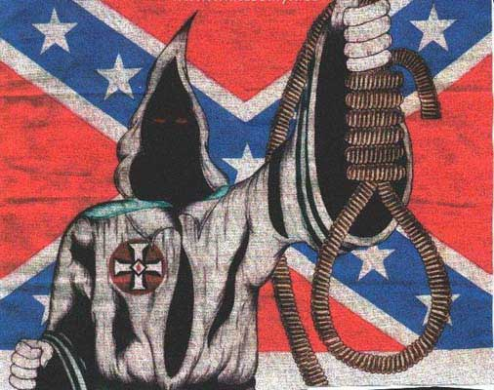
What are Jim Crow Laws?
Series of states’ laws passed throughout the nation (most notably in the South) aimed at separating the races.
Separate facilities provided were always inferior, sometimes absolutely horrific.

Slide 6
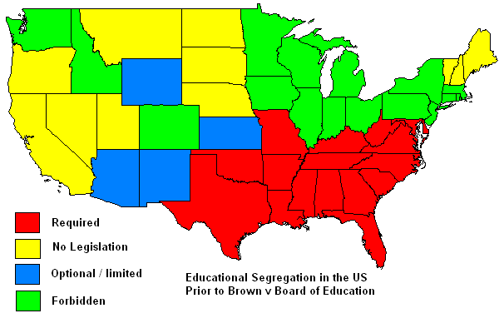
Education

Slide 7
Take the Test…
Will you be granted the right to vote?
Process:
Take off work to go register, potentially get fired. (Bosses who did not fire were harassed)
Fill out an application form, oaths you had to take were four pages long. You had to swear that your answers to every single question were true under penalty of perjury…the information you entered on the form would be passed on to the KKK.
Pass the literacy test.
If you pass and make it past these levels, you will be hunted down by the KKK and often lynched.

Slide 8


