Slide 1
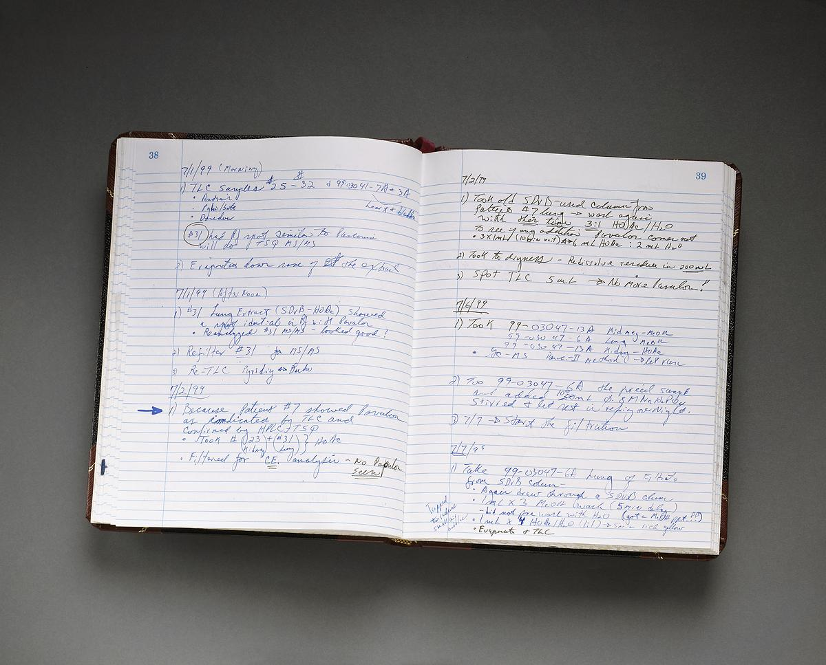
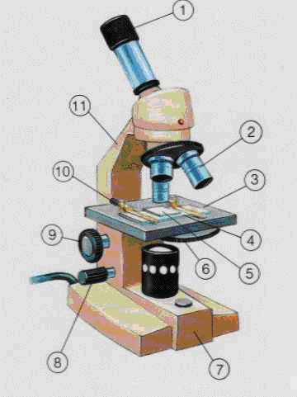
Microscope Notes
Paste this paper into your notebook on the right side.
Write the function of each part on the left.

Slide 2
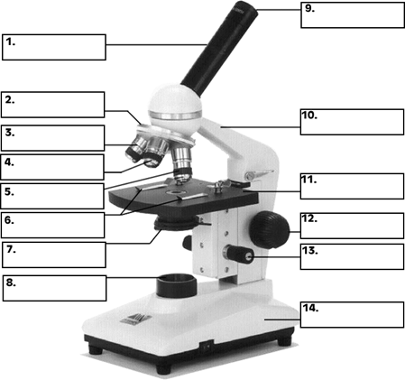
1.
Eye piece
View specimen
Magnification of 10.

Slide 3
2.
Objectives
  Red (small) 4x
  Yellow (medium) __x
  Blue (large) ___X

Slide 4
3.
Stage
Platform where microscope slide is placed.

Slide 5
4.
Stage clip
Secures the microscope slide to the stage.

Slide 6
5.
Microscope slide with cover slip
Secures specimen for viewing

Slide 7
6.
Disc diaphragm
Adjust the amount of light for viewing.

Slide 8
7.
Base
Supports the stage & body of microscope.

Slide 9
9.
Coarse adjustment
Moves stage up & down.
“rough focus”

Slide 10
8.
Fine adjustment
Brings image into a sharper focus.
“fine tune”

Slide 11
10.
Stage adjustment
Moves stage left to right or forward & back.

Slide 12
11.
Arm
Supports body tube.

Slide 13
YOUR DRAW 12.
Nose Piece
Supports the objectives.
Rotates the objectives.

Slide 14
YOU DRAW 13.
Light source
Provide light

Slide 15
You draw 14.
Cord hanger
Hangs the electric cord

Slide 16
Write the steps of how to focus a slide.

Slide 17
How to make a wet mount…
Go to the supply table.
Grab 1 microscope slide.
Use the pipette and place 2 drops of water onto the slide.
Pluck 1 elodea leaf. Lay the leaf flat into the water.
Grab 1 cover slip and cover the leaf.
Go back to seat. Be sure the stage is at its lowest point and the red objective is directly above the stage.
WAIT FOR INSTRUCTIONS!
DO NOT GO ANY FURTHER!

Slide 18
How to focus a slide.
Use the coarse adjustment and lower the stage to its lowest point.
Rotate the nose piece so that the lowest objective (the red one) is above the stage.
Open the stage clip and slide microscope slide onto the stage. Gently let go of the stage clip so that is secures the slide.
Use the stage adjustment to move the microscope slide to that the it is directly above the hole in the center of the stage.

Slide 19
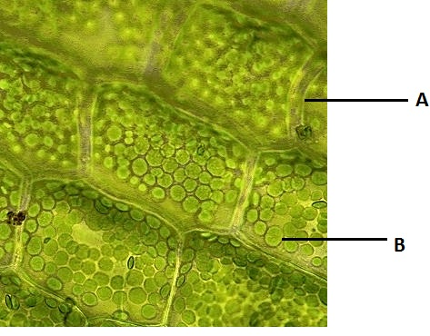

Slide 20
How to focus a slide continued
Use the coarse adjustment to raise the stage.
Watch in the eye piece! Raise the stage until you see “something”. Remember…rough focus.
Now that you see “something” use the fine adjustment and make it even clearer. You should be able to make out what you are looking at.
Now use the nose piece and rotate the objectives to medium magnification. DO NOT MOVE THE STAGE!
Use the fine adjustment and make it even clearer. It should be slightly bigger.

Slide 21
How to focus a slide continued
Now use the nose piece and rotate the objectives to largest magnification. This time WATCH! If your slide has a bump, it could hit the objective. If it looks like its going to hit use the coarse adjustment to move the stage SLIGHTLY…SLIGHTLY! If you move it too much you have to do it all over again.
Use the fine adjustment and make it even clearer. It should be bigger and you should be able to see clearly what the specimen is.

Slide 22
Write the steps of how to remove a slide from the stage of the microscope.

Slide 23
How to remove a slide.
Use the coarse adjustment and lower the stages to its lowest point.
Rotate the nose piece so that the smallest objective is above the stage.
Open the stage clip and slide the microscope slide off the stage.

Slide 24
Got it?
Excellent!
Go to you class page on QUIA and complete the microscope review.

