Slide 1
5.2.1 Draw and label a diagram of the carbon cycle to show the processes involved
Carbon is an essential nutrient that is:
an important component of organisms
a reactant of photosynthesis
a product of cellular respiration
Like other nutrients, carbon must be recycled in ecosystems.
The cycling processes of releasing and re-using essential elements are called .

Slide 2
5.2.1 Draw and label a diagram of the carbon cycle to show the processes involved
The Carbon Cycle:

Slide 3
5.2.2 Analyze the changes in concentration of atmospheric carbon dioxide using historical records
Carbon cycles between .
The amount .
The amount of carbon in the atmosphere has changed over time, why?

Slide 4
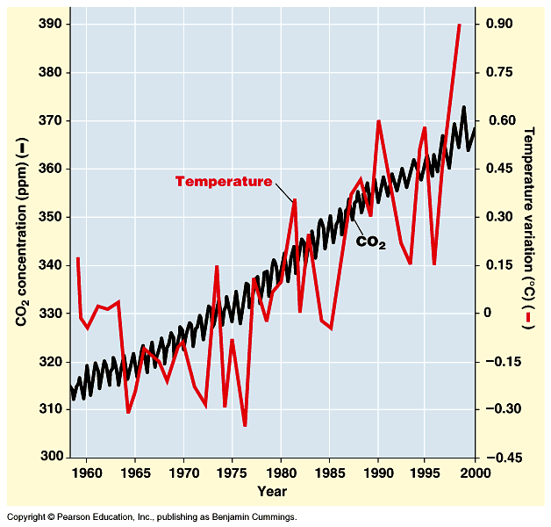
5.2.2 Analyze the changes in concentration of atmospheric carbon dioxide using historical records
The amount of atmospheric CO₂ has been monitored by various stations, one of which is located at .
This station has recorded .

Slide 5
5.2.2 Analyze the changes in concentration of atmospheric carbon dioxide using historical records
Since , CO₂ in the atmosphere has
The most recent sharp rise is attributed to the
Another contributing factors is (cutting of tens of millions of acres of forest each year)

Slide 6
5.2.3 Explain the relationship between rises in concentration of atmospheric carbon dioxide, methane and oxides of nitrogen and the enhanced greenhouse effect.
What is the effect of increasing amounts of CO₂?
Radiant energy from the sun includes:
This energy

Slide 7
5.2.3 Explain the relationship between rises in concentration of atmospheric carbon dioxide, methane and oxides of nitrogen and the enhanced greenhouse effect.
Some of this heat and is
CO₂ is called a because it acts similarly to the glass in a greenhouse -
Other greenhouse gases include
Greenhouse effect is a

Slide 8
5.2.3 Explain the relationship between rises in concentration of atmospheric carbon dioxide, methane and oxides of nitrogen and the enhanced greenhouse effect.

Slide 9
5.2.3 Explain the relationship between rises in concentration of atmospheric carbon dioxide, methane and oxides of nitrogen and the enhanced greenhouse effect.
have amplified the greenhouse effect leading to
Each decade is showing

Slide 10
5.2.3 Explain the relationship between rises in concentration of atmospheric carbon dioxide, methane and oxides of nitrogen and the enhanced greenhouse effect.
Scientists predict a rise of 1.5º to 4.5º C in average world air temps by end of 21st century
Last ice age was only 5º C lower than present but that increase led to ocean levels rising and moving inland by about 100 miles and great changes in species composition

Slide 11
5.2.6 Outline the consequences of a global temperature rise on arctic ecosystems
Consequences of global warming:
Sea levels will rise as polar ice caps and glaciers melt – (breeding grounds for many species of bird, fish, shrimp, crabs – may become extinct)
Shift in global distribution of temps and rainfall –
May have – may wipe out hardwood forests of eastern US
May

Slide 12
5.2.4 Outline the precautionary principle
The Precautionary principle:
Says that (Better safe than sorry!)
Those who wish to

Slide 13
5.2.5 Evaluate the precautionary principle as a justification for strong action in response to the threats posed by the enhanced greenhouse effect
Some people argue against measures to combat global warming because there is no absolute proof that the greenhouse effect is harmful
Counter argument is that by the time there is proof, there will have already been catastrophic consequences to the environment

Slide 14
Other ways humans are impacting ecosystems:
Biological magnification:

Slide 15
DDT was one of the first pesticides and was thought to be harmless. However:
DDT is harmful because:
It is

Slide 16
Because of inefficient energy transfer between trophic levels, herbivores eat large quantities of plant material, carnivores eat larger amounts of herbivores, etc. leading to biological magnification
Higher trophic levels (top carnivores)have highest concentrations in their tissues
DDT continues to accumulate in predator’s body throughout it’s life

Slide 17
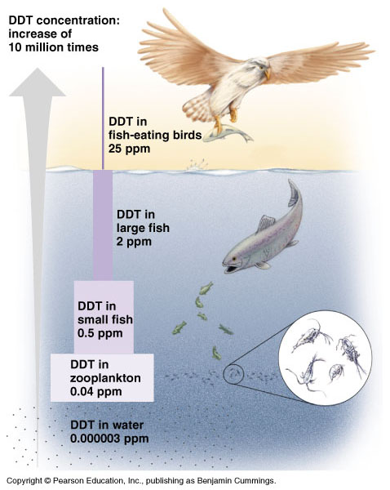

Slide 18
The widespread use of DDT threatened populations of many animals—especially fish-eating birds like the bald eagle—with extinction.
Their eggs were so fragile they did not survive.
By the early 1970s, DDT was banned in the U.S. and in most other industrialized countries; as a result, affected bird populations have recovered.

Slide 19
Acid rain
As humans have moved toward using fossil fuels for energy, acid rain has become a major global issue (in addition to global warming)
The US discharges of sulfur dioxide into the atmosphere each year
90% of sulfur dioxide in atmosphere comes from
Nitrogen oxide is also released from vehicles, power plants and industry

Slide 20
Sulfur dioxide and nitrogen oxide combines with
Acid often falls hundreds or thousands of miles away (pollutants carried by the wind) dissolved in rain (snow, fog) or as microscopic dry particles

Slide 21
Acid eats away statues, buildings, damages trees and crops, kills life in lakes
Lakes become too acid to support life
Acid rain washes away essential nutrients and kills microbes that recycle nutrients
Toxic metals (aluminum, lead, mercury, cadmium) dissolve easier in acid rain and run into lakes and streams – accumulates in fish leading to biological magnification

