Slide 1
The Reagan Years 1981-1989

Slide 2
Background
B-Movie Actor
President of SAG from 1947-1952 & had to testify for HUAC
Married: Jane Wyman
& Nancy Davis, 2 kids
Still the only U.S. President to have been divorced
Nancy “Just say no!”

Slide 3
Governor of California 1967-1975
Republican (Democrat in younger years - left when JFK elected over Nixon)
“Send the welfare bums back to work.”
“I’m going to clean up the mess at Berkeley”
“Pro-life” but signed abortion bill
Law and Order
Pro-Capital punishment

Slide 4
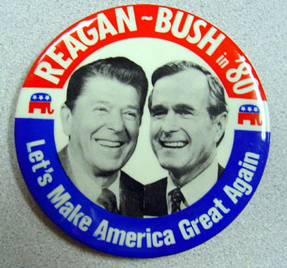
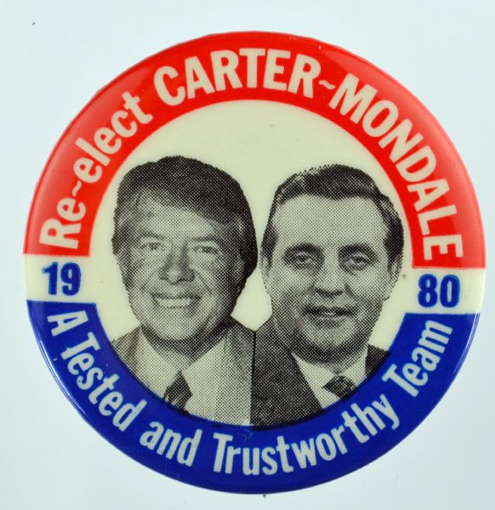
1980 Election “Morning in America”
V.P. George H.W. Bush
Reagan platform:
Lower taxes “Taxpayer’s Revolt” - CA Prop. 13 (Howard Jarvis)
Anti-busing & Affirmative Action – UC Regents v. Bakke (1978)
Deregulation, anti-abortion, anti-ERA, pro-school prayer
State’s rights - reduced government spending – promised a balanced budget
Increased defense spending
Carter was blamed for recession and Iran-Hostage Crisis
“Are you better off than you were four years ago?”

Slide 5
The “Reagan Revolution”
Republicans gain control of Senate for 1st time since 1954
And gain 33 seats in the House?
How did Reagan break the Democratic New Deal coalition?

Slide 6
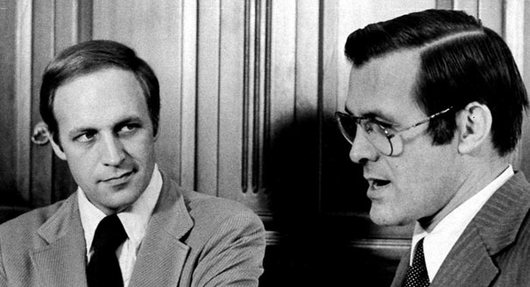
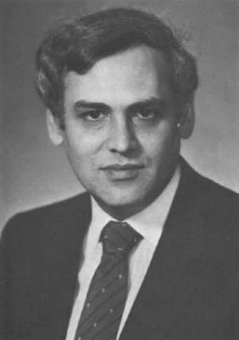
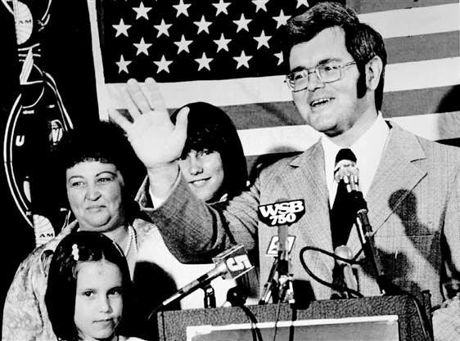
Reagan “Revolution” Coalition
Christian conservatives - “Moral Majority” “Christian Coalition” Support of Televangelists: Jim Bakker, Oral Roberts, Pat Robertson. Anti- “secular humanism” of the Left
2. Neoconservatives - “Neo-cons” & “Hawks” – Cheney, Rumsfeld, Gingrich, Paul Wolfowitz, Richard Perle
3. Corporate Elites - Wealthy business leaders
4. Libertarians (conservative populists
Perle
Jerry Falwell
Pat Robertson
Newt Gingrich

Slide 7
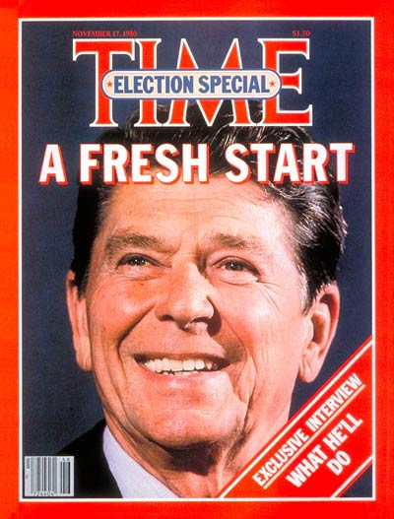
1st Term 1981-1985
Oldest elected president (69 - 73 in ‘84)
"Government is not the solution to our problems; government is the problem.” Problem?
Assassination attempt by March, 1981
Restored confidence & a feeling of the Ike years - 1950s
“The Great Communicator” – Charismatic
Hands-off president
“Surround yourself with the best people you can find, delegate authority, and don't interfere.”
“I have left orders to be awakened at any time in case of national emergency, even if I’m in a cabinet meeting.”
Critics accused him of “acting” the role of president
John Hinkley Jr.

Slide 8
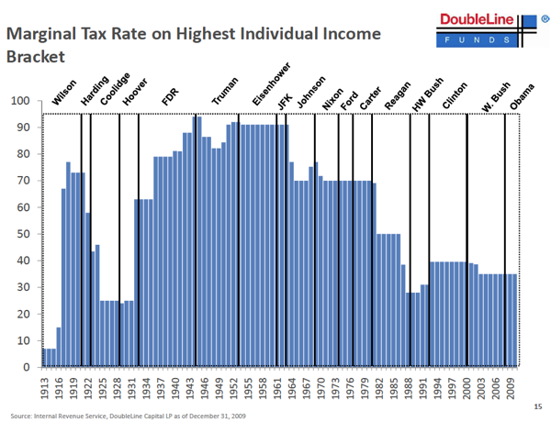
“Reaganomics”
“Supply-Side” Economics - tax cuts to the wealthy - trickle-down theory - similar to Mellon during Coolidge and Hoover admin.
Tax cuts: corporate taxes, capital gains tax, inheritance taxes
Top income levels cut 28%
Cut $40 billion - food stamps, student loans, and public transportation, welfare, LBJ social programs
BUT Increased Defense spending 40% from 1981-1985 "Peace through Strength”
SDI - “Star Wars” speech March 1983
Early crisis - 11% unemployment by 1982
Tax Cuts + Increased defense spending = Extreme national debt - more in 8 years than all of the previous presidents combined $900 billion to $2.7 trillion “Voodoo Economics” – Bush 1980
Recovery by mid-1984 - end of inflation - “Yuppies” - “Greed is good”
Widening gap between rich and the poor
“Peacekeeper Missiles”

Slide 9
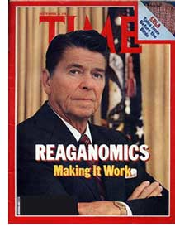
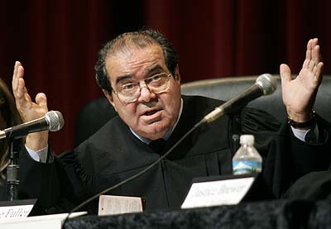

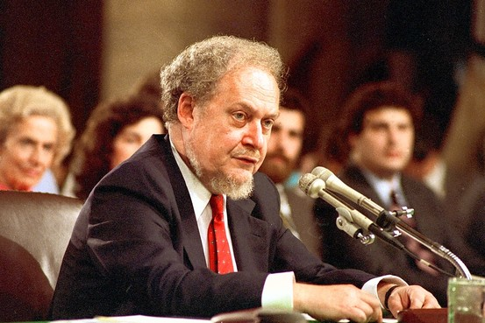
Deregulation & Conservative Supreme Court
Deregulation of Savings and loan
Loosened mergers and takeover restrictions
Cut auto emission and safety regulations
Cut EPA funding and rolled back environmental protections
SUPREME COURT:
Sandra Day O’Conner - 1st woman in 1981
Antonin Scalia (most conservative today)
William Rehnquist as Chief Justice
Senate Rejection of Robert Bork ‘87
Anthony Kennedy (moderate swing voter)

Slide 10
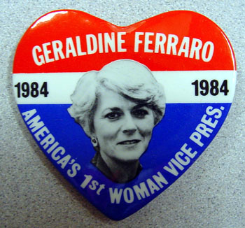
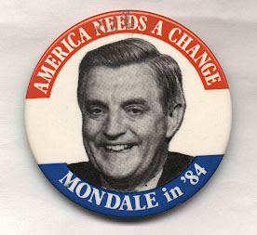
Easily defeats liberal Walter Mondale, Geraldine Ferraro
Becomes 1st female major party VP candidate.

Slide 11
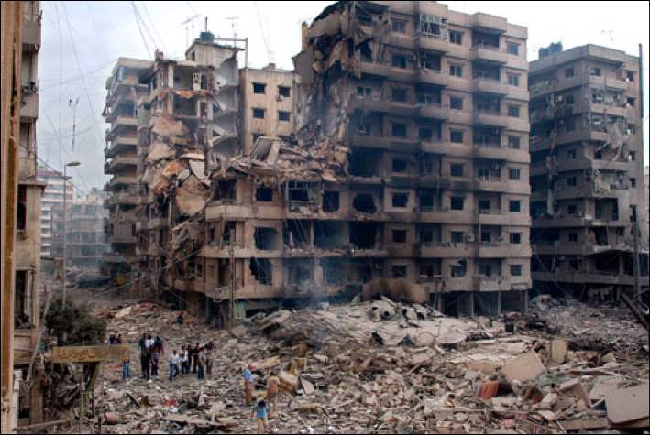
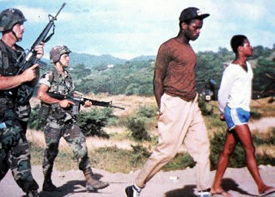
FP - World Events
Reagan Doctrine - US to provide military and economic aid to “freedom fighters” to aggressively fight communist governments in any Third World country
“Rollback” replaces Containment
Beirut barracks bombing 1983 - 241 US soldiers killed
Reagan pulled out (criticized by neo-cons)
Invasion of Grenada 1983 - tiny island pop. less than 100,000 (2 days later)
Bombing of Libya in 1986 in response to terrorist bombing of a Berlin disco
“When our citizens are attacked or abused anywhere in the world on the direct orders of hostile regimes, we will respond so long as I'm in this office.” - Reagan

Slide 12
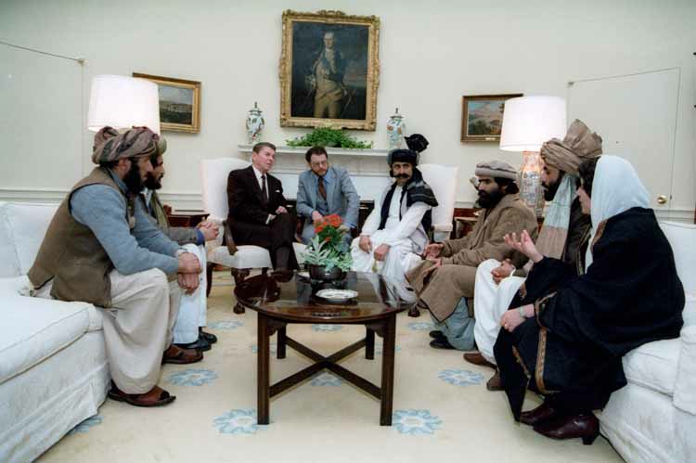
The enemy of my enemy is my friend?
The Reagan administration supports and arms Iraq
in its war with Iran in the early 1980s & funded future Taliban leaders in Afghanistan vs. USSR.

Slide 13
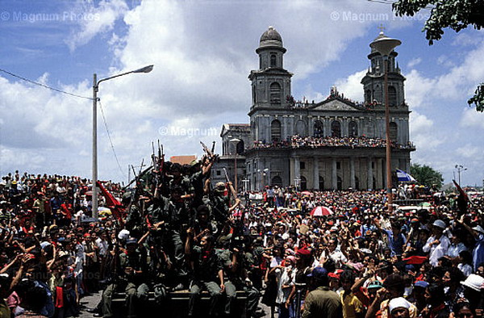
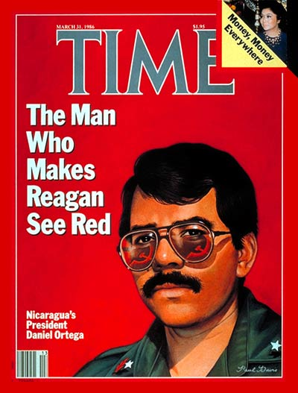
Iran-Contra Scandal
1979 – Sandinistas oust dictator Somoza in Nicaragua
Reagan Doctrine: fund “Contras” – mercenaries to oust Sandinistas and Marxist rebels in El Salvador
Boland Amendment 1985
1986 - Secretly sold weapons to Iran in exchange for 3 hostages and funneled profits illegally to “Contras” in Nicaragua
“I Don’t recall.”- Reagan = “Teflon President”
Approval ratings drop to 36% & Republicans lose control of Senate

Slide 14
Foreign Policy
Hard-line anti-communist
USSR = “Evil Empire”
Cold War = Good vs. Evil Right vs. Wrong
Gorbachev 1985 introduces glasnost & perestroika
Reagan & Gorbachev summit meetings
INF Treaty & 1988 Moscow Summit
Berlin Wall “falls” in 1989 & USSR collapse official by 1991
“Mr. Gorbachev tear down this wall!”

