Slide 1
Parasites: Fish Tapeworm Pork Tapeworm

Slide 2
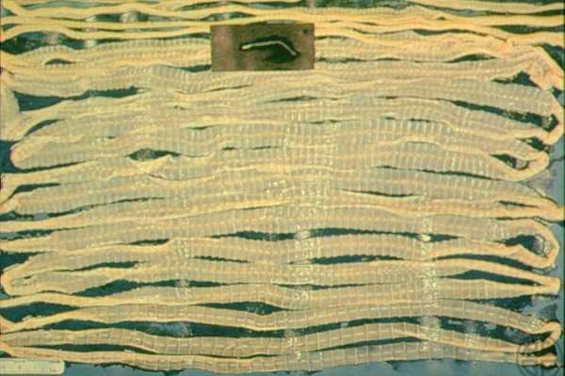
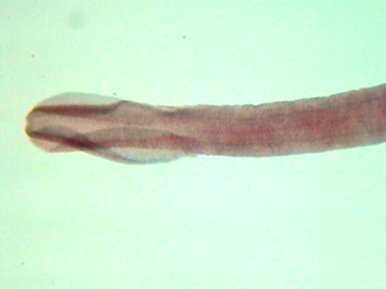
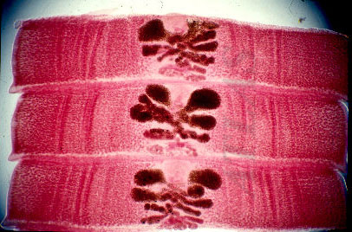
Fish Tapeworm
Scientific name is: Diphyllobothrium latum (just write D. latum, no one in science writes that whole name anyway)
All tapeworms consist of 2 main portions:
Scolex: the attachment organ; varies in the different species of tapeworms
Proglottids: segmented portion of the tapeworm; matures as they get further away from the scolex. Contain reproductive organs.
D. latum may be several meters in length

Slide 3
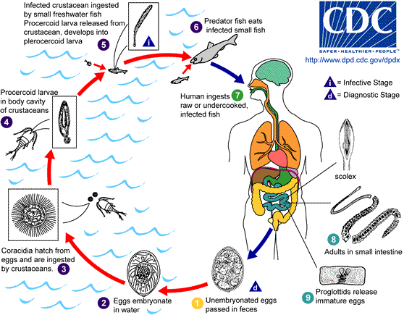
Life Cycle
Coracidium is ingested by a copepod (small water crustacean; 1st intermediate host)
Copepod ingested by fish (2nd intermediate host) and larvae develops further inside the fish.
We ingest infected fish and larva migrates to small intestine. Released eggs passed in feces.

Slide 4
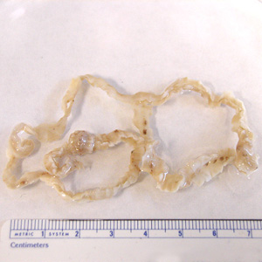
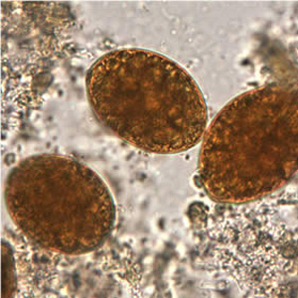
Symptoms
Most infections are asymptomatic.
However symptoms can include:
abdominal discomfort, diarrhea, vomiting, and weight loss
Complications include intestinal blockage and gall bladder disease caused by migration of proglottids

Slide 5
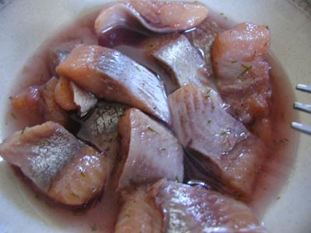

Epidemiology
Parasite is not defined by geographical area and can be found from Alaska, Canada to Peru and other South American countries.
More associated with cultures that eat raw or improperly cooked fish.

Slide 6

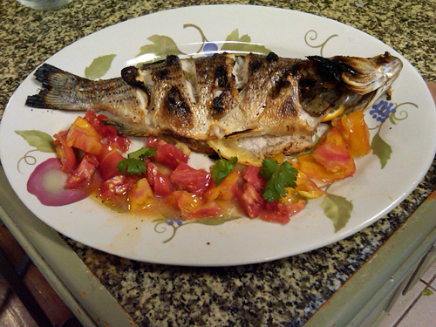
Prevention/ Treatment
Prevention:
Proper disposal of human feces to break cycle
Cooking and handling infected fish properly
Treatment
A single dosage of Praziquantel
Cure rate is over 95%
To get rid of worm, have to be administered a saline purge 1 to 2 hours later to keep it intact.

Slide 7
Group Activity
At your table, talk in a group and come up with some common themes that have been seen in our investigation of all the parasites covered up to this point.
Look at:
Life Cycles
Hosts
Prevention/Treatment
Talk about 1 parasite you think has the biggest repercussions for a community stricken with it.
Take about 5 minutes to discuss and then we will discuss as a class. Each group will share

Slide 8
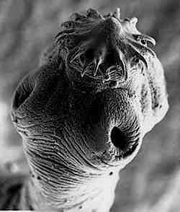
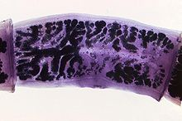
Pork Tapeworm
Scientific name is: Taenia solium
Has 2 different ways that it can infect humans
Ingestion of infected pork
Eggs eaten by human
Like D. latum, proglottids contain both male and female reproductive organs
Scolex bears 4 suckers and also a double crown of hooks

Slide 9
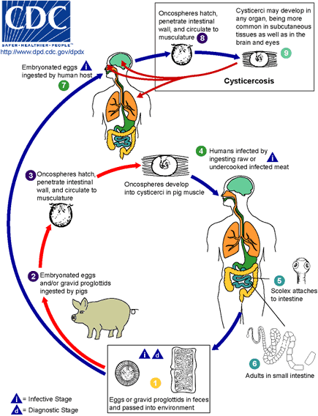
Life Cycle
Intermediate host is the pig
Can get infected by eating infected pork or by ingesting the eggs.
Ingesting the eggs causes Cysticerosis and you get larva formation in muscle and brain.
Tapeworm attaches to small intestine.

Slide 10
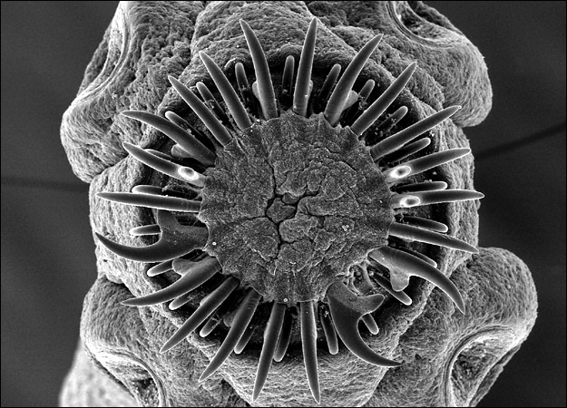
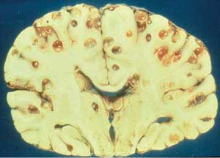
Symptoms
Tapeworm Symptoms:
Asymptomatic and mild symptoms
Can cause digestive problems including abdominal pain, loss of appetite, weight loss and upset stomach.
Cysticercosis Symptoms:
Caused by ingesting eggs
When in the brain may cause seizures and/ or headaches
Other symptoms include confusion, vertigo, brain swelling
Can result in death

Slide 11
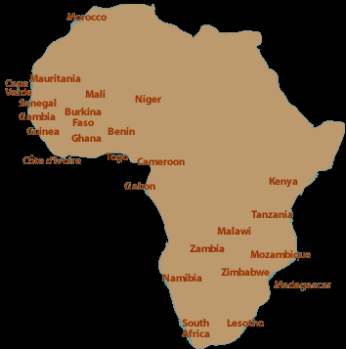
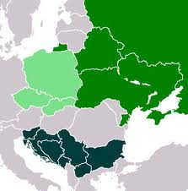
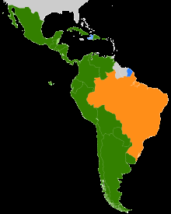
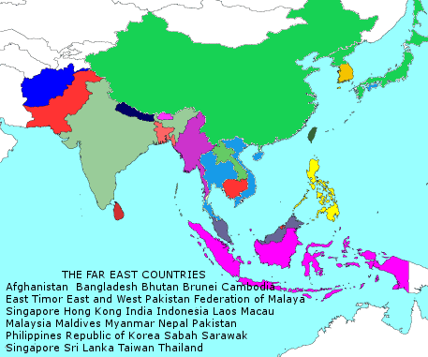
Epidemiology
Occurs in areas with poor sanitary conditions as well as free range pig farms. Area in which it is prevelent: Mexico, Latin America, Slavic countries, Africa, Southeast Asia and China.

Slide 12
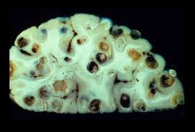
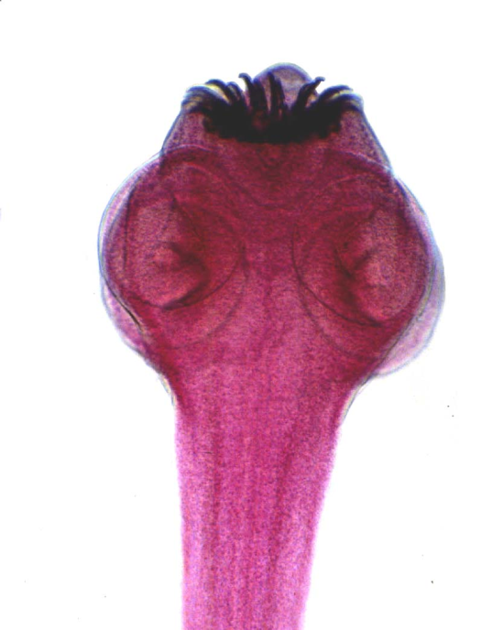
Prevention/Treatment
Prevention:
Cooking of pork or freezing pork for a few days.
If universally practiced would eliminate infection
Treatment:
For tapeworm infection:
Single dose of Praziquantel
Cysticerosis:
Anti-seizure drugs
Different surgical methods to relieve swelling and remove cyst.

