Slide 1

Our numbers expand but Earth’s natural systems do not
Lester R. Brown

Slide 2
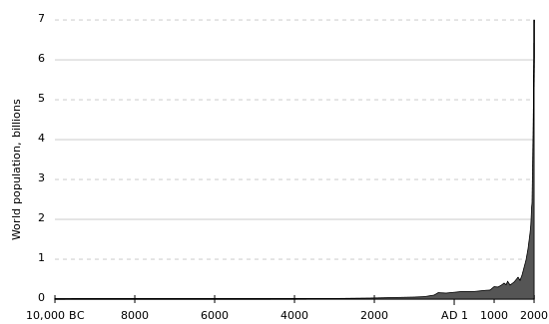
Human Population and Its Impact(6)
We do not know how long we can continue increasing the earth’s carrying capacity for humans without seriously degrading the life-support system for humans and many other species.
For most of history, human population grew slowly. But in the last 200 years, human population has experienced rapid exponential growth. The world’s population is projected to increase from 6.7 billion to 9.1- 9.3 billion between 2006 and 2050.
The addition of 2.4-2.6 billion people by 2050
The debate over interactions among population growth, economic growth, politics, and moral beliefs is one of the most important and controversial issues in environmental science.
Three major factors that account for this population increase:
Humans developed the ability to expand into diverse new habitats and climate zones.
Modern agriculture allowed more people to be feed for each unit of land. (Agricultural Revolution)
Development of sanitation systems, antibiotics, and vaccines. (Industrial Revolution and Modern Medicine)
As a result death rate dropped far below birth rate.

Slide 3
How Many People can the Earth Support?
A brief history:
1. 10,000 years ago when agriculture began there were 5 million humans of the planet.
2. It took until 1927 to get the first 2 billion humans
3. 1977 to get second 2 billion (only 50 years)
4. 2002 to get the third 2 billion (only 25 years)
Here lies the concern!
Reasons the human population has been so dramatic in the last century
The Industrial Revolution
Modern Medicine
Some argue that the planet has too many people.
Some feel that the world can support billions of more people due to technological advances.
There is a constant debate over the need to reduce population growth.
  Must consider moral, religious, and personal freedom.
  Human population growth continues but is unevenly distributed:
  In 2006, the population of developed countries grew exponentially at 0.1% per year.
  Much of the world’s population growth occurs in developing countries like China and India where people are living in acute poverty.. Developing countries grew (15 times faster at 1.5% per year.

Slide 4
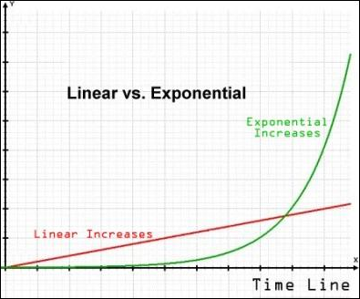
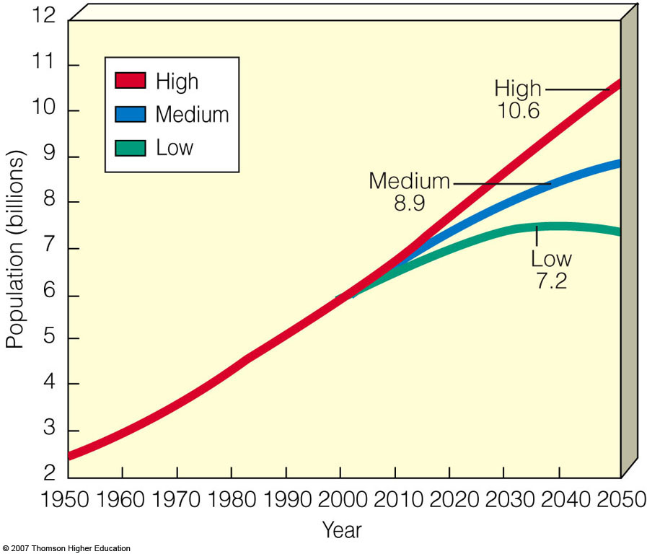
Cultural Carrying Capacity
Cultural carrying capacity is the optimum level that would allow most people to live in reasonable comfort and freedom without impairing the ability of the planet to sustain future generations.
In 1798 Thomas Malthus hypothesized that the human population tends to increase exponentially, while food production tends to increase in a liner rate(slower). Due to genetic and technological advances in the industrialization of food this is not the case. (There have been some drawbacks).
U.N. world population projection based on women having an average of 2.5 (high), 2.0 (medium), or 1.5 (low) children.

Slide 5
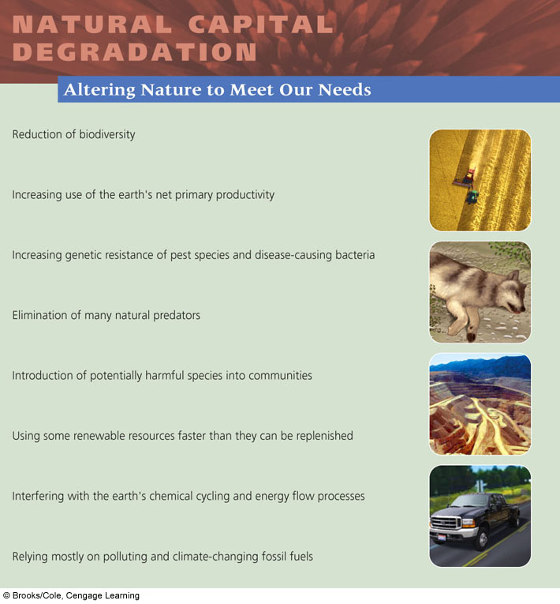

Slide 6
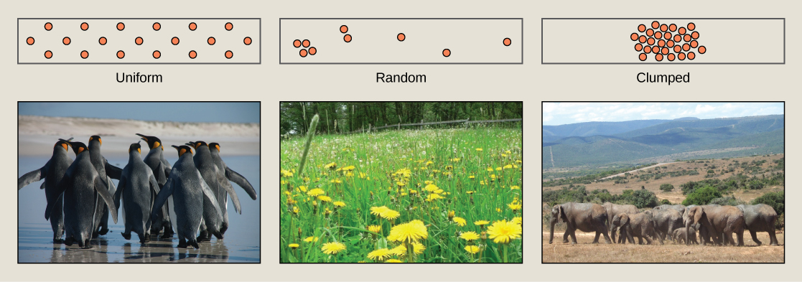
What Limits the Growth of Populations?
Population dynamics is the study of how populations change in response to environmental change like temperature, disease, harmful chemicals, resource availability, and arrival or disappearance of competing species.
Four characteristics that determine how a population responds:
Distribution
Numbers
Age structure
Density
There are three general distribution patterns (dispersion) of individuals within a population
Type: | Example: | Why:
Clumping or patches (most populations) | Wolf pack, Vegetation around water, flocks of birds, schools of fish and herds. | Cluster where their resource is, Searching for resources in groups increase chances of finding them, protection from predators, Group hunting, mating chances and young caring.
Uniform dispersion | Desert plants, organisms in harsh environments | Resources are to scarce to share or animals are territorial
Random dispersion (rare) | Dandelions and other plants. | Seed dispersed randomly by wind

Slide 7

Numbers: Over time the number of individuals in a population will increase, decrease, remain about the same, or go up and down in cycles in response to changes in environmental conditions.
Four variables govern changes in population size:
Births (increase)
Deaths (decrease)
Immigration (increase)
Emigration (decrease)
Instead of using raw numbers, crude birth rates and crude death rates are used (based on total number of births or deaths per 1,000 people in a population).
Population equations:
growth rate = new population
Original population
Growth Rate = (Births + Immigration) – (Deaths + Emigration)
X 100
Population size
or
Growth Rate = (Crude Births rate) - (Crude Death rate)
10 (to adjust the per 1000 to per 100 for %)
Doubling Time (years) = 70
Growth rate
% Change = new – old
old
X 100
Rule of 70

Slide 8
Population Math
The United States has a population growth rate of approximately 2.2 percent. In how many years will the population double if that growth rate remains constant?
At the current rate of population growth, Earth’s population will double in about 64 years. What is the current percentage of the population growth rate.
If a population has a crude birth rate of 15 per 1,000 people, and a crude death rate of 3 per 1,000 people, what is the natural annual percentage increase of its population?
Earth’s current population is almost 7 billion and is growing at an annual rate of 1.1 percent. At this rate of growth, how many people will be added in this next year?
An island off the coast of Costa Rica where 500 birds of a particular species live. Population biologist determined that this bird population was isolated with no immigration or emigration. After one year, the scientists were able to count 60 births and 10 deaths. What is the net growth for this population? What is the doubling time for this population?
A nation currently has a population of 100 million and an annual growth rate of 3.5 percent. If the growth rate remains constant, what will the population of the nation be in 40 years?
If a population of 10,000 experiences 100 births, 40 deaths, 10 immigrants and 30 emigrants in a year, what is the net annual percentage growth rate?
If a population of a country grows at a rate of 5% a year, the number of years required for the pop to double is what?

Slide 9
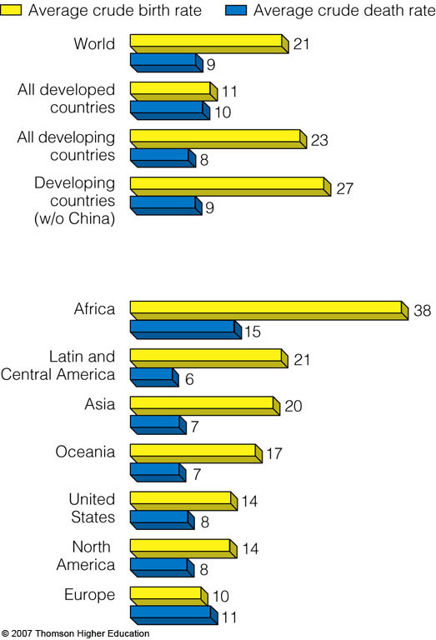
Average crude and birth rates for various groupings of countries in 2006.

Slide 10
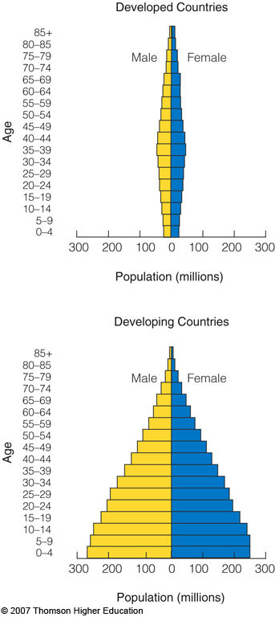
Age Structure
A population’s age structure is the proportion of individuals at various ages and has a strong effect on how rapidly the population increases or decrease in size.
  Pre-reproductive age: not mature enough to reproduce.
  Reproductive age: those capable of reproduction.
  Post-reproductive age: those too old to reproduce.
Growth of populations: Population size will tend to increase if the individuals are mainly in the reproductive age or soon to enter.
Decline of populations: Population size will tend to decrease it the individuals are mainly in the post-reproductive age or soon to enter.
Stability of populations: Population size will remain stable if the individuals are evenly distributed in the three groups.

Slide 11
Population Density
Population density is the number of individuals in a population in a particular area or volume. Density takes into consideration number of individuals and size of habitat.
Density-dependent factors on population:
Predation: High density may shield some members from predators.
Parasitism and infectious disease: High density makes transmission easier.
Competition: High density makes food, space water, sunlight and other resources hard to get.
Sexual reproduction: High density helps in finding mates but increase competition for them.
Density-independent factors on population: Abiotic
Cold, heat, floods, fire, habitat destruction, pollution, etc.

Slide 12
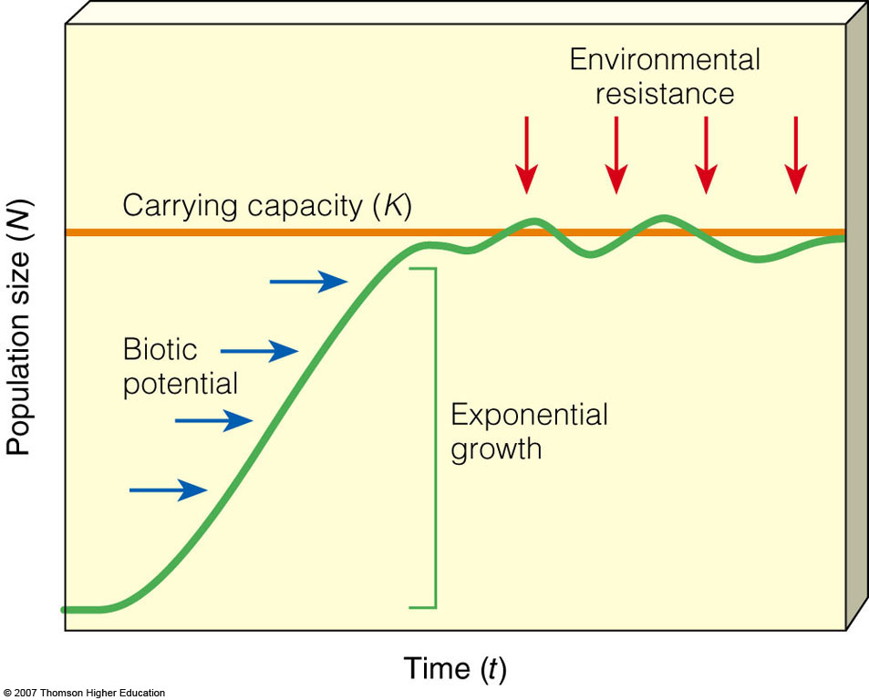
Carrying Capacity (K)
  The intrinsic rate of increase (r) is the rate at which a population would grow if it had unlimited resources. No population can continue to grow indefinitely because of limitations on resources and because of competition among species for those resources.
Carrying capacity: The number of organisms in that population that an ecosystem can support. Therefore the carrying capacity is the largest number a population can grow before members will die due to a lack of resources.
The biotic potential is the capacity of a population to grow under ideal (perfect) conditions.
Environmental resistance is the combination of all factors that act to limit the growth of a population.
Over time species may increase their carrying capacity by developing adaptations.
Some species maintain their carrying capacity by migrating to other areas.
Biotic potential + Environmental resistance = K

Slide 13
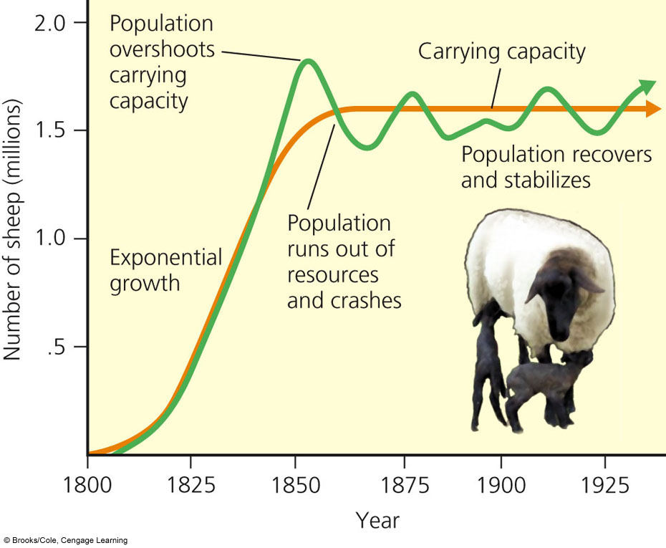
J and S Curve
The J curve is the initial exponential growth of a population towards the carrying capacity.
The initial exponential growth usually results in a overshoot followed by a crash.
The S curve is the stabilization around the carrying capacity. Due to many environmental resistors populations don’t stay exactly at the carrying capacity.
The biotic potential of the common housefly: can lay 120 eggs in each generation. If nothing hurt the eggs or the flies, in 7 generations there would be 6,182,442,727,320 flies. Thank you environmental resistance.

Slide 14
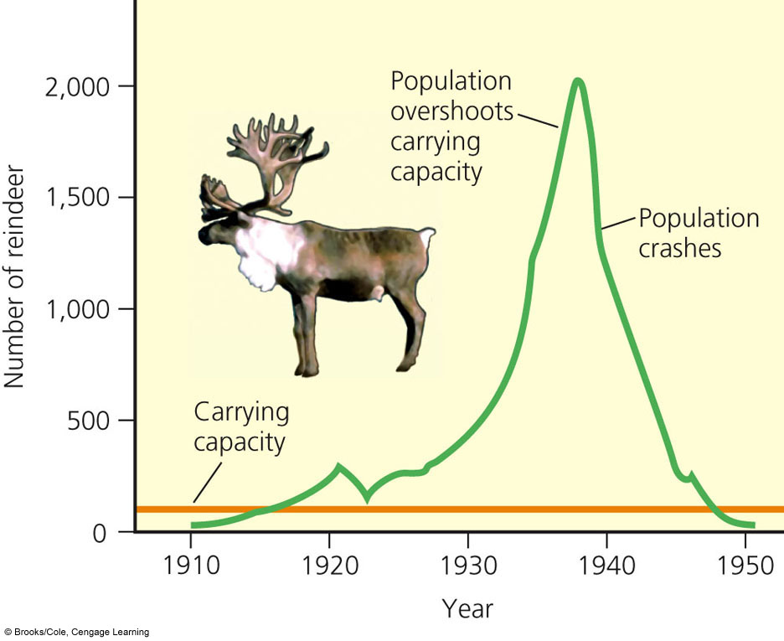
Overshoot and Crash
The overshoot occurs because of a reproductive time lag or the period needed for birth rate to fall and death rate to rise in response to resource overconsumption.
In these case the overshoot is followed by a dieback or crash unless the excess individuals can emigrate to new areas.
The carrying capacity can fluctuate year to year. Environmental change (weather, predators etc.) can increase or decrease the carrying capacity for an area.

Slide 15
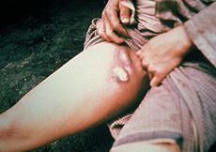
Humans are not Exempt from Population Controls
Although, technological, social, and other cultural changes have extended the earth’s carrying capacity for humans, humans are not exempted from diebacks and overshoot.
Ireland 1845 the potato famine (a fungus killed the plants) 1 million died and 3 million fled.
14th century, the bubonic plague killed 25 million Europeans (30-60%). Rat fleas began to bite humans spreading the disease. Without treatment, the bubonic plague kills about two thirds of infected humans within four days. Because the plague killed so many of the working population, wages rose and some historians have seen this as a turning point in European economic development.
Currently the world is experiencing a global epidemic of eventually fatal AIDS, caused by the HIV (human immunodeficiency virus).
Killed 25 million people (584,000 in the U.S.)
Claims 2.1 million per year or four death per minute.
Buboes on the leg, caused by bubonic plague
Some say we can keep expanding our ecological footprint indefinitely based on technological ingenuity. Other say sooner or later, we will reach the limits that nature always imposes on populations.

Slide 16
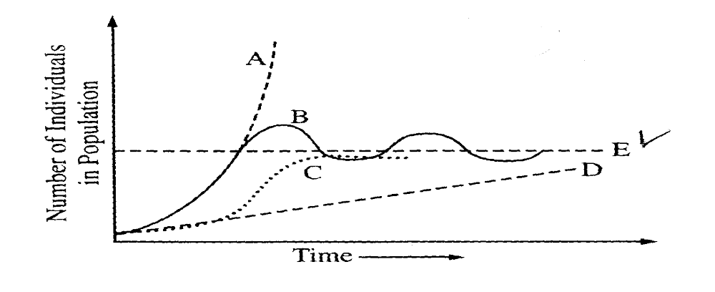
F
G
H
A: Represents the biotic potential of the species
B: Shows how the population overshoots the carrying capacity
C: Represents the logistic growth (A model for a quantity that increases quickly at first and then more slowly as the quantity approaches an upper limit).
D: Represents linear growth
E: Carrying capacity
F: Environmental resistance
G: S-curve, stabilization
H: J-curve, exponential growth

Slide 17
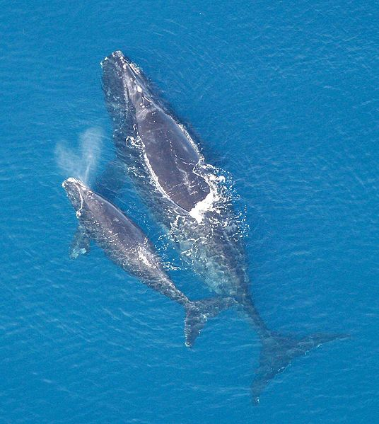
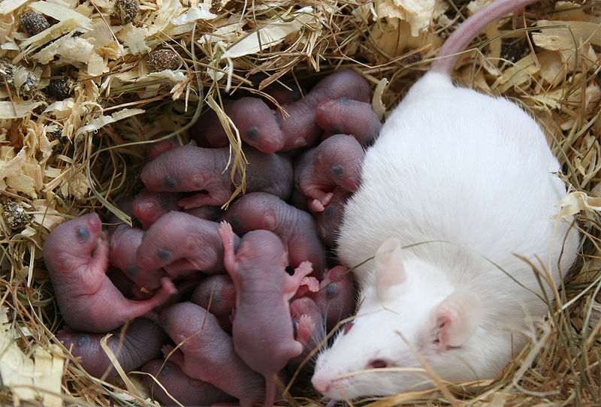
Reproductive Strategies
In ecology, R/K selection theory relates to the selection of combinations of traits in a species that inversely relate parental investment and the quantity and quality of offspring. Each selection seems to promote success in different environments. Neither mode of propagation is intrinsically superior, and they can coexist in the same habitat; e.g., rodents and elephants.
Environmental instability or unpredictability favors R- selection, quick reproduction and renders useless competitive adaptations. In stable or predictable environments, K-selection predominates as the ability to compete successfully for limited resources.
A North Atlantic Right Whale with solitary calf. Whale reproduction follows a K-selection strategy, with few offspring, long gestation, long parental care, and a long period until sexual maturity.
A litter of rats with their mother. The reproduction of rats follows an r-selection strategy, with many offspring, short gestation, less parental care, and a short time until sexual maturity.

Slide 18
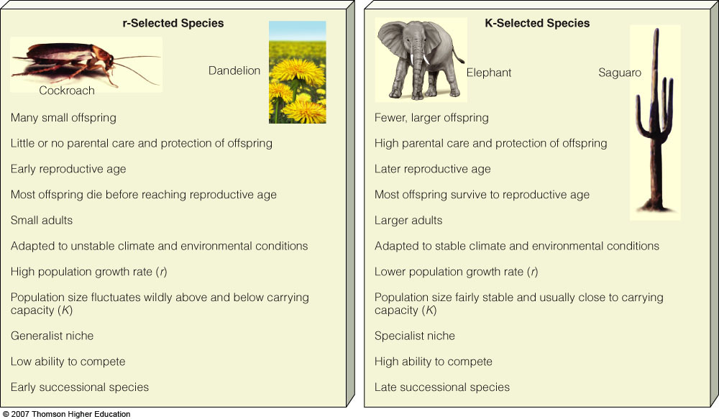
Tend to be Opportunistic
Tend to be Competitors

Slide 19
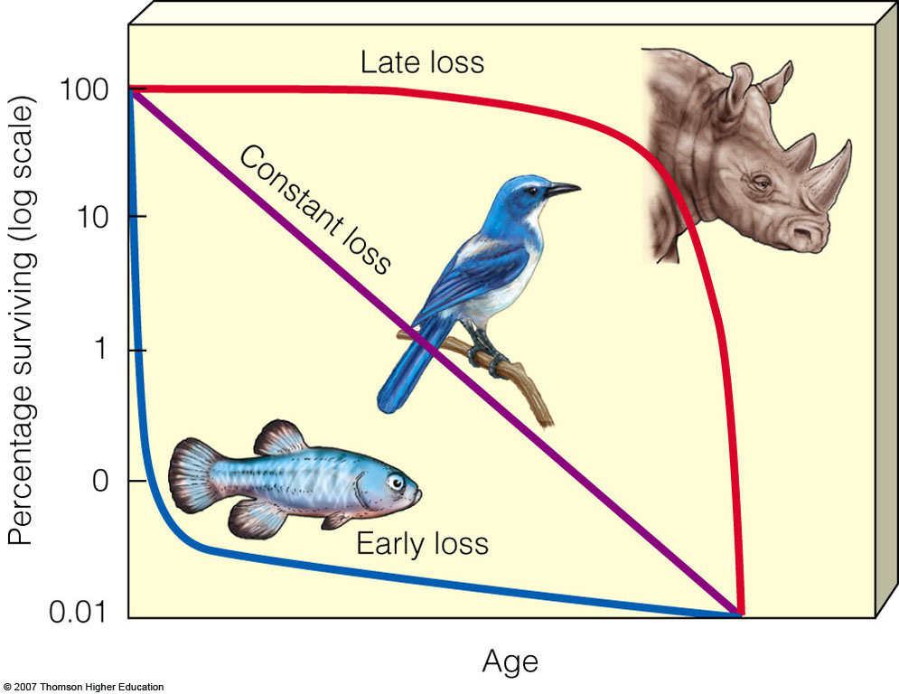
Survivorship Curves
A survivorship curve is a graph showing the number or proportion of individuals surviving at each age for a given species or group.
There are three generalized types of survivorship curves, which are simply referred to as Type I, Type II and Type III curves.
Type I survivorship curves are characterized by high survival in early and middle life, followed by a rapid decline in survivorship in later life. Humans are one of the species that show this pattern of survivorship. (K selected)
Type II curves are an intermediate between Type I and III, where roughly constant mortality rate is experienced regardless of age. Some birds follow this pattern of survival. (mix of R and K)
In Type III curves, the greatest mortality is experienced early on in life, with relatively low rates of death for those surviving. This type of curve is characteristic of species that produce a large number of offspring (R selected)

Slide 20
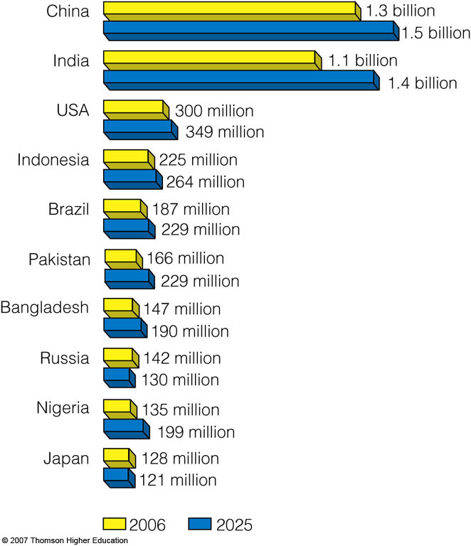
The world’s 10 most populous countries in 2006 with projections in 2025.

Slide 21
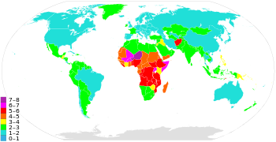
Fertility Rate
Women are having fewer babies but not enough to stabilize the world’s population.
Fertility rate is defined as the number of children born to a woman in her lifetime.
Two types of fertility rates affect a country’s population and growth rate:
  1. Replacement-level fertility (RLF): the number of children a couple must bear to replace themselves. 2.1 in developed countries and up to 2.5 in developing countries. These numbers reflect the fact that some children die before reproductive age.
A world map showing global variations in fertility rate per woman
  2. Total fertility rate (TFR): the average number of children a woman has during her reproductive years currently 2.6 (still above the replacement fertility rate).
Since 1950
Developed countries 2.5 down to 1.6
Developing countries 6.5 down to 2.8

Slide 22
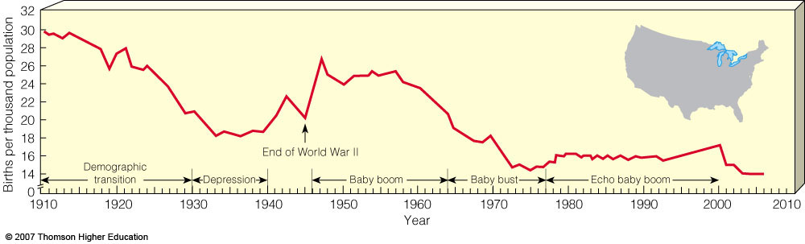
Population of the U.S.
The United States population is growing faster than that of any other developed country. Nearly 2.9 million people were added to the U.S. in 2008:
  59% occurred because of births outnumbering deaths.
  41% came from illegal and legal immigration.
Changes in lifestyle in the U.S. during the 20th century: In 1907:
The leading causes of death were pneumonia, tuberculosis and diarrhea.
90% of doctors had no college education
20% of adults could not read or write
6% of Americans graduated from high school
Average salary $200-400 a year (22 cents an hour)
9000 cars and 144 miles of road
30 people lived in Las Vegas
Marijuana, heroin and morphine were over the counter drugs.
230 reported murders

Slide 23
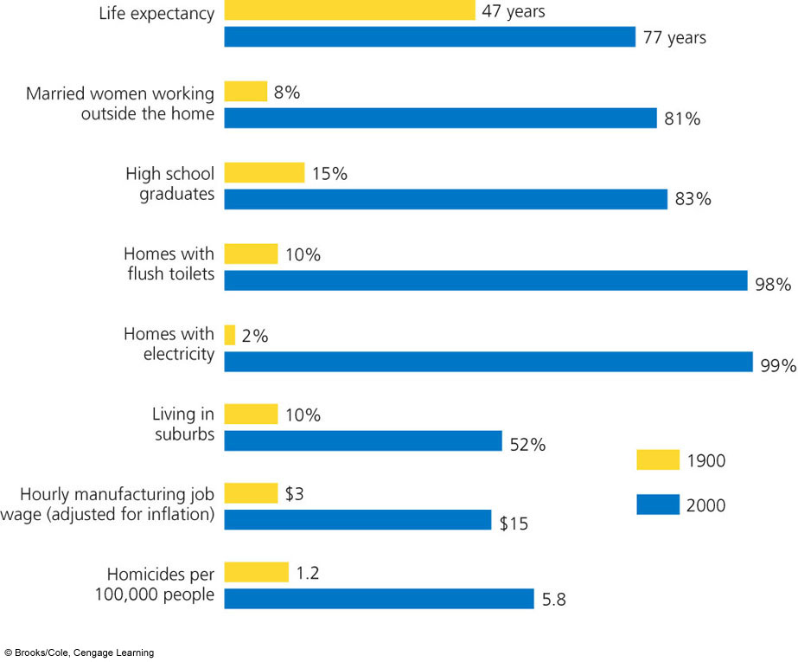

Slide 24
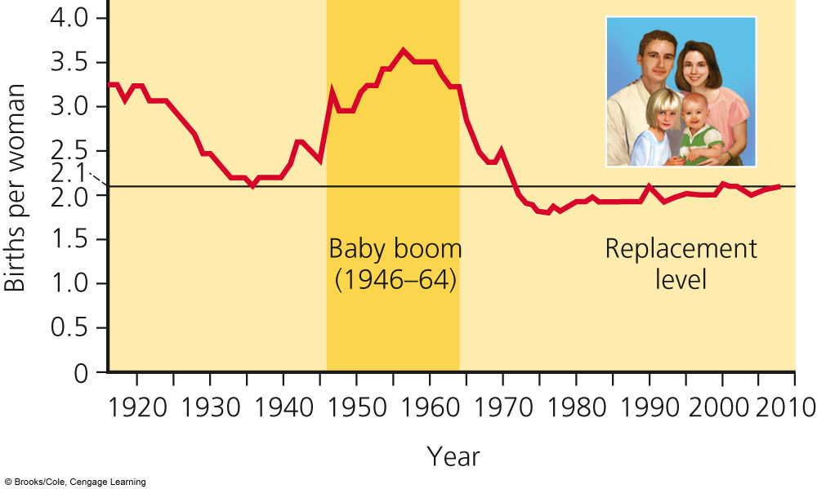
The U.S. Baby Boom and Bust
The end of World War II brought a baby boom to many countries, especially Western ones.
The baby bust that followed the baby boom was largely due to delayed marriage, contraception, and abortion.

Slide 25
Factors Affecting Birth Rates
The number of children women have is affected by:
  The importance of children in the work force (Increase birth rates in developing countries) More industrialization, less agriculture
  The cost of raising and educating them (lowers birth rates in developed countries) Costs $290,00 to raise a child for birth to 18 in the U.S
  Availability of pensions ( in developed countries, pensions reduce the need to have many children to support them in later life)
  Urbanization (urban living allows for family planning) control fertility, choose number of children to have
  Education and employment opportunities for women (TFR tends to be low when women have education and employment opportunities outside the home) In all societies better educated women tend to marry later and have fewer children by and average of two children less.
  Infant deaths (infant mortality rate: the number of children per 1,000 that die before the age of 1) Low infant mortality rates lowers the TFR.
  Marriage age or average age women have their first child (Longer they wait the fewer children they have)
  Availability of contraception and abortion (less available in developing countries) control fertility, choose number of children to have
  Religion, and culture (some favor large families)
The most important factor in reducing TFR is lowering infant mortality rate followed by education and employment for women.

Slide 26
Factors Affecting Death Rates
The world’s population growth has been caused largely by the decline in crude death rates.
Death rates have declined because of:
  Increased food supplies, better nutrition and distribution.
  Advances in medicine (immunizations and antibiotics).
  Improved sanitation and personal hygiene (stopped the spread of disease).
  Safer water supplies (stopped the spread of disease).
U.S. infant mortality rate is high due to
  Inadequate health care for poor women during pregnancy and their infants
  Drug addiction among pregnant women
  High birth rate among teenagers
The overall health of a region is based on life expectancy and infant mortality rate.
Infant mortality rate 1965 and 2008
Developed countries 20 to 6.3
Developing countries 118 to 59
If a mother lives in an area with a high infant mortality rate she will tend to have a lot of children to ensure some will make it to adulthood.

Slide 27
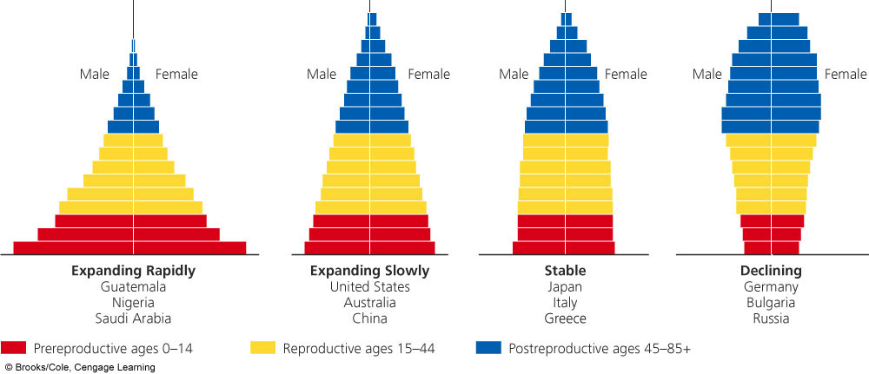
How Does Age Structure Predict Population Changes
The Age structure, the numbers of males and females in young, middle, and older age groups determine how fast a population grows or declines.
Population experts construct age structure diagrams by plotting the percentages of males and females in each age category:
  Pre-reproductive ages (0-14)
  Reproductive ages (15-44)
  Post-reproductive ages (45 and up)

Slide 28
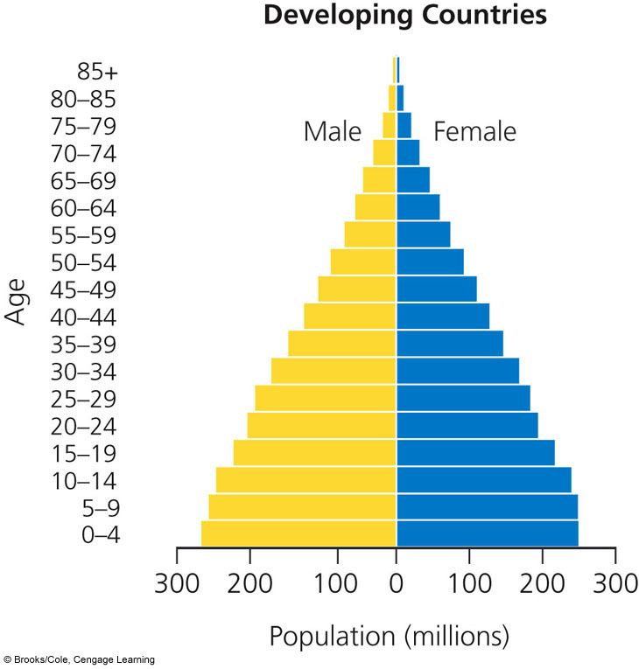
Expanding Rapidly (Young and Growing)
Seen in developing Populations with a large proportion of its people in the pre-reproductive ages 0-14 have a large potential for rapid population growth. These individuals will soon be having children. Easy to identify based on it broad base (pyramid shaped)
Birth rate exceeds the death rate. Population is getting larger. Kenya, Nigeria and Saudi Arabia.
Have high infant mortality rates because:
Unindustrialized
Contaminated drinking water
Poor nutrition
Lack of food
Poor or no health care
Few or no educational opportunities for women.
They have a high TFR based on high IMR.
32% of the people in developing countries were under 15 years old in 2006 versus only 17% in developed countries.

Slide 29
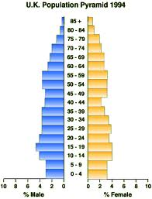
Zero Growth/Slow Growth
Birth rate almost equals death rate. The population is not getting any larger or is growing very slowly. Histogram shape is straighter and more box-like until about age 45-85.
U.S., Australia & Canada has slow
Denmark, Austria and Italy has stable
Infant mortality rate is low:
Industrialized
Clean drinking water
Good nutrition
Ample food supplies
Good health care
Good educational opportunities for women.
The have a low TFR based on low IMR.
Zero Population Growth (ZPG)- When the number of births, equals the number of deaths. No growth in the population.

Slide 30
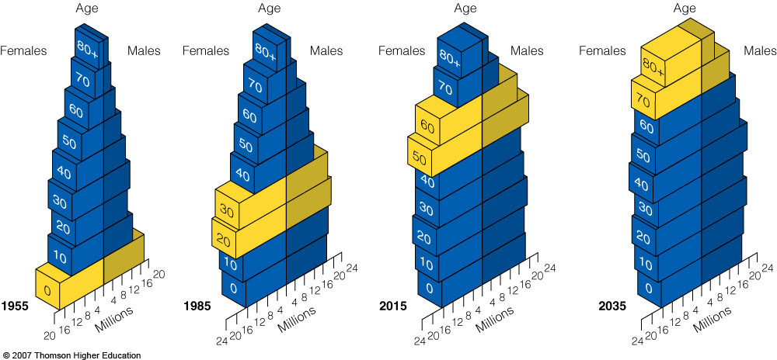
The Baby Boomers
Changes in the distribution of a country’s age groups have long-lasting economic and social impacts. Today, baby boomers make up nearly half of all adult Americans and dominate the populations demand for goods and services.
Because of the ‘Baby Boom’ the U.S. has a bulge in the pyramid with people in their 50’s-60’s.
There are also more women than men in the older age group because of differences in longevity between the sexes. The US has a high % of retired people because of long life expectancy. This makes us realize the importance of social security, etc.

Slide 31
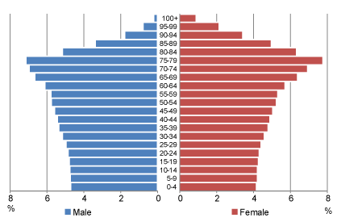
Declining
When the birth rate is smaller than the death rate. The pyramid bulges near the top or is inverted. Occurs mainly in older developed countries.
Ex. Germany, Bulgaria, Japan & Hungary.
Some causes:
People don’t want to have kids
The TFR falls to 1.5
People decide to travel and dedicate to careers
Kids are expensive
A negative world outlook
Top-heavy population pyramid with higher proportions in older age groups indicates a declining population. This may result from a long period of below replacement fertility, alongside low death rates.

Slide 32
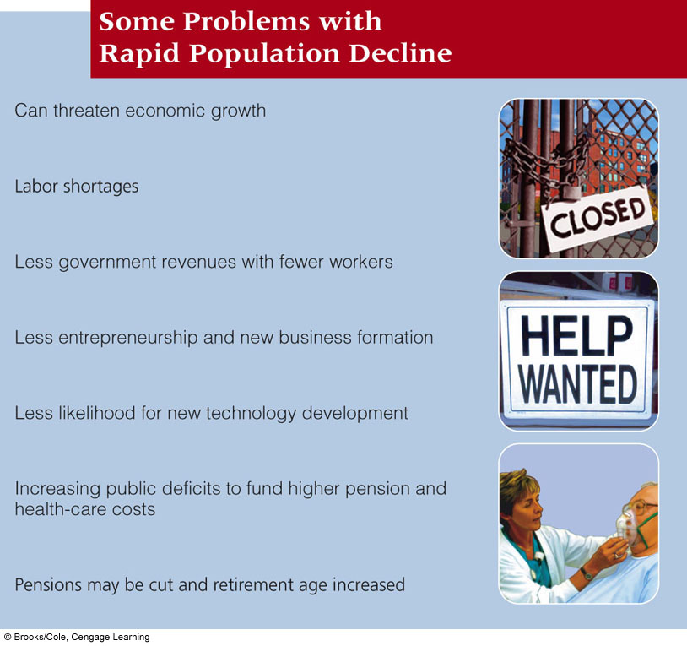

Slide 33
How Can We Slow Human Population Growth?
Experience indicates that the most effective ways to slow human population growth are to encourage reduce the infant mortality rate, family planning, to reduce poverty, and to elevate the status of women.
Demographic Transition: As countries become economically developed, their birth and death rates tend to decline. As countries becomes industrialized their birth rates decline.
  Preindustrial stage: little population growth due to high infant mortality. Harsh living conditions lead to a high birth rate and high death rate. Thus, there is little population growth.
  Transitional stage: industrialization begins, death rates drops and birth rates remain high. As industrialization begins, food production rises and health care improves.
  The population grows rapidly.
  Industrial stage: Industrialization is wide spread. Birth rate drops and approaches death rate. This is because of:
  1. Better access to birth control
  2. Decline in the infant mortality rate increased job opportunities for women
  3. The high cost of raising children who don’t enter the work force until after high school or college.
Postindustrial stage: The birth rate declines even further, equaling the death rate and thus reaching zero population growth. Then, the birth rate falls below the death rate and the total population size slowly decreases. 37 countries have reached this stage. (mainly in W. Europe). To most population experts, the challenge is to help the remaining 88% of the world to get to this stage.

Slide 34
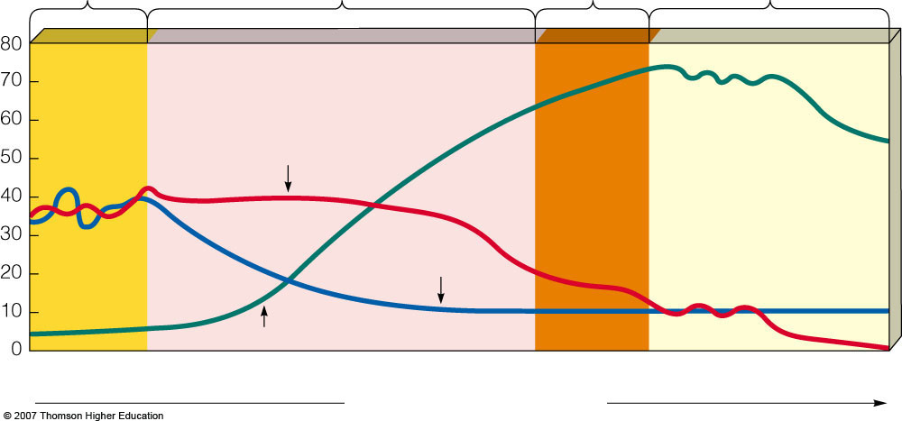
Stage 1
Preindustrial
Stage 2
Transitional
Stage 3
Industrial
Stage 4
Postindustrial
High
“Tribal”
Mexico, China and India
Birth rate
U.S.
Japan and places with castles
Birth rate and death rate
(number per 1,00 per year)
Relative population size
Death rate
Total population
Low
Low
Increasing
Very high
Decreasing
Low
Zero
Negative
Growth rate over time
Population
grows very
slowly because
of a high
birth rate
(to compensate
for high infant
mortality) and a
high death rate
Population growth slows as both birth
and death rates drop because of improved food production, health, and education
Population growth levels off and then declines as birth rates equal and then fall below death rates
Population grows rapidly because birth rates are high and death rates drop because of improved food production and health care

Slide 35
Other Slowing Methods
Besides moving through demographic transition, other strategies are being employed to slow human population growth.
The best way to slow population growth is a combination of:
  1. Investing in family planning. Family planning has been a major factor in reducing the number of births and abortions throughout most of the world.
  2. Reducing poverty decreasing the infant mortality rate.
  3. Elevating the status of women. Educated, Hold a paying job outside the home and do not have their human right suppressed
“For poor women the only holiday is when you are asleep”
in India is based on efforts largely sponsored by the Indian government. In the 1965-2009 period, contraceptive usage has more than tripled (from 13% of married women in 1970 to 48% in 2009) and the fertility rate has more than halved (from 5.7 in 1966 to 2.6 in 2009), but the national fertility rate is still high enough to cause long-term population growth. India adds up to 1,000,000 people to its population every 15 days.

Slide 36
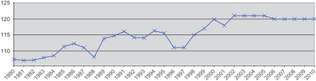
China’s Policy
The one-child policy, officially the family planning policy, is the population control policy of the People's Republic of China. Many demographers consider the term "one-child" policy a misnomer, as the policy allows many exceptions: rural families can have a second child if the first child is a girl or is disabled. Families in which neither parent has siblings are also allowed to have two children. Residents of the Special Administrative Regions of Hong Kong and Macau, and foreigners living in China are also exempt from the policy.
This policy was introduced in 1979 to alleviate social, economic, and environmental problems in China. Demographers estimate that the policy averted 200 million births between 1979 and 2009. The policy is controversial both within and outside China because of the manner in which the policy has been implemented, and because of concerns about negative social consequences. The policy has been implicated in an increase in forced abortions, female infanticide, and underreporting of female births, and has been suggested as a possible cause behind China's sex imbalance.
Sex ratio at birth in mainland China, males per 100 females, 1980–2010

Slide 37
Has it Worked for China?
Currently, China’s TFR is 1.6 children per women.
China has moved 300 million people out of poverty.
Problems:
  Strong male preference leads to gender imbalance.
  Male children sometimes are fed better than female children.
  Female babies are sometimes killed or sold.
  Female babies are aborted at a much higher rate than males, often time forced upon women by family members.
  Average population age is increasing.
  Not enough resource to support population.
  Pressures on social system and healthcare
  Reduced work force
Gross domestic product (GDP) is the market value of all officially recognized final goods and services produced within a country in a year, or other given period of time. GDP per capita is often considered an indicator of a country's standard of living.

Slide 38
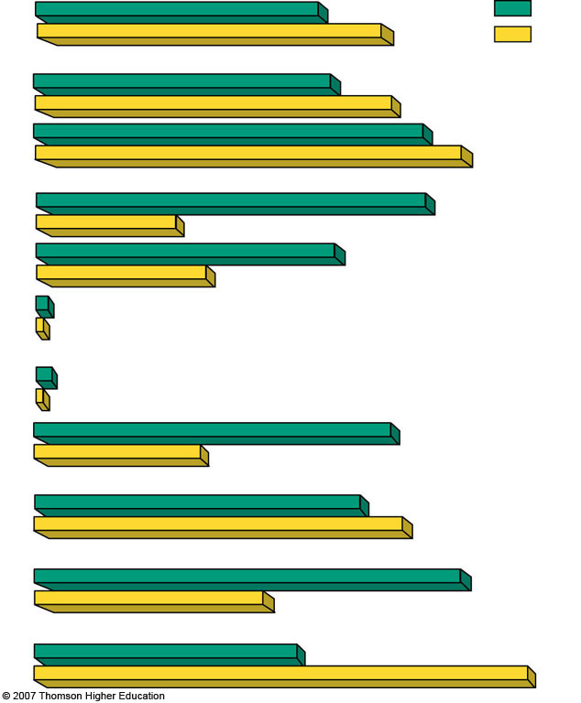
Percentage
of world
population
17%
India
20%
China
Population
1.1 billion
1.3 billion
Population (2050)
(estimated)
1.4 billion
1.6 billion
Illiteracy (% of adults)
47%
17%
Population under age 15 (%)
36%
20%
Population growth rate (%)
1.6%
0.6%
Total fertility rate
2.9 children per women (down from 5.3 in 1970)
1.6 children per women (down from 5.7 in 1972)
Infant mortality rate
58
27
62 years
Life expectancy
70 years
Percentage living
below $2 per day
80
47
GDP PPP per capita
$3,120
$5,890

Slide 39
Government Incentives
Family planning incentives: Make family planning more accessible, subsidized (cheaper), or free:
1. Free clinical services and birth control
2. Free education about birth control
3. Subsidized birth control and education.
Economic rewards or penalties:
1. Monetary compensation to individuals that are sterilized and paid leave from work for women getting fertility operations.
2. Removing income tax deductions for more than one child.
3. For families of 0-1 children
Free-health care for families
Free higher education for women and children
Increased social security or pension
Better job opportunities for women or couples and their one child
Monetary bonus at the of each year of every month
Government subsidized housing
Additional food rations
4. Pay an extra government tax for each child over your first.
Other methods:
1. Raise legal marriage age, reducing number of children and increase age of first.

Slide 40
Developing Countries
China is the largest but has taken drastic population control methods. Developing countries have 82% of the world’s population and is expected to grow and add 97% to the total world population.
By 2050, India is predicted to pass it. Pakistan is projected to become 3rd with Iran and Ethiopia following.
However, Russia is losing 600,000 people a year, after being the 4th largest country in 1950. This is because their standard of living has declined drastically (environmental pollution, hyperinflation, crime, corruption, disease and despair).
For more than five decades, India has tried to control its population growth with only modest success.
Poor planning.
Bureaucratic inefficiency.
Low status of women.
Extreme poverty.
Lack of administrative financial support.
Disagreement over the best ways to slow population growth.
From 1960 -2000, many measures have reduced the annual population change by 40-50% however even with these drops there are so many people that the population size rose 90%.

Slide 41
Environmental Impact Equation
(Paul Ehrlich Formula)
Population X affluence (wealth) X technology = Environmental impact
Developed Countries:
High rates of resource use Result in high levels of pollution and environmental degradation per person.
It is estimated that a US citizen consumes 35 X’s as much as the average citizen of India and 100 X’s as much as the average person in the world’s poorest countries.
Thus, poor parents in a developing country would need 70-200 kids to have the same lifetime environmental impact as 2 typical US kids.
Urbanization:
What happens with trash, sewage, homelessness, slums. Jan 24, 2011 - Particulate fecal depositions that originated from Mexico City. Strong winds that blow through poverty stricken towns aerates the feces, causing what some call fecal snow.
Urban areas must import most of its food, water, energy, minerals, & other resources.
They produce enormous quantities of wastes that can pollute the air, water & land.
44% of the world’s people live in urban areas that occupy only 5% of the world’s land & they consume 75% of the world’s resources.
Environmental pressures of urbanization from population growth are reduced because birth rates in urban areas usually are 3-4 X’s lower than in rural areas. Cities provide education opportunities.

Slide 42
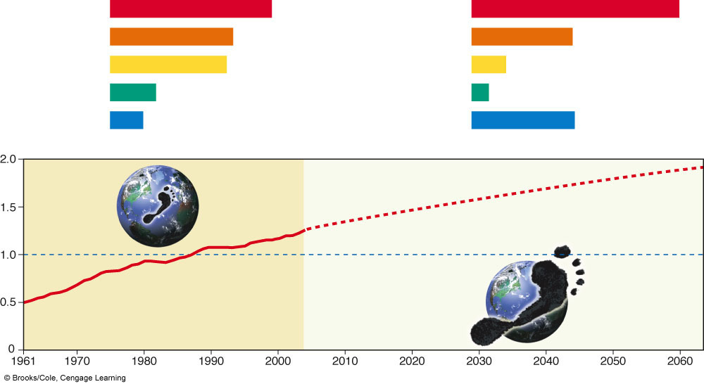
Ecological Footprint
An ecological footprint is the amount of biologically productive land and water needed to supply people with the resources they need and dispose of the waste they make. As our ecological footprints grow, we are depleting and degrading more of the earth’s natural capital.
Total Ecological Footprint (million hectares)
and Share of Global Ecological Capacity (%)
Per Capita Ecological Footprint
(hectares per person)
United States
2,810 (25%)
United States
9.7
European Union
2,160 (19%)
European Union
4.7
China
2,050 (18%)
China
1.6
India
780 (7%)
India
0.8
Japan
540 (5%)
Japan
4.8
Projected footprint
Earth's
ecological
capacity
Number of Earths
Three major cultural events
  Agricultural revolution
  Industrial-medical revolution
  Information-globalization revolution
Ecological
footprint

Slide 43

Carbon Footprint
A carbon footprint has historically been defined as "the total sets of greenhouse gas (Mainly Carbon dioxide and to a lesser extent methane) emissions caused by an organization, event, product or person."
Greenhouse gases (GHGs) can be emitted through transport, land clearance, and the production and consumption of food, fuels, manufactured goods, materials, wood, roads, buildings, and services.
The Average Carbon Footprint in the United States vs. World The average U.S. household carbon footprint is about 50 tons CO₂e per year. The single largest source of emissions for the typical household is from driving (gasoline use). Transportation as a whole (driving, flying & small amount from public transit) is the largest overall category, followed by housing (electricity, natural gas, waste, construction) then food (mostly from red meat, dairy and seafood products, but also includes emissions from all other food), then goods followed lastly by services. The carbon footprint of U.S. households is about 5 times greater than the global average, which is approximately 10 tons CO₂e per household per year. For most U.S. households, the single most important action to reduce their carbon footprint is driving less or switching to a more efficient vehicle.

Slide 44
World Hunger
Over 9 million people die worldwide each year because of hunger and malnutrition. 5 million are children.
Reasons for World Hunger Issues:
1. Unequal distribution of available food (biggest reason)
2. Loss of arable land (land used for crops)
3. Increasing population growth rate
4. Increasing poverty in developing countries
Strategies for ensuring adequate nutrition for a growing population:
1. Increase the number of new food crops from a diversity of plant species
2. Distribute food more equitably
3. Increase land are that is dedicated to grain production rather than meat production
4. Assist developing countries in efficient crop irrigation systems.

