Slide 1
Ch. 3 Key Issue 3
Why do migrants face obstacles?

Slide 2
Obstacles for Migrants
Migrants have difficulty getting permission to enter other countries
They face hostility from local citizens once they arrive
Immigration laws restrict the number of legal immigrants entering the U.S.
Europe and the Middle East- workers migrate temporarily to perform menial jobs

Slide 3
Ch. 3 Key Issue 4
Why do people migrate within a country?

Slide 4
Interregional migration
Migration between rural and urban regions
  (country to city)
  * Was important in settling the frontier of the U.S., Russia and Brazil

Slide 5
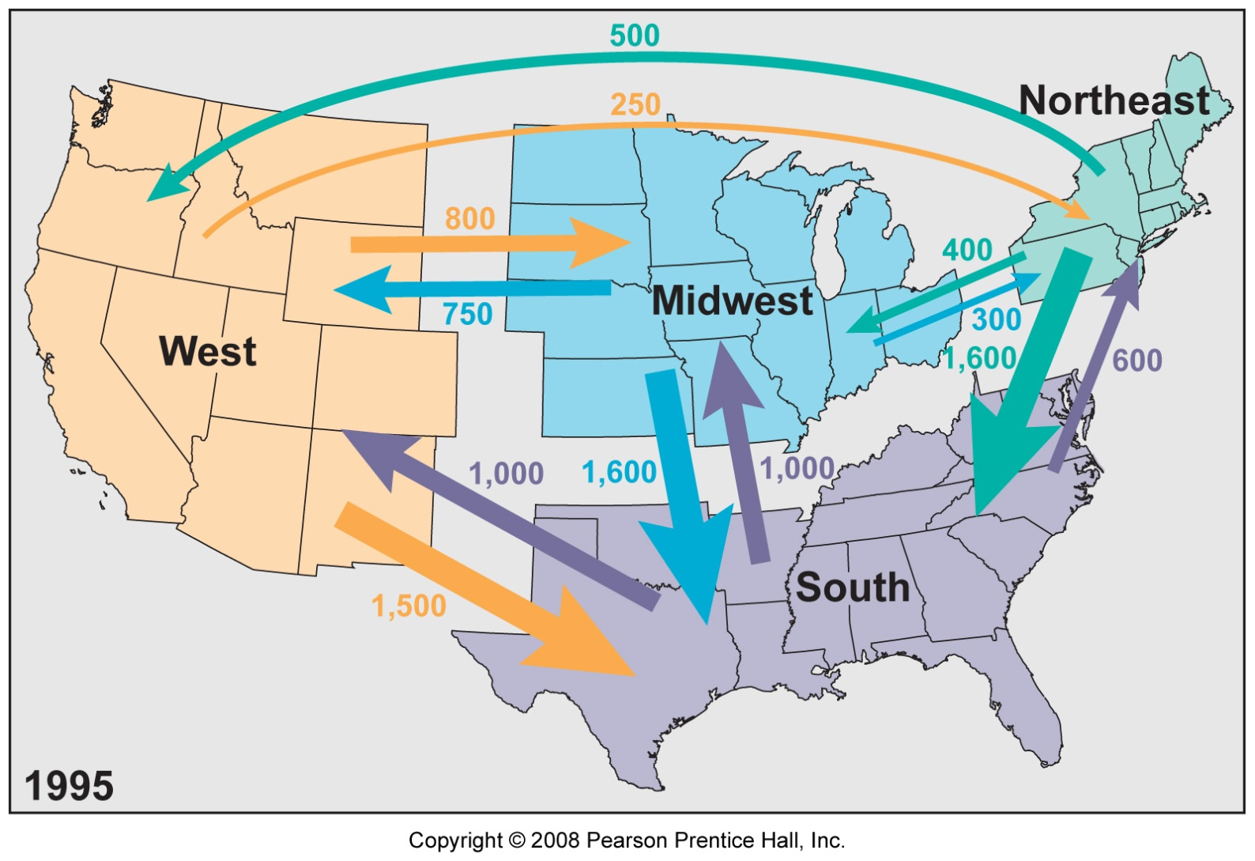
U.S. Interregional Migration, 1995

Slide 6
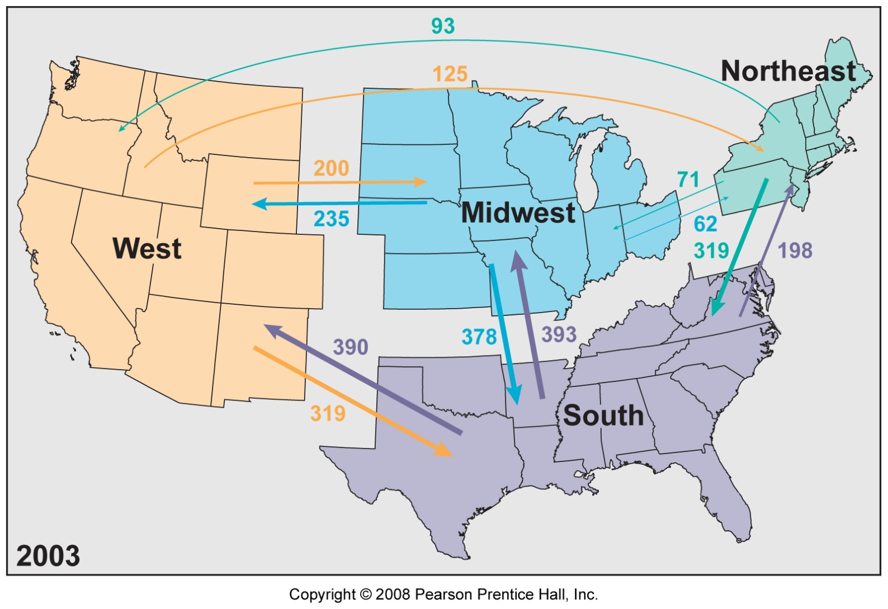
U.S. Interregional Migration, 2003

Slide 7
Intraregional Migration
From older cities to suburbs
Persists today because of differences among regions of a country in economic conditions, climate and other environmental factors
Most important intraregional trends- from rural to urban areas within less developed countries
From cities to suburbs within more developed countries

Slide 8
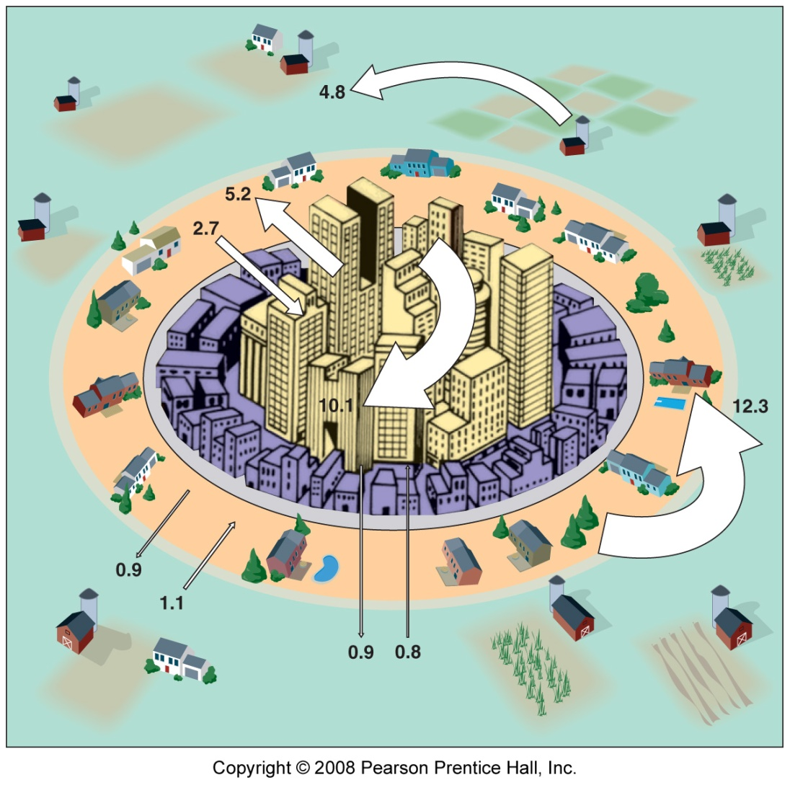
Intraregional Migration in the U.S.
Fig. 3-14: Average annual migration among urban, suburban, and rural areas in the U.S. during the 1990s. The largest flow was from central cities to suburbs.

Slide 9
Questions on the same binder paper with your notes
Write 5 level 1 questions
Write 2 level 2 questions
Write 2 level 3 questions

