Slide 1
Chernenko Political Cartoons
Angela Ko
Sherman Lee
Nathalie Tabunar

Slide 2
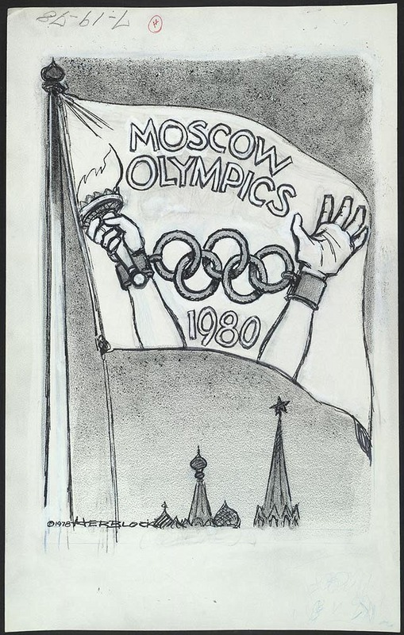
In 1980, America boycotted the Summer Olympics held in 1980 because of an ultimatum posed by Jimmy Carter to boycott the olympics if the Soviets did not withdraw from Afghanistan. Other countries such as Japan, West Germany, China, Philippines, Argentina, and Canada joined the United States. This particular cartoon was to depict the recent arrest and conviction of Anatoly Shcharansky that lead to increasing attention towards human rights in the USSR.

Slide 3
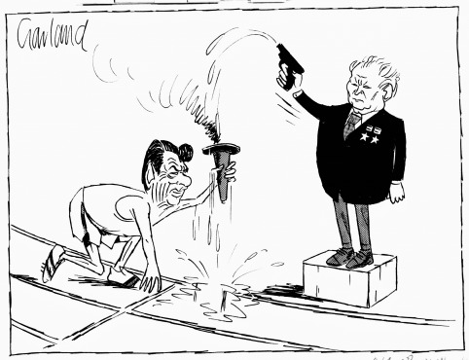
The announcement of USSR not to participate in the 1984 Los Angeles Olympics in response to the 1980 Moscow Summer Olympics Boycott. The Soviets along with other members of the Eastern Bloc boycotted the Olympics in Los Angeles and held their own “Friendship Games”.

Slide 4
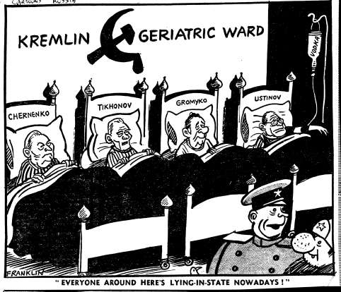
Here are all the Soviet cadres who were growing frail, representing an older generation of Communists dying off. This depicted the inability of the elder leaders, as all of them are "lying-in-state". For instance, Chernenko who succeeded Andropov was already 72 years old and could barely read the eulogy for Andropov, and died 13 months later. He could not chair meetings and had to have Gorbachev hold meetings in his place and relay his messages. In fact, Gorbachev was the only Soviet leader who was born after the 1917 Russian Revolution. Interestingly, the Minister of Defense Ustinov was given a dose of Vodka as life support.

Slide 5
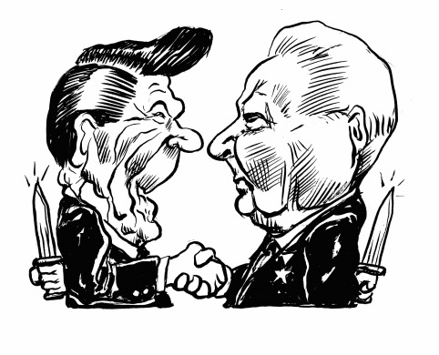
With 72 years of age Chernenko first installed as the Soviet leader in 1984, and in the following time he consistently clashed with Reagan on foreign affairs and military reduction issues. In 1979, though he was not Soviet Leader at the time, he attended the Strategic Arms Limitation Talks (SALT). Reagan proposed to cut the number of missiles of both sides in half starting with the Soviet Union, but the Soviets refused because they were already halting their arms production.

Slide 6
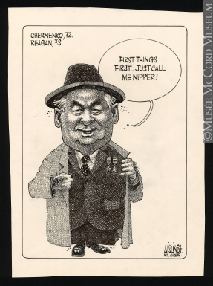
There was a rivalry existing between Reagan and Chernenko even before Chernenko became leader of the Soviet Union. Later in 1984, after Chernenko became leader of Soviet Russia, Reagan wished to hold a summit and meet with the new Soviet leader yet Chernenko refused to meet until it is certain that Reagan would be re-elected.

Slide 7
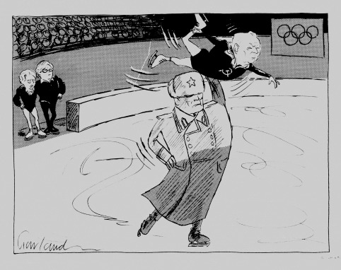
In the 1984 Winter Olympics in Sarajevo, the British skaters Jayne Torvill and Christopher Dean took the gold medal for ice dancing, a recently-introduced event previously dominated by Soviet dancers. In Nicholas Garland's cartoon, Soviet decline in this Olympic event is linked to the weakness of the Soviet Union itself. The Soviet leader Yuri Andropov had recently died, after only fifteen months in office, many of them spent in a hospital bed, and his successor, Konstantin Chernenko, was almost too ill to read the eulogy at his funeral. Garland shows Margaret Thatcher and her Foreign Secretary, Geoffrey Howe, watching the Soviet Union supporting its new leader across the ice, as they wait to perform their own routine. Chernenko died a year later.

Slide 8
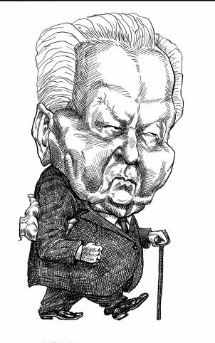
By the time Chernenko was in office, he was already 72 years old and he was barely capable of reading the eulogy for Andropov. Eventually dying 13 months after his term, allowing Gorbachev to come into power.

Slide 9
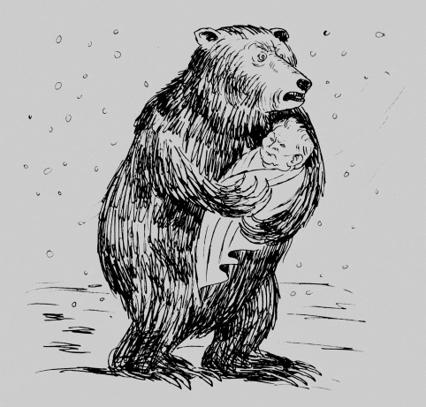
This cartoon depicts the Russian bear holding the aged Chernenko as if he were a child, as Chernenko was incapable of leading the Soviet Union under his condition in which he had to lay in bed all the time and could not even hold meetings.

Slide 10
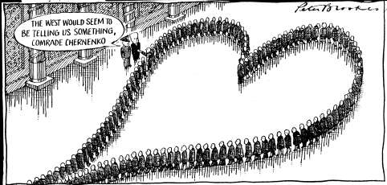
This depicts Chernenko’s conflicts with the West, especially Reagan, as he refused the arms limitations.

Slide 11
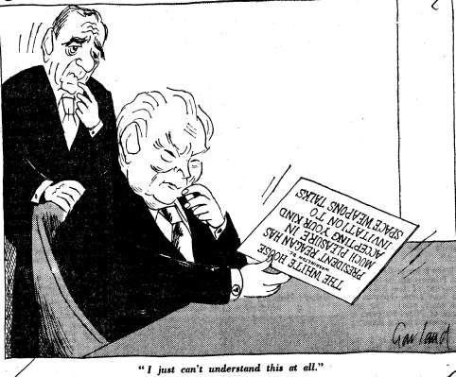
Similar to the previous picture, this picture depicts Chernenko’s refusal, and inability to comprehend the West’s desires for peace.

Slide 12
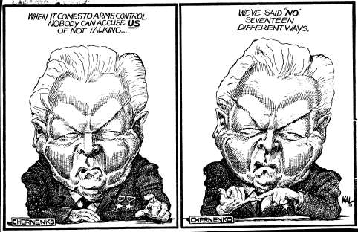
This picture depicts Chernenko’s refusal to agree to arms control and prevented the renewal of detente

Slide 13
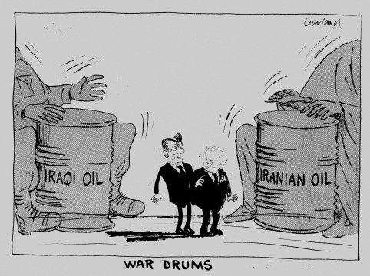
This cartoon is showing the rivalry between Reagan and Chernenko, specifically towards oil in the Middle East because though Soviets had large oil reserves, they lacks the technology to extract the oil.

Slide 14
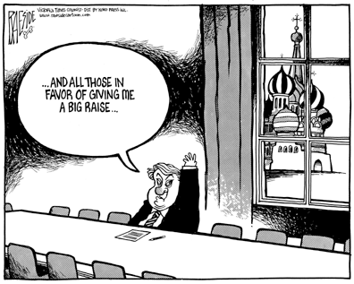
Chernenko symbolized a return to the late Brezhnev era policies, which did not include political openness. Even when he was lying in bed due to illness and age, he was still making Gorbachev relay his messages on to the people of the politburo.

Slide 15
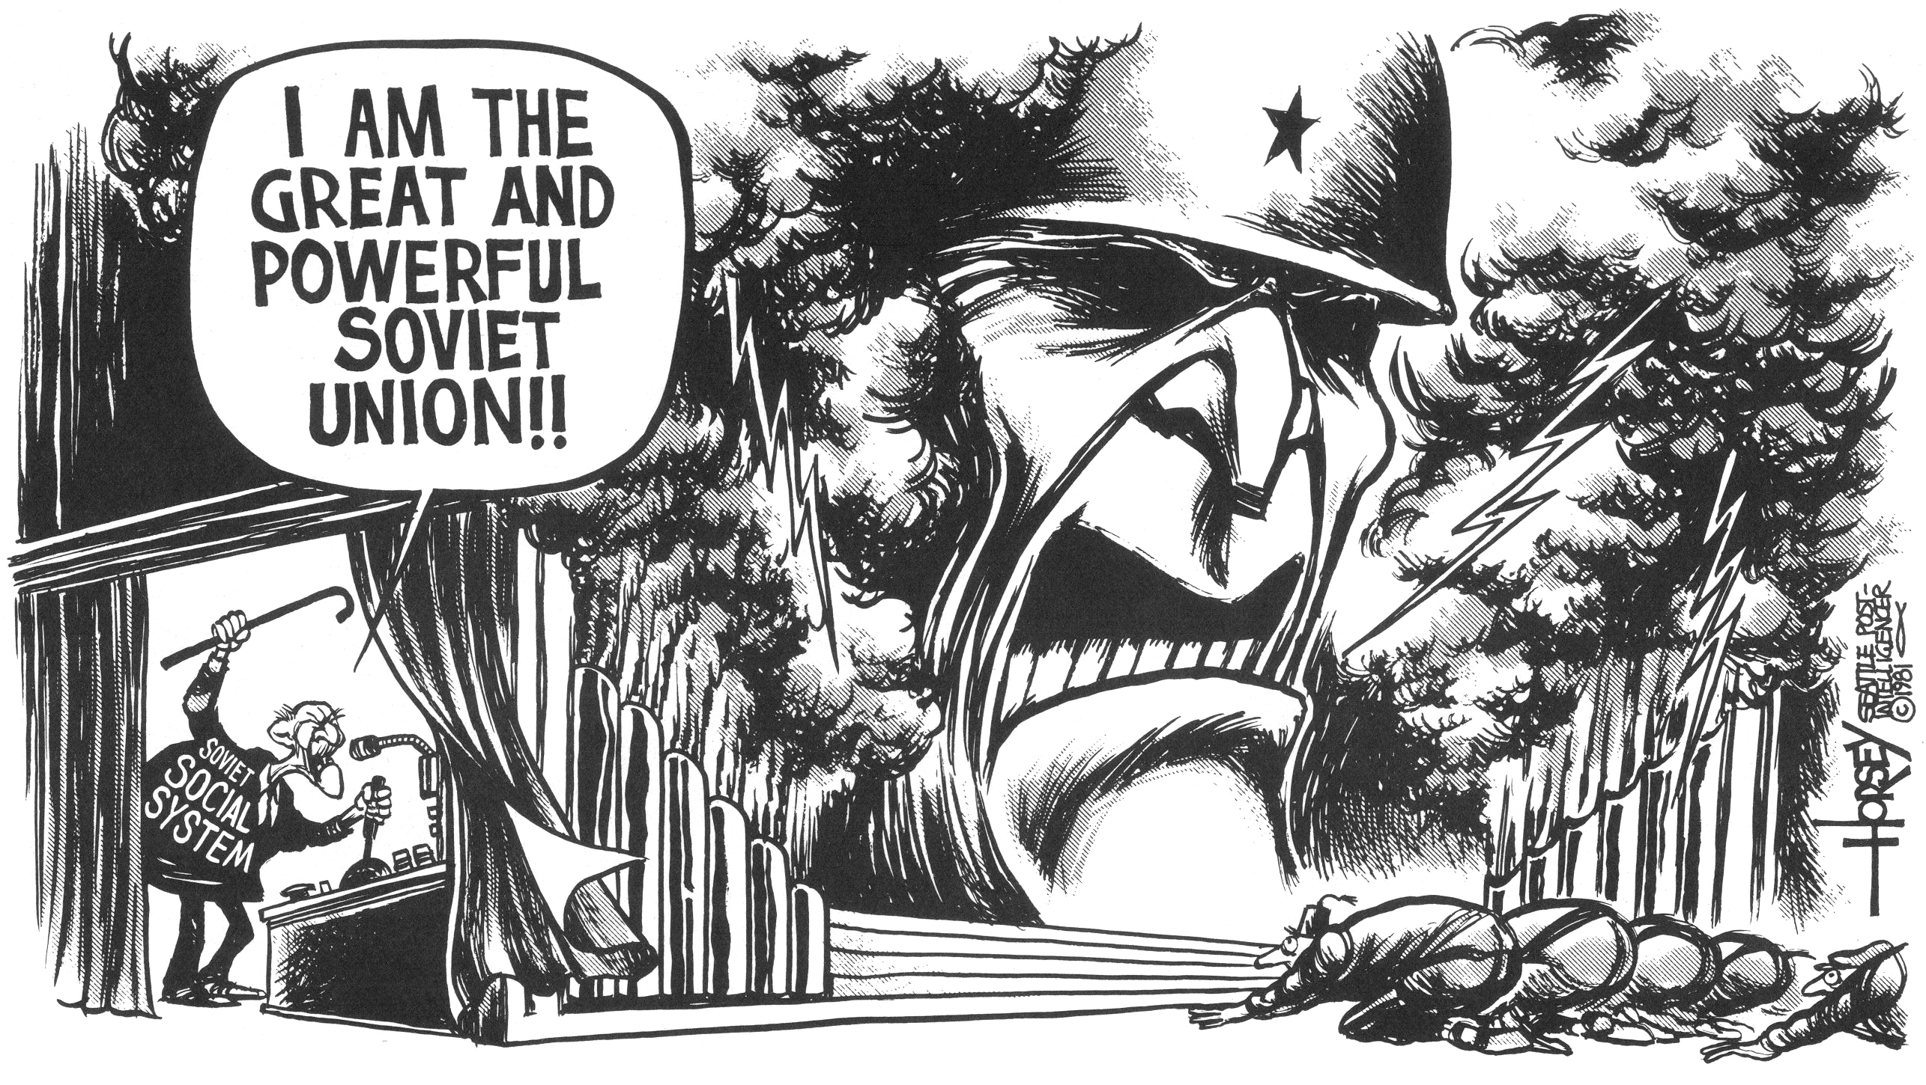
This cartoon shows though the Soviets seemed to appear as they are still militarily inclined, they are actually incapable of continuing their desire to create arms and had to cut back. This caused Chernenko to be reluctant to agree to more arms controls, leading to tension between Chernenko and Reagan

Slide 16
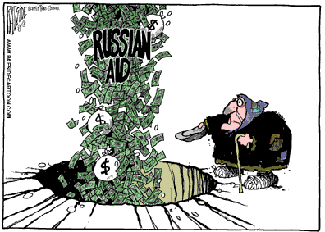
This cartoon depicts how though there was a massive amount of Russian aid, the citizen barely benefited from them and continued to suffer from poverty. This caused the grain embargo that Carter set upon the Russians because he believed that the Soviets were not using the cheap grain for the citizens, but for war and military.

