Slide 1
Warm-up #6
Write a paragraph describing the feudal class system. Include the role or each social class and what life was like for peasants/serfs.

Slide 2
Japanese and European Feudalism
Europe | Both | Japan
Christianity Religious themes in art and literature No ritual suicide Chivalry – focused on protecting women, old, and children. Women were not allowed to be warriors. Monarch has much power Peasants are tied to the land. Heavy metal armor. | Warrior class (respected by society) Warriors from upper class Warriors have a code of honor. Peasants/merchants at bottom on social hierarchy. Only upper class owns land (nobles and daimyo) Peasants work the land to feed the entire population while remaining poor. | Buddhism and Confucianism Nature praised in art and literature Ritual suicide for warriors Bushido Women could be samurai Emperor is a figurehead with little power. Feudalism lasted longer until the late 1800s. Flexible leather armor

Slide 3
Design a manor including these elements:
Five serf homes
Manor House
Three fields (one fallow, one wheat, and one barley).
Church for worship
Pasture
Lord’s Forest
*Mill (process wheat to flour)
*Tithe Barn (stored the lords crops)
*Black Smith

Slide 4
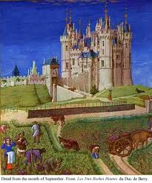
The Manor System
A large estate owned by a knight or lord was called a manor.
The manor included a large house or castle, pastures, fields, and forests.
Most medieval lords kept one-half to one-third of the land for themselves.
The rest of the land was divided among peasants and serfs, workers who were tied to the land on which they lived.

Slide 5
The Manorial System
The feudal system was a political and social system. A related system governed medieval economics. This system was called the manorial system because it was built around large estates called manors.
Lords, Peasants, and Serfs
Serfdom
Free People
Manors owned by wealthy lords, knights
Peasants farmed manor fields
Were given protection, plots of land to cultivate for selves
Most peasants on farm were serfs, tied to manor
But could not leave, marry without lord’s permission
Manors had some free people who rented land from lord
Others included landowning peasants, skilled workers like blacksmiths, millers
Also had a priest for spiritual needs

Slide 6
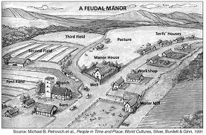

Slide 7
A Typical Manor
Most of manor’s land occupied by fields for crops, pastures for animals
Middle Ages farmers learned that leaving field empty for year improved soil
In time, practice developed into three-field crop rotation system
Rotation
Small Village
One field planted in spring for fall harvest
Another field planted in winter for spring harvest
Third field remained unplanted for year
Each manor included fortified house for noble family, village for peasants, serfs
Goal to make manor self-sufficient
Typical manor also included church, mill, blacksmith

Slide 8
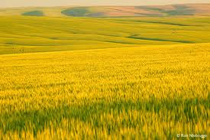
Farming
Farmers did not know how to enrich the soil by the use of fertilizers . So each year they cultivated only two-thirds of the land, letting the other third lie "fallow" (uncultivated), that it might recover its fertility. They changed the crops they grew in each field. This was called crop rotation.
Manor lands were therefore farmed using the three-field system of agriculture. One field was devoted to winter crops, another to summer crops, and a third lying fallow each year. The land was worked by peasants.
Year | North Field | West Field | South Field
1 | Barley | Fallow | Wheat
2 | Wheat | Barley | Fallow
3 | Fallow | Wheat | Barley

Slide 9
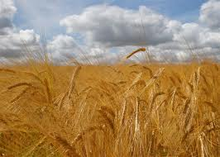
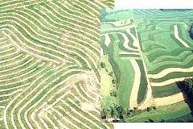
Farming
Strip farming meant that villeians had to work together. A whole field would be sown and harvested, and each villein worked closely with his neighbor to get his work done.
The other land around the village was also important. Peasants and serfs collected wood from the woodland, their animals grazed on the common lands, fish could be collected from the river, which was also used for washing and cooking.

Slide 10
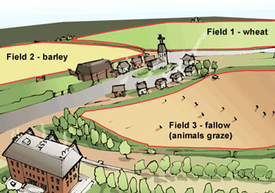
Manorial System

Slide 11

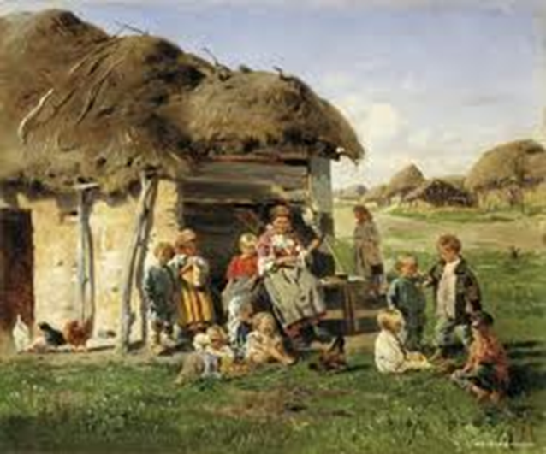
Peasant/Serf Homes
Villeins (villagers, peasants, and serfs) would live in crunck-houses. Their house would have a small garden where vegetables like carrots and cabbages could be grown. They usually build their own house, and have very few possessions. They would have some animals like pigs, sheep, cows and chickens.
Most medieval homes were cold, damp, and dark. Windows were very small openings with wooden shutters that were closed at night or in bad weather. The small size of the windows allowed those inside to see out, but kept outsiders from looking in.
Peasant homes were rarely more than one or two rooms. The houses had thatched roofs and were easily destroyed.

Slide 12
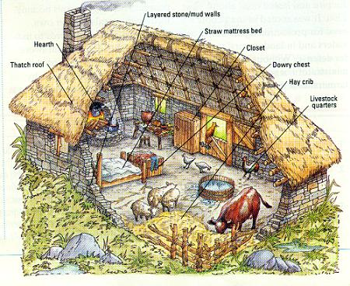

Slide 13
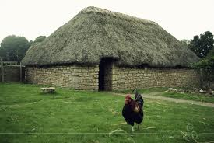

Peasant Homes

Slide 14
Peasant’s Daily Life
Daily Diet
6 am – Breakfast: coarse black bread, with ale. 10 am – Dinner: coarse black bread, eggs, and cheese, with ale. 4 pm – Supper: Coarse black bread, pottage (thick veggie soup) with ale.
A villein’s diet was very different to ours. It did not change much. Usually they did not eat meat. If they did, it was usually bacon because pigs were easy to keep. There were no refrigerators, so meat was salted or smoked to keep it fresh. Spices were used to cover the taste of spoiling meat. Poor family often went hungry. One child in every three would die before turning one because there was often not enough food.
Possessions
Animals Crunk-house Hay, to wear as socks, cover the floor and for mattress. A chest (dresser) Stools Table One change of clothes A few small wool blankets.

Slide 15
Manor House
The Manor House was the residential property of the lord of the Manor. It differed from castles in that it was not built for the primary purpose of attack or defense. The Manor House varied in size, according to the wealth of the lord but generally consisted of a Great Hall, solar, kitchen, storerooms and servants quarters. Sometimes it included a stone wall around it for protection. The homes of wealthy lords could rival that of the King.

Slide 16
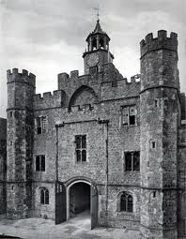
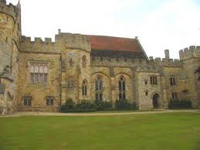
Medieval Manor House

Slide 17
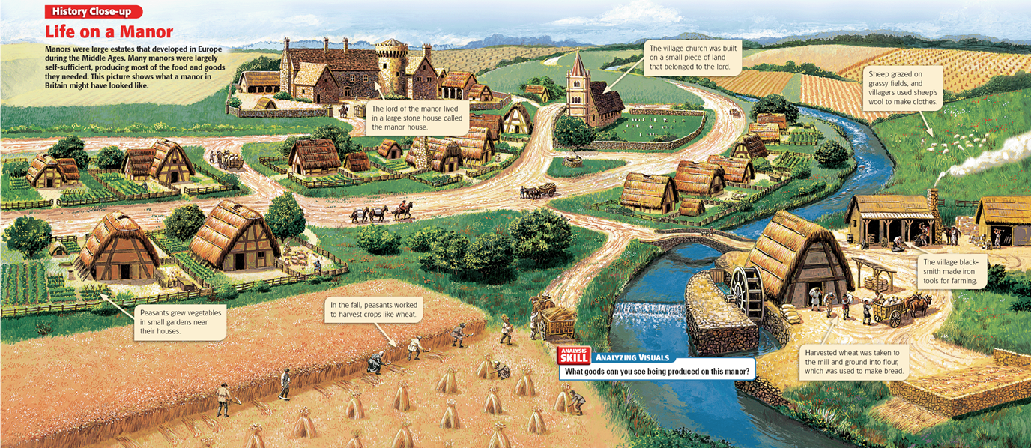

Slide 18
Other Important parts of a Manor
Church for worship (remember most people were Roman Catholic)
Pasture – for raising livestock
Forest – for wood and the lord or kings hunting.
River or stream – allows fresh water for drinking, washing, and watering fields.

Slide 19
Homework
Design, label, color your manor.
Write one or two paragraphs describing how it works or why you designed it the way you did.

