Slide 1
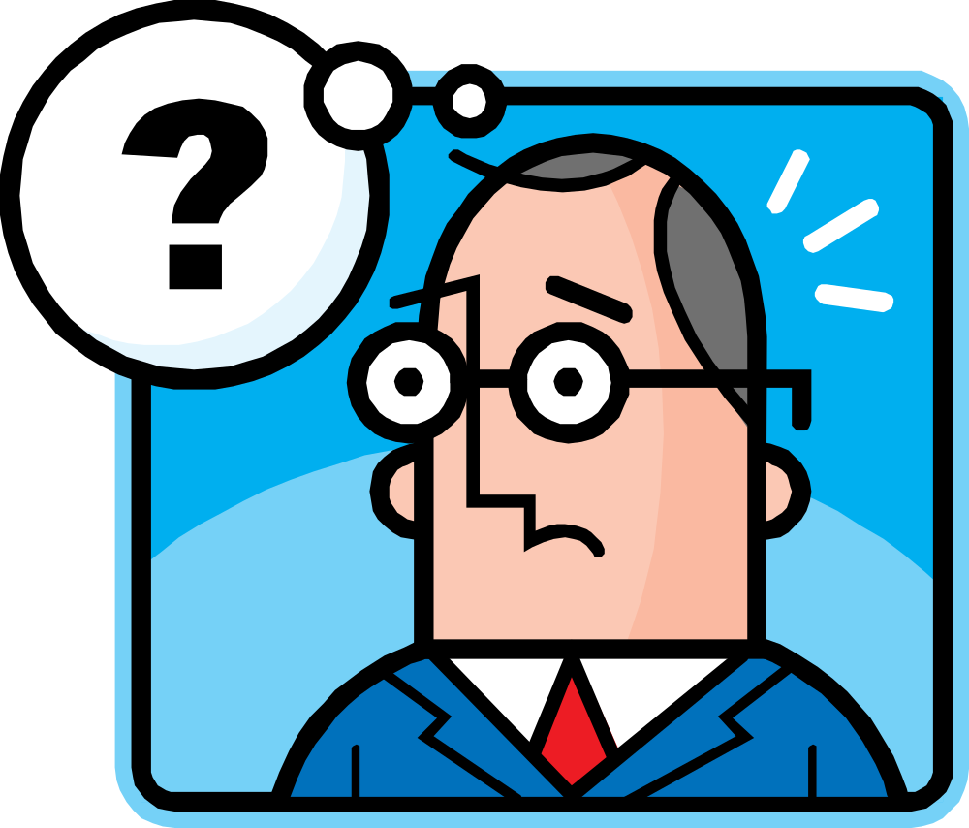
WRITING MYTHS

Slide 2
The Real Answers
WRITING MYTH | TRUE | FALSE | CORRECT ANSWER | WHY? (PPT Notes)
1. Teens hate to write. |  |  | FALSE | 1.Bad experiences-you are not born hating to write; you grew up telling great stories, which lead to learning to love to write!
2. Real writers get it right the first time. |  |  | FALSE | 2.There are always multiple drafts, even with famous writers. It is important to keep writing until you say what you mean.
3. Teens have nothing interesting to say. |  |  | FALSE | 3.You are filled with unique experiences and viewpoints about the world AND you always seem to find something to talk about with friends!
4. You have to know what you are going to say before you begin writing. |  |  | FALSE | 4.Writing helps you to think; Many writers don’t know what they want to say until after they’ve written MANY pages.
5. If you can’t spell, you can’t write. |  |  | FALSE | 5. Good writers edit and revise many times. Spelling only counts in the final draft. ☺
6. Writing is built on one sentence at a time. |  |  | FALSE | 6. Writing is made up of words and sentences, BUT it begins first as chunks of ideas to be revised later.
7. Only great writers can be creative. |  |  | FALSE | 7. Different types of writing: poems, letters, reports, etc. can be written in creative ways.
8. Good writers work alone. |  |  | FALSE | 8. Very few people actually work alone. Most writers collaborate with coworkers and peers. Most students learn to write better by sharing ideas, asking questions, and revising their writing.
9. You can spot a good writer at a glance. |  |  | FALSE | 9. Good writers come in many forms, they write in many different environments, and they use different techniques. There is no specific “look” of a good writer.
10. Poor marks (grades/corrections) make good writers. |  |  | FALSE | 10. A marked-up paper does not make for a great writer later. Writers improve most when they receive feedback about what is good and what needs improvement in their writing.

Slide 3
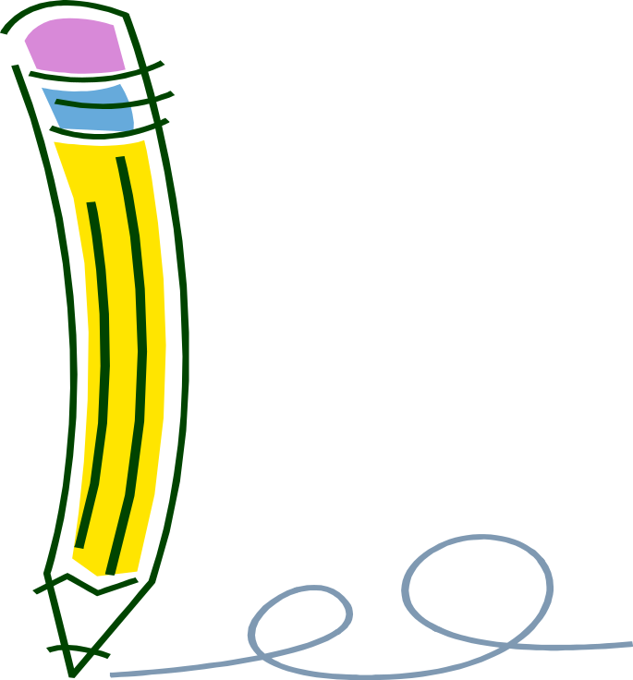
Essential Vocabulary
Copy the following definitions in the box listed on your handout.

Slide 4
to change the form of a verb to indicate person or tense, as in “I am, you are, he/she/it is, they are” and “I was, you were,” etc.
Conjugate

Slide 5
a system for naming things
Nomenclature

Slide 6
arranging words and phrases to build sentences
Syntax

Slide 7
a misplaced modifier, as in “I saw the trailer peeking through the window.” (Strunk & White)
Dangling Participle

Slide 8
the comma before “and” in a series
Oxford Comma

Slide 9
Words that are pronounced alike but have different meanings, as “your/you’re,” “to, too, two.”
Homophone

Slide 10
Literal language means exactly what it says. Figurative language means something other than what it says.
Figurative vs. Literal Language

Slide 11
mistaken, poorly chosen
Errant

Slide 12
unclear, confusing
Incoherent

Slide 13
ideograms, “smileys”
Emoji

Slide 14


