Slide 1
Notes: Ch.6-2 Clues About Evolution
EQ: What evidence or clues are used to verify that evolution occurs (give 3 examples)?

Slide 2
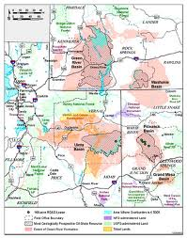
Clues from Fossils
About 50 million years ago, the Green River Formation in Wyoming, Utah and Colorado was covered by lakes.
This area was home to many fish, crocodiles, lizards and turtles.
Also Palms, fig trees, willows and other vegetation grew on the lakeshores.

Slide 3
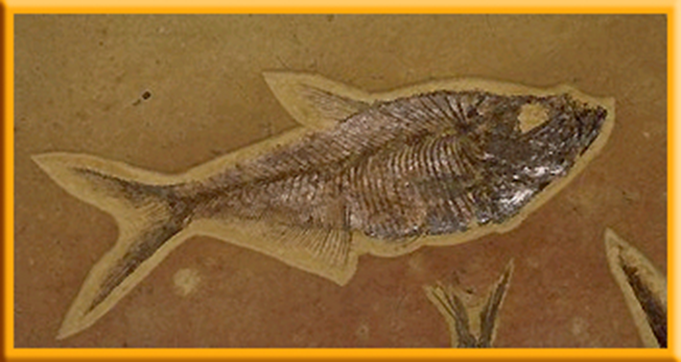
Clues from Fossils
After these organisms died, they were covered with silt and mud.
Over millions of years, they became the fossils that have made the Green River Formation one of the richest deposits in the world.

Slide 4
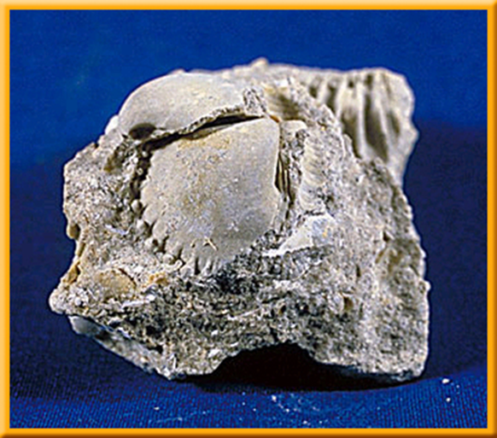
Types of Fossils
Most of the evidence for evolution comes from fossils
A fossil is the remains, an imprint, or a trace of a prehistoric organism.
The fossil record provides evidence that living things have evolved.

Slide 5
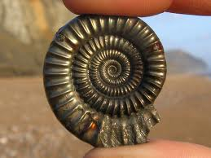
Determining a Fossil’s Age
Paleontologists use clues provided by unique rock layers and the fossils they contain.
The clues provide information about the geology, weather, and like-forms that must have been present during each geologic time period.
Two basic methods for dating fossils– relative dating and radiometric dating – usually used together to help estimate the age of the rocks and fossils

Slide 6
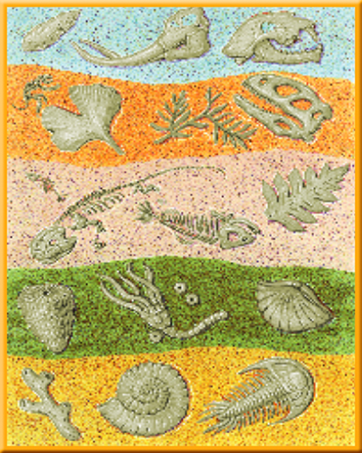
Relative Dating
Relative dating is based on the idea that in undisturbed areas, younger rock layers are deposited on top of older rock layers.
Relative dating provides only an estimate of a fossil’s age.

Slide 7
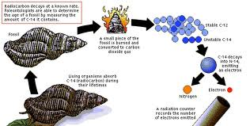
Radiometric Dating
Scientist can obtain a more accurate estimate of the age of a rock layer by using radioactive elements.
A radioactive element gives off a steady amount of radiation as it slowly changes to a nonradioactive element.

Slide 8
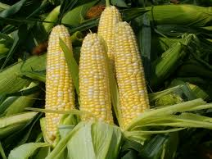
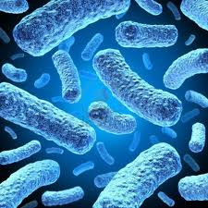
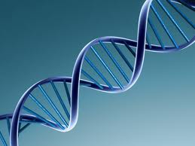
More Clues about Evolution
Plant breeders observe evolution when they use cross-breeding to produce genetic changes in plants.
The development of antibiotic resistance in bacteria
Similarities in embryo structures, the chemical makeup of organisms including DNA, and the way organisms develop into adults

Slide 9
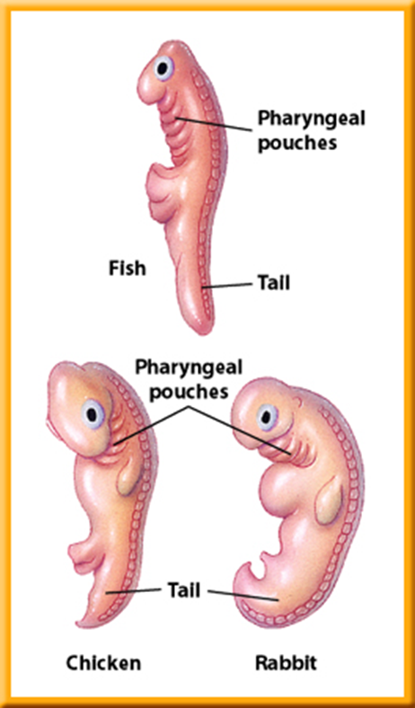
Embryology
The study of embryos and their development is called embryology.
Fish develop gills, but the other organisms develop other structures as their development continues
Fish, birds and reptiles keep their tails, but many mammals lose theirs.
These similarities suggest an evolutionary relationship among all vertebrate species.

Slide 10
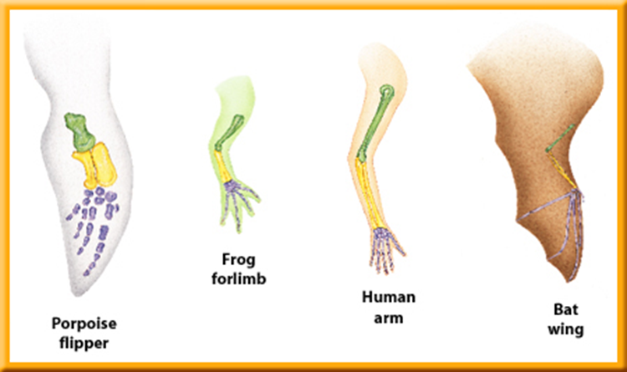
Homologous Structures
Body parts that are similar in origin and structure are called homologous.
Homologous structures also can be similar in function.
They often indicate that two or more species share common ancestors

Slide 11
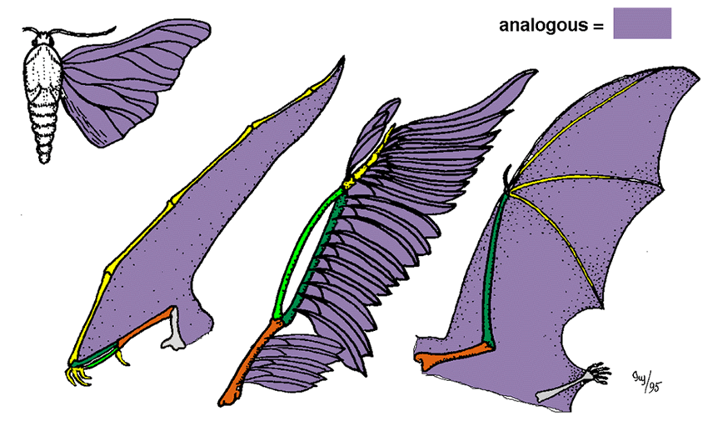
Analogous Structures
Body parts that are similar in function but may not have exactly the same structure

Slide 12
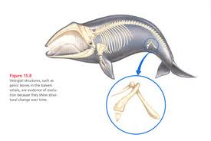
Vestigial Structures
The bodies of some organisms include vestigial structures – structures that don’t seem to have a function.
Vestigial structures also provide evidence for evolution.
The human appendix is a vestigial structure
Scientists hypothesize that vestigial structures are body parts that once functioned in an ancestor

Slide 13
DNA
Similar DNA also can suggest common ancestry.
Looking at genes and gene interactions we can look at how different genes work from species to species and find similarities.
This is also used as another clue for evolution.

