Slide 1
Literary Movements and techniques

Slide 2
Naturalism
Movement in the late 19th century
Writing explores the conditions of the people rather than focusing on the beauty of the language and the story
Explores conflicts between social classes (especially the exploitation of workers)
Usually focuses on a specific occupation or trade
Emphasizes characters who cannot escape their fate

Slide 3
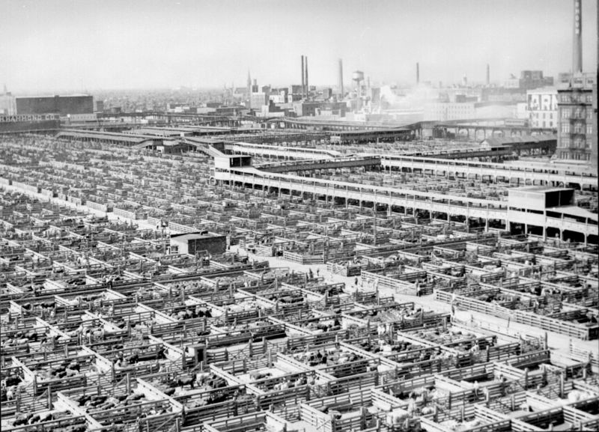
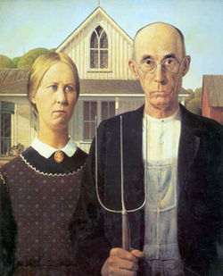
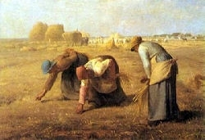
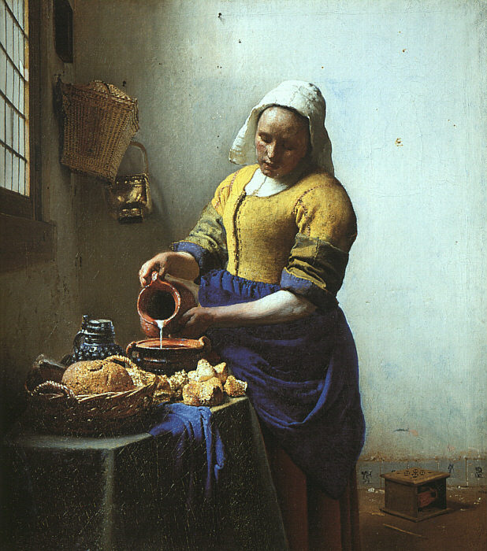

Slide 4
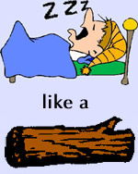
Simile
Using “like” or “as” to compare two seemingly unrelated things

Slide 5
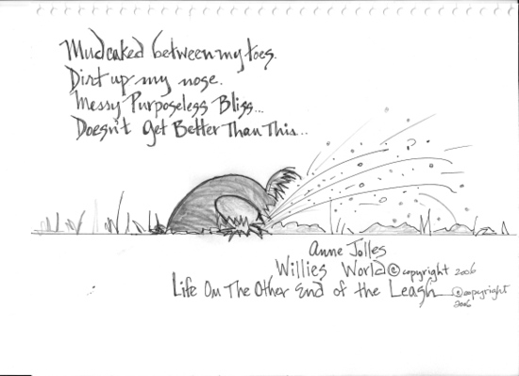
Metaphor
A figure of speech in which an implied comparison is made between two unlike things that actually have something in common.
Metaphor for parenting teens

Slide 6
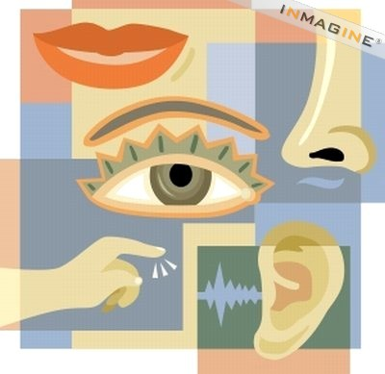
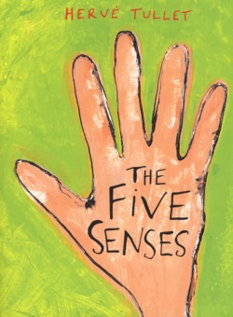
Imagery
descriptive language that appeals to one or more of the five senses – sight, sound, touch, taste, and smell.

Slide 7


foreshadowing
A technique in which an incident, behavior, conversation, or atmosphere prepares the reader for what will happen later.

Slide 8
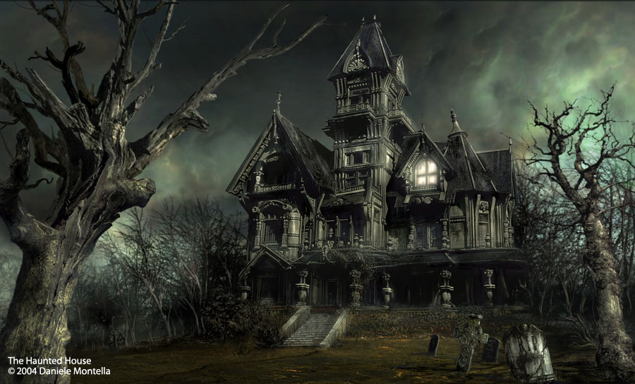
mood
the feeling that a literary work conveys to readers
mood is created through the use of plot, character, the author’s descriptions, etc.

Slide 9
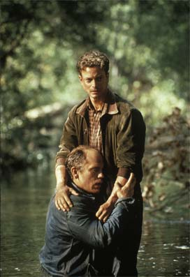
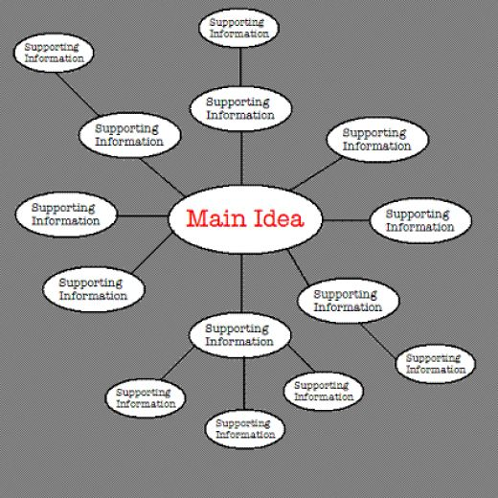
Theme
The main idea, expressed or implied, of a work of literature.
Usually a lesson (or moral) that everyone can relate to at some point in their lives

Slide 10
Themes in of mice and men
The impossibility of the American dream
Loneliness and isolation during the depression
One of the most important things in life is to have somebody
Nature
Violence

Slide 11
Your challenge!
While reading look for examples of these literary techniques and highlight any that you see.
I challenge you to identify as many literary techniques as you can and bring them up during class discussions.

