Slide 2
Calotype
Calotype- the first photographic process utilizing negatives and paper positives, invented by William Henry fox Talbot in the late 1830’s. It is paper coated with silver iodide.
Talbot came up with the name “calotype” from the Greek term for “beautiful image.”
Talbot's process became the basis of modern photography.
“soliloquy of the broom” gives evidence of his conviction that photography might offer a creative artistic outlet for those without the manual talent to draw or paint.

Slide 3
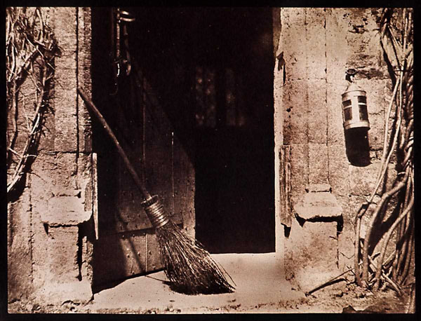
"The Open Door"‘
18.8 x 23.1 cm. By 19th century English polymath William Henry Fox Talbot, an inventor of photography.
Notes:
"The Open Door"‘
18.8 x 23.1 cm. By 19th century English polymath William Henry Fox Talbot, an inventor of photography.

Slide 4
Daguerreotype
An early photographic process (developed from the camera obscure) developed by Louis Daguerre
A copper plate is coated with iodine, when the surface is exposed to light and dipped in a salt solution, an image is produced on the plate.
3-D quality
Made in the early 1800s
Very realistic, they became relics for people
No copies, it’s a precious individual
It completely revolutionized the ability to realistically portray images

Slide 5
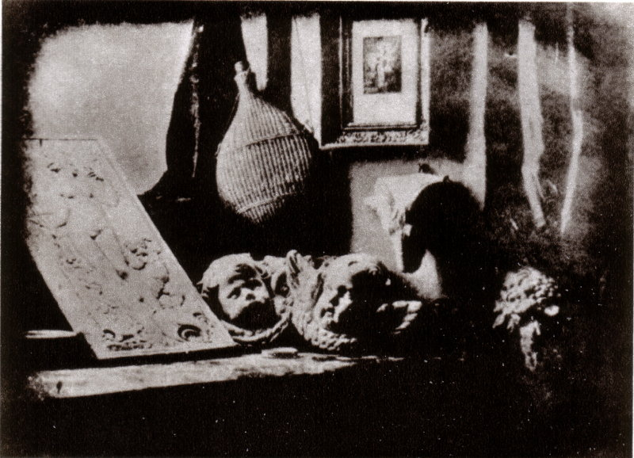
Louis Daguerre L’Atelier de l'artiste (The Artist’s Studio) 1837
Daguerreotype Société Française de Photographie, Paris

Slide 6
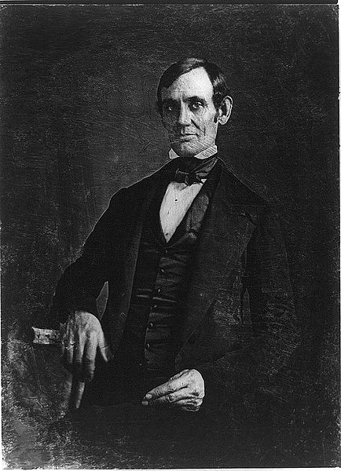
Nicholas H. Shepherd Abraham Lincoln
1846
Daguerreotype
Library of Congress

Slide 7
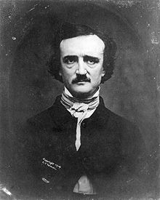
Edgar Allan Poe
William S. Hartshorn 1848
Daguerreotype
Library of Congress

Slide 8
Wet Collodion Photography
What is Collodion?
Collodion= a thick liquid, made of nitrated cotton that has been dissolved in alcohol and ether
How is the technique employed?
A glass plate is coated with a mixture of light sensitive salts and collodion, once most of the liquid has evaporated the plate is submerged in a chemical compound (silver nitrate in early days, but with time the process changes) then QUICKLY placed into the camera for exposure. (Quickly, because the plate must be wet in order for the image to be captured). Once the plate has been exposed it must be QUICKLY brought to a darkroom to be bathed in an acidic solution that develops the image.
The Benefits of Wet Collodion Technique
The photographer can produce several prints from one plate in record time, or use the plate itself as a collodion positive (the desired image) vs. collodion negative. The plates are BIG!! Meaning bigger pictures!!!

Slide 9
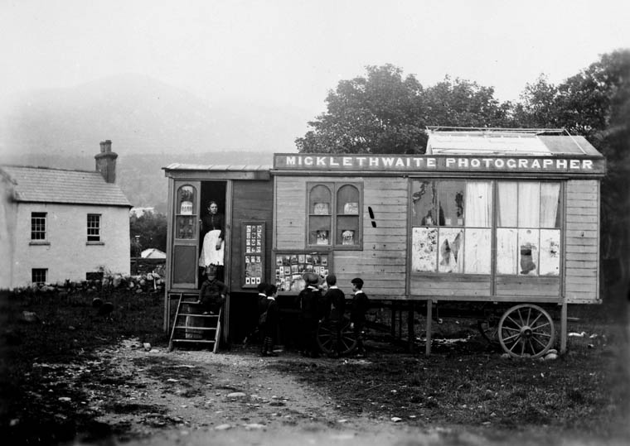
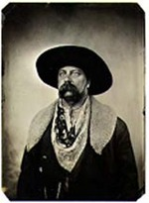
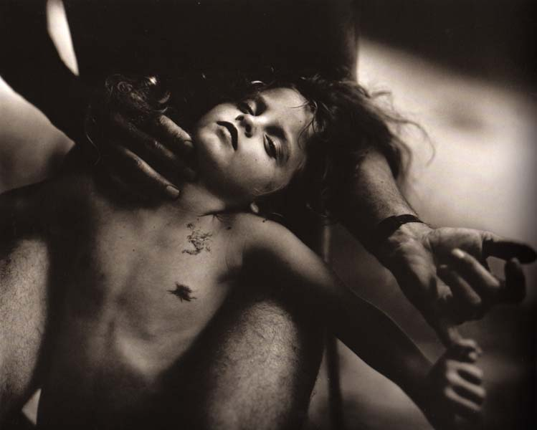
Limitations of the Technique
A dark room is needed, meaning the technique is not very portable. The plates are huge and heavy!!! How is a photographer going to photograph nature? He/She is going to need a mule, maybe a couple of them.
Exemplary Use

