Slide 1
Warm-up #1
What is a colony? Who are they owned/controlled by?
Describe what the first colonists in Virginia believed about finding gold in the New World.

Slide 2
I. Geography:
A) Definitions
City – a populated area (town) with an organized government.
State - one of the geographic and political units united under a government
Country – a group of political territories run by a single government.
Continent - One of the seven main land masses of the earth. (How many can you name?)

Slide 3
City
State
Country
Continent

Slide 4
Los Angeles
California
USA
North
America

Slide 5
II. Immigration
Take two minutes to brainstorm as many reasons as you can that someone would move to a new country.
A. Definitions
Push-factors –things that force someone to leave their country.
Pull-factors – things that attract someone to a new country.

Slide 6
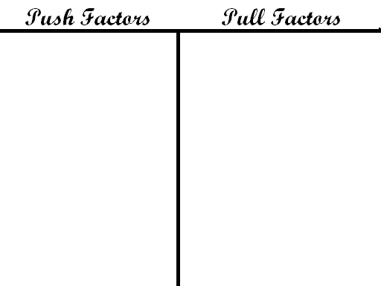
B. Create a T-Chart and group your immigration factors on your chart

Slide 7



C. Three main motivators for immigration are:
God (religion, to escape religious persecution in Eu Europe)
    Gold (wealth, money, and land were promised to colonist and indentured servants who were poor in Europe)
    Glory (Enlightenment ideas of fame, curiosity, and adventure motivated people to explore)
Return to your T Chart and draw the above symbols on factors that fit into each group.

Slide 8
Quick write
Describe where your family is originally from including the city, state/province, country and continent. What was your family’s motivation to immigrate (3 Gs)?

Slide 9

Homework
Finish your quick write (on back of world geography worksheet)
Use the atlas in your textbook, an atlas, and/or internet resources to complete the mapping activity.

Slide 10
Warm-up #2
Write a paragraph explaining the difference between a city, state, country, and continent? Provide examples.

Slide 11
Early Colonies Vocabulary
Divide your page into three columns (Word, Definition, picture/sentence)
As I show you the words, write you own definition and use it in a original sentence, or make a drawing to represent the word.

Slide 12


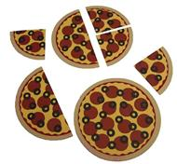
Join-stock company - A business where investors combine their money to make a profit.

Slide 13
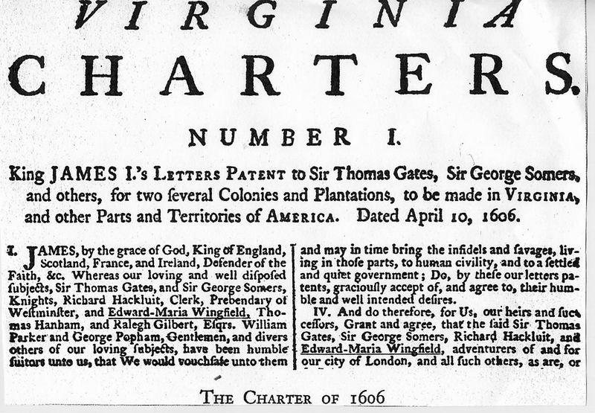
Charter - a government contract that gives the holder the right to establish a colony.

Slide 14
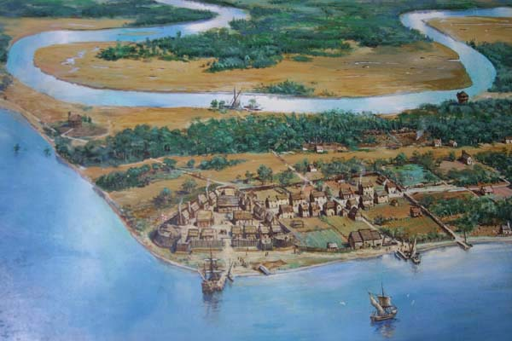
Jamestown - The first permanent English settlement in North America.

Slide 15
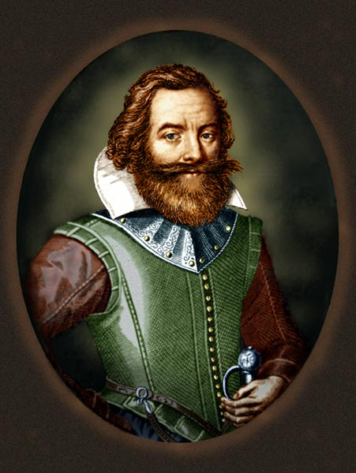
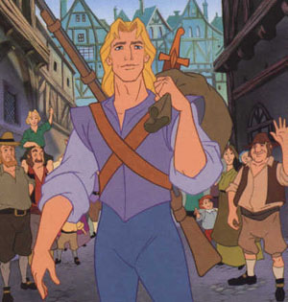
John Smith - The founder of Jamestown

Slide 16
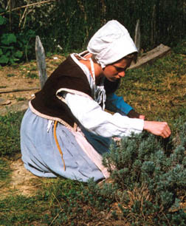
Indentured Servant - A person who sold their labor for 5 to 7 years in exchange for passage to America.

Slide 17
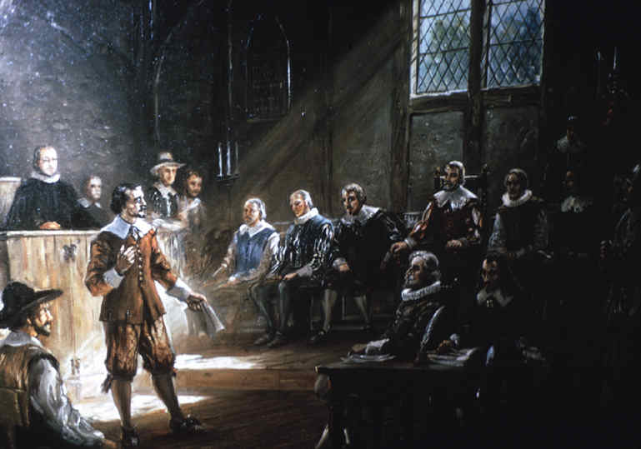
House of Burgesses - The first representative assembly in the American colonies, established in 1619.

Slide 18
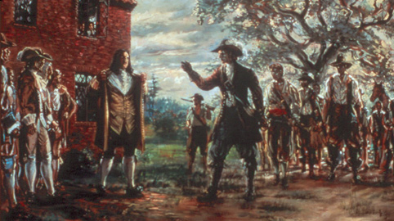
Bacon’s Rebellion - a revolt against Jamestown’s colonial authority led by Nathaniel Bacon in 1676.

Slide 19
Matching Terms and Names
Joint-stock company
Charter
Jamestown
John Smith
Indentured servant
House of Burgesses
Bacon’s Rebellion
a government contract that gives the
holder the right to establish a colony.
a revolt against Jamestown’s colonial authority led by Nathaniel Bacon in 1676.
The first representative assembly in the American colonies, established in 1619.
A business where investors combine their money to make a profit.
The first permanent English settlement in North America.
The founder of Jamestown
A person who sold their labor for 5 to 7 years in exchange for passage to America.

Slide 20
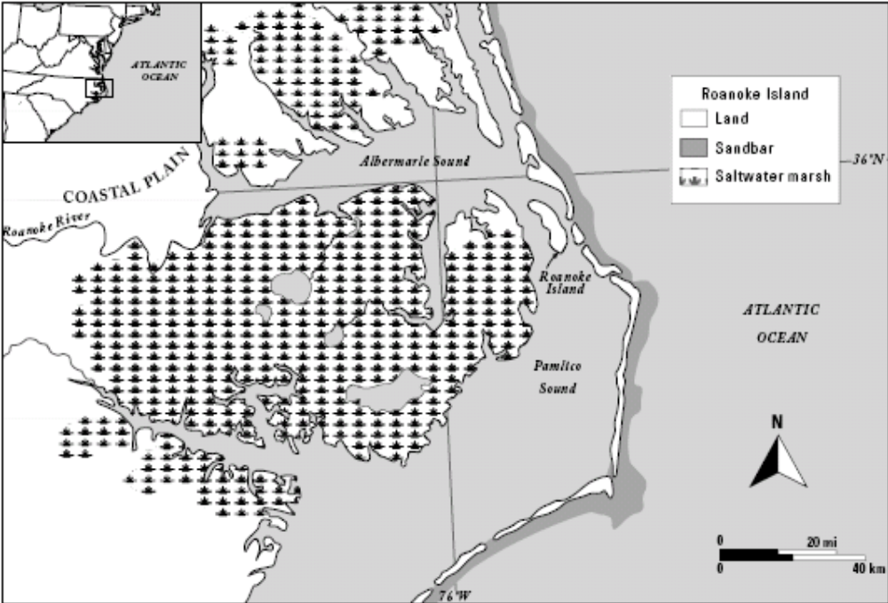
Roanoke Island

Slide 21

Roanoke Island

Slide 22
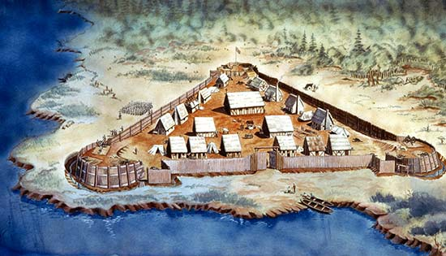
Jamestown
Get books from bookshelf (your #/president only).
Read Chapter 3, Section 1 (pages 85-89).
There will be one section in the notes for each red sub header.
We will start together and you will finish the notes on your own.
Only fill in the notes section (we will do summary and main idea questions later).

Slide 23
Jamestown Comic Strip
Flip your notebook horizontally and divide your page into six boxes.
As you read about Jamestown on pages 27 to 29 in your textbook. Write a caption (a few complete sentences) and draw a picture (color and outlined) in you comic to explain each of the following:
  Founding of the colony.
  Difficult living conditions.
  African Americans in Jamestown
  Starving time.
  The role of tobacco in the colony.
  Relationships with native Americans.

Slide 24
Homework
Complete Jamestown Comic Strip.

Slide 25
Warm-up #3
What challenges faced the colonists in Jamestown?
What or who do you think was responsible for Jamestown’s survival? Explain.

Slide 26
Around the Clock Jamestown Review
1 o’clock – First permanent English settlement in the New World.
4 o’clock – What is a charter? Who owned the charter for Jamestown?
5 o’clock – What were some challenges faced in Jamestown?
10 o’clock – What role did John Smith play in the survival of Jamestown?
12 o’clock – What role did the introduction of tobacco play in Jamestown?

Slide 27
Colonial Regions Brochures
Number off
  1 = New England
  2 = Middle Colonies
  3 = Southern Colonies
You will become an expert on your region, go through a series of interviews, then make a travel brochure about your region.
Use your book to help you fill out the matrix on your colonial region.

Slide 28
Do Now
Take out your materials and read the project check list and rubric on your desk.

Slide 29
Do Now
Take out your materials and on your project.

