Slide 1
Chromosomes and DNA Replication
EQ: How does the structure of DNA allow it to be able to be copied easily?

Slide 2
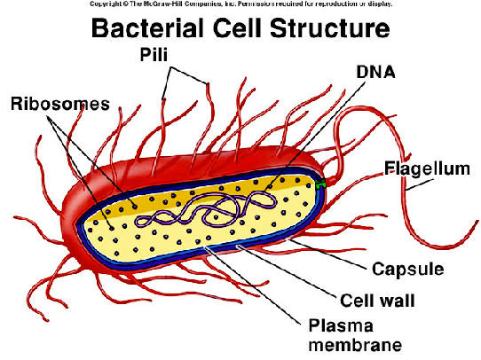
DNA and Chromosomes
In prokaryotic cells, DNA is located in the cytoplasm
Most prokaryotes have a single DNA molecule

Slide 3
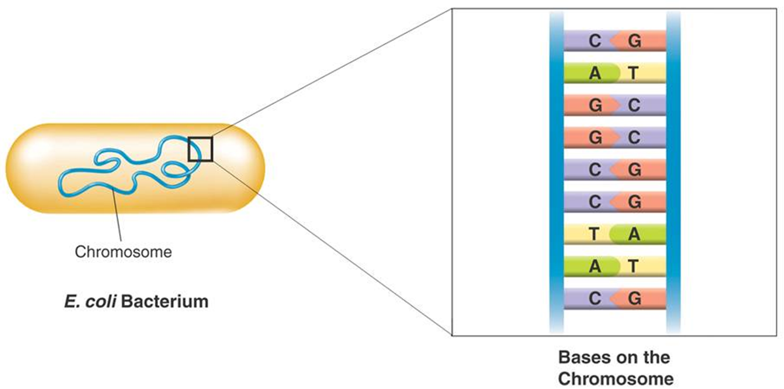

Slide 4
DNA and Chromosomes
Many eukaryotes have 1000 times the amount of DNA as prokaryotes.
Eukaryotic DNA is located in the cell nucleus and makes up the chromosomes
The number of chromosomes varies widely from one species to the next

Slide 5
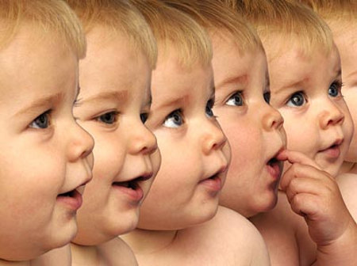
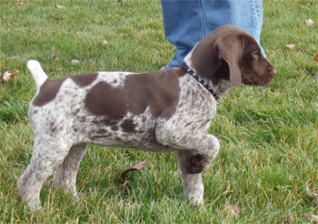
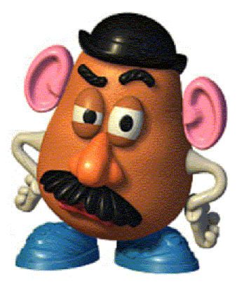
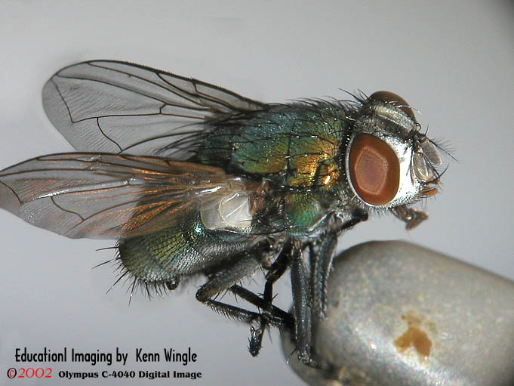
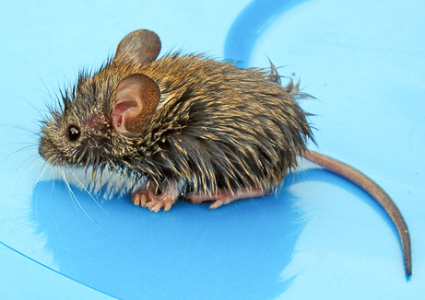
DNA and Chromosomes
Humans – 46 chromosomes
Dogs – 78 chromosomes
Potatoes – 48 chromosomes
Mice – 40 chromosomes
Flies – 8 chromosomes

Slide 6
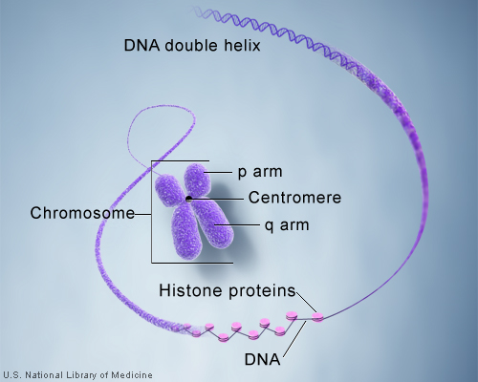
Chromosome Structure
Eukaryotic chromosomes contain DNA and protein, tightly packed together to form chromatin.
Chromatin consists of DNA tightly coiled around proteins called histones.

Slide 7
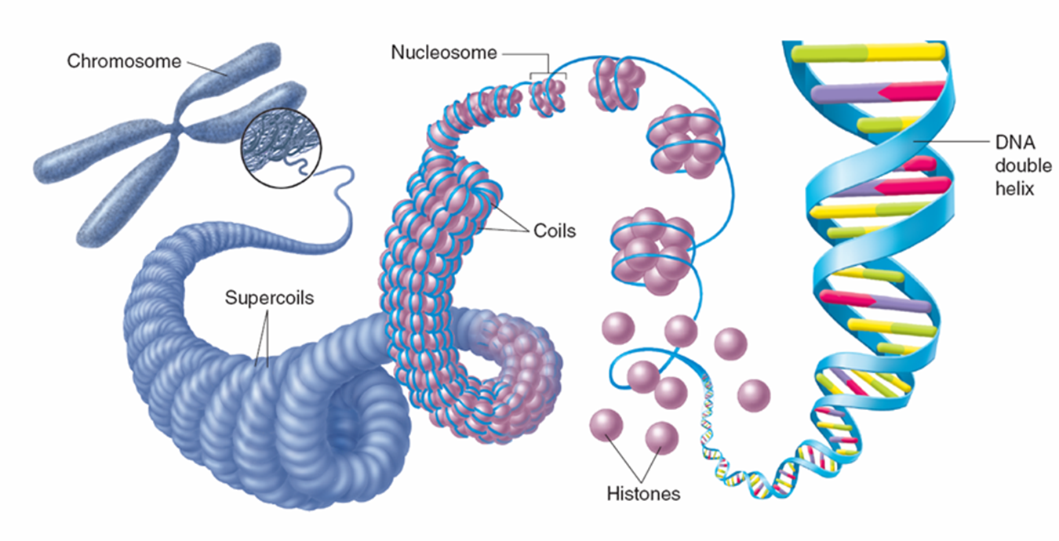
Eukaryotic Chromosome Structure

Slide 8
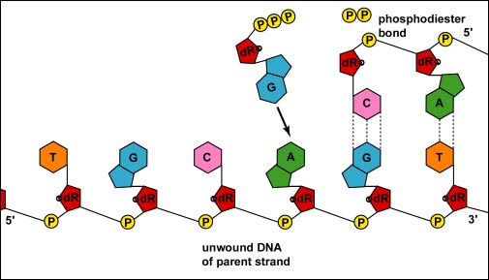
DNA Replication
Each strand of the DNA double helix has all the information needed to reconstruct the other half by the mechanism of base pairing.

Slide 9
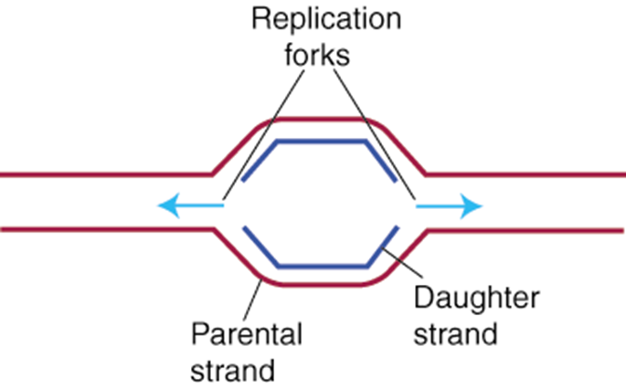
DNA Replication
In eukaryotic chromosomes, DNA replication occurs at hundreds of places. Replication proceeds in both directions until each chromosome is completely copied.
The sites where replication occur are called replication forks.

Slide 10
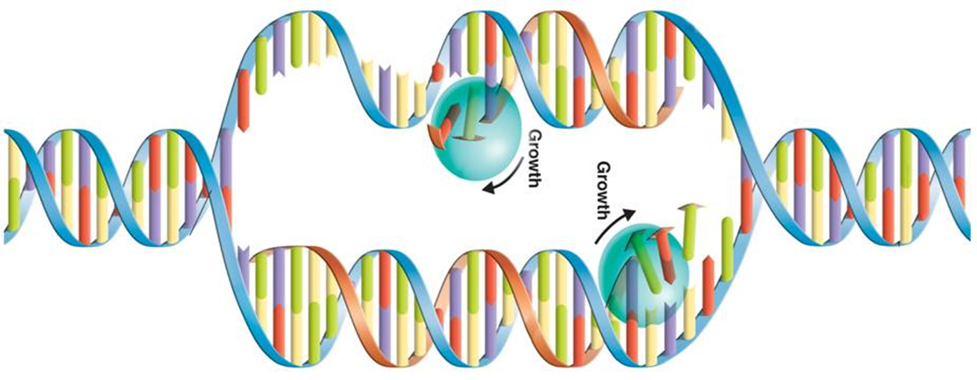
Duplicating DNA
Before a cell divides, it duplicates its DNA in a process called replication.
Replication ensures that each resulting cell will have a complete set of DNA.

Slide 11
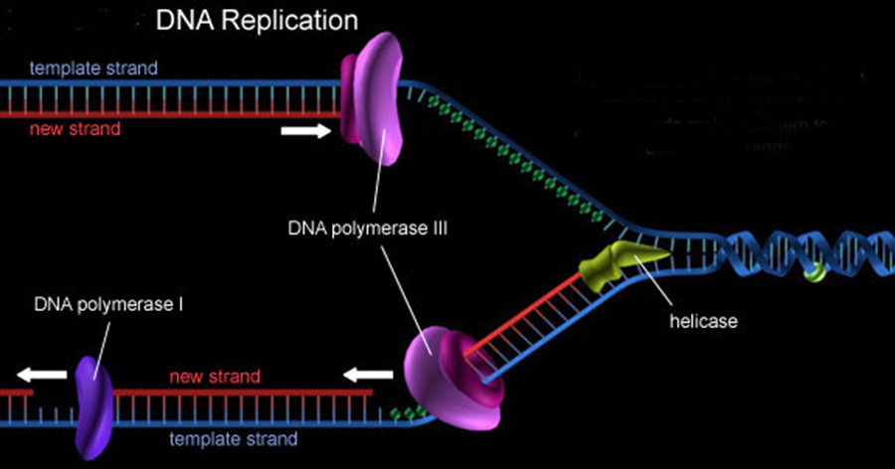
How Replication Occurs
DNA replication is carried out by enzymes that “unzip” a molecule of DNA.
Hydrogen bonds between base pairs are broken and the two strands of DNA unwind.

Slide 12
How DNA Replication Occurs
The principal enzyme involved in DNA replication is called DNA polymerase.
DNA polymerase matches up base pairs and joins nucleotides to produce a DNA molecule and then “proofreads” each new DNA.
http://www.youtube.com/watch?feature=endscreen&NR=1&v=zdDkiRw1PdU

Slide 13
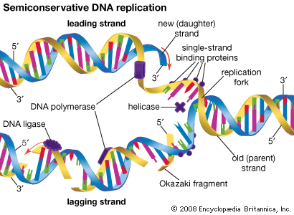
Semi-Conservative Replication
This type of Replication is called Semi-Conservative because ½ of the original DNA is conserved while a new ½ is added by DNA polymerase.

Slide 14
Question 1
In prokaryotic cells, DNA is found in the
Cytoplasm
Nucleus
Ribosome
Cell Membrane

Slide 15
Question 2
The first step in DNA replication is
Producing two new strands
Separating the strands
Producing DNA polymerase
Correctly pairing bases

Slide 16
Question 3
A DNA molecule separates, and the sequence GCGAATTCG occurs in one strand. What is the base sequence on the other strand?
GCGAATTCG
CGCTTAAGC
TATCCGGAT
GATGGCCAG

