Slide 1
Wednesday Oct. 6th
Have your homework Key Issue 1 packet ready
Textbook open to Key Issue 1
Calculator if you have one ☺

Slide 2
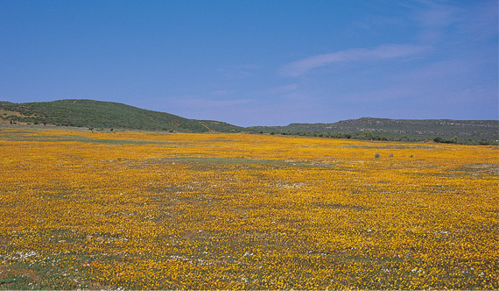
Sparsely Populated Regions

Slide 3
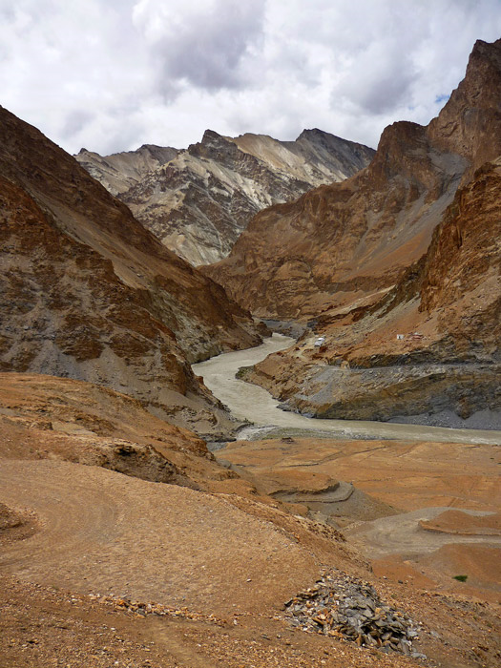
Few people live in regions that are:
  Too dry
  Too wet
  Too cold
  Too mountainous

Slide 4
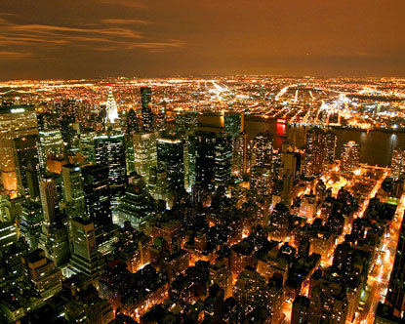
Ecumene: portion of Earth’s surface occupied by permanent human settlement

Slide 5
Areas considered too harsh to live in has diminished over time as the Earth becomes more populated = ecumene has increased
¾ of the world’s population live on only 5% of the Earth’s surface

Slide 6
Dry Lands
Areas too dry to farm cover 20% of the Earth’s land surface
2 largest desert regions in the world:
    Northern Hemisphere- 15○ and 50○ north latitude
    Southern Hemisphere- 20○ and 50○ south latitude
Largest desert region- N. Africa to Southwest and Central Asia- Sahara, Arabian, Thar, Takla Makan, Gobi deserts
A smaller desert region comprises much of Australia

Slide 7
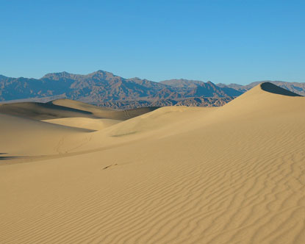
Deserts
Usually lack enough water to grow crops to feed a large population
Some people adapt by raising animals (camels)
Constructing irrigation systems, allows people to grow some crops
Deserts have much of the world’s oil reserves= increasing demand for people to live closer (work)

Slide 8
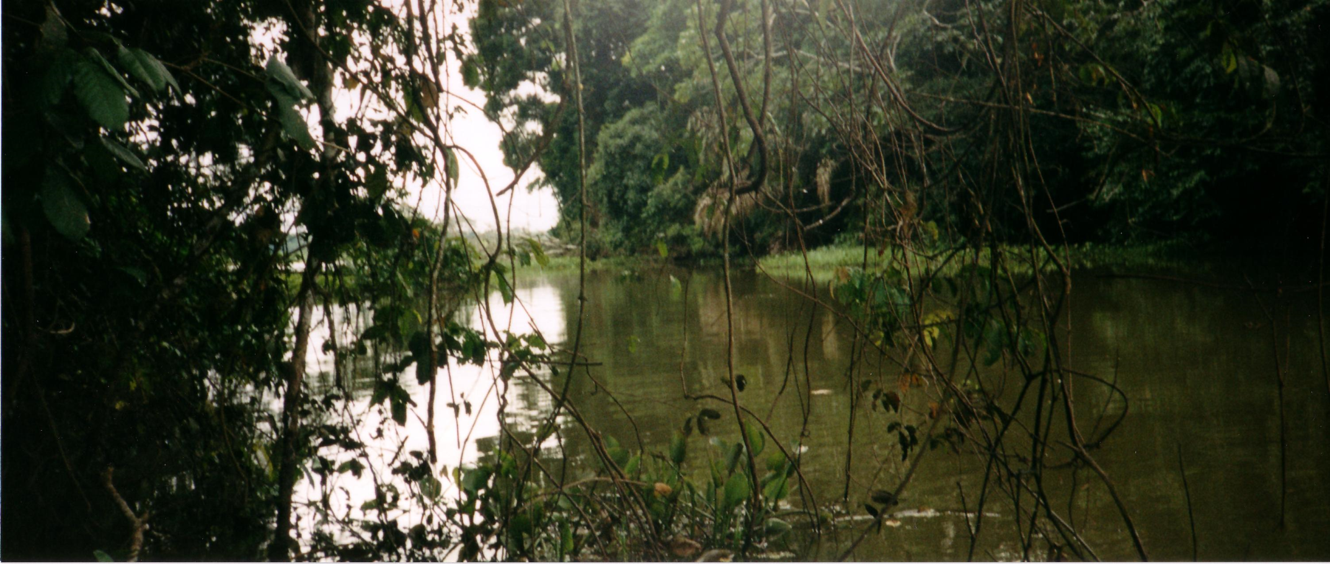
Wet lands

Slide 9
Wet lands
Land that receives high levels of rain may also be inhospitable for human living
Located primarily near the equator 20 north and south latitude in South America, Central Africa, Southeast Asia
Rainfall averages 50 inches/year
Rain and heat takes away nutrients from the soil from the soil = agriculture

Slide 10
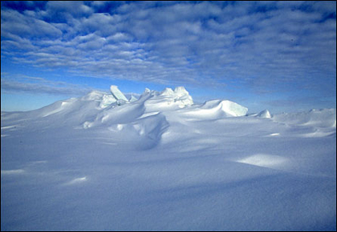
Cold Lands
Land near the North and South poles is constantly covered with ice or the ground is permanently frozen (permafrost)
Small annual snowfall accumulates onto thick ice
Few animals can survive the extreme cold

Slide 11
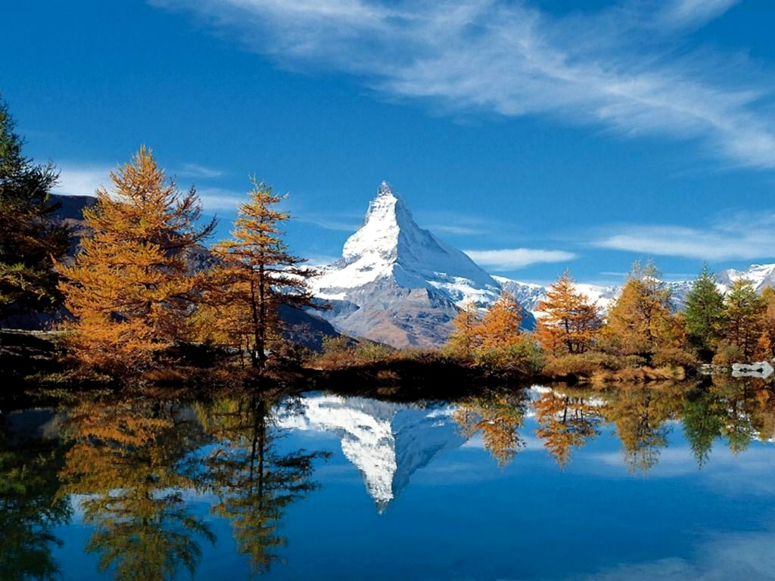
High Lands
High elevation
Example: Half of Switzerland’s land is more than 3,300 feet above sea level & only 5 % of the country live there

Slide 12
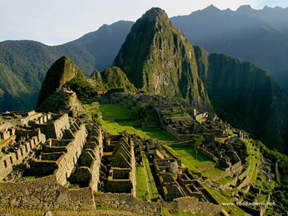
Exemptions: some may prefer higher lands if temperatures and weather are uncomfortably high at lower elevations

