Slide 1
Causes of the Depression

Slide 2
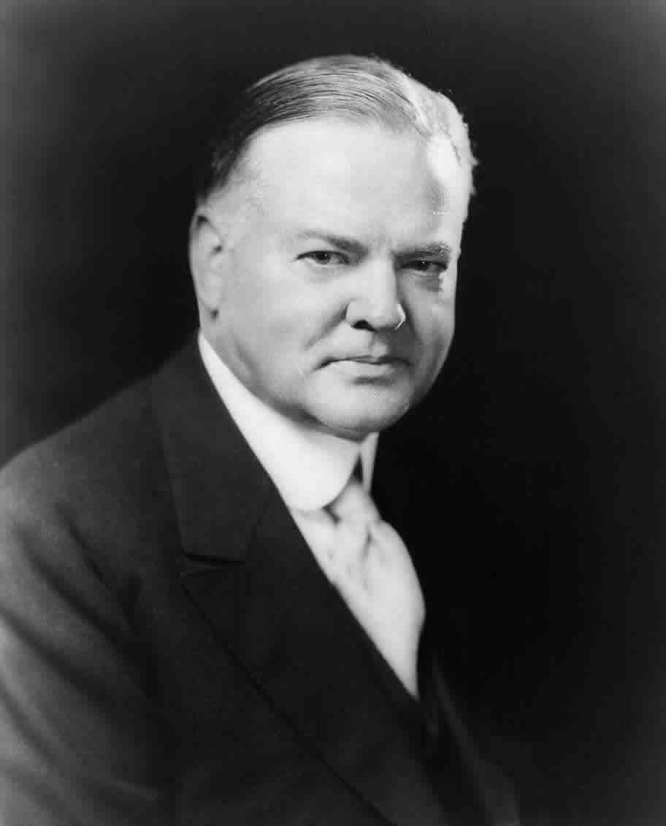
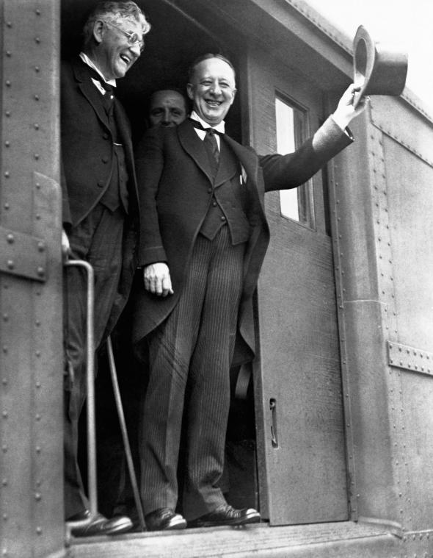
The Election of 1928
The Candidates:
Herbert Hoover (Rep)
Successful engineer
Former head of the Food Administration in WWI
7 years as secretary of commerce in the Harding and Coolidge admins.
Alfred E. Smith (Dem)
4 time gov of NY
Irish American from New York’s Lower East Side
First Roman Catholic nominated as a Presidential candidate

Slide 3
Campaign Issues:
Prohibition
Hoover: Dry
Smith: Wet
Religion
Smear campaign against Smith who believed the Catholic Church financed the Dem Party and would rule the US if Smith won.
Prosperity of the 1920’s
Reps took credit for the prosperity and promised “two cars in every garage”
Hoover (Quaker) tried to squash the slurs.
Result: Smith’s candidacy was seriously damaged

Slide 4
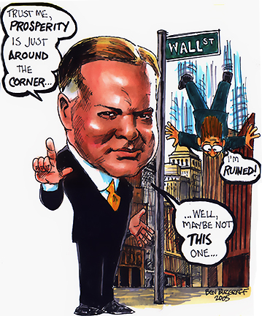
The Winner:
Hoover received 6 million more votes than Smith and won the electoral college 444 to 87
It’s a landslide WIN
At his inaugural address movie cameras filmed for the first time and radios broadcast the address worldwide.
Hoover stated “I have no fears for the future of our country.” “It is bright with hope.”

Slide 5

The Long Bull Market
With Hoover’s optimism stock prices soared!
Vocab:
Stock Market: system of buying and selling shares of companies
Bull Market: Period of rising stock prices
With a prolonged bull market in the late 1920s, many Americans were convinced to heavily invest in stocks.
1929: 3 million Americans owned stocks.

Slide 6

The Long Bull Market Continued
I have $1,000 and I want to buy $10,000 of stocks on margin. A stockbroker will loan me $9,000 to purchase the stocks!
Stocks were bought on margin (small cash down payment) (See Pic)
The stockbroker earned a commission on the sale and interest on the loan. The broker held the stock as collateral.
Cha-Ching when stock prices continued rising.
Epic fail when stock prices fell.
Margin call issued by broker when price fell. The investor was required to repay the loan immediately.
Investors were sensitive to stock prices falling.
Late 1920s many new investors bid stock prices up without regard to a company’s earnings and profits.
Investors engaged in speculation: investing money at great risk with the anticipation that the price will rise.

Slide 7
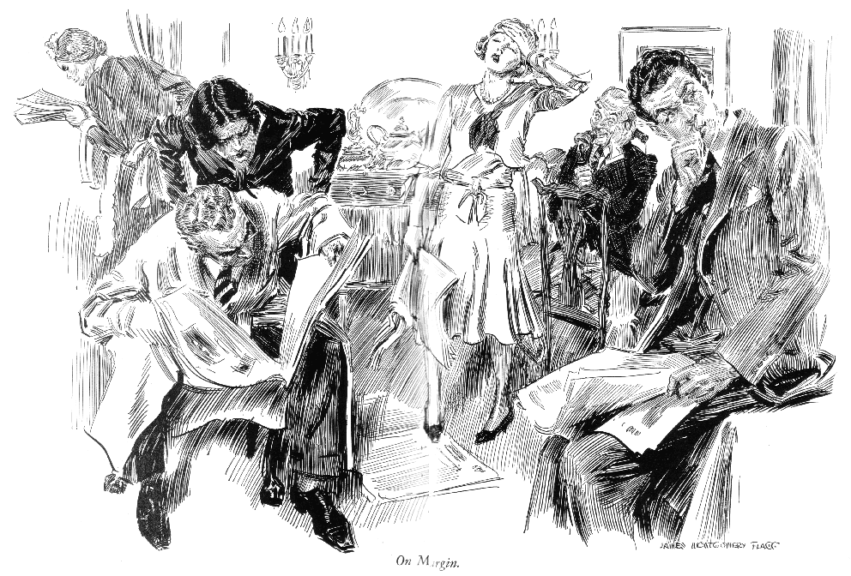

Slide 8

The Great Crash
1929: Without new customers the bull market couldn’t continue.
Sept: Professional investors sensed danger and began selling off their holdings.
Result: prices slipped
Other investors sold shares to pay the interest on their brokerage loans.
Result: prices fell further

Slide 9
CRASH of 1929!
Monday October 21: Frightened customers sold stocks at a frenzied pace when margins were called in.
Result: market went into a tailspin
October 24 “Black Thursday”: Market plummeted further
October 29 “Black Tuesday”: Prices took the steepest dive. Stocks lost $10 to $15 billion in value.
Mid-November: Stocks had dropped by over one-third. $30 billion was lost (equivalent to the amount earned by Americans in 1929).
Significance: The stock market crash undermined the economy’s ability to hold out against its other weaknesses.

Slide 10
Banks in a Tailspin
Scenario 1: Many banks had lent money to stock speculators
Result 1: After experiencing losses, many banks cut back drastically on the loans they made. With less credit available, consumers and businesses were unable to borrow as much money as they had previously. Result: Recession
Scenario 2: Many banks had invested depositors’ money in the stock market, hoping for higher returns than they could get by using the money for conventional loans.
When stocks dropped, the banks lost money on their investments and the speculators defaulted on their loans.
Result 2: Some banks closed due to losses. The govt didn’t insure bank deposits SO customers lost their savings! This caused a crisis of confidence in the banking system. People made runs on their banks so more banks collapsed b/c banks didn’t have enough money available. 3,000 banks closed during the first two years of the depression (10% of US banks)

Slide 11
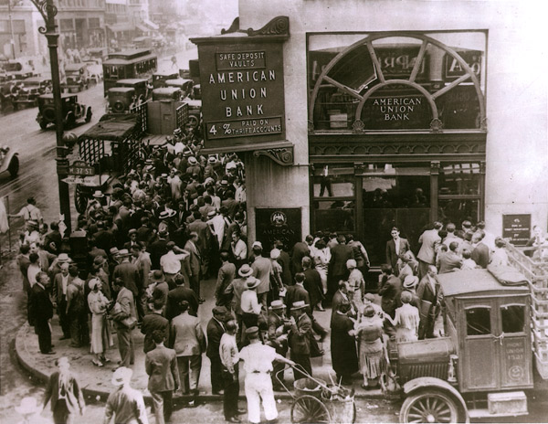

I need to get my money!

Slide 12
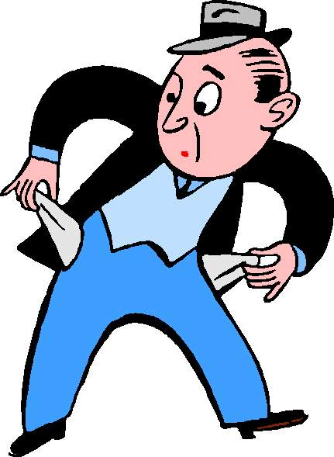
The Roots of the Great Depression
REASON 1: The Uneven Distribution of Income
With more efficient machinery production increased and most Americans didn’t earn enough to buy up the flood of goods they helped produce.
Manufacturing output per person/hour increased 32%
Avg worker’s wage increased 8%
1929:
Top 5% earned 30% of nation’s income.
2/3rds of families earned less than $2,500/yr … so little expendable income.
Many Americans purchased high cost items on the installment plan. Some buyers couldn’t pay off their debts without reducing other purchases.
Result: low consumption led manufacturers to cut production and lay off employees. When radio sales slumped, orders for copper wire decreased SO Montana copper miners lost jobs, and these workers cut back purchases.

Slide 13
REASON 2: The Loss of Export Sales
When the bull market accelerated, US banks made high interest loans to stock speculators instead of lending money to foreign companies. Without loans, foreign companies purchased fewer American products.
June 30: Hawley-Smoot Tariff raised the avg tariff rate to the highest level in American history. It aimed to protect American manufacturers from foreign competition BUT it damaged American sales abroad. With imports costing more, Americans purchased less foreign goods, so foreign countries raised their tariffs on American goods, so fewer American goods were sold overseas.
1932: US exports fell to 1/5 of 1929 exports.

Slide 14
REASON 3: Mistakes by the Federal Reserve
Instead of raising interest rates to curb excessive speculation, the Fed Reserve Board kept its rates very low.
Result 1: By keeping rates low, it encouraged member banks to make risky loans.
Result 2: Low interest rates led business leaders to think the economy was still expanding SO they borrowed more money to expand production leading to overproduction when sales were falling.
When the Depression hit, companies layed off workers to cut costs and the Fed raised interest rates, tightening credit.

