Slide 1
Chapter 15: The West and the Changing World Balance
AP World History II

Slide 2
Key Concepts…
The Decline of the Arab Caliphate, with its fall in 1258, and the disruptions of the Mongolian Empires caused a shift in world power.
China stepped up to the plate early, but was soon followed by Western Europe.
Western Europe initiated many internal changes first, with Italy, Spain, and Portugal leading the way.

Slide 3
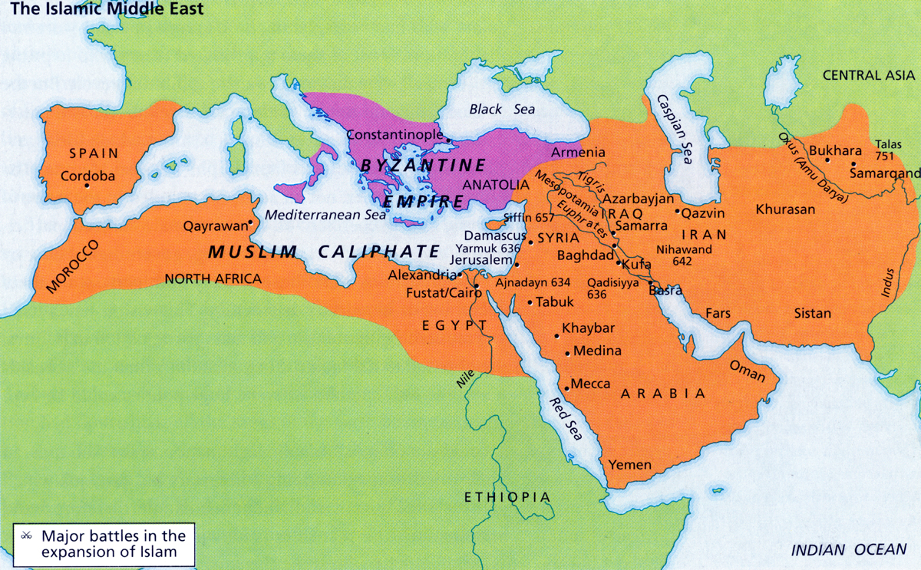
Out with the Old…
1200: Middle East is dominated by two major empires, Byzantine and Islamic Caliphate.

Slide 4
Out with the Old…
By 1400, the Byzantine Empire was in decline (with the help of Ottoman Turks).
  Constantinople falls in 1453 to the Turks.
1258: Fall of the last Arab Caliphate (Abbasid)
  The fall of Islamic Caliphate did NOT delete Islam, nor its empires from the maps of the world.
    Trade was disrupted, but will rebound by 1400
    The Ottoman Turks will reestablish much of the power lost by the Caliphate in the 1500s-1700s.

Slide 5
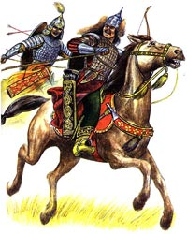
Transition
The Mongols were of the first to develop an alternative Global framework.
Soon after, China would repel the Mongols, leading to a brief era of Chinese expansionism.
  1368: Ming Dynasty (lasts until 1644)

Slide 6
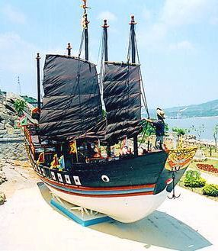
China’s Ming Dynasty
Ming rulers secure China, pushing Mongols to the North.
  Forced tribute payments from Korea, Vietnam, and Tibet.
Early 1400’s: Huge trading expeditions to Southern Asia and beyond.

Slide 7
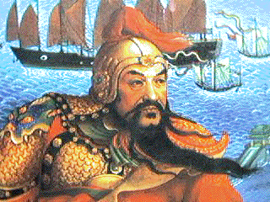
Zhenghe’s trading expeditions…
1405-1433: Admiral Zhenghe, a Chinese Muslim eunuch.
  Led expeditions that hugged Asian coastline
  28,000 armed troops aboard
  Improved compass, and better maps
  Goods for trade

Slide 8
The end of Asian expansion
Zhenghe’s expeditions were called off in 1433.
  Resented by Confucian bureaucracy
  Unacceptable costs (especially when fighting the Mongols, and building a new capital city in Beijing)
  Rooted in China’s history of emphasizing internal development, keeping commercial development at bay.
  China squanders the opportunity, but internally becomes stronger as a result.

Slide 9
Rise of the West
Where was the west before 1400?
  The Church (dominant institution of the Middle Ages) was under attack.
  1215: Magna Carta
  Medieval Philosophy…not so creative
  Warrior aristocrats…not as warrior-like
  By 1300, population outpaced food supply…causes famine
    No new food supply techniques were discovered.

Slide 10
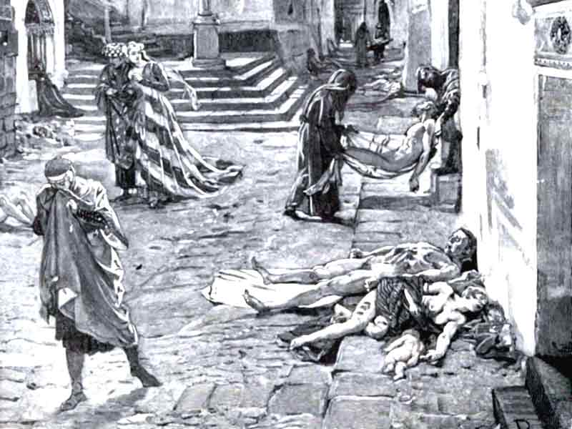
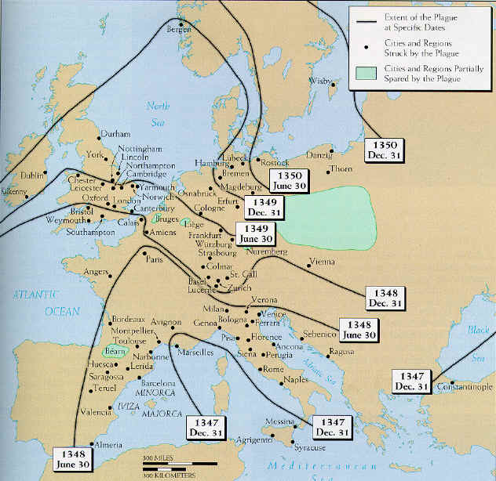
The Rise of the
West
The Black Plague (or, Bubonic Plague):
  Reduces Chinese population by 30% by 1400.
  Follows trade routes from India to the Middle East
  1348-1375: Europe’s worst episode, killing 30 Million people, roughly 1/3 of Europe.

Slide 11
The Rise of the West
How did the West achieve dominance?
  Strengthening of Feudal Monarchy
  Hundred Years’ War (Britain and France) stimulated Military technology
    Central power of governments increase
  Christians drove Muslims out of Spain and Portugal
  Growth of cities spurs urban economies centered on commercial capitalism.
  Technology continued to expand

Slide 12
The Rise of the West
How else, then, did the West achieve dominance?
  Mongol domination of Asia in the 13th and early 14th centuries opened up Asian technology to the Westerners.
    Printing press
    Compass
    Gunpowder
  Ever since the Crusades, Europeans had a greater desire for Asian made goods, resulting in an unfavorable balance of trade, causing a Gold Famine that threatened the European economy.

Slide 13
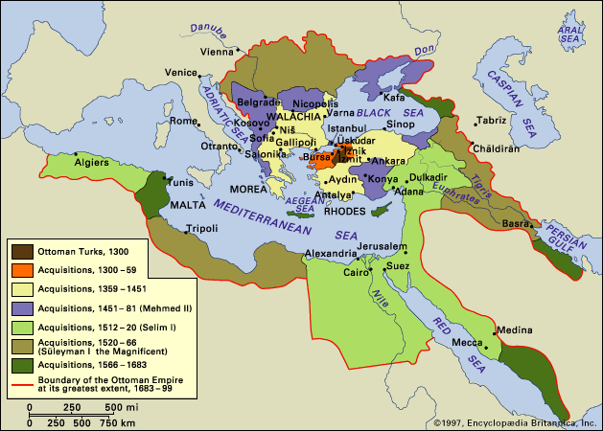
The Rise of the West
The rise of the Ottoman’s also led to increased fear over a Muslim surge in power.
  Search for new ways around the newly-developing Muslim Empire

Slide 14
The Rise of the West
1400’s: Italy, cultural and political movement known as rebirth, or the Renaissance
  Stressed more secular subjects
  Realistic portrayals of people and nature
Why Italy?
  Connection to Ancient Rome
  14th Century: Led the West in Banking and trade
    Healthy commercial practices gave the money to be able to support cultural activities.

Slide 15
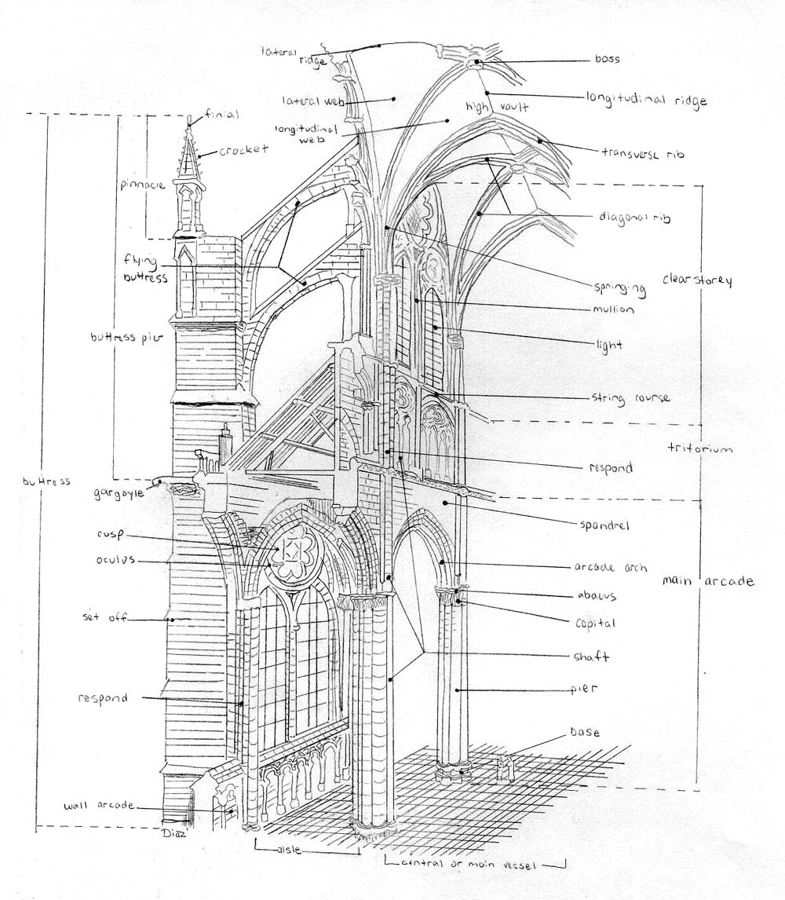
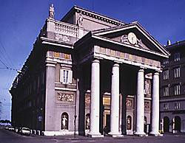
Renaissance Culture
A Cultural Movement
  Practical ethics, urban codes of behavior
  Art and Music flourish
    Themes include nature and people
  Architecture moves from Gothic to Classical

Slide 16
Impact of the Renaissance
Little influence outside of Italy
  Focused on high culture, not popular culture
  Minimal interest in Science
  Not a FULL-break from Medievalism
Although, Italian commerce proved to be a building block of European power.
  The “Renaissance spirit” spurred innovation.

Slide 17
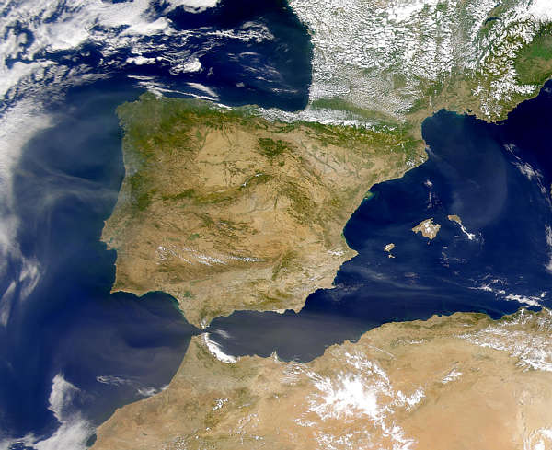
The Iberian Contribution
Christian leaders had been pushing back Muslim forces for years.
After 1400 regional monarchies had been established in the provinces of Castile and Aragon, united in Marriage in 1469.

Slide 18
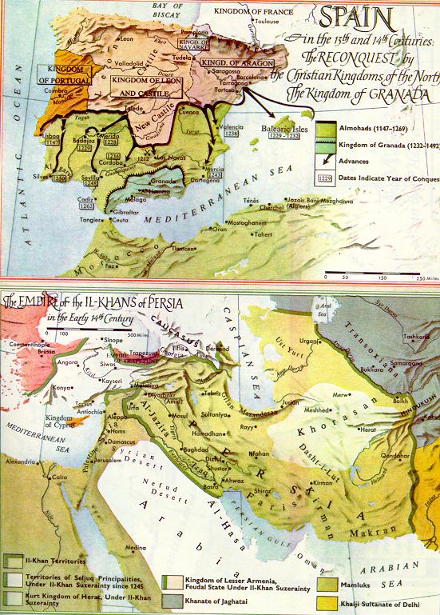
Ferdinand and Isabella
Spanish and Portuguese formed a unified agenda for the expulsion of the Muslims, continued by the marriage of Ferdinand and Isabella
  Effective armies with cavalry
  Government should promote Christianity through conversion.
  Close links between Church and State

Slide 19
Western Expansion…attempt #1
Early ventures were inhibited by technological barriers.
  Efforts were underway to improve these technologies through Arab contacts, who learned from the Chinese.
  Mapmaking improved
1498: Vasco de Gama was the first European to reach India by sea.
LATEEN SAIL? Look it up

Slide 20
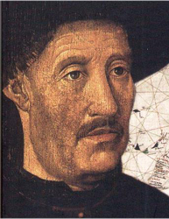
Colonial Patterns
Prince Henry of Portugal (Prince Henry the Navigator) was a driving force in making the colonies Spain and Portugal already had, profitable.
  Student of astronomy and Nautical Science
  Sponsored a third of Portuguese ventures before his death in 1460.
  Mixture of curiosity, knowledge, money, and religion motivate him.

Slide 21
Colonial Patterns
Iberians set up a system of colonialism that would be seen for years to come.
  Colonists set up large agricultural estates for cash crops to be sold on European market.
  Introduced sugar, then cotton and tobacco
  Used slave labor from Northwest Africa
Sound familiar?

Slide 22
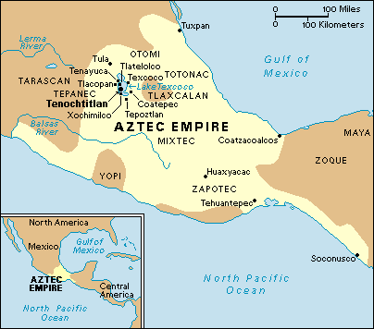
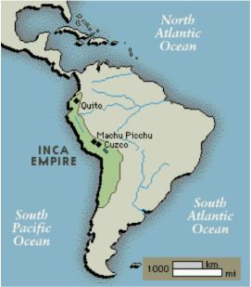
What’s going on elsewhere?
Important note: Changes elsewhere are happening simultaneously, but unrelated to changes in Europe, Middle East, and Asia.
  Disunity in Aztec/Incan Empires, and overextension throughout the 1400s caused weakened empires throughout the Americas

Slide 23
What’s going on elsewhere?
Polynesia: Expansion beyond the Society Islands (Tahiti, Samoa, Tonga &, Fiji).
  Migration to Hawaii, where Hawaiians and Polynesians mixed quickly. Pigs were imported to Hawaii
    Set up regional kingdom structure that was highly warlike.
      Social caste system dominated life

Slide 24
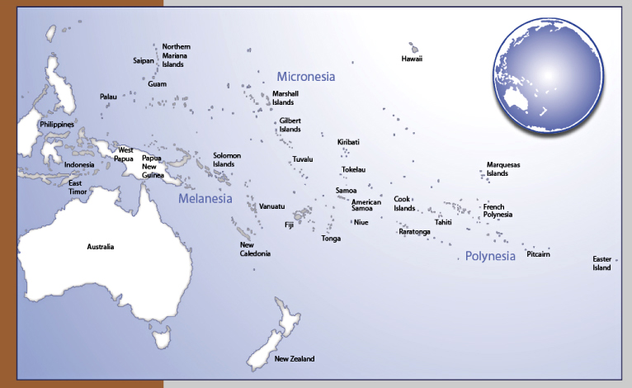

Slide 25
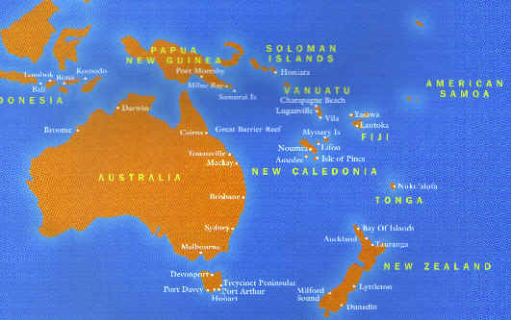
Elsewhere…
Maori’s migrate from Polynesia south to New Zealand.
  Successful adaptation to colder environment.
  Tribal military leaders hold power
  Polynesia will be of the last places to be colonized by Europe later in history.

Slide 26
Put it all together…
Many changes, if not all, occur independently. Every change is explainable, but their combination is accidental.
  Technology
  Roles of individuals
  Impact of political shifts
  Cultural movements
  Revolutions in commerce

